Slide 1
Networking Hardware

Slide 2
Objectives
Identify major hardware
devices in a computer network
Describe the factors involved in choosing a network adapter, hub, switch, or router
Describe the functions of repeaters, hubs, bridges, switches, and gateways
Identify problems associated with connectivity hardware

Slide 3
Network Adapters
Also called network interface cards (NICs)
Connectivity devices enabling a workstation, server, printer, or other node to receive and transmit data over the network media
In most modern network devices, network adapters contain the data transceiver

Slide 4
Types of Network Adapters
For a desktop or tower PC, network adapter is likely to be a type of expansion board
  Expansion boards connect to the system board through expansion slots
The circuit used by the system board to transmit data to the computer’s components is the computer’s bus

Slide 5
Types of Network Adapters
PCMIA
  Developed in early 1990s to provide standard interface for connecting any type of device to a portable computer
  More commonly known as PC Cards
USB (universal serial bus) port
  Standard external bus that can be used to connect multiple types of peripherals
A parallel port network adapter
Wireless network adapters
A variety of Ethernet network adapters

Slide 6
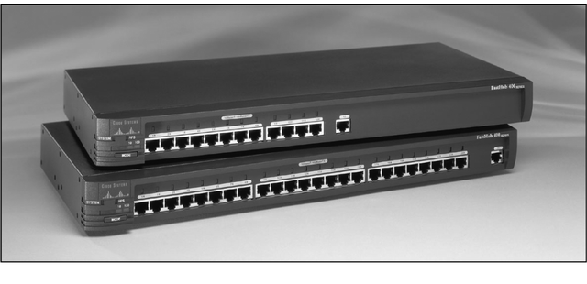
Repeaters
Connectivity devices that regenerate and amplify an analog or digital signal

Slide 7
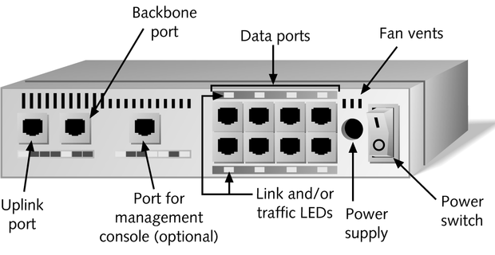
Hubs
Multiport repeater containing multiple ports to interconnect multiple devices

Slide 8
Hubs
Passive hubs
  Only repeats signal
Intelligent hubs
  Possesses processing capabilities

Slide 9
Hubs
Standalone Hubs
  Hubs that serve a group of computers that are isolated from the rest of the network
    Best suited to small, independent departments, home offices, or test lab environments
  Disadvantage to using a single hub for many connection ports is that it introduces a single point of failure on the network
Stackable Hubs
  Physically designed to be linked with other hubs in a single telecommunications closet

Slide 10
Choosing the Right Hub
Factors to consider when selecting the right hub for your network:
  Performance
  Cost
  Size and growth
  Security
  Management benefits
  Reliability

Slide 11
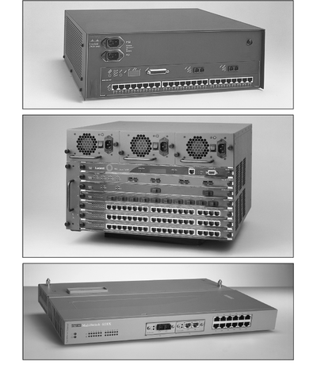
Switches
Subdivide a network into smaller logical pieces

Slide 12
Cut-Through Mode and
Store and Forward Mode
Cut-through mode
  Switching mode in which switch reads a frame’s header and decides where to forward the data before it receives the entire packet
  Cut-through switches can detect runts, or packet fragments
Store and forward mode
  Switching mode in which switch reads the entire data frame into its memory and checks it for accuracy before transmitting the information

Slide 13
Using Switches to Create VLANs
Virtual local area networks (VLANs)
  Network within a network that is logically defined by grouping its devices’ switch ports in the same broadcast domain
Broadcast domain
  Combination of ports that make up a Layer 2 segment and must be connected by a Layer 3 device

Slide 14
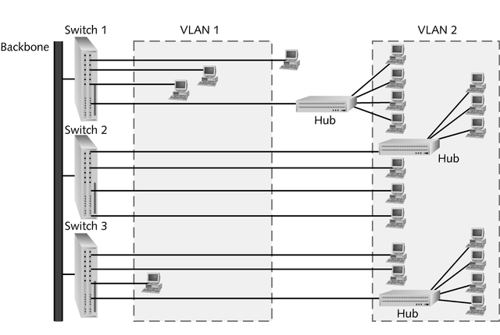
Using Switches to Create VLANs
A simple VLAN design

Slide 15
Higher-Layer Switches
Switch capable of interpreting Layer 3 data is called a Layer 3 switch
Switch capable of interpreting Layer 4 data is called a Layer 4 switch
These higher-layer switches may also be called routing switches or application switches

Slide 16
Full Duplex Switches
A full duplex switch allows for simultaneous transmission and reception of data to and from a workstation.
This full duplex connection helps to eliminate collisions.
To support a full duplex connection to a switch, two sets of wires are necessary - one for the receive operation and one for the transmit operation.

Slide 17
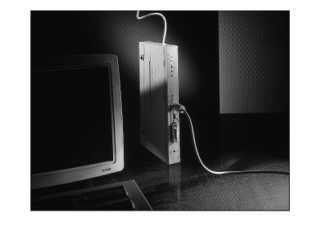
Bridges
Like a repeater, a bridge has a single input and single output port
Unlike a repeater, it can interpret the data it retransmits

Slide 18
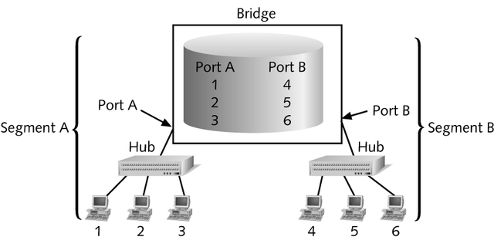
Bridges
Filtering database
  Collection of data created and used by a bridge that correlates the MAC addresses of connected workstations with their locations
  Also known as a forwarding table

Slide 19
Bridges
A bridge (or bridge-like device) can be used to connect two similar LANs, such as two CSMA/CD LANs.
A bridge can also be used to connect two closely similar LANs, such as a CSMA/CD LAN and a token ring LAN.
The bridge examines the destination address in a frame and either forwards this frame onto the next LAN or does not.
The bridge examines the source address in a frame and places this address in a routing table, to be used for future routing decisions.

Slide 20
Transparent Bridge
A transparent bridge does not need programming but observes all traffic and builds routing tables from this observation.
This observation is called backward learning.
Each bridge has two connections (ports) and there is a routing table associated with each port.
A bridge observes each frame that arrives at a port, extracts the source address from the frame, and places that address in the port’s routing table.
A transparent bridge is found with CSMA/CD LANs.

Slide 21
Transparent Bridge
A transparent bridge can also convert one frame format to another.
Note that some people / manufacturers call a bridge such as this a gateway or sometimes a router.
The bridge removes the headers and trailers from one frame format and inserts (encapsulates) the headers and trailers for the second frame format.

Slide 22
Source-routing Bridge
A source-routing bridge is found with token ring networks.
Source-routing bridges do not learn from watching tables.
When a workstation wants to send a frame, it must know the exact path of network / bridge / network / bridge / network …
If a workstation does not know the exact path, it sends out a discovery frame.
The discovery frame makes its way to the final destination, then as it returns, it records the path.

Slide 23
Remote Bridge
A remote bridge is capable of passing a data frame from one local area network to another when the two LANs are separated by a long distance and there is a wide area network connecting the two LANs.
A remote bridge takes the frame before it leaves the first LAN and encapsulates the WAN headers and trailers.
When the packet arrives at the destination remote bridge, that bridge removes the WAN headers and trailers leaving the original frame.

Slide 24
Routers
Multiport connectivity device
Can integrate LANs and WANs running at different transmission speeds and using a variety of protocols
Routers operate at the Network layer (Layer 3) of the OSI Model

Slide 25
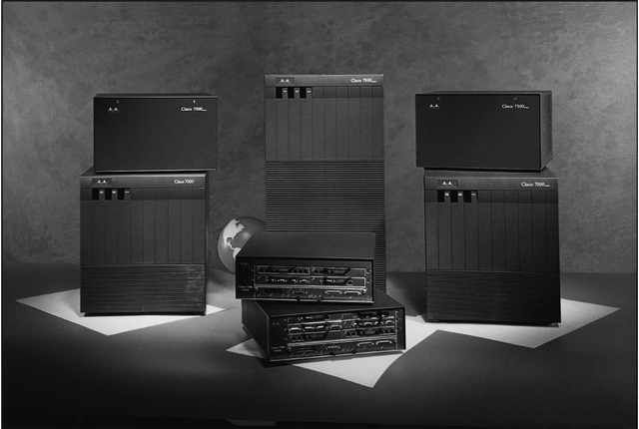
Router Features and Functions
Modular router
  Router with multiple slots that can hold different interface cards or other devices

Slide 26
Router Features and Functions
Filter out broadcast transmission to alleviate network congestion
Prevent certain types of traffic from getting to a network
Support simultaneous local and remote activity
Provide high network fault tolerance through redundant components
Monitor network traffic and report statistics to a MIB
Diagnose internal or other connectivity problems and trigger alarms
Routers often incorporate firewall functions
A router accepts an outgoing packet, removes any LAN headers and trailers, and encapsulates the necessary WAN headers and trailers
Because a router has to make wide area network routing decisions, the router has to dig down into the network layer of the packet to retrieve the network destination address

Slide 27
Router Features and Functions
Static routing
  Technique in which a network administrator programs a router to use a specified paths between nodes
Dynamic routing
  Automatically calculates best path between nodes and accumulates this information in a routing table
Hop
  Term used in networking to describe each trip data take from one connectivity device to another

Slide 28
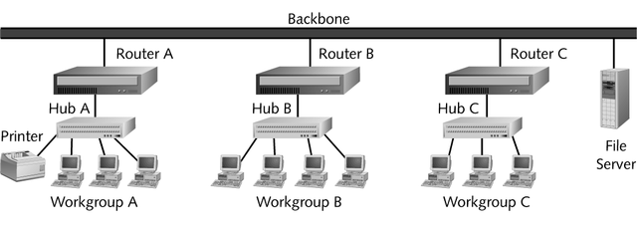
Router Features and Functions

Slide 29
Routing Protocols
To determine the best path, routers communicate with each other through routing protocols
In addition to its ability to find the best path, a routing protocol can be characterized according to its convergence time and bandwidth overhead
  Convergence time
    The time it takes for a router to recognize a best path in the event of a change or outage
  Bandwidth overhead
    Burden placed on an underlying network to support the routing protocol

Slide 30
Routing Protocols
The four most common routing protocols:
  RIP (Routing Information Protocol) for IP and IPX
  OSPF (Open Shortest Path First) for IP
  EIGRP (Enhanced Interior Gateway Routing Protocol) for IP, IPX, and AppleTalk
  BGP (Border Gateway Protocol) for IP

Slide 31
Brouters and Routing Switches
Bridge router
  Also called a brouter
  Industry term used to describe routers that take on some characteristics of bridges
Routing switch
  Router hybrid that combines a router and a switch

Slide 32
Gateways
Combination of networking hardware and software that connects two dissimilar kinds of networks
Popular types of gateways include:
  E-mail gateways
  IBM host gateways
  Internet gateways
  LAN gateways

