Slide 1
Family of Ethernet technology

Slide 2
A Quick Word about Aloha Networks
Developed in late 60’s by Norm Abramson at Univ. of Hawaii (!!) for use with packet radio systems
  Any station can send data at any time
  Receiver sends an ACK for data
  Timeout for ACK signals that there was a collision
    What happens if timeout is poorly timed?
  If there is a collision, sender will resend data after a random backoff
Utilization (fraction of transmitted frames avoiding collision for N nodes) was pretty bad
  Max utilization = 18%
Slotted Aloha (dividing transmit time into windows) helped
  Max utilization increased to 36%
CS 640

Slide 3
A Quick Word about Token Ring
Developed by IBM in early 80’s as a new LAN architecture
  Consists of nodes connected into a ring (typically via concentrators)
  Special message called a token is passed around the ring
    When nodes gets the token it can transmit for a limited time
    Every node gets an equal opportunity to send
  IEEE 802.5 standard for Token Ring
Designed for predictability, fairness and reliability
  Originally designed to run at either 4Mbps and 16Mbps
Still used and sold but beaten out by Ethernet

Slide 4
Ethernet
History
  Developed by Bob Metcalfe and others at Xerox PARC in mid-1970s
  Roots in Aloha packet-radio network
  Standardized by Xerox, DEC, and Intel in 1978
  LAN standards define MAC and physical layer connectivity
    IEEE 802.3 (CSMA/CD - Ethernet) standard – originally 2Mbps
    IEEE 802.3u standard for 100Mbps Ethernet
    IEEE 802.3z standard for 1,000Mbps Ethernet
CSMA/CD: Ethernet’s Media Access Control (MAC) policy
  CS = carrier sense
    Send only if medium is idle
  MA = multiple access
  CD = collision detection
    Stop sending immediately if collision is detected
CS 640

Slide 5

Ethernet Standard Defines Physical Layer
802.3 standard defines both MAC and physical layer details
Metcalfe’s original
Ethernet Sketch

Slide 6
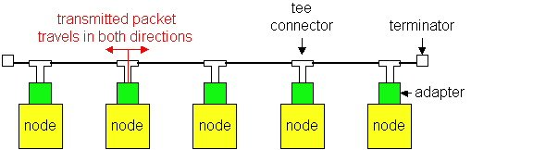
Ethernet Technologies: 10Base2
10: 10Mbps; 2: under 185 (~200) meters cable length
Thin coaxial cable in a bus topology
Repeaters used to connect multiple segments
  Repeater repeats bits it hears on one interface to its other interfaces: physical layer device only!

Slide 7
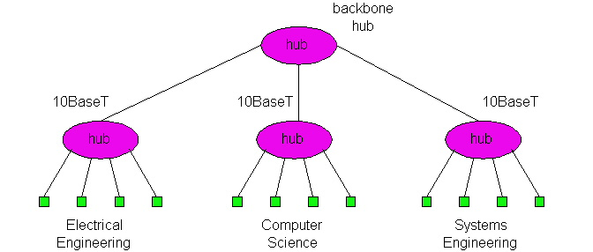
10BaseT and 100BaseT
10/100 Mbps rate
T stands for Twisted Pair
Hub(s) connected by twisted pair facilitate “star topology”
  Distance of any node to hub must be < 100M

Slide 8
Physical Layer Configurations for 802.3
Physical layer configurations are specified in three parts
Data rate (10, 100, 1,000)
  10, 100, 1,000Mbps
Signaling method (base, broad)
  Baseband
    Digital signaling
  Broadband
    Analog signaling
Cabling (2, 5, T, F, S, L)
  5 - Thick coax (original Ethernet cabling)
  F – Optical fiber
  S – Short wave laser over multimode fiber
  L – Long wave laser over single mode fiber

Slide 9
Ethernet Overview
Most popular packet-switched LAN technology
Bandwidths: 10Mbps, 100Mbps, 1Gbps, 10Gbps
Max bus length: 2500m
  500m segments with 4 repeaters
Bus and Star topologies are used to connect hosts
  Hosts attach to network via Ethernet transceiver or hub or switch
    Detects line state and sends/receives signals
  Hubs are used to facilitate shared connections
  All hosts on an Ethernet are competing for access to the medium
    Switches break this model
Problem: Distributed algorithm that provides fair access

Slide 10
Ethernet Overview (contd.)
Ethernet by definition is a broadcast protocol
  Any signal can be received by all hosts
  Switching enables individual hosts to communicate
Network layer packets are transmitted over an Ethernet by encapsulating
Frame Format
64
48
48
16
32
Preamble
Dest
Src
Type
Body
CRC
addr
addr

Slide 11
Characteristic of Ethernet’s tech
Ethernet
Fast Ethernet
Gigabit Ethernet
10-Gigabit Ethernet

Slide 12
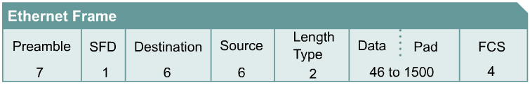
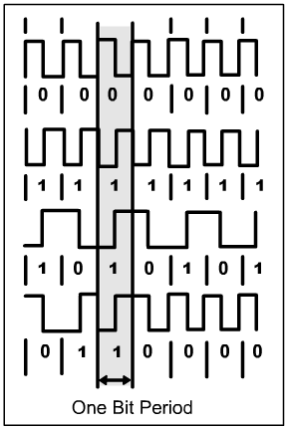
10-Mbps Ethernet
10BASE5, 10BASE2, and 10BASE-T Ethernet are considered Legacy Ethernet.
ALL share the same timing parameters
ALL have a common frame format.
ALL use 'Manchester' line coding on the physical layer. This line code is especially useful in carrying the clock signal from the transmitter to the retiming circuit in the receiver
10BASE5 (1980; 500m) and 10BASE2 (1985; 185 m; <=30 stations/segment) only run in half-duplex mode. 5-4-3-rule is obliged. Both are not recommended for installations in networks today .
Parameter Value
Bit time 100 ns
Slot time 512 bit times
Interframe Spacing 96 bit (9,6us)
Collision attempt limit 16
Collision Backoff limit 10
Collision Jam Size 32 bit
Maximum Frame Size 1518 byte
Minimum Frame Size 64 byte
Manchester Line Code
Notes:
http://www.ethermanage.com/ethernet/sqe/sqe.html

Slide 13
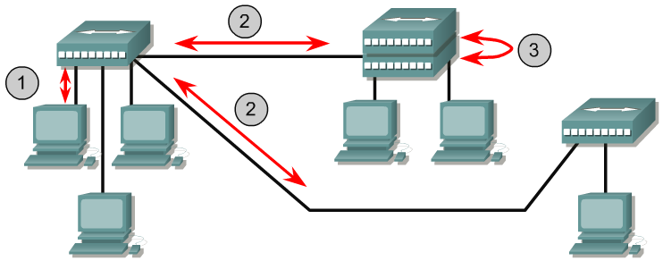
10BaseT Architecture
10BASE-T was introduced in 1990
10BASE-T uses cheaper and easier to install Category 3 unshielded twisted pair (Cat-3 UTP; Cat-5 is recommended!) copper cable.
Interconnection is provided by hubs cabled in star and extended star topology
Originally 10BASE-T was a half-duplex protocol, but full-duplex features were added later. Half duplex or full duplex is a configuration choice.
10BASE-T carries 10 Mbps of traffic in half-duplex mode and 20 Mbps in full-duplex mode.
10BASE-T also uses Manchester encoding.
Maximum cable length is 6m wiring closet cabling + 90 m horizontal cabling + 3m patch cable between end system and outlet.
Prefer switches because hubs (=repeaters) increase the collision domain and therefore impose a distance limit. With switches this is not a problem unless all connection lengths are <= 100m
UTP Link length is up to 100 m with UTP cable between hosts and hubs or between hubs and hubs.
Each hub is a multiport repeater, so links between hubs count towards the 4-repeater limit.
Two "stackable" hubs with interconnected backplanes count as only one hub or repeater.
1024 stations/segment maximum

Slide 14
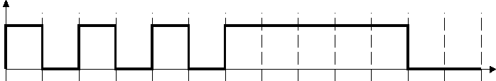


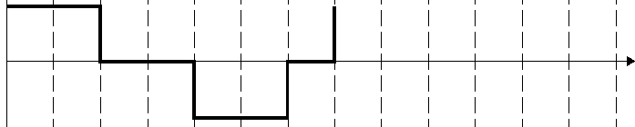
100-Mbps Ethernet
100-Mbps Ethernet is also known as Fast Ethernet.
100BASE-T (1995) uses a copper UTP medium and 100BASE-FX uses a multimode optical fiber medium.
Common characteristics of 100BASE-T and 100BASE-FX:
  timing parameters
  frame format, and
  parts of the transmission process.
100BASE-T carries 100 Mbps of traffic in half-duplex mode. In full-duplex mode, 100BASE-T can exchange 200 Mbps of traffic.
Fast Ethernet uses a 2 step line encoding scheme:
  First a 4B/5B line coding is used by T and FX technology. This coding scheme provides sufficient clocking information for the receiver at the expense of increasing the bandwidth from 100 Mbaud up to 125 Mbaud. In contrast, Manchester code would require 200 Mbaud bandwidth.
  Second, 100BASE-T uses Multi-Level Transmit-3 levels MLT-3 encoding and FX uses NRZI encoding of the 4B5B coded bit stream.
Non-Return-to-Zero (NRZ):
0 → No Signal;
1 → +Signal
Manchester-Code:
1 → +|- Signal
0 → -|+ Signal
NRZ-I:
0 → No signal
1 → Signal
Multi-Level-Transition-3 (MLT-3):
1 → Signal
(1111 → +1|0|-1|0)
0 → No signal
MLT-3 coding requires 1 Hz of bandwidth per 4 symbol times. For 125 Mbaud ( 1 baud = 1 symbol per second) MLT-3 needs 31,25 MHz bandwidth.

Slide 15
100-Mbps Ethernet
100Base-T is preferred in inhouse networks. Cable run length is restricted to 100 m.
100Base-FX is preferably used between floors and between buildings in backbone networks. Because of it's immunity against electromagnetic interference it's also preferred in high noise environments. Distance is limited to 400 m.
Two fibers are needed, one for each transmission direction.
However, 100Base-FX was never adopted successfully. Gigabit Ethernet standards are now the dominant technology for backbone installations.

Slide 16
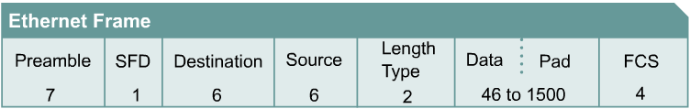
1000-Mbps Ethernet
1000BASE-T (IEEE 802.3ab), 1000BASE-SX, and 1000BASE-LX (IEEE 802.3z) use the same timing parameters, as shown in the table.
One of the most important attributes of the 1000BASE-T standard is that it be interoperable with 10BASE-T and 100BASE-T. It requires the cabling to pass the Cat-5e test.
The Gigabit Ethernet frame has the same format as is used for 10- and 100-Mbps Ethernet.
The differences between standard Ethernet, Fast Ethernet and Gigabit Ethernet occur at the physical layer.
Fiber-based Gigabit Ethernet (1000BASE-X) uses 8B/10B encoding which is similar to the 4B/5B concept. This is followed by the simple Non-Return to Zero (NRZ) line encoding of light on optical fiber.
Gigabit Ethernet is required to operate with a bit error rate (BER) of ≤ 10⁻¹⁰
Parameter Value
Bit time 1 ns
Slot time 4096 bit times
Interframe Spacing 96 bit
Collision attempt limit 16
Collision Backoff limit 10
Collision Jam Size 32 bit
Maximum Frame Size 1518 byte
Minimum Frame Size 64 byte
Notes:
http://grouper.ieee.org/groups/802/3/tutorial/march98/mick_170398.pdf

Slide 17
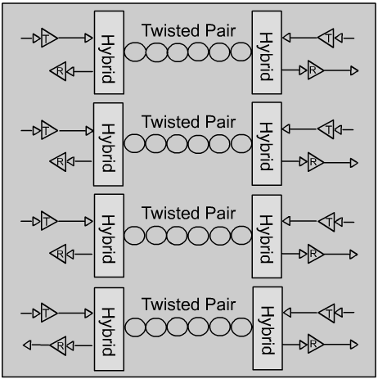
1000Base-T Bandwidth Requirements
Start with 1000 Mbit/s
Use all 4 circuits full duplex
  250 Mbps per circuit in both directions
  Requires ECHO and NEXT cancelling
  Requires Master/Slave clocking
5 Level Signalling – 2 bits/Symbol requires 4 levels - the remaining 5th level supports FEC
  Pulse Amplitude Modulation 5 (PAM5) is used on Cat5e (UTP)
  125 Mbaud per circuit in both directions requires 72,5 MHz circuit bandwidth
  Requires FEC to get back the 6 dB SNR

Slide 18
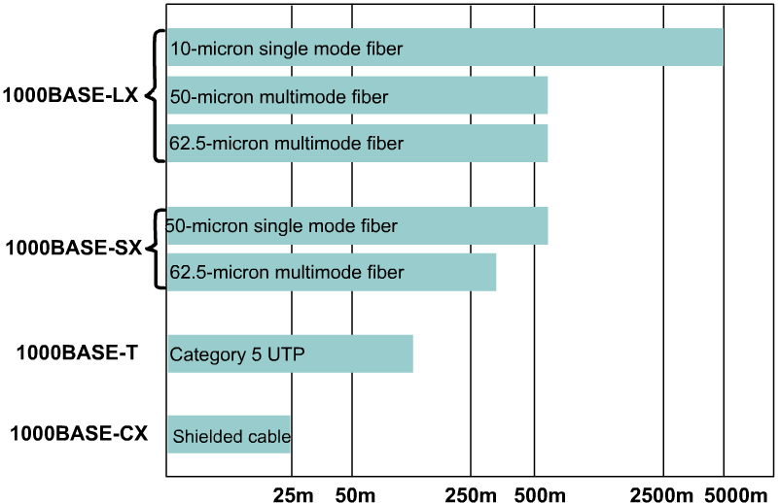
1000BASE-SX and -LX
The IEEE 802.3 standard recommends
that Gigabit Ethernet over fiber be the
preferred backbone technology with
the benefits
  Noise immunity
  No grounding problems
  Excellent distance characteristics
  Many 1000BASE-X device options
Optical transmitter technology
  Short-wavelength:
    uses an 850 nm laser or LED source in multimode optical fiber (1000BASE-SX).
    lower-cost option but has shorter distances.
  Long-wavelength:
    Uses 1310 nm laser source
    either single-mode or multimode optical fiber (1000BASE-LX).
    Distances up to 5000 meters with single-mode fiber and Laser sources
Separate fibers are used for transmitting (Tx) and receiving (Rx). The connection is inherently full duplex.
Max. Distance of full-duplex links is only limited by the medium, and not the round-trip delay.
Gigabit Ethernet permits only a single repeater between two stations.
Notes:
http://www.cisco.com/en/US/tech/tk389/tk214/tech_brief09186a0080091a8a.html

Slide 19
10-Gigabit Ethernet
IEEE 802.3ae (June 2002) includes 10 Gbps
full-duplex transmission over fiber optic cable.
This 10-Gigabit Ethernet (10GbE) is evolving
for not only LANs, but also MANs, and WANs.
10GbE physical layer standards allow both an
extension in distance to 40 km over single-mode
fiber and compatibility with synchronous optical
network (SONET) and synchronous digital
hierarchy (SDH) networks.
How does 10GbE compare to other varieties of Ethernet?
  Frame format is the same, allowing interoperability between all varieties of legacy, fast, gigabit, and 10 Gigabit, with no reframing or protocol conversions.
  Bit time is now 0.1 ns. All other time variables scale accordingly.
  Only full-duplex fiber connections are used. CSMA/CD is not necessary
  The IEEE 802.3 sublayers within OSI Layers 1 and 2 are mostly preserved, with a few additions to accommodate 40 km fiber links and interoperability with SONET/SDH technologies.
  Flexible, efficient, reliable, relatively low cost end-to-end Ethernet networks become possible.
Parameter Value
Bit time 0.1 ns
Slot time na
Interframe Spacing 96 bit
Collision attempt limit na
Collision Backoff limit na
Collision Jam Size na
Maximum Frame Size 1518 byte
Minimum Frame Size 64 byte
Burst Limit 65536 bits

Slide 20
10-Gigabit Ethernet Variants
A variety of implementations are being considered with 10GbE, including:
10GBASE-SR – Intended for short distances over already-installed multimode fiber, supports a range between 26 m to 82 m
10GBASE-LX4 – Uses wavelength division multiplexing (WDM), supports
240 m to 300 m over already-installed multimode fiber and 10 km over single-mode fiber
10GBASE-LR and 10GBASE-ER – Support 10 km and 40 km over single-mode fiber
10GBASE-SW, 10GBASE-LW, and 10GBASE-EW – Known collectively as 10GBASE-W are intended to work with OC-192 synchronous transport module (STM) SONET/SDH WAN equipment.

Slide 21
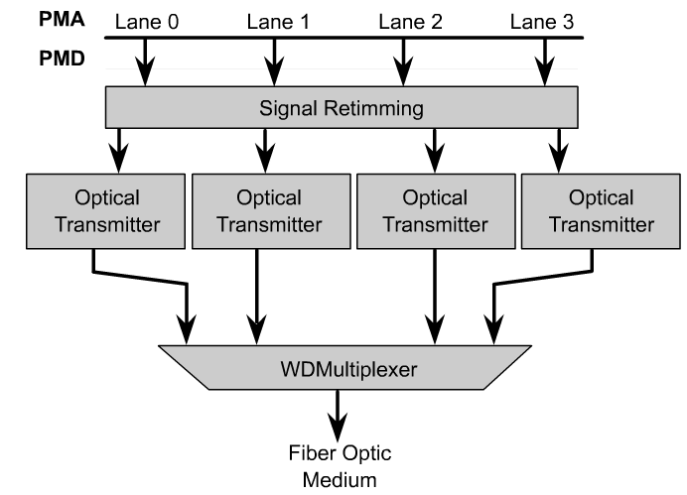
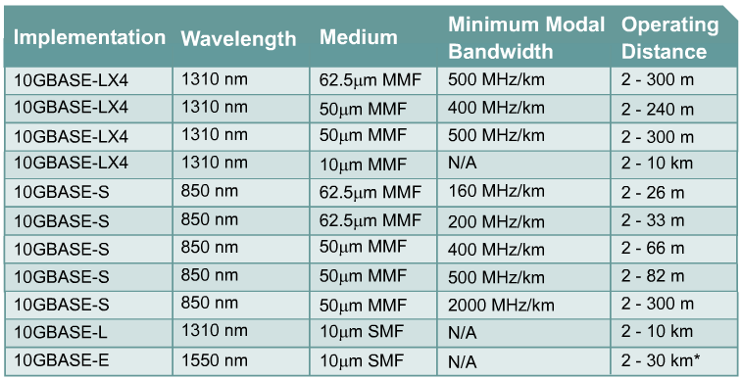
10-Gigabit Ethernet architectures
10GBASE-LX4, which uses Wide Wavelength Division Multiplex (WWDM) to multiplex four bit-simultaneous bit streams as four wavelengths of light launched into the fiber at one time.
Currently, most 10GbE products are in the form of modules, or line cards, for addition to high-end switches and routers.
No repeater is defined for 10-Gigabit Ethernet
Notes:
http://www.corning.com/opticalfiber/ products__services/ Frame_products.asp? BodyURL= /opticalfiber/pdf/ wp4237%2Epdf

