Slide 1
IP Addressing

Slide 2
IP Addresses
MAC Addresses
Structure of an IP address
Symbolic Addresses

Slide 3
MAC Addresses
A media access control address (MAC address), also called physical address, is a unique identifier assigned to network interfaces for communications on the physical network segment.
MAC address usually encodes the manufacturer's registered identification number.
The standard (IEEE 802) format for printing MAC-48 addresses in human-friendly form is six groups of two hexadecimal digits, separated by hyphens (-) in transmission order (e.g. 01-23-45-67-89-ab)

Slide 4
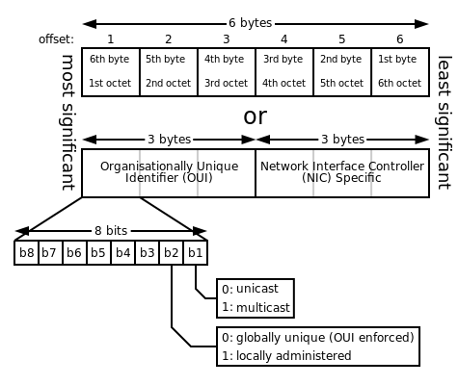
Structure of MAC address

Slide 5
IP Addresses

Slide 6
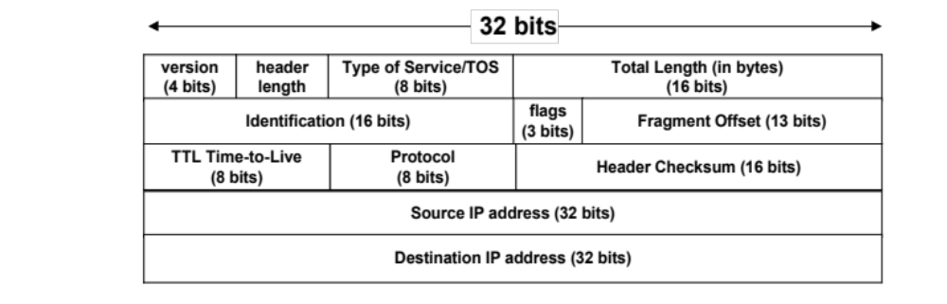
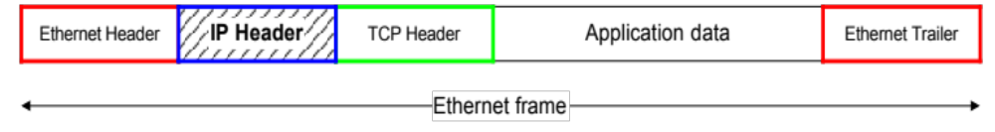
IP Addresses

Slide 7
What is an IP Address?
An IP address is a unique global address for a network interface
An IP address:
- is a 32 bit long identifier
- encodes a network number (network prefix)
and a host number

Slide 8
Dotted Decimal Notation
IP addresses are written in a so-called dotted decimal notation
Each byte is identified by a decimal number in the range [0..255]:
Example:
10000000
10001111
10001001
10010000
1st Byte
= 128
2nd Byte
= 143
3rd Byte
= 137
4th Byte
= 144
128.143.137.144

Slide 9
Network prefix and Host number
The network prefix identifies a network and the host number identifies a specific host (actually, interface on the network).
How do we know how long the network prefix is?
  The network prefix used to be implicitly defined (class-based addressing, A,B,C,D…)
  The network prefix now is flexible and is indicated by a prefix/netmask (classless).
network prefix
host number

Slide 10

Classes of Addresses

Slide 11

Classes and Blocks
The classful addressing wastes a large part of the address space.
  Class A:
  Class B:
  Class C:
  Class D:
19.<number>

Slide 12

Structure of IPv4 Address
Consists of Net ID and Host ID.
Mask
  32-bit number of contiguous 1’s followed by contiguous 0’s.
  To help to find the net ID and the host ID.
19.<number>

Slide 13
Example
Example: ellington.cs.virginia.edu
IP address is 128.143.137.144
  Is that enough??? -> No, need netmask or prefix
Using Prefix notation IP address is: 128.143.137.144/16
  Network prefix is 16 bits long
Network mask is: 255.255.0.0 or hex format: ffff0000
  -----> Network id (IP address AND Netmask) is: 128.143.0.0
  -----> Host number (IP address AND inverse of Netmask) is: 137.144
128.143
137.144

Slide 14
Subnetting
Problem: Organizations have multiple groups/entities within their organization which are independently managed. Each would prefer to manage their own IT facilities, i.e., own network
  Solution 1: Allocate to each entity their own IP network/domain
    Organization must own multiple IP address domains
    Expensive (each IP domain costs money) and cumbersome to manage
  Solution 2: Add another level of hierarchy to the existing IP addressing structure
University Network
Engineering
School
Medical
School
Library
Subnetting

Slide 15
Basic Idea of Subnetting
Split the host number portion of an IP address into a subnet number and a (smaller) host number.
Result is a 3-layer hierarchy
Then:
    Subnets can be freely assigned within the organization
    Internally, subnets are treated as separate networks
    Subnet structure is not visible outside the organization
network prefix
host number
network prefix
subnet number
host number
extended network prefix

Slide 16
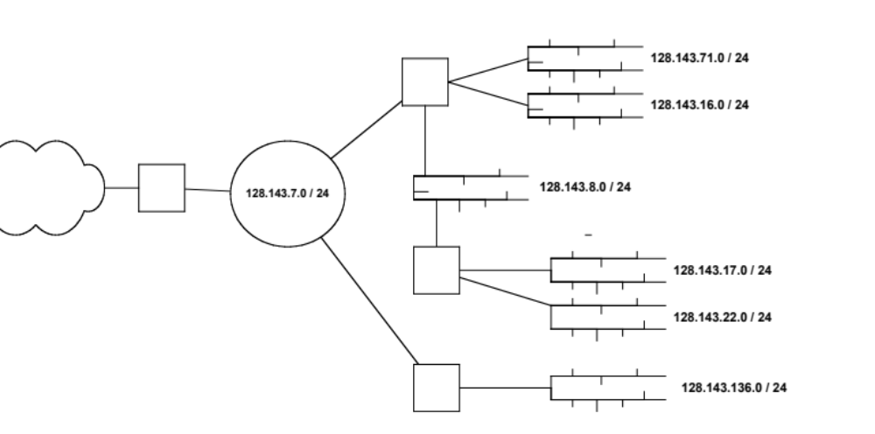
Typical Addressing Plan for an Organization that uses subnetting
In this IP domain, each Ethernet segment is allocated a subnet address.
Network Prefix
Extended Prefix
128.143.0.0/16

Slide 17
Advantages of Subnetting
With subnetting, IP addresses use a N-layer hierarchy. E.g., a 3 layer hierarchy would be:
        Network (IP domain)
        Subnet
        Host
Improves efficiency of IP addresses by not consuming an entire address space for each physical network.
Reduces router complexity. Since external routers do not know about subnetting, the complexity of routing tables at external routers is reduced.
Note: Length of the subnet mask need not be identical at all subnetworks.

Slide 18

Network Address Translation (NAT)
Benefits
  Use of a single IP address among many devices in a network
  Use of a dynamic IP address for home user for sharing
Private Addresses
19.<number>

Slide 19

Network Address Translation (NAT)

Slide 20

Network Address Translation (NAT)

Slide 21
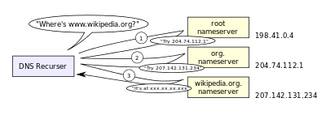
Domain Name Service (DNS)
The Domain Name System (DNS) is a hierarchical decentralized naming system for computers, services, or any resource connected to the Internet or a private network

