Slide 1
TCP\IP protocols

Slide 2
Internet Protocol (IP RFC-791)
TCP/IP Internet provides 3 layers of service
Application services
Transport Services
Connectionless packet delivery service
Layering allows one to replace one service without affecting others
IP layer (basic unit of transfer in TCP/IP) provides:
  Best-effort (does not discard capriciously), unreliable (no guarantees)
    Packet may be lost, duplicated, out-of-order with no notification
  Connectionless (each packet treated independently)
  IP software provides routing

Slide 3
Internet datagram
Basic transfer unit
Format of Internet datagram
Datagram header
Datagram data area
0
4
8
16
19
24
31
Vers
Hlen
Type of serv.
Total length
Identification
Flags
Fragment offset
TTL
Protocol
Header Checksum
Source IP address
Destination IP address
IP Options (if any)
Padding
Data
…

Slide 4
IP datagram format (cont.)
Vers (4 bits): version of IP protocol (IPv4=4)
Hlen (4 bits): Header length in 32 bit words, without options (usual case) = 20
Type of Service – TOS (8 bits): little used in past, now being used for QoS
Total length (16 bits): length of datagram in bytes, includes header and data
Time to live – TTL (8bits): specifies how long datagram is allowed to remain in internet
  Routers decrement by 1
  When TTL = 0 router discards datagram
  Prevents infinite loops
Protocol (8 bits): specifies the format of the data area
  Protocol numbers administered by central authority to guarantee agreement, e.g. TCP=6, UDP=17 …

Slide 5
IP Datagram format (cont.)
Source & destination IP address (32 bits each): contain IP address of sender and intended recipient
Options (variable length): Mainly used to record a route, or timestamps, or specify routing

Slide 6
IP Fragmentation
How do we send a datagram of say 1400 bytes through a link that has a Maximum Transfer Unit (MTU) of say 620 bytes?
Answer the datagram is broken into fragments
  Router fragments 1400 byte datagrams
    Into 600 bytes, 600 bytes, 200bytes (note 20 bytes for IP header)
    Routers do NOT reassemble, up to end host
Net 1
MTU=1500
Net 3
MTU=1500
Net 2
MTU=620

Slide 7
Fragmentation Control
Identification: copied into fragment, allows destination to know which fragments belong to which datagram
Fragment Offset (12 bits): specifies the offset in the original datagram of the data being carried in the fragment
  Measured in units of 8 bytes starting at 0
Flags (3 bits): control fragmentation
  Reserved (0-th bit)
  Don’t Fragment – DF (1st bit):
    useful for simple (computer bootstrap) application that can’t handle
    also used for MTU discovery (see later)
    if need to fragment and can’t router discards & sends error to source
  More Fragments (least sig bit): tells receiver it has got last fragment
TCP traffic is hardly ever fragmented (due to use of MTU discovery). About 0.5% - 0.1% of TCP packets are fragmented .
Notes:
Need routing to get message back to origin

Slide 8
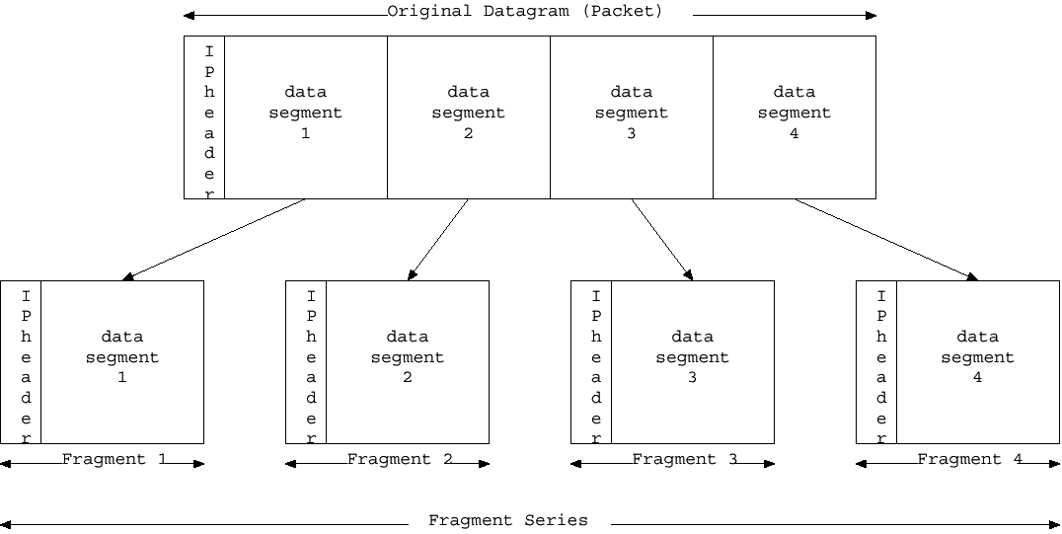
Fragment series composition
Offset=0
More frags
Offset=1480
More frags
Offset=2960
More frags
Offset=3440
Last frag
NB. If data segment contains its own header that is not replicated

Slide 9
Routing
Routers must select next hop for packet
Get route information from other routers via a routing protocol (RIP, OSPF, EIGRP etc.)
Note the following are non-routable:
  private networks: 10.0.0.0/8, 172.16.0.0/12, 192.168.0.0/16
  Loopback 127.0.0.0/24

Slide 10
MTU Discovery
Path MTUs vary
Fragmentation is bad
Small transmission units are bad
SO need to discover optimum MTU (largest without fragmentation)
Host sends a packet with the Don’t Fragment bit set
  Length is lesser of local MTU and MSS announced by remote system
  If MTU between hosts requires fragmentation (e.g. at an intermediate router), then
    if an ICMP DF bit set & must fragment then an ICMP message is sent back to source, saying “I can’t fragment”
    try again with smaller size.

Slide 11
User Datagram Protocol - UDP
RFC 768, Protocol 17
Provides unreliable, connectionless on top of IP
Minimal overhead, high performance
  No setup/teardown, 1 datagram at a time
Application responsible for reliability
  Includes datagram loss, duplication, delay, out-of-sequence, multiplexing, loss of connectivity
Demux on
Port number
App.
Port 1
Port 2
Port 1
Port 2
Transport
TCP
UDP
Demux on IP protocol
Network
IP
Notes:
Low overhead since: no set up or tear down, deals with only one datagram at a time

Slide 12
UDP Datagram format
0
8
16
24
31
Source port
Destination port
UDP message len
Checksum (opt.)
Data
…
Source/destination port: port numbers identify sending & receiving processes
  Port number & IP address allow any application in any computer on Internet to be uniquely identified
  Used to demultiplex datagrams to processes
  Ports can be static or dynamic
    Static (< 1024) assigned centrally, known as well known ports
    Dynamic
Message length in bytes includes the UDP header and data

Slide 13
UDP applications
Message oriented, e.g. SNMP, DNS, time
File system, e.g. NFS, AFS
Lightweight file transfer, e.g. tftp, bootp

Slide 14
Transmission Control Protocol -TCP
RFC 768 & host requirements RFC 1122
  Reliable stream transport
    Connection oriented (full duplex virtual circuit)
      Conceptually place call, two ends communicate to agree on details
      After agreeing application notified of connection
      During transfer, ends communicate continuously to verify data received correctly
      When done, ends tear down the connection
      If UDP is like regular mail, TCP is like phone call
    Provides buffering and flow control
    Takes care of lost packets, out of order, duplicates, long delays
    Isolates application program from network details
    Jargon
      Segment = TCP packet
      Socket= source (address + port) + destination (address + port)

Slide 15
TCP layering
To ID connection need:
  Source: (address, port) AND Destination: (address, port)
  Only need one port on host to allow multiple connections, since each connection will have different (host, port) at other end
    E.g. single host can serve multiple telnet connections
Passive open: application contacts OS & indicates will accept incoming connection, OS assigns port and listens
Active open: application requests OS to connect to an (host, port)
App.
Port 1
Port 2
Port 1
Port 2
Demux on
Port number
Transport
TCP
UDP
Demux on IP protocol
IP port 6
Network
IP

Slide 16
TCP – providing reliability
Positive acknowledgement (ACK) with retransmission
  Sender keeps record of each packet sent
  Sender awaits an ACK
  Sender starts timer when sends packet
Sender site
Receiver site
Send pkt 1
Rcv pkt 1
Send ACK 1
Time
Rcv ACK 1
Send pkt 2
Rcv pkt 2
Send ACK 2
Rcv ACK 2
Network messages

Slide 17
TCP – simple lost packet recovery
Sender site
Receiver site
Send pkt 1
Start timer
Loss
Pkt should arrive
ACK should be sent
ACK normally
arrives
Timer expires
Retransmit pkt 1
start timer
Rcv pkt 1
Send ACK 1
Rcv ACK 1
Network messages

Slide 18
TCP – improving performance
BUT simple ACK protocol wastes bandwidth since it must delay sending next packet until it gets ACK
Use sliding window
Sender can send 4 packets of data without ACK
  When sender gets ACK then can send another packet
  Window = unacknowledged packets/bytes
  Keeps timer for each packet
Window slides
Initial window of 4 packets
    2 3 4 5 6 7 8 …
    2 3 4 5 6 7 8 …
Packets successfully sent
Packets to be sent
Packets sent, awaiting ACK

Slide 19
Tuning to fill pipe
Optimal window size depends on:
  Bandwidth end to end, i.e. min(BW_{links}) AKA bottleneck bandwidth
  Round Trip Time (RTT)
  For TCP keep pipe full
    Window (sometime called pipe) ~ RTT*BW
  Can increase bandwidth by
  orders of magnitude
Windows also used for flow control
Src
Rcv
t = bits in packet/link speed
ACK
RTT

Slide 20
Implementation
Sliding window operates at byte level, NOT packet
Receiver keeps similar window to put stream back together
Since full duplex, altogether 4 windows & pointer sets
Current window
    2 3 4 5 6 7 8 …
Highest byte that can be sent
3 pointers
Highest byte sent
Bytes sent and acknowledged

Slide 21
TCP flow control
Windows vary over time
  Receiver advertises (in ACKs) how many it can receive
    Based on buffers etc. available
  Sender adjusts its window to match advertisement
  If receiver buffers fill, it sends smaller adverts
Used to match buffer requirements of receiver
Also used to address congestion control (e.g. in intermediate routers)

Slide 22
TCP Segment format
8
16
24
Source/Dest port: TCP port numbers to ID applications at both ends of connection
Sequence number: ID position in sender’s byte stream
0
4
10
31
Source port
Destination port
Sequence number
Acknowledgement number
Hlen
Resv
Code
Window
Checksum
Urgent ptr
Options (if any)
Padding
Data if any
…

Slide 23
TCP segment format – cont.
Acknowledgement: identifies the number of the byte the sender of this segment expects to receive next
Hlen: specifies the length of the segment header in 32 bit multiples. If there are no options, the Hlen = 5 (20 bytes)
Reserved for future use, set to 0
Code: used to determine segment purpose, e.g. SYN, ACK, FIN, URG

Slide 24
TCP Segment format- cont
Window: Advertises how much data this station is willing to accept. Can depend on buffer space remaining.
Checksum: Verifies the integrity of the TCP header and data. It is mandatory.
Urgent pointer: used with the URG flag to indicate where the urgent data starts in the data stream. Typically used with a file transfer abort during FTP or when pressing an interrupt key in telnet.
Options: used for window scaling, SACK, timestamps, maximum segment size etc.

Slide 25
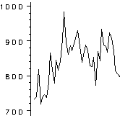
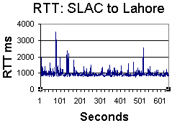
TCP timeout
Need a timeout estimate that will work for LANs (RTT < msec.) to satellite WANs (hundreds of msec. to secs). RTT can vary a lot with time of day, day of week, or one second to next.
  TCP records time segment sent
  and time ACK received
  Then calculates RTT sample
  Smooth & use to estimate timeout, e.g.
    Timeout=beta * RTT_{s}
    Timeout= RTT_{s} + eta{=4}*f(dev(RTT_{s}))
  Needs to take account of losses, e.g.
    New_timeout=gamma{2} * timeout
May 12th
RTT ms.
Time of day

Slide 26
TCP connection establishment
3 way handshake
Initial sequence numbers (x, y) are chosen randomly
Guarantees both sides ready & know it, and sets initial sequence numbers, also sets window & mss
Once connection established, data can flow in both directions, equally well, there is no master or slave
Site 1
Site 2
Send SYN seq x
Active
Win 4096, mss 1024
Rcv SYN segment
Passive
Win 4096, mss 1024
Send SYN seq=y, ACK x+1
Rcv SYN/ACK
Send ACK y+1
Rcv ACK segment

Slide 27
TCP close connection
Modified 3 way handshake (or 4 way termination)
App tells TCP to close, TCP sends remaining data & waits for ACK, then sends FIN
Site 2 TCP ACKs FIN, tells its application “end of data”
Site 2 sends FIN when its app closes connection (may be long delay (e.g. require human interaction).
Site 1
Site 2
(App closes)
Send FIN seq=x
Rcv FIN segment
Send ACK x=1
(inform app)
Rcv ACK segment
(app closes connection)
Send FIN seq=y, ACK x+1
Rcv FIN + ACK seg
Send ACK y+1
Receive ACK segment

Slide 28
Internet Usage Statistics for Africa
( Africa Internet Usage and Population Stats )
INTERNET USERS AND POPULATION STATISTICS FOR AFRICA
Population
Pop. %
Internet Users,
Penetration
Users
Facebook
AFRICA REGION
(2012 Est.)
of
31
-
Dec
-
11
(% Population)
% World
30
-
June
-
12
World
Total for Africa
1,073,380,925
15.3 %
139,875,242
13.3 %
6.2 %
43,404,160
Rest of World
5,939,122,375
84.7 %
2,127,358,500
36.1 %
93.8 %
824,642,360
WORLD TOTAL
7,012,503,300
100.0 %
2,267,233,742
32.7 %
100.0 %
868,046,520
Source:Internet World Stats 2012

Slide 29
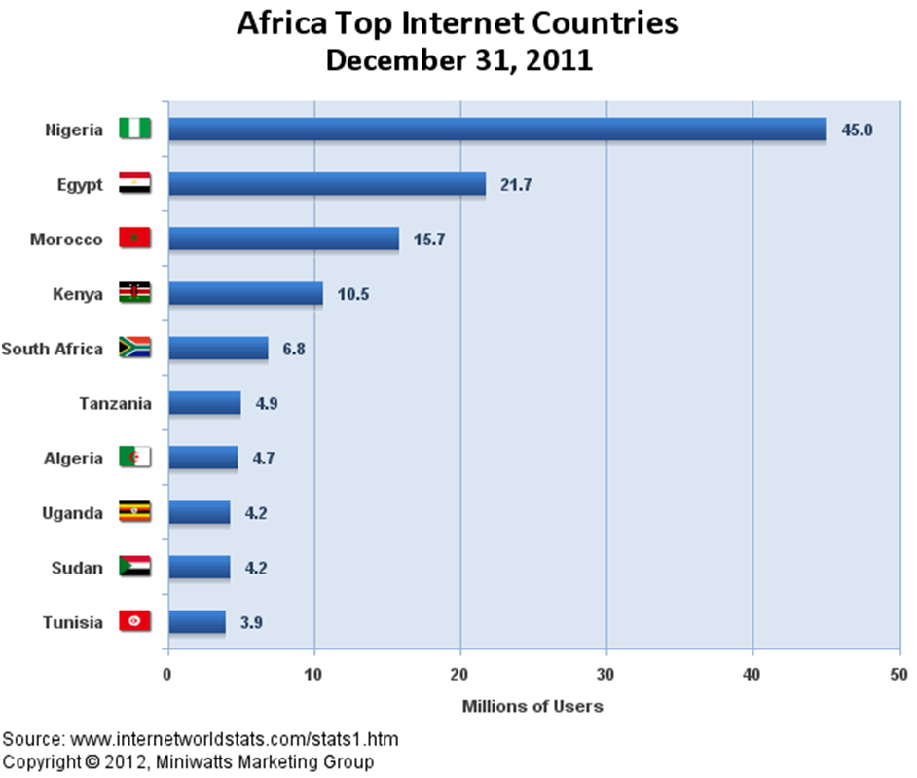

Slide 30
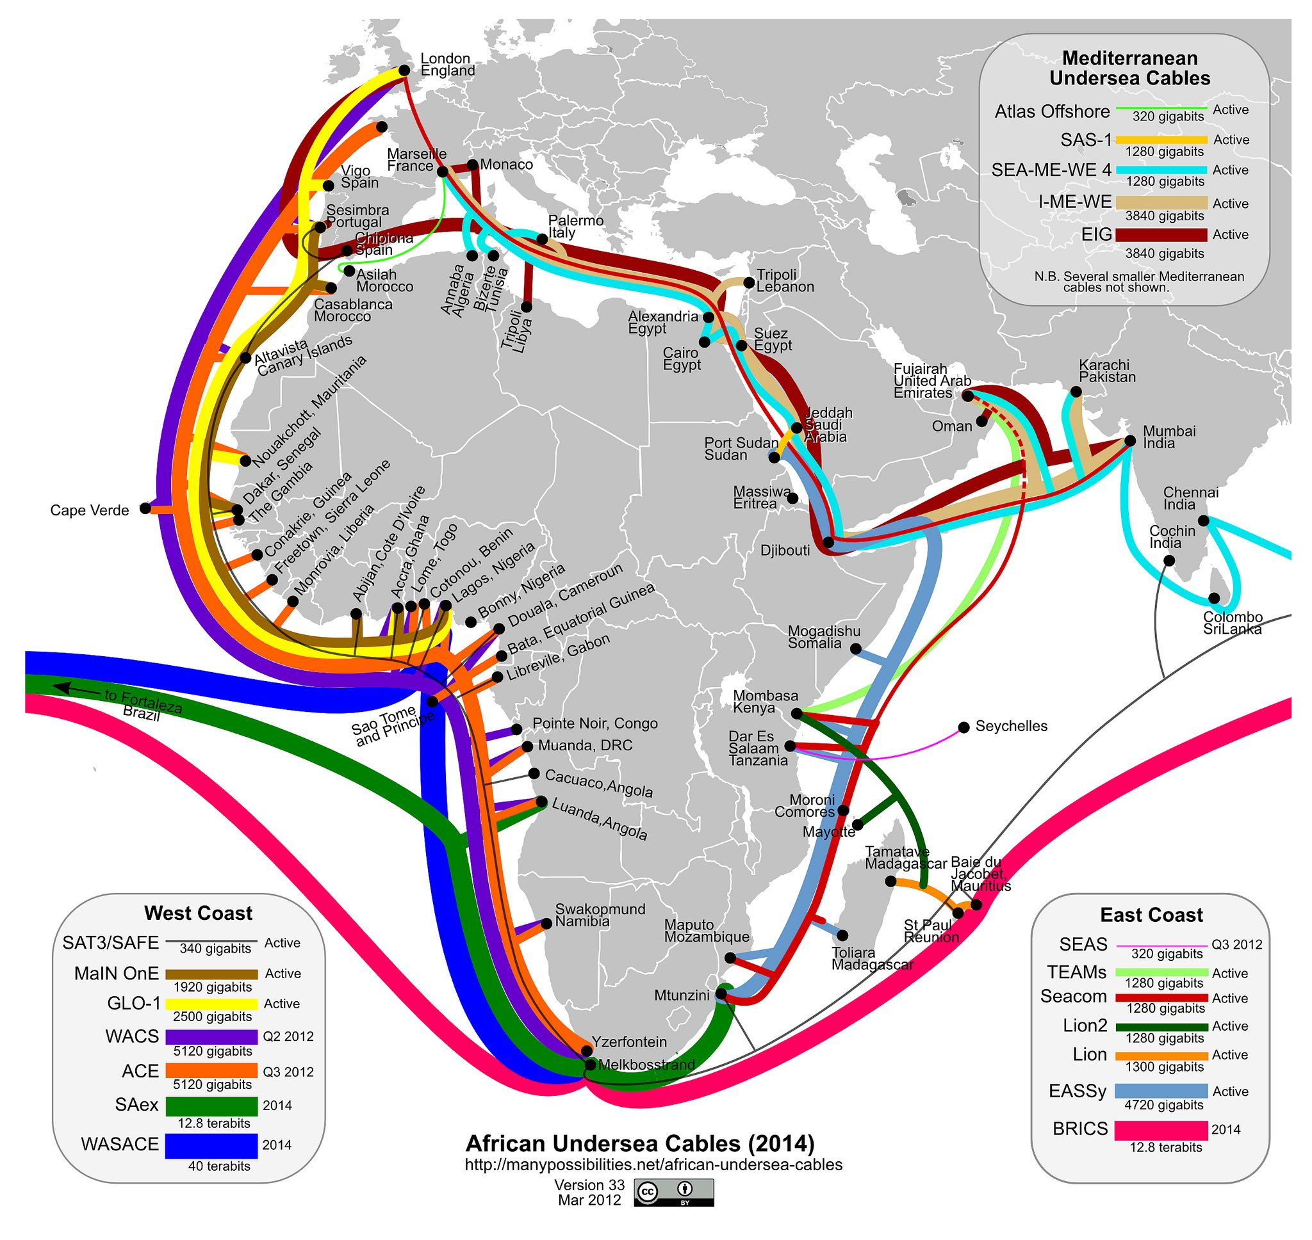
Submarine communications cables

Slide 31

Main One is a communications services company providing open access wholesale international connectivity and broadband capacity to countries in West Africa. Main One built and own the first privately owned submarine cable over a distance of 7,000 kilometres along the West African coastline, with initial landing stations in Nigeria, Ghana and Portugal. The Cable currently delivers high speed bandwidth of 1.92 terabits per second (but has been proven to provide capacity of at least 4.96 tbps) with branching units in Morocco, Canary Islands, Senegal and Ivory Coast. Main One provides open access, wholesale, international broadband capacity to countries along the western coast of Africa.
Main One is present at various internet exchange points both regionally and internationally. We are available to interconnect at
Internet Exchange Point of Nigeria (IXPN)
Ghana Internet Exchange (GIX)
London Internet Exchange (LiNX)
As a result MainOne is able to provide shorter routes, lower latency service and bandwidth scalability at affordable prices.

Slide 32
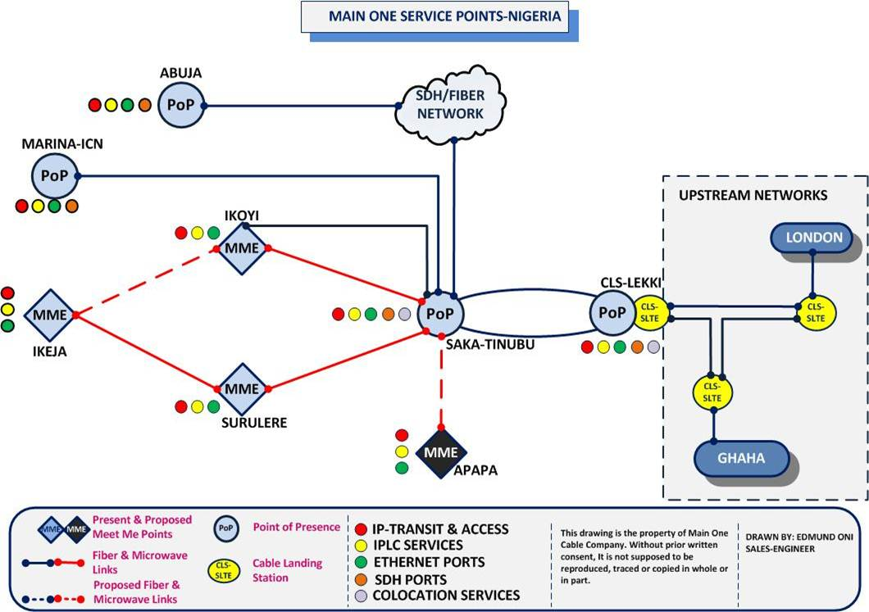
Main One Points of Presence
Source: Main One Cable Company

Slide 33

Network Infrastructure: National Data Network
Globacom owns a robust infrastructure and is the only operator in Nigeria with integrated domestic and International network.
Globacom high speed optic fibre network spans more than 10000 km covering almost entire Nigeria. The network covers all the major cities– Lagos, Ibadan, Benin, Warri, PortHarcourt, Abuja, Zaria, Kaduna, Kano, Abeokuta etc.
The network is configured in multiple ‘self-healing’ rings to ensure error free service.
Besides this, Globacom is establishing a Metro ring across all the 20 major cities of Nigeria.
The backbone and metro rings of Globacom are equipped with Single Mode 96 F Optic Cable with ITU-T G.652 standard. It is armoured cable for extra protection from rodent.
Source:Globacom Nigeria

Slide 34
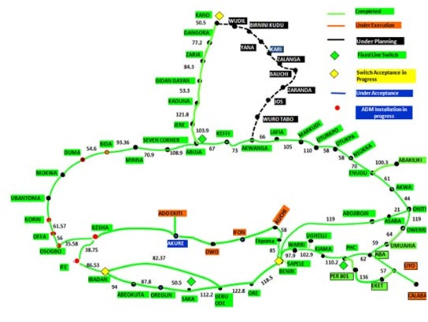
Fiber Network
Source: Globacom Nigeria

Slide 35
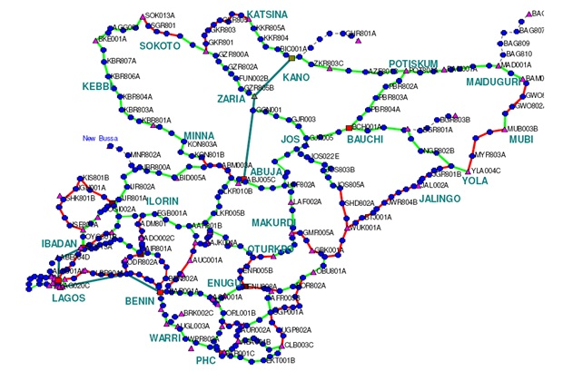
Microwave Network
Source: Globacom Nigeria

Slide 36

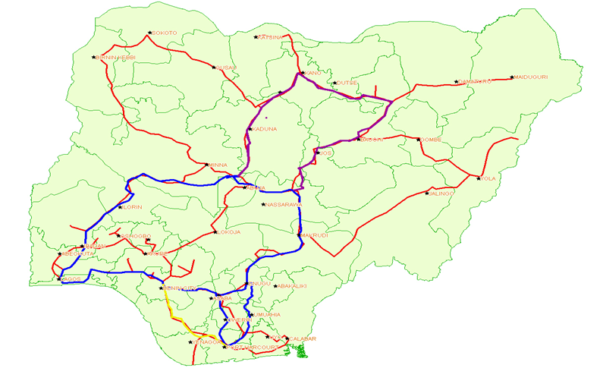

MTNN’s backbone microwave and fibre optics cable transmission infrastructure
Source:MTNN

Slide 37

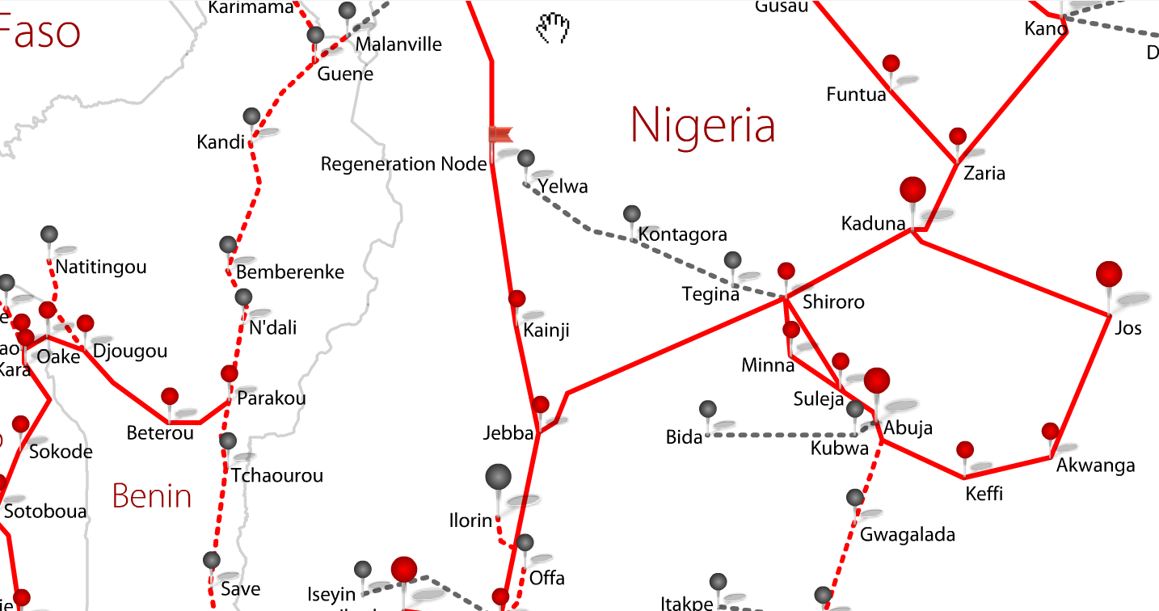
Network Infrastructure
Source: Phase 3 Telecom

