Slide 1
CAPSTONE PRES. 2
MIKE MCMULLEN & HART SINTERHAUF
SPONSORED BY PROF. TIAN ZHAO

Slide 2
RESEARCH PATH SO FAR
MQTT
lightweight TCP based subscribe and Publish mesaging protocol
Apache Spark
Process large volumes of streaming data using resilient distributed datasets (RDD = nodes)
DAG - multistep operational flow control with Actions and Transformations
ThingsBoard.io rule engine
Not efficient solution for programmers as the mechanics of stream composition is abstracted from the user
Node.js Stream Library
Reactive programming with Push based Streams
Created a module for:
Multiplexing and demultiplexing streams
Functionally composing streams based on provided callback
Functional Reactive Programming: REScala
Main objective switched from 'Glueing' IOT streams together with FRP to Providing Fault
Tolerance to existing solutions
Fault-Tolerant Distributed Reactive Programming: REScala
Fault-Tolerance in the context of Rx.js

Slide 3
RECAP & END OF SEMESTER GOALS
NODE.JS MIDDLEWARE FOR DATA ANALYSIS OF IOT STREAMS
FAULT TOLERANT – MULTIPLE QOS OPTIONS
CLEAN LOGGING OPTIONS – BETTER DEBUGGING
FUNCTIONALLY COMPOSABLE
CALCULATE WINDOW-BASED AND POINT-BASED KPI'S
RESEARCH FRP SOLUTIONS FOR HANDLING IOT STREAMING APPLICATIONS (RX.JS)
DEMO: CONNECT MQTT CLIENTS WITH A NODE.JS EXPRESS SERVER USING OUR MIDDLEWARE
REMOVE AND CONNECT CLIENTS PERIODICALLY TO DEMONSTRATE QOS & LOGGING

Slide 4
RX.JS
Library for composing asynchronous and event-based programs using observable sequences
Support for Map, Reduce, Filter, Every, etc
Observer Pattern - design pattern where object maintains a list of its dependents, called observers, and notifies them automatically of any state changes
Push - client automatically updates any dependents when it's value changes
observables can be subscribed to with callbacks registered for various states such as next, error, or complete

Slide 5
Demo Architecture Outline
Individual Data Topics
Processed Data
Raw Data
Fault Tolerant Stream Processing Middleware
Data consumer (IoT Dashboard, Web application/server, file system, Database, Console log, etc)
JavaScript Publisher
MQTT Broker
Publishes data as json strings to topics on the broker
Simulates IoT devices broadcasting data
Manages connections
Delivers messages published to topics for subscribers of each topic
Subscribes to topics provided by the broker
Creates and composes streams using provided data
Processes streams into consumable data

Slide 6
Architecture Details
Module Functions:
Fault-Tolerance combined with Distributed Reactive Programming already provided by Rx.JS
Concise Error statements
All Module Functions will extend or encapsulate Rx.js functionality
Docker Images: MQTT Mosquitto Broker, Node.Jsj MQTT clients, Express KPI Server, React Frontend

Slide 7
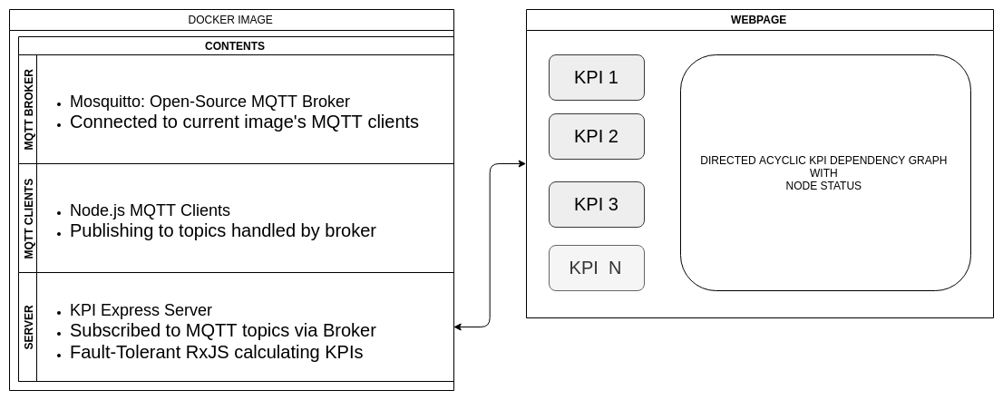
Demo Architecture

Slide 8
Middleware Example
Tank Pressure (PSI)
=TP
(Gallons Per Minute)
(TP,EP)
(Gallons Per Minute)
Combine()
Map()
Duplicate()
Exit Pressure (PSI)
=EP
Reduce()
Total Output (Gallons)

Slide 9
Fault Tolerance
Faults:
Unanticipated connection lose due to network issues, or hardware failure
Missing or Invalid Data
Proposed Solutions for Recovery or Failing Gracefully
Eventual Consistency
Block dependent calculations until recovery
Handle Error Propagation
Comprehensive Error Reporting/logging
Full restart with restored state (Extreme Case)

Slide 10
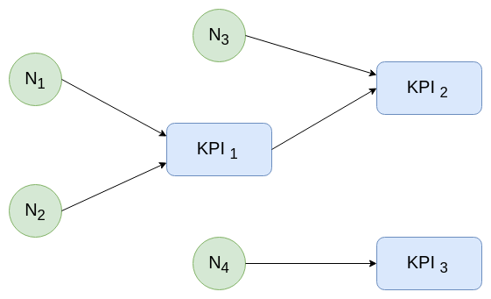

Slide 11
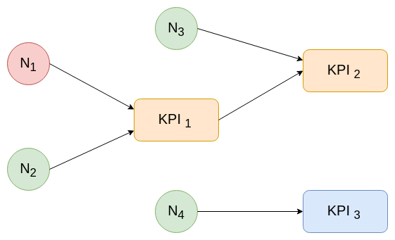

Slide 12
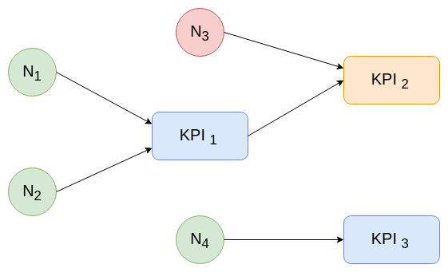

Slide 13
