Slide 1


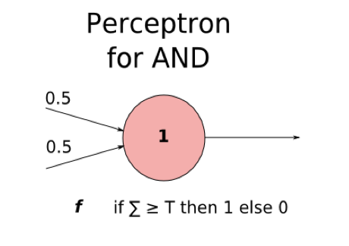
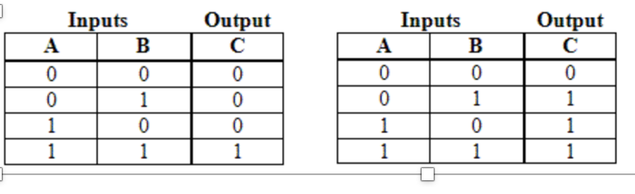
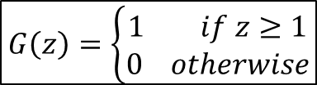
Homework 05 （PPT）
Prove the M-P Model is an “AND” Logic
$$G\left(z\right)=\left\{\begin{aligned}1 if z≥1 \\ 0 otherwise\end{aligned}\right.$$
Transfer Function is G (z)

Slide 2
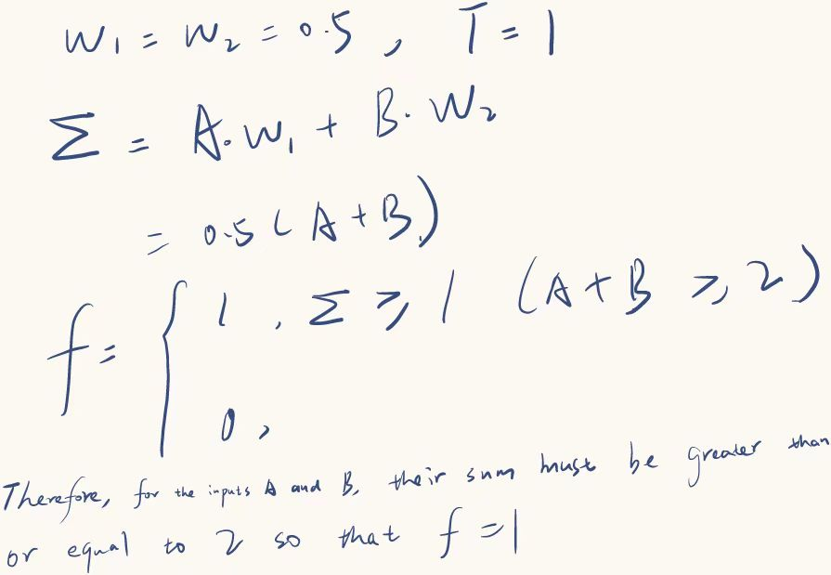

Homework 05 （PPT）
Prove the M-P Model is an “AND” Logic
Transfer Function is G (z)
$$G\left(z\right)=\left\{\begin{aligned}1 if z≥1 \\ 0 otherwise\end{aligned}\right.$$

Slide 3
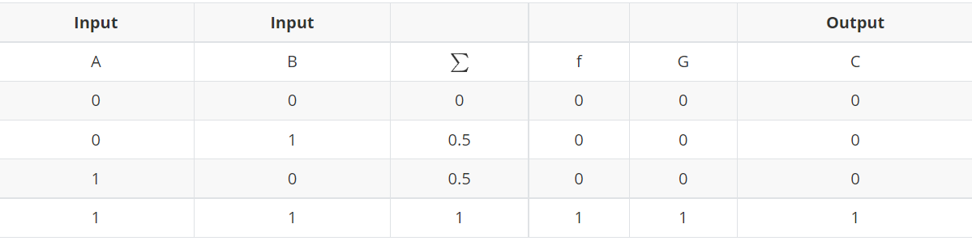
Homework 05 （PPT）
Prove the M-P Model is an “AND” Logic
It proves that the M-P Model is an “AND” Logic, which only if the inputs A and B are both 1 , the output C is 1.

