Slide 1


Homework 8
Suppose we now have the following data set, in which flower color and leaf shape are discrete features, and flower types are their labels. Now, we want to classify the flower species in the dataset through decision tree, please answer the following questions.
serial number | flower color | leaf shape | flower type
1 | red | circle | Iris-Ame
2 | red | strip | Iris-Ame
3 | white | acicular | Iris-Ame
4 | white | acicular | Iris-Somnus
5 | white | strip | Iris-Somnus
6 | purple | circle | Iris-Somnus
7 | purple | acicular | Iris-XinQ
8 | red | circle | Iris- XinQ
9 | purple | strip | Iris- XinQ
（1）Please calculate the information gain of flower color and leaf shape as selected features separately.
（2）Please explain which feature should be selected based on the calculation results in (1)?

Slide 2
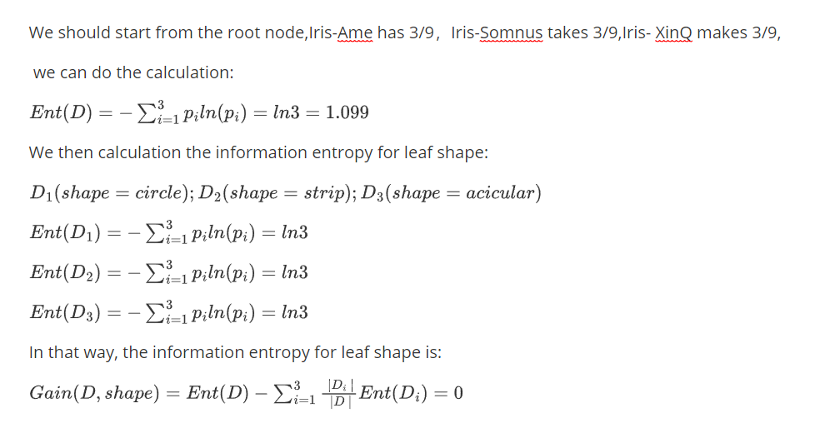
Homework 8

Slide 3
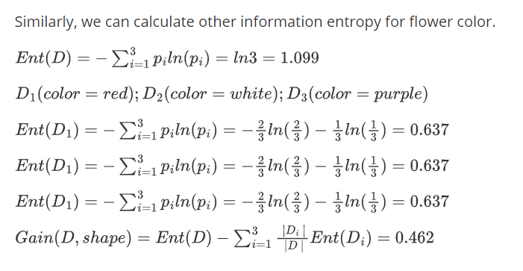
Homework 8

Slide 4

Homework 8
From the above calculation, we can find that
Therefore, we select the feature with the maximum information gain as the splitting feature for the current node.
As a result, flower color should be selected based on the calculation results in (1)

