Slide 1
Homework 12-1
The following table shows the sample data of 3 cases of myopia. The labels are {0,1,2}, where 0 represents normal samples, 1 represents mild myopia, and 2 represents severe myopia. The table shows the results of the model predicting samples into various classes. Please write the one-hot encoding corresponding to the true label of the sample based on the data in the table and calculate the cross-entropy loss.
Number | Normal | Mild Myopia | Severe Myopia
1 | 0.6 | 0.3 | 0.1
2 | 0.2 | 0.5 | 0.3
3 | 0.0 | 0.25 | 0.75

Slide 2
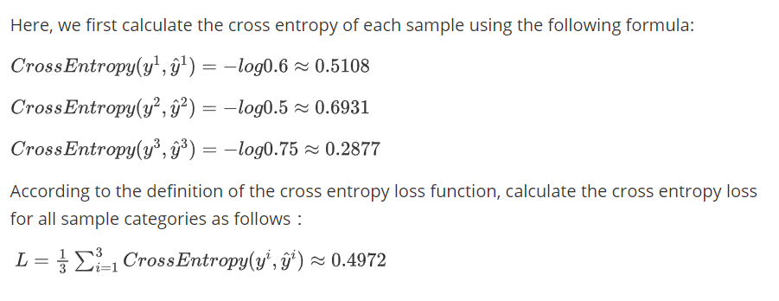
Homework 12-1
The one-hot encoding and the calculation of the cross entropy are as follows:
Number | Real Label | Predicted Result
1 | (1,0,0) | (0.6,0.3,0.1)
2 | (0,1,0) | (0.2,0.5,0.3)
3 | (0,0,1) | (0.0,0.25,0.75)

Slide 3
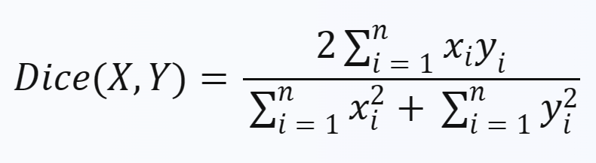
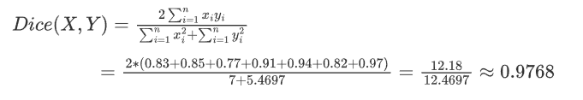

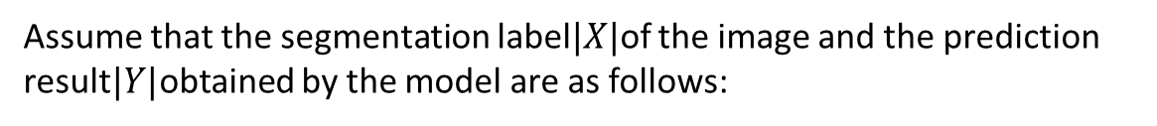
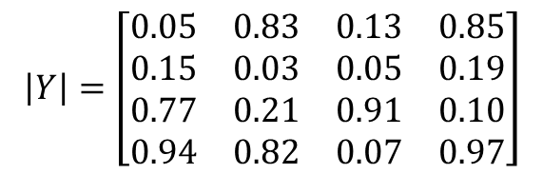
Homework 12-2
Assume that the segmentation label$|X|$of the image and the prediction result$|Y|$obtained by the model are as follows:
$\left|X\right|=\left[\begin{matrix}0 & 1 & 0 & 1 \\ 0 & 0 & 0 & 0 \\ 1 & 0 & 1 & 0 \\ 1 & 1 & 0 & 1\end{matrix}\right]$
$$\left|Y\right|=\left[\begin{matrix}0.05 & 0.83 & 0.13 & 0.85 \\ 0.15 & 0.03 & 0.05 & 0.19 \\ 0.77 & 0.21 & 0.91 & 0.10 \\ 0.94 & 0.82 & 0.07 & 0.97\end{matrix}\right]$$
Please calculate the Dice coefficient according to the method of summing the squares of elements:
Reference formula:
The Dice coefficient according to the method of summing the squares of elements is 0.9768.

Slide 4

Homework 12-3
Assume there are 4 samples,
The labels corresponding to the samples are {3, -1, 2, -5},
The predicted values output by the model are {2.5, -1.2, 3.1, -4.9}.
Please calculate the mean square error loss.

