Slide 1

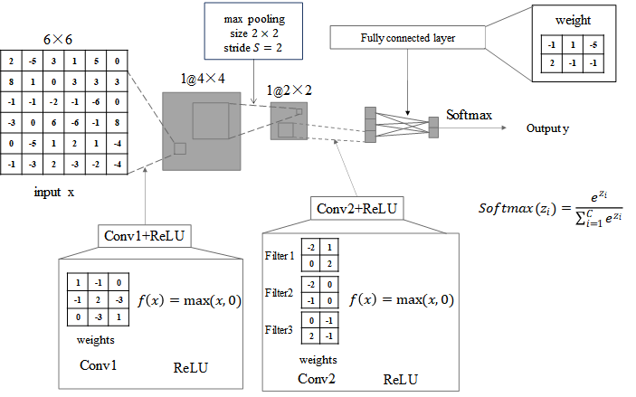
Homework 13
Given a simple convolutional neural network structure as follows, it contains an input layer, two convolutional layers (Conv1 and Conv2), a maximum pooling layer, and a fully connected layer. where all layers do not contain bias vectors and the weights are given in the figure. Assume that a 6x6 matrix as shown in the figure is input to the model. Please calculate the output value of the model and give the calculation results of the middle layer. (Note: The convolution calculation needs to be flipped)

Slide 2
Homework 13
After conv1
2 | -13 | -4 | 8
18 | -23 | 32 | 0
1 | 30 | -21 | -22
-5 | -14 | 19 | 9
After max pooling
18 | 32
30 | 19
After ReLU
2 | 0 | 0 | 8
18 | 0 | 32 | 0
1 | 30 | 0 | 0
0 | 0 | 19 | 9

Slide 3
Homework 13
After conv2
After ReLU
18 | 32
30 | 19
34
-66
9
34
0
9

Slide 4
Homework 13
After fully connected layer
After Softmax
34
0
9
-1 | 1 | -5
2 | -1 | -1
-34-45
68-9
-79
59
4.9e-35
4.2e25
Output y
0
1

