Slide 1
Home Work 6: Please Verify the Table
Iter | x | y | yˆ | w
0 | (3.7, −10.5, 27.49) | +1 | 0 | (0, 0, 0)
1 | (4.8, 0.13, 21.75) | −1 | +1 | (3.7, −10.5, 27.49)
2 | (4.9, 1.25, 22.31) | −1 | +1 | (−1.1, −10.63, 5.74)
3 | (4.8, 0.13, 21.75) | −1 | −1 | (−6., −11.88, −16.57)
4 | (3.7, −10.5, 27.49) | +1 | −1 | (−6., −11.88, −16.57)
5 | (4.9, 1.25, 22.31) | −1 | +1 | (−2.3, −22.38, 10.92)
6 | (3.7, −10.5, 27.49) | +1 | −1 | (−7.2, −23.63, −11.39)
7 | (4.9, 1.25, 22.31) | −1 | +1 | (−3.5, −34.13, 16.1)
8 | (4.8, 0.13, 21.75) | −1 | −1 | (−8.4, −35.38, −6.21)
9 | (3.7, −10.5, 27.49) | +1 | +1 | (−8.4, −35.38, −6.21)
10 | (4.9, 1.25, 22.31) | −1 | +1 | (−8.4, −35.38, −6.21)
11 | (4.8, 0.13, 21.75) | −1 | −1 | (−8.4, −35.38, −6.21)

Slide 2
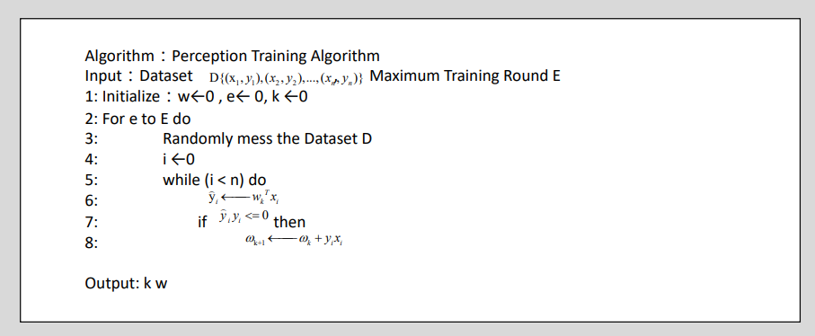
Home Work 6: Please Verify the Table
根据感知器的训练算法，
我们有训练集D={(3.7, −10.5, 27.49), (4.8, 0.13, 21.75), (4.9, 1.25, 22.31) }
我们取初始值w=0,e=0,k=0,E=10

Slide 3
Home Work 6: Please Verify the Table
从这个表格我们可以看出，当输出与标签不同时，对于这个模型的权重便会更新，但当前权重可以准确预测训练集的数据时，权重便会停止更新。经过4轮共12次迭代以后，我们发现w的值不再改变，并得到了如下的表格：
Iter | x | w^k | yˆ=x*w^k | y | yˆy | w_(k+1)=w_k OR w^(k+1)=w^k+y_k*x_k
0 | (3.7, -10.5, 27.49) | (0, 0, 0) | 0 | 1 | 0 | (3.7, -10.5, 27.49)
1 | (4.8, 0.13, 21.75) | (3.7, -10.5, 27.49) | 1 | -1 | -1 | (-1.1, -10.63, 5.74)
2 | (4.9, 1.25, 22.31) | (-1.1, -10.63, 5.74) | 1 | -1 | -1 | (-6., -11.88, -16.57)
3 | (4.8, 0.13, 21.75) | (-6., -11.88, -16.57) | -1 | -1 | 1 | (-6., -11.88, -16.57)
4 | (3.7, -10.5, 27.49) | (-6., -11.88, -16.57) | -1 | 1 | -1 | (-2.3, -22.38, 10.92)
5 | (4.9, 1.25, 22.31) | (-2.3, -22.38, 10.92) | 1 | -1 | -1 | (-7.2, -23.63, -11.39)
6 | (3.7, -10.5, 27.49) | (-7.2, -23.63, -11.39) | -1 | 1 | -1 | (-3.5, -34.13, 16.1)
7 | (4.9, 1.25, 22.31) | (-3.5, -34.13, 16.1) | 1 | -1 | -1 | (-8.4, -35.38, -6.21)
8 | (4.8, 0.13, 21.75) | (-8.4, -35.38, -6.21) | -1 | -1 | 1 | (-8.4, -35.38, -6.21)
9 | (3.7, -10.5, 27.49) | (-8.4, -35.38, -6.21) | 1 | 1 | 1 | (-8.4, -35.38, -6.21)
10 | (4.9, 1.25, 22.31) | (-8.4, -35.38, -6.21) | -1 | -1 | 1 | (-8.4, -35.38, -6.21)
11 | (4.8, 0.13, 21.75) | (-8.4, -35.38, -6.21) | -1 | -1 | 1 | (-8.4, -35.38, -6.21)

Slide 4
Home Work 6: Please Verify the Table
对比前后两个表格，我们发现这个表格在第10次迭代后，yˆ的地方出现了错误，应该由1改为-1，其余结果完全正确
Iter | x | y | yˆ | w
0 | (3.7, −10.5, 27.49) | +1 | 0 | (0, 0, 0)
1 | (4.8, 0.13, 21.75) | −1 | +1 | (3.7, −10.5, 27.49)
2 | (4.9, 1.25, 22.31) | −1 | +1 | (−1.1, −10.63, 5.74)
3 | (4.8, 0.13, 21.75) | −1 | −1 | (−6., −11.88, −16.57)
4 | (3.7, −10.5, 27.49) | +1 | −1 | (−6., −11.88, −16.57)
5 | (4.9, 1.25, 22.31) | −1 | +1 | (−2.3, −22.38, 10.92)
6 | (3.7, −10.5, 27.49) | +1 | −1 | (−7.2, −23.63, −11.39)
7 | (4.9, 1.25, 22.31) | −1 | +1 | (−3.5, −34.13, 16.1)
8 | (4.8, 0.13, 21.75) | −1 | −1 | (−8.4, −35.38, −6.21)
9 | (3.7, −10.5, 27.49) | +1 | +1 | (−8.4, −35.38, −6.21)
10 | (4.9, 1.25, 22.31) | −1 | +1 | (−8.4, −35.38, −6.21)
11 | (4.8, 0.13, 21.75) | −1 | −1 | (−8.4, −35.38, −6.21)
以这种方式，我们得到最终权重w为：w = (-8.4, -35.38, -6.21)
-1

