Slide 1

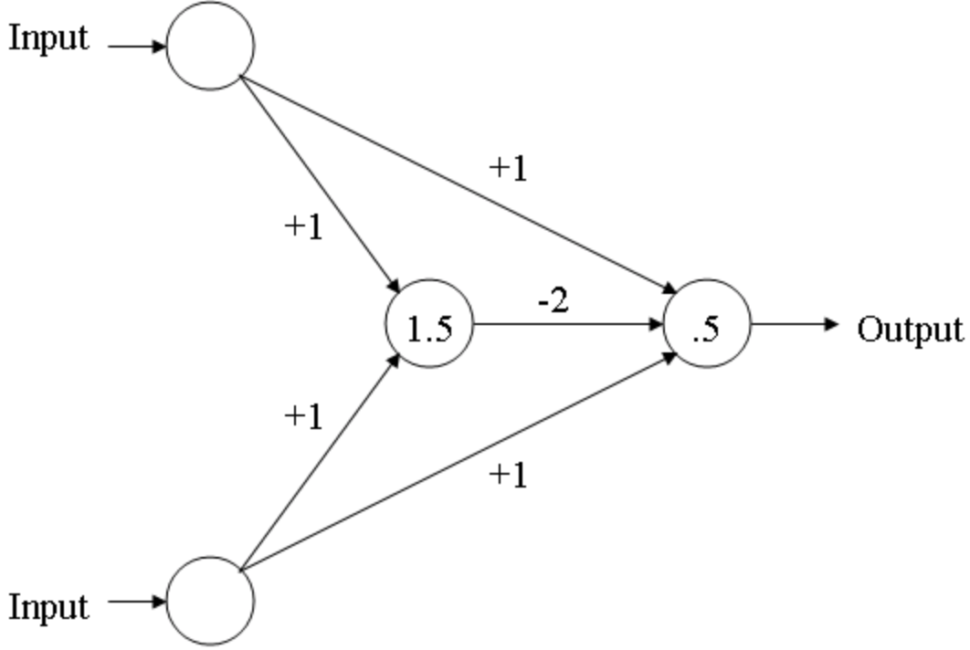

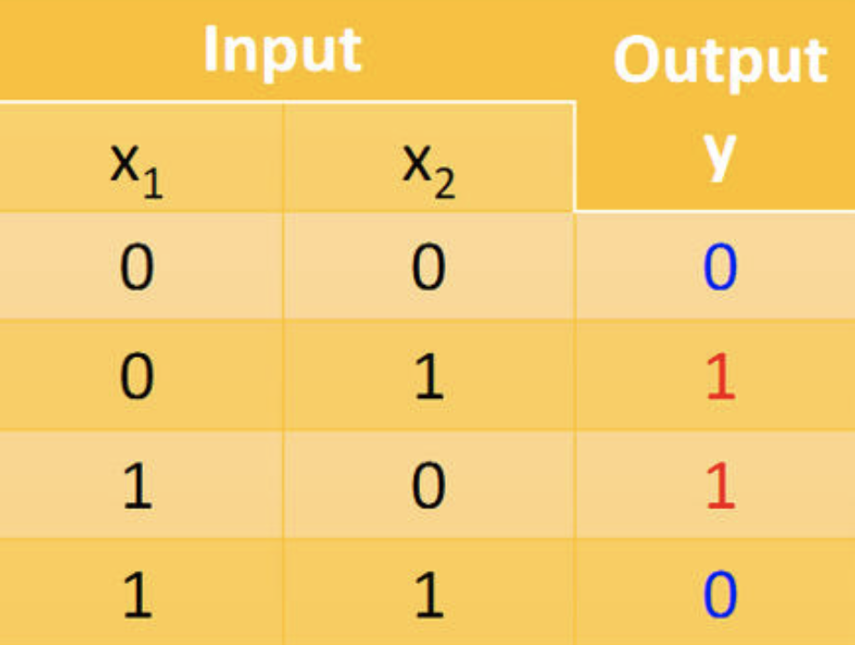
Homework 7： Prove The Following MLP Can Implement XOR Logic
From the above table, we can prove that the MLP can implement XOR Logic.

