Slide 1
Delay Locked Loop (DLL)

Slide 2
Introduction to Silicon Process and VLSI
CND121
Project #4
Delay Locked Loop (DLL)
Name | ID
AbdulRahman Ahmad Hasan AlSindiony | V23010058
Karim Mohamed Aboualenin | V23009983
Mohamed Mohamed Mohamed Hawas | V23010069
Dr Mourad Elsobky
TA / Eng Hossam Moataz

Slide 3
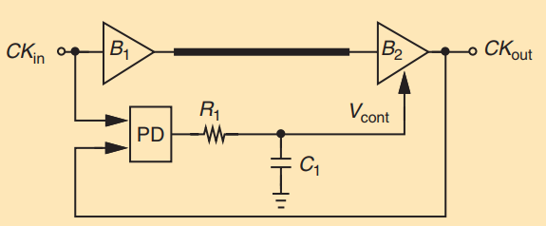
Introduction
Delay-locked loops (DLLs) can be considered as feedback circuits that phase lock an output to an input without the use of an oscillator. In some applications, DLLs are necessary or preferable over phase-locked loops (PLLs), with their advantages including lower sensitivity to supply noise and lower phase noise. This article deals with fundamental DLL design concepts.
The origins of DLLs can be traced to a paper published in 1961. The authors present the topology shown in Figure 1 as a “delay-lock discriminator” operating on random signals. The feedback loop consists of a controlled delay line, a multiplier acting as a phase detector (PD), and a lowpass filter. The use of DLLs in modern CMOS design evidently began with the work by Bazes in 1985 and Johnson and Hudson in 1988.

Slide 4
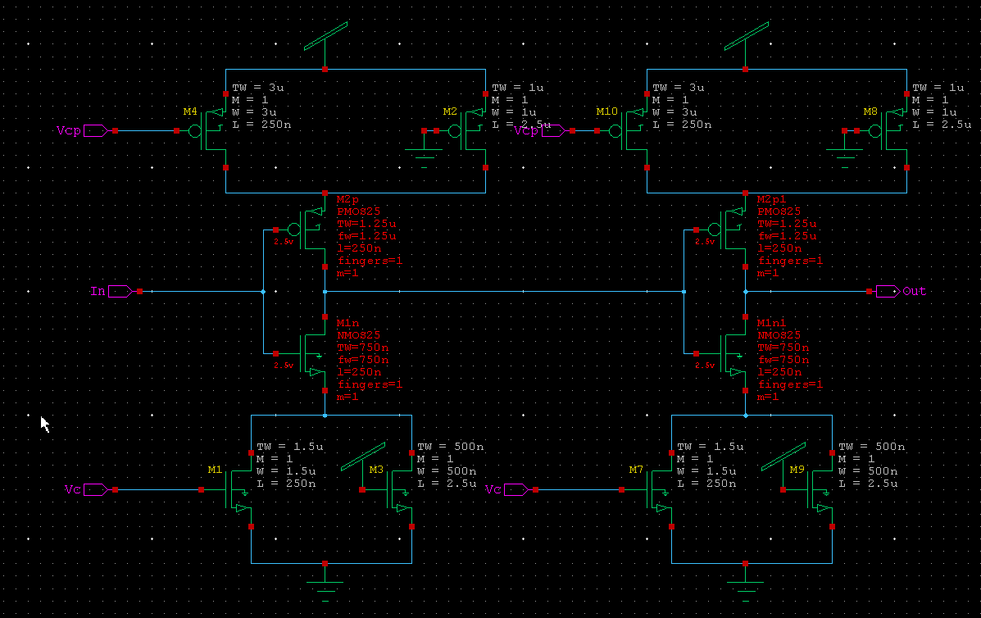
Main VCDL Cell Schematic

Slide 5
Main Cell Schematic : Inverters

Slide 6
Main Cell Schematic : Control CSs
Main Control Current Sources, reflect the effect of the control voltage on the inverter current.
Increasing Vc decreases Vcp, the inverter current increases, which decrease the delay.

Slide 7
Main Cell Schematic :Back-up CSs
Back-up current sources.
Small current sources, to make sure that the inverters always have currents even if Vc = 0, i.e. the main current sources are off.
The sizes are intentionally small.

Slide 8
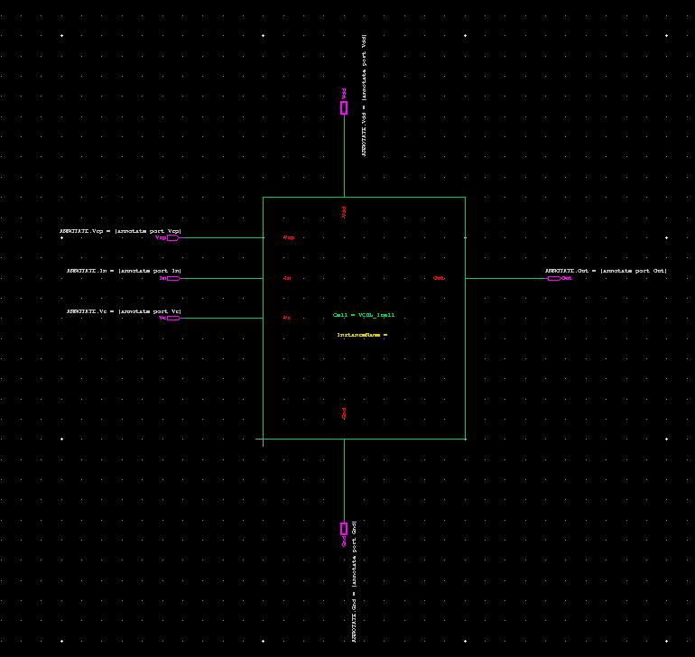
Main Cell Schematic : 1 Cell Symbol

Slide 9
Main Cell Schematic : 1 Cell Symbol
Each Cell has 12 Transistors. Vdd, Gnd, Vc for NMOS CS control, Vcp for PMOS CS, and the input signal to be delayed.

Slide 10
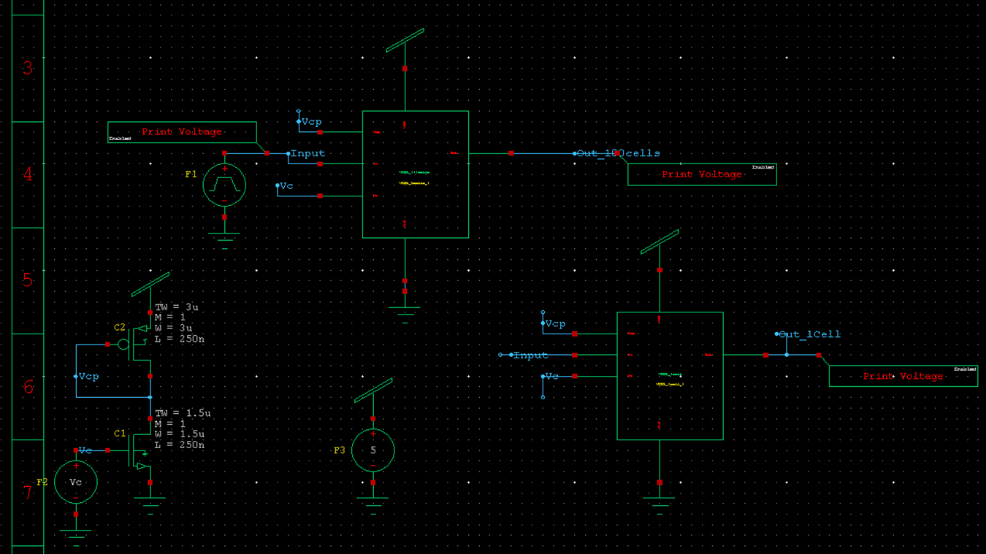
Test Bench Schematic
Current Mirror Connection to Generate Vcp, with the same sizing of main Current Sources (CSs).

Slide 11
Test Bench Schematic
Vdd = 5V

Slide 12
Test Bench Schematic
1 Cell Test Bench

Slide 13
Test Bench Schematic
100 Cells Test Bench

Slide 14
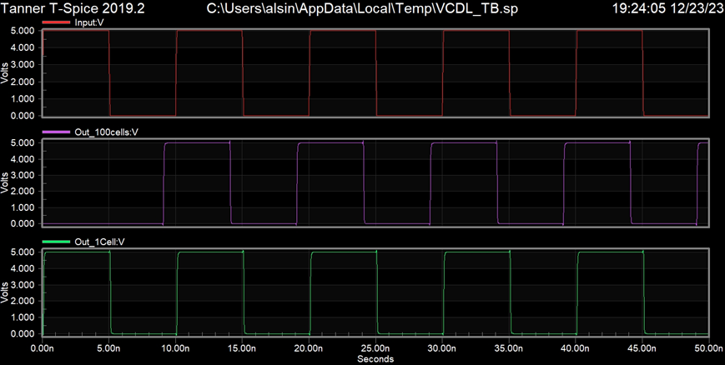
Test Bench Outputs
Voltage Controlled Delay Line (VCDL) Test outputs.
Input Frequency: 100MHz

Slide 15
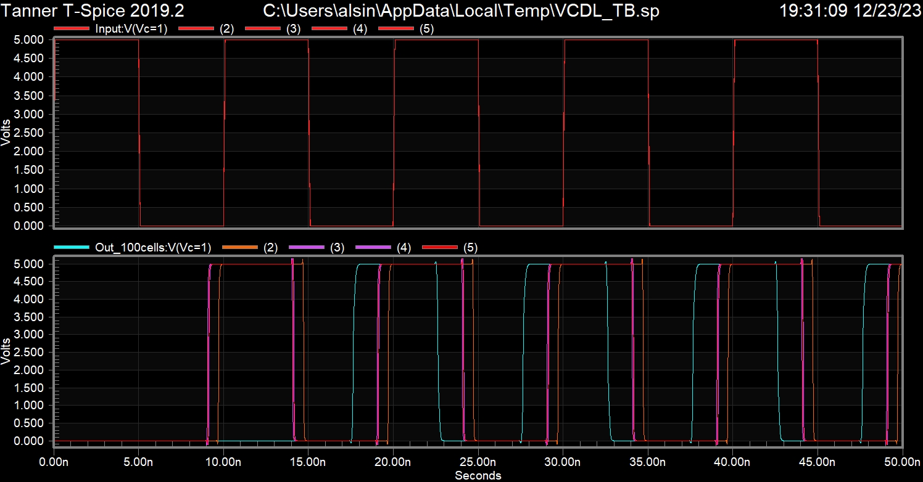
Test Bench Outputs
Voltage Controlled Delay Line (VCDL) Test outputs.
Input Frequency: 100MHz
Vc = {1,2,3,4,5}.
Maximum Delay for 1V, and Minimum Delay For 5V.

Slide 16
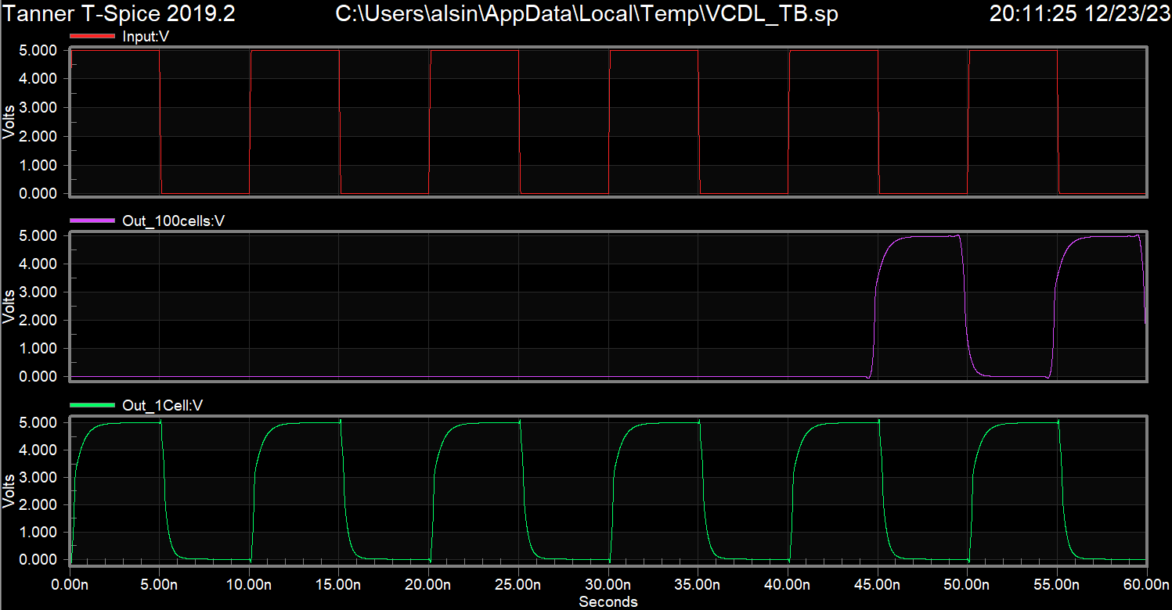
Test Bench Outputs
4.5 Delay Periods for Vc = 0V, for 100 Cells Delay Line

Slide 17
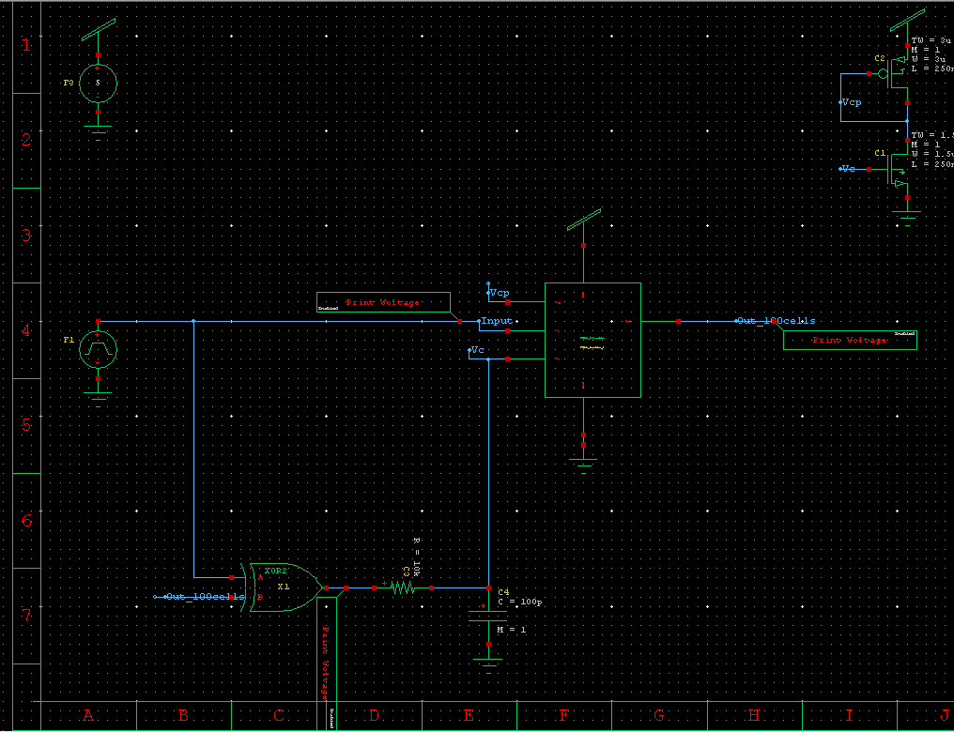
DLL Schematic
XOR represents simple Phase Detector(PD)

Slide 18
DLL Schematic
LPF to get Vc out of phase error

Slide 19
DLL Schematic
Voltage Controlled Delay Line (VCDL)

Slide 20
DLL Schematic
Current Mirror, To get Vcp out of Vc

Slide 21
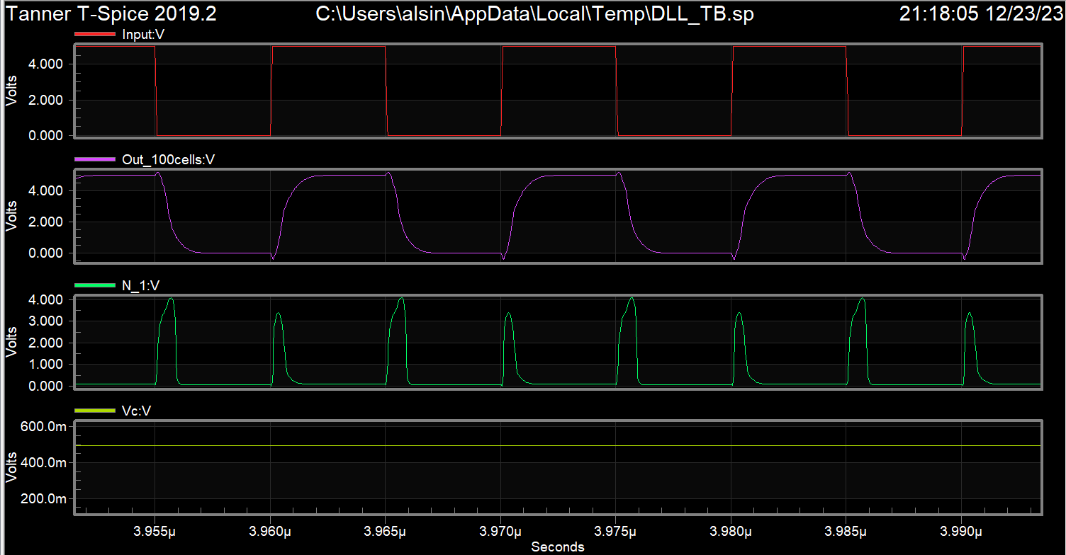
DLL Schematic
DLL locked state using 75 Delay cells.

Slide 22
DLL Schematic
Residual Phase error, resulting from rise and fall times.

Slide 23
DLL Schematic
Lock state with control voltage 0.5 Volts

Slide 24
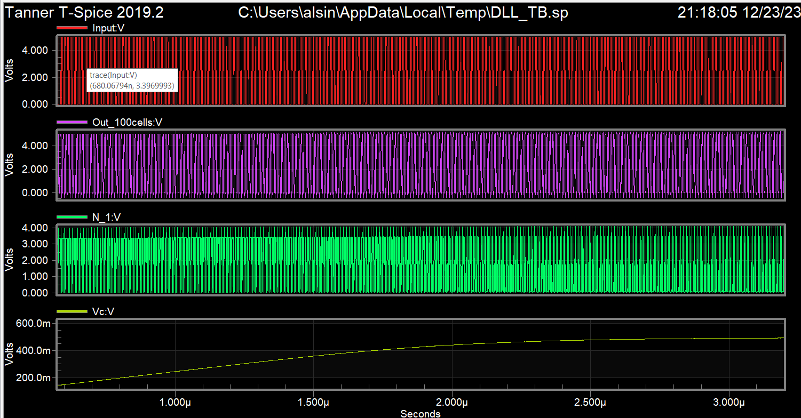
DLL Schematic
The adaptive change of control Voltage Vc.

Slide 25
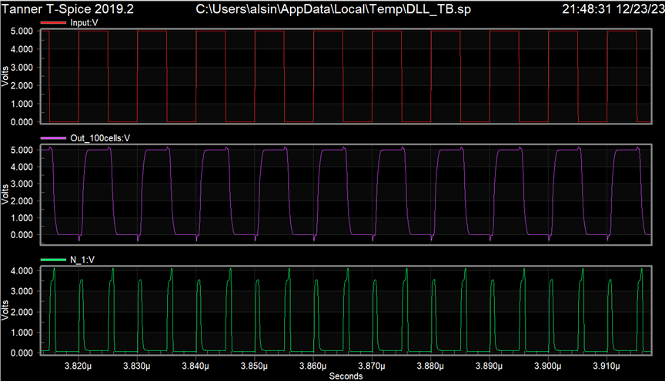
DLL Schematic
Lock State for 100 Delay Cells Used.

Slide 26
The End
Thank You

