Slide 1
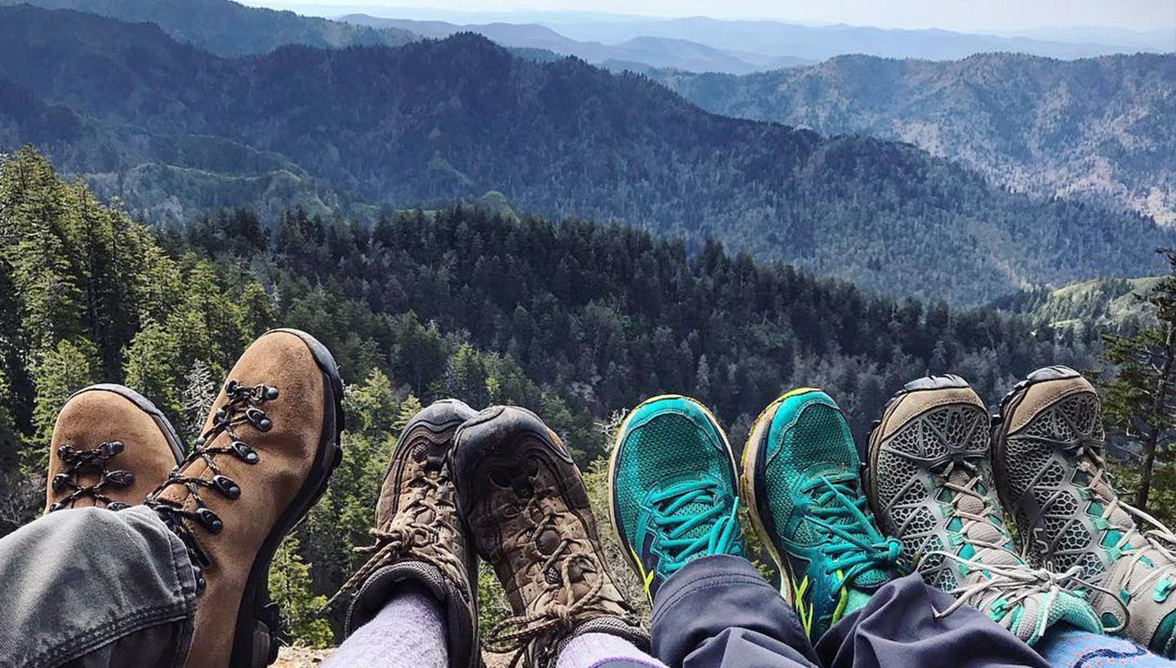
On Your Fit

Slide 2
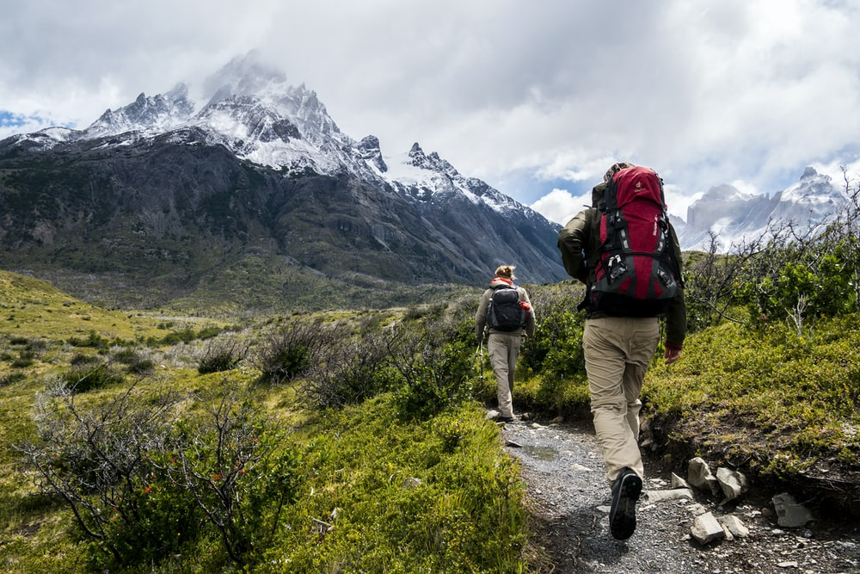
Our Team
Shawanda Ford
Sendy Mederos
Philip Robbins

Slide 3
About “On Your Fit”
This application is designed to assist hikers find the best trail in a city based on 3 parameters (difficulty grade, conditional status and/or location) set by the end user.
Our Motivation: In the midst of COVID-19, we wanted to give users a way of finding an outdoor activity that will provide them a way to interact while maintaining social distancing.
User Story:
AS A hiker
I WANT to find the hiking trails in a city that will best accommodate my needs
SO THAT I can maximize my experience

Slide 4

The Process
Technologies used:
CSS Frameworks: Pure CSS and Animate CSS
Third party APIs: leaflet.js, mapbox and moment.js
Server-side APIs: Openweather and Hiking Project
Breakdown of tasks and roles: We began by brainstorming to get our ideas together. We took into consideration accessibility, originality and functionality to determine the project. Tasks were delegated based on our strengths, experience and availability.
Notes:
While we had specific tasks, it was our mission to check and balance each others work by understanding, revising and optimizing our work at the end of each task.

Slide 5
The Process
Challenges
Mobile first/media query flexibility
API accessibility(CORS)
Override third-party API properties
Concatenation of API calls
Successes
Working as a team
Being able to fully deliver what we envisioned

Slide 6
On Your Fit Demo

Slide 7

For Future Development
Carousel for the trails.
Render the trail shape accurately on the map using the coordinates.
Adding more settings for the user to filter by (i.e. difficulty, rating or trail type).

Slide 8

Links
Deployed: https://plrobbins.github.io/onyourfit/
GitHub Repo: https://github.com/plrobbins/onyourfit

