Slide 1
Navigating Chicago’s Cyclistic Bike-Share Company’s Success
Patricia

Slide 2
Ensuring Data Integrity: Sourcing and Transformation
The data used for this analysis was provided by Motivate International Incorporation which was made public under a specific Data License Agreement.
Two datasets were provided under the original names; Divvy Trips 2019 and Divvy Trips 2020.
Both of the above datasets were analysed and there were no significant changes made to them during the course of the analysis.

Slide 3
Converting Casual Users to Subscribers for Speedy Success
PLEASE NOTE: Throughout the course of this analysis, Casual users would be referred to as Customers while Annual Members would be referred to as Subscribers.
The purpose of this analysis is to show how both of these user types differ and how the information can be used to formulate effective ways to turn most of them into Subscribers to guarantee the future success of the company.

Slide 4
Notes:
The analysis of the 2019 Trip data shows that Subscribers have an average ride length of 13.89 minutes while Customers average 61.93 minutes. The 2020 Trip data shows that Subscribers average 12.68 minutes while Customers average 95.79 minutes.

Slide 5
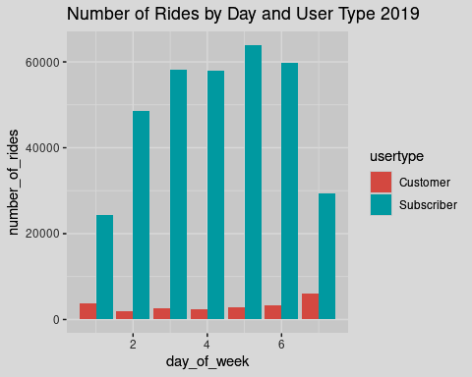
Day_of_Week
Sunday=1
Saturday=7

Slide 6
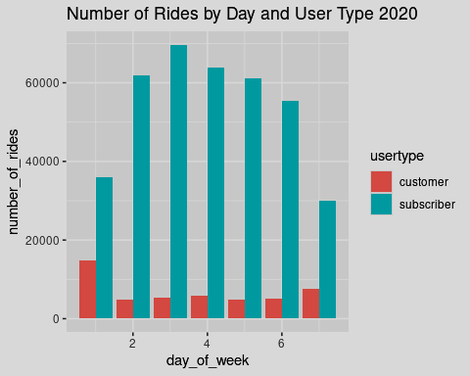
Day_of_Week
Sunday=1
Saturday=7

Slide 7
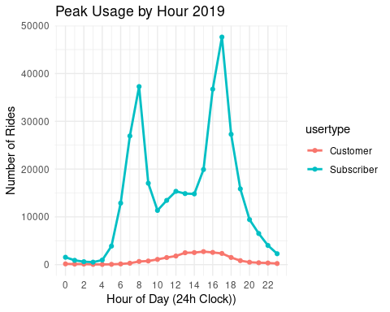

Slide 8
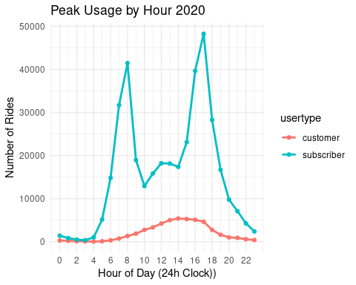

Slide 9
Summary
The average ride length for customers (casual users) exceeds that of the Annual subscribers even though we have a significantly higher number of rides from these subscribers.
From the analysis, it is clear that unlike the subscribers, the casual users generally do not follow a traditional 9 to 5 worker profile for their bike usage. Rather, the way they use the bike share service reflects leisure and recreation rather than daily commuting.

Slide 10
Recommendations
Since most of the casual riders would naturally avoid annual subscriptions because they do not commute daily, less-expensive and flexible membership tiers like Weekend-Only Memberships (which would include unlimited rides) and Monthly Subscription Options should be provided.
Some sort of reward system should also be implemented, for example, casual riders can earn points as they use the serviced towards a discounted annual membership. Also, the existing annual members can also earn points by referring frequent casual users.
Digital marketing campaigns during peak summer months should be launched when casual rider activity is highest.

Slide 11
THANK YOU

