Slide 1
OOP244_NHH
Week2

Slide 2
Agenda
Types
Forward declaration
Function overloading, default parameters
References
Dynamic memory allocation
Empty state

Slide 3
Types
bool type
bool var = true;
cout << var << endl; // displays 1
cout << !var << endl; // 0
cout << !!var << endl; // 1
int x = 4; cout << !!4 << endl ; // 1

Slide 4
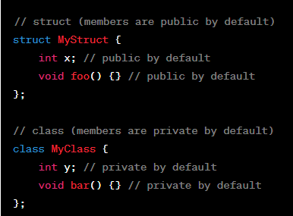
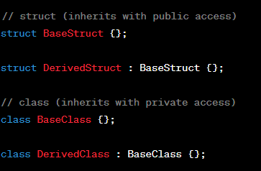
Compound types
Struct and Class --> VERY similar in C++
Inheritance ^

Slide 5
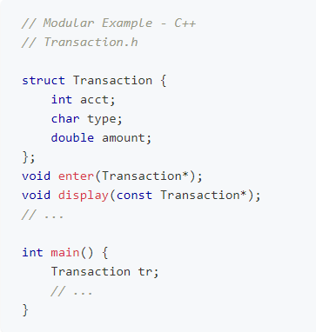
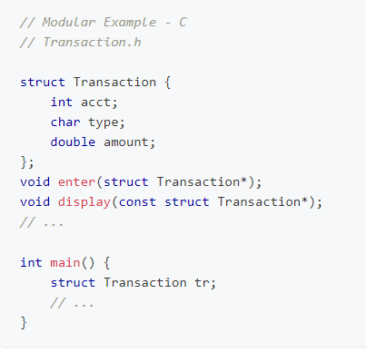
Compound types

Slide 6

auto keyword
Deduces the object's type directly from its initializer's type
Range based for loop demo

Slide 7
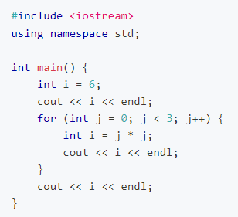
Shadowing
Guess the output

Slide 8
Scope resolution
Guess the output
int i = 0;
for (i = 0; i < 3; i++) {
int j = 2 * i;
cout << "The value of j inside" << j << endl;
}
cout << "The value of i outside" << i << endl;
cout << "The value of j outside" << j << endl;

Slide 9
One def rule: Forward declaration

Slide 10
Function Overloading
drawLine function
Default parameter values

Slide 11
References
Simple func

Slide 12
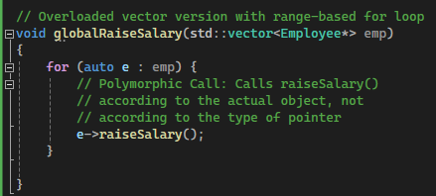
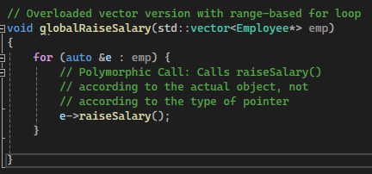
References:
Which of the following is able to raise salary correctly?
Range based loop with COPY
Range based loop with REFERENCE

Slide 13
Memory allocation
Allocation vs initialization
Static and dynamic allocation

Slide 14
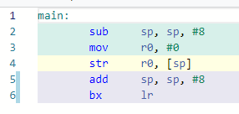
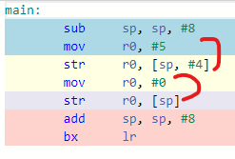
Assembly Analysis
int main() {
int i;
int n{};
}
Let's look at assembly to see what the compiler does in each case for allocating on stack
int main() {
int i=5;
int n{};
}

Slide 15
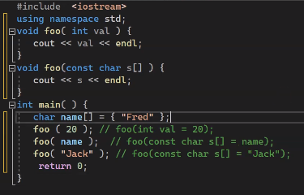
How functions are called

Slide 16
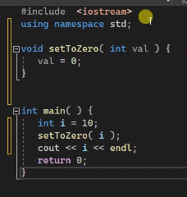
How functions are called
Guess the output

Slide 17
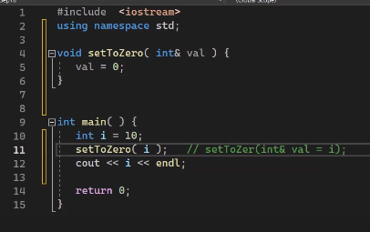
How functions are called
Calling through
reference

Slide 18
Returning reference from a function

Slide 19
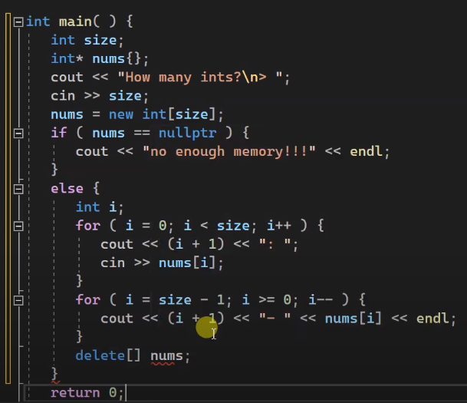
Dynamic memory
Variable sized array
Employee example

Slide 20
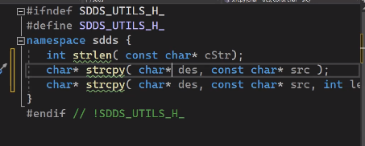
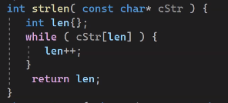
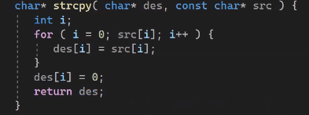
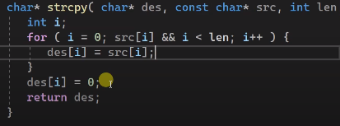
Employee Example
Utils.h

Slide 21
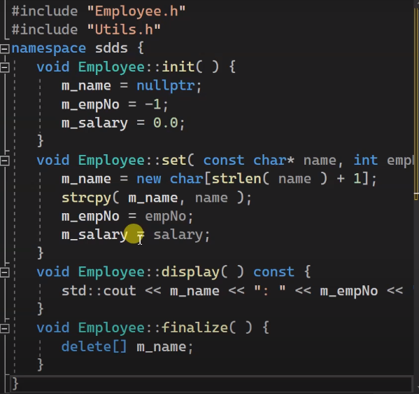
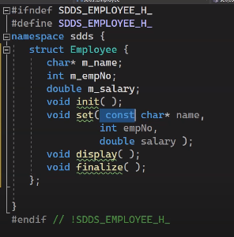

Slide 22
Empty State

