Slide 1
OOP244_NHH
Lecture 1

Slide 2
Agenda:
Welcome to Object-Oriented
Object Terminology

Slide 3
Blackboard walk through

Slide 4
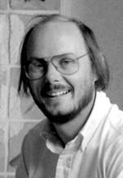




How C++ came along..
Highly Performant :)
Lack of organization :(
Poor Performant :(
Highly Organized (Classes) :)
Bjarne Stroustrup
High Performant :)
Highly Organized (Classes) :)
Notes:
Writing a simulator for PHD in cambridge, wrote using simula (a way to think and organize), easy to debug (as violations are from user defined types e.g class). But took a lot of time in the university mainframe. So he wanted something fast. Initially C++ was called (C with Classes)

Slide 5
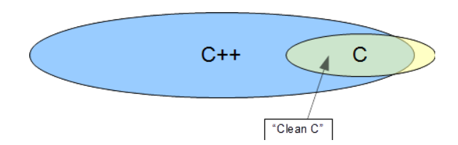
C++ Hello world

Slide 6
Some features of C++
Abstraction
Namespace
Encapsulation
Polymorphism
Inheritance

Slide 7




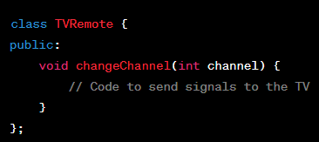
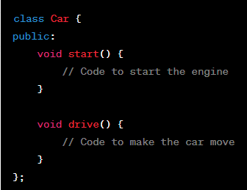
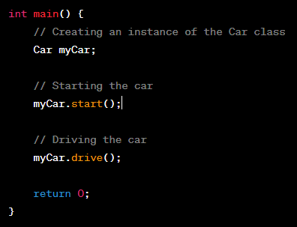
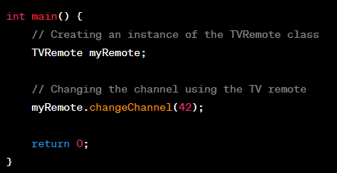
Abstraction

Slide 8

Abstraction: Exercise
Think of abstracted "functions" that should be in these "class" of objects

Slide 9
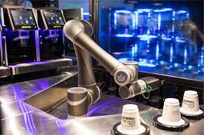
Live Coding: Robo Coffee Machine

Slide 10


Namespace
Chapter 1
Chapter 2
Chapter 3
...
Chapter 1
Chapter 2
Chapter 3
...
Chapter 1
Chapter 2
Chapter 3
...
Notes:
Think of the library as your codebase, each book as a namespace, and chapters as functions and variables.

Slide 11
Namespace example coding

Slide 12
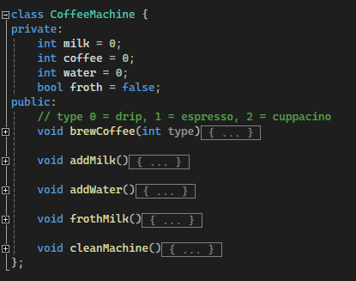
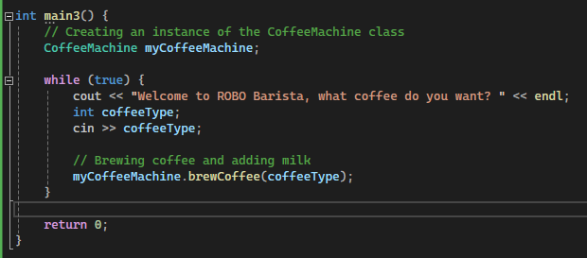
Encapsulation
Encapsulation is the primary concept of object-oriented programming. It refers to the integration of data and logic within a class' implementation that establishes the crisp interface between the implementation and any client.
Client

Slide 13
Encapsulation: Security
Bank Example

Slide 14

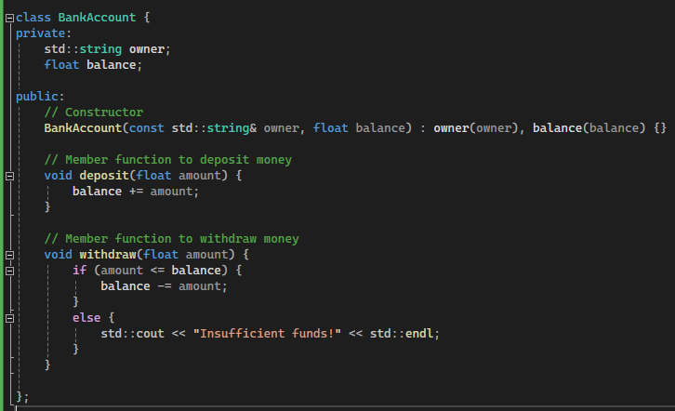
Inheritance: Exercise
Create a Square class, which has two members width and height, and a method for printing the width and height of the square:

Slide 15
Inheritance: Coding

Slide 16
Polymorphism
What if we want to have the same function (calculateArea) in all the derived classes, but each with their own logic?

