Slide 1
OOP244_NDD
Lecture 1

Slide 2
Agenda:
Welcome to Object-Oriented
Object Terminology

Slide 3
Blackboard walk through

Slide 4
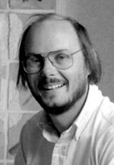




How C++ came along..
Highly Performant :)
Lack of organization :(
Poor Performant :(
Highly Organized (Classes) :)
Bjarne Stroustrup
High Performant :)
Highly Organized (Classes) :)
Notes:
Writing a simulator for PHD in cambridge, wrote using simula (a way to think and organize), easy to debug (as violations are from user defined types e.g class). But took a lot of time in the university mainframe. So he wanted something fast. Initially C++ was called (C with Classes)

Slide 5
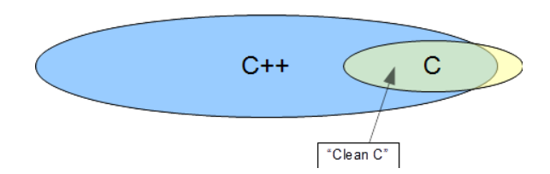
C++ Hello world

Slide 6
Some features of C++
Abstraction
Namespace
Encapsulation
Polymorphism
Inheritance

Slide 7




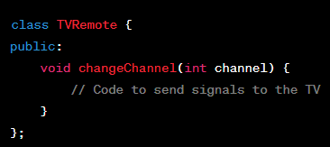
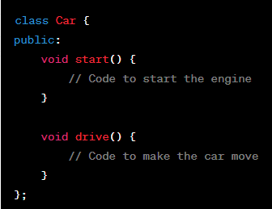
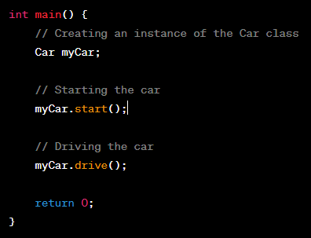
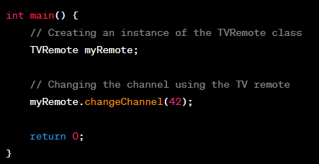
Abstraction

Slide 8
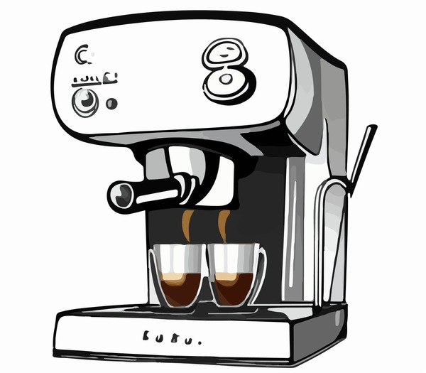
Abstraction: Exercise
Think of abstracted "functions" that should be in these "class" of objects

Slide 9
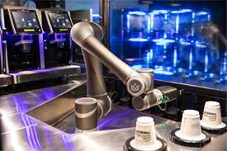
Live Coding: Robo Coffee Machine

Slide 10


Namespace
Chapter 1
Chapter 2
Chapter 3
...
Chapter 1
Chapter 2
Chapter 3
...
Chapter 1
Chapter 2
Chapter 3
...
Notes:
Think of the library as your codebase, each book as a namespace, and chapters as functions and variables.

Slide 11
Namespace
A namespace is a scope for the entities that it encloses.
Scoping rules avoid identifier conflicts across different namespaces.
namespace Tom { int main() { void foo(); Tom::foo(); } Dick::Foo(); }
using namespace Tom; namespace Dick { int main() { void foo(); foo(); } }

Slide 12
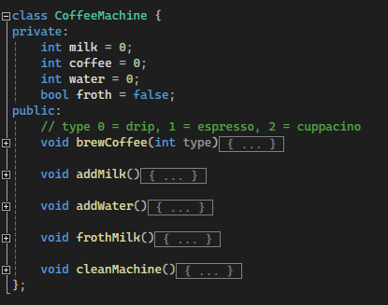
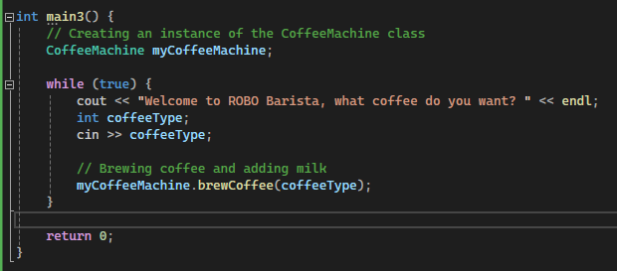
Encapsulation
Encapsulation is the primary concept of object-oriented programming. It refers to the integration of data and logic within a class' implementation that establishes the crisp interface between the implementation and any client.
Client

Slide 13
Encapsulation: Security
Bank Example

Slide 14
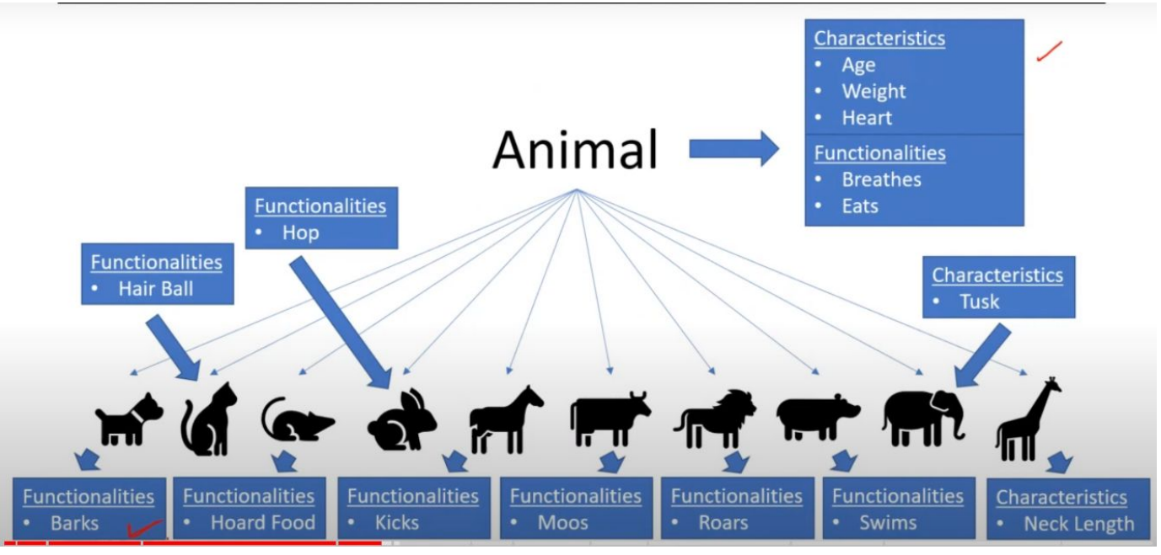
Inheritance

Slide 15
Polymorphism
The “same thing” does different things based on the context

