Slide 1
OOP244_NHH
Lecture 2

Slide 2
Agenda
Inheritance
Polymorphism
How compiler works
Preprocessing
Type Safety
Modules
Debug using Visual Studio

Slide 3
A word on inheritance
Public: Accessible from anywhere in the program. They can be accessed by any function or object.
Private: Members declared as private are only accessible within the class. They cannot be accessed directly from outside the class, even by derived classes.
Protected: Members declared as protected are accessible within the class and its derived classes. They are not accessible from outside the class hierarchy.

Slide 4
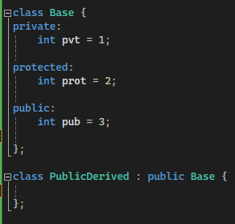
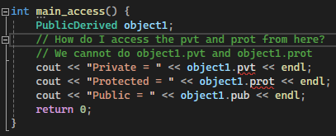
Inheritance: Question

Slide 5
Polymorphism
You have different kind of employees, but you want a simple function for raising salary for ALL kinds of employees

Slide 6
How compiler works
a.h
b.h
c.h
#include<a.h>
a.cpp
#include<b.h>
b.cpp
#include<b.h>
#include<c.h>
c.cpp
#include<b.h>
#incude<c.h>
main.cpp
compiler
a.o
b.o
c.o
main.o
linker
executable

Slide 7
Demo of 2 phase compilation

Slide 8
Preprocessor directive
Compilation safeguard
Include is just copy and paste
Will it work if put it reverse?
As header files are copy and paste, we have safeguards to avoid copying twice

Slide 9
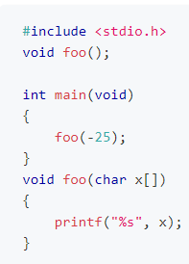
Type safety
Guess the output of the following
C program

Slide 10
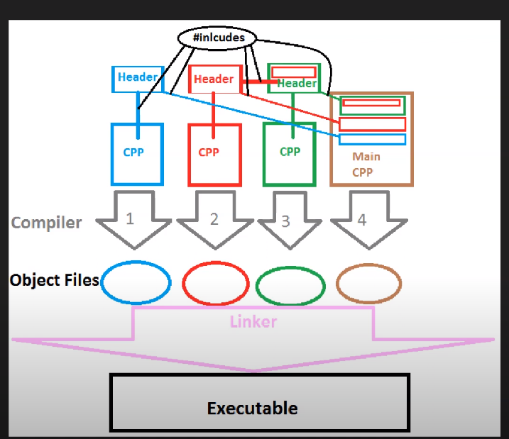
Preprocessor directive
Compilation safeguard
Include is just copy and paste
Will it work if put it reverse?
As header files are copy and paste, we have safeguards to avoid copying twice
4.cpp include 3.h AND 2.h, but 3.h already includes 2.h, so we avoid duplicate copying

Slide 11
Modular programming
Calculator

Slide 12
A word on including header files
Avoid include <cstdio> because too much copying will happen
Always include system headers first, then yours. Because you do not want your code to mess up system headers
Including <iostream> in a header file does not guarantee the use of std::cout etc in the cpp file, so include <iostream> in the cpp file

Slide 13
Debugging demo

