Slide 1

Lab Safety
SES250
PROFESSOR: Jacky Lau, jacky.lau@senecacollege.ca

Slide 2
Content
Laboratory First Aid
Electrical Safety
Emergency Procedure
Personal Protective Equipment

Slide 3
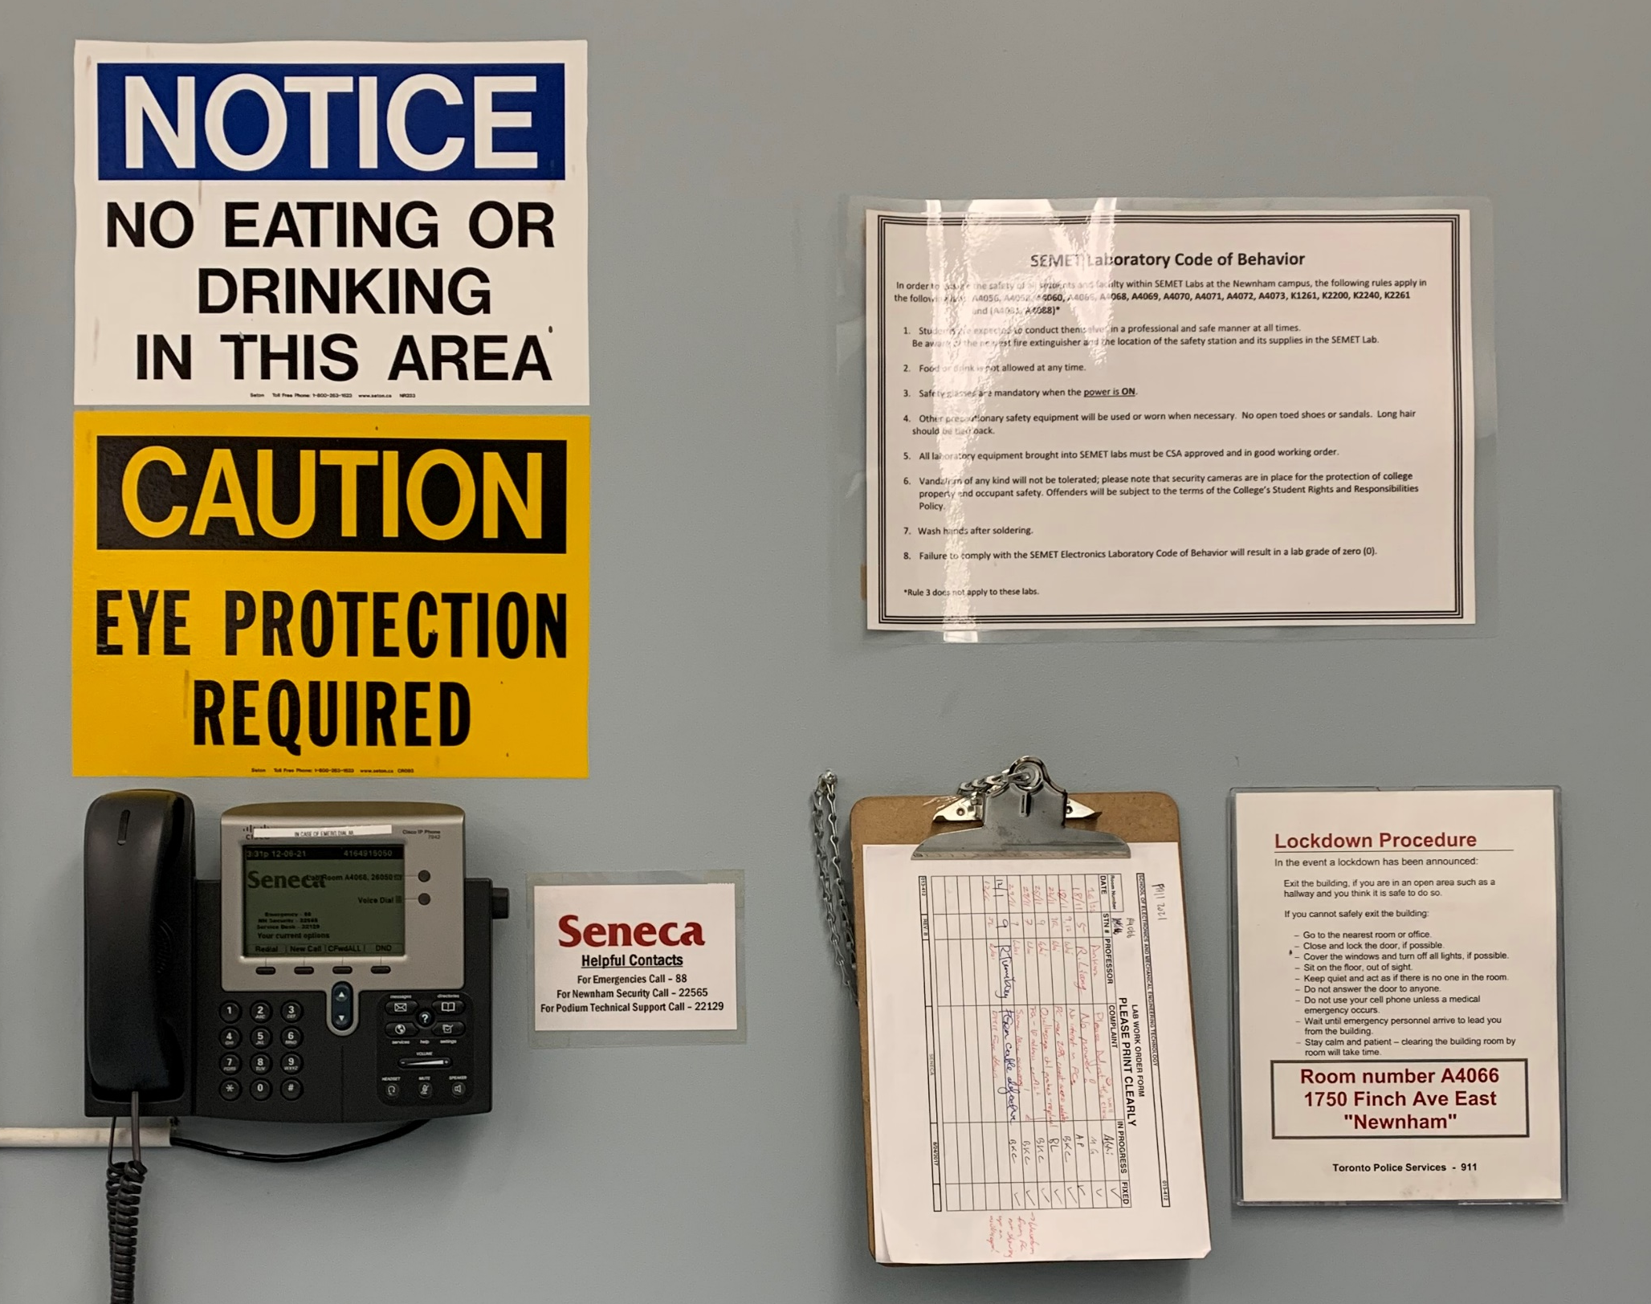
Emergency Contact
In case of life threatening emergency:
Call 911
For fire, medical, or police
Then call:
Campus security:
416-764-0911
For assistance

Slide 4
Emergency Contact
If it is NOT a life threatening situation and you just need assistance:
Campus security:
416-764-0911
Seneca Land Line phone is NO longer in service

Slide 5
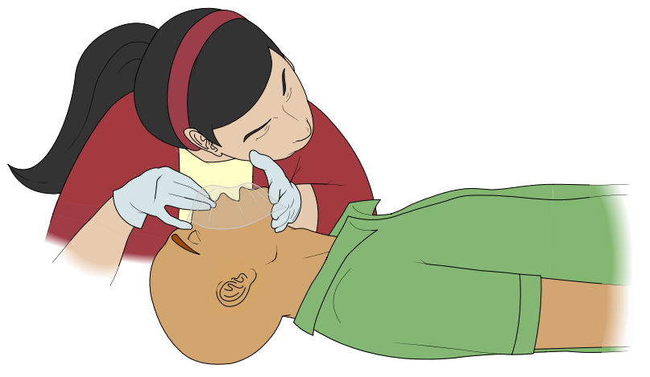
Laboratory First Aid
In case of emergency:
Call 911 then Campus security 416-764-0911
Only perform first-aid if you are qualified and feel comfortable.
There are no laws in Ontario saying you must administrate first-aid! If you are not sure what to do, call for help.
Only perform first-aid if you are qualified and feel comfortable.
There are no laws in Ontario saying you must administrate first-aid! If you are not sure what to do, call for help.
Someone with Difficulty Breathing
Determine if the victim is conscious. Tap her/him on shoulder and yell: “ARE YOU OKAY?” If there’s no response, start first aid at once.
The first step is to open up her/his airway. Put one hand under their neck and gently lift up, while with the other hand you gently push down on their forehead. This “head tilt” will move tongue away from the back of the throat.
Now check for air. Place your ear and cheek close to the mouth and nose. Listen and feel for return of air. At the same time, look for the chest to rise and fall.
Check for about 5 seconds. If there’s still no breathing, start mouth-to-mouth resuscitation.
St. John Ambulance Reference: https://www.sja.ca/en/resources/downloads-tools

Slide 6
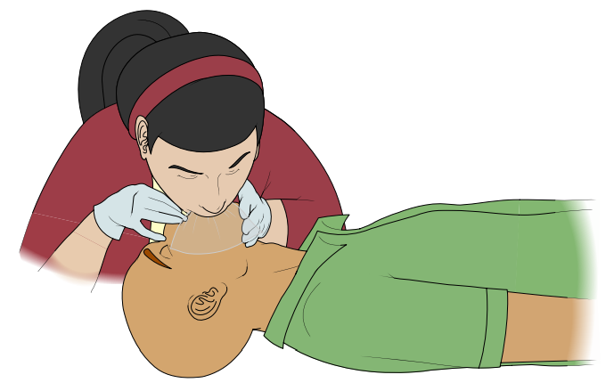
Laboratory First Aid
In case of emergency:
Call 911 then Campus security 416-764-0911
In case of emergency:
Call 911 then Campus security 416-764-0911
Only perform first-aid if you are qualified and feel comfortable.
There are no laws in Ontario saying you must administrate first-aid! If you are not sure what to do, call for help.
Only perform first-aid if you are qualified and feel comfortable.
There are no laws in Ontario saying you must administrate first-aid! If you are not sure what to do, call for help.
Someone with Difficulty Breathing
Mouth-to-mouth Resuscitation
Maintaining a head-tilt, pinch the nose shut with the hand you had on the forehead; this will prevent leakage.
Now open your mouth wide, take a big breath, seal your mouth around her/his mouth, and blow 4 full breaths as fast as you can. You should take only enough time between breaths to lift your head slightly for better inhaling.
If this still doesn’t start an air exchange, re-position the head and try again. After 4 more quick breaths, again monitor whether there is air exchange If there is still nothing happening, change your rate to one breath every 5 seconds, and continue patiently until the person starts to breathe on their own.
St. John Ambulance Reference: https://www.sja.ca/en/resources/downloads-tools

Slide 7
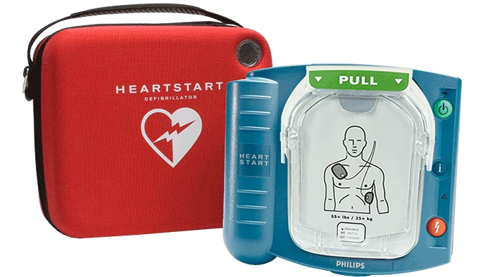
Laboratory First Aid
In case of emergency:
Call 911 then Campus security 416-764-0911
In case of emergency:
Call 911 then Campus security 416-764-0911
Only perform first-aid if you are qualified and feel comfortable.
There are no laws in Ontario saying you must administrate first-aid! If you are not sure what to do, call for help.
Only perform first-aid if you are qualified and feel comfortable.
There are no laws in Ontario saying you must administrate first-aid! If you are not sure what to do, call for help.
Someone with Difficulty Breathing
Do NOT start CPR unless you are qualified or received instruction from medical serivce over the phone.
If you cannot find the victim’s pulse, Call 911 then call security to ask for an AED.
St. John Ambulance Reference: https://www.sja.ca/en/resources/downloads-tools

Slide 8

Laboratory First Aid
In case of emergency:
Call 911 then Campus security 416-764-0911
In case of emergency:
Call 911 then Campus security 416-764-0911
Only perform first-aid if you are qualified and feel comfortable.
There are no laws in Ontario saying you must administrate first-aid! If you are not sure what to do, call for help.
Only perform first-aid if you are qualified and feel comfortable.
There are no laws in Ontario saying you must administrate first-aid! If you are not sure what to do, call for help.
Poisoning Aid
If the victim is unconscious, Call 911 then campus security. Only perform AR / CPR if you think the poison will not harm you. Do NOT give fluid to an unconscious victim.
If the victim is conscious, dilute poison by giving the person a glass of water or milk – if he/she is not convulsing.
  If victim is convulsing, just maintain an open airway.
Save the label or container of the suspected poison for identification. (If the victim vomits, save sample for analysis.)
Phone Poison Control Centre 416-813-5900 and seek assistance.
If the victim is vomiting, turn the head so that material drains.
St. John Ambulance Reference: https://www.sja.ca/en/resources/downloads-tools

Slide 9
Laboratory First Aid
In case of emergency:
Call 911 then Campus security 416-764-0911
In case of emergency:
Call 911 then Campus security 416-764-0911
Only perform first-aid if you are qualified and feel comfortable.
There are no laws in Ontario saying you must administrate first-aid! If you are not sure what to do, call for help.
Only perform first-aid if you are qualified and feel comfortable.
There are no laws in Ontario saying you must administrate first-aid! If you are not sure what to do, call for help.
Poisoning Aid (If the victim is convulsing or confused)
If the victim is unconscious, Call 911 then campus security. Only perform AR / CPR if you think the poison will not harm you. Do NOT give fluid to an unconscious victim.
Do NOT attempt to restrain the victim: just position her/him in such a way that they will not injure them self by knocking against objects.
Loosen clothing at neck and waist.
Watch for obstruction of airway and correct it by head positioning.
Do NOT force a finger between her/his teeth. Do NOT give fluids. Do NOT induce vomiting. (If the victim is vomiting, position the head so that the material drains.)
After the convulsion, place in prone position with head turned to allow fluids to drain.
St. John Ambulance Reference: https://www.sja.ca/en/resources/downloads-tools

Slide 10
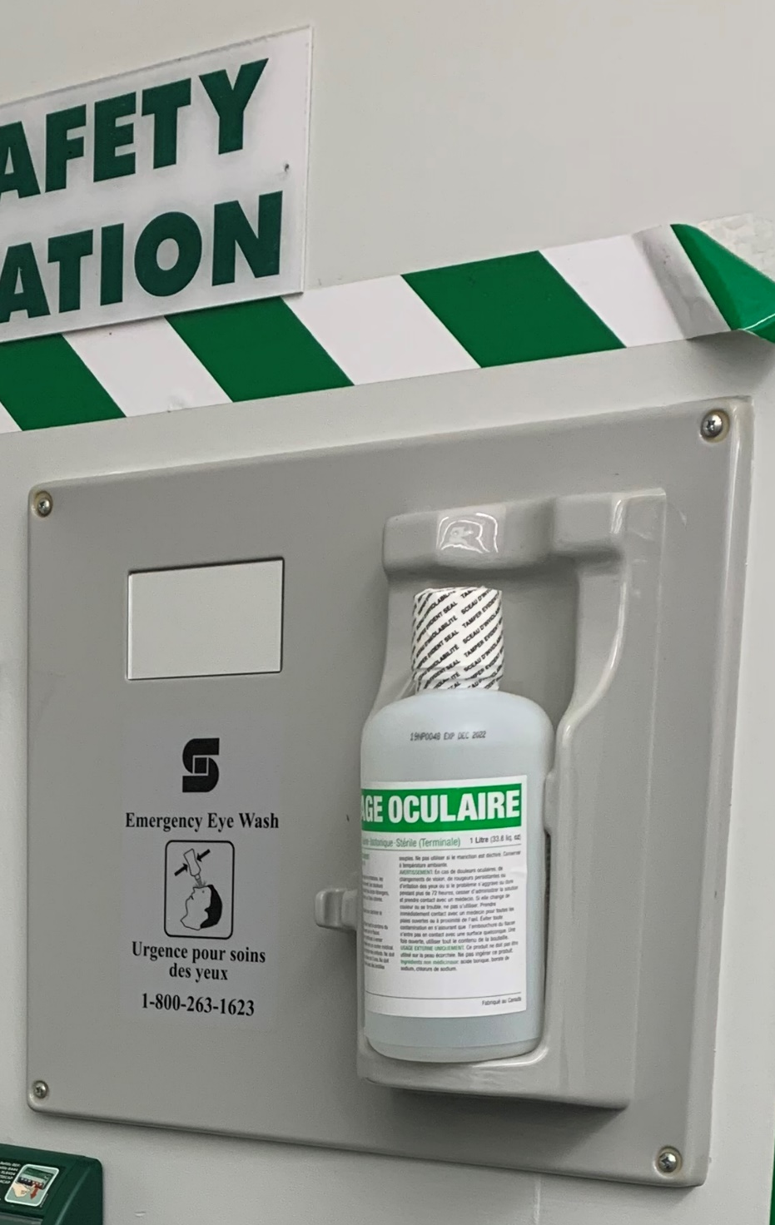
Laboratory First Aid
In case of emergency:
Call 911 then Campus security 416-764-0911
In case of emergency:
Call 911 then Campus security 416-764-0911
Only perform first-aid if you are qualified and feel comfortable.
There are no laws in Ontario saying you must administrate first-aid! If you are not sure what to do, call for help.
Only perform first-aid if you are qualified and feel comfortable.
There are no laws in Ontario saying you must administrate first-aid! If you are not sure what to do, call for help.
Eye Aid (If something got into your eye)
USE the eyewash fluid, don’t be afraid to use it. Flush out your eye with water at once. Pour luke-warm water gently into inside corner of the victim's eye and tilt head so that water flows across eyeball and off the face. Use a container of water or a tap that’s 2 or 3 inches above eye. Do this for 15 minutes. (Victim can also use shower to wash eyes.)
Call Poison Control Centre at 416-813-5900 or physician for additional advice.
St. John Ambulance Reference: https://www.sja.ca/en/resources/downloads-tools

Slide 11
Laboratory First Aid
In case of emergency:
Call 911 then Campus security 416-764-0911
In case of emergency:
Call 911 then Campus security 416-764-0911
Only perform first-aid if you are qualified and feel comfortable.
There are no laws in Ontario saying you must administrate first-aid! If you are not sure what to do, call for help.
Only perform first-aid if you are qualified and feel comfortable.
There are no laws in Ontario saying you must administrate first-aid! If you are not sure what to do, call for help.
Skin Aid (If something got onto your skin)
Remove comteminated clothing and wash skin with large amounts of water.
Call Poison Control Centre at 416-813-5900 or physician for additional advice.
St. John Ambulance Reference: https://www.sja.ca/en/resources/downloads-tools

Slide 12
Laboratory First Aid
In case of emergency:
Call 911 then Campus security 416-764-0911
In case of emergency:
Call 911 then Campus security 416-764-0911
Only perform first-aid if you are qualified and feel comfortable.
There are no laws in Ontario saying you must administrate first-aid! If you are not sure what to do, call for help.
Only perform first-aid if you are qualified and feel comfortable.
There are no laws in Ontario saying you must administrate first-aid! If you are not sure what to do, call for help.
Bleeding aid
For large cut with major lose of blood, Call 911 then campus security for assistance.
For minor cut, use Band-Aid at the safety station or apply pressure by placing your palm on a dressing directly over the open wound. In an emergency, you can use your bare hand – but only until compress can be obtained.
The compress, a thick pad of cloth, will absorb blood and allow it to clot. Never disturb clots formed within the pad. If blood soaks through pad without clotting, don’t remove it. Just add additional pads and continue pressing more firmly.
On most parts of the body a pressure bandage can be used to hold a pad on a severe wound and free your hands. Place centre of bandage directly over pad on wound. Keep steady pull on bandage to hold pad in place as you wrap both ends around body part. Then, tie knotting directly over pad.
Note: if there’s no fracture, always elevate an open wound to the hand, arm or leg.
St. John Ambulance Reference: https://www.sja.ca/en/resources/downloads-tools

