Slide 1
OPS245
Configuring a Service
SSHD

Slide 2
Introduction
In this lesson you will learn the basic concepts of configuring a service on Linux.
We will use the SSHD service because it is one you are already familiar with from the client side.
Most of the concepts that we see here will be applied to numerous services you work with throughout your career.

Slide 3
Network Administration
As system administrators, one of our primary jobs is setting up a network, as discussed in our previous lecture and covered in Lab 6.
However, once it’s set up, we must maintain that network, and any computers or services that are a part of it.
Network maintenance includes troubleshooting, fixing connection issues, and maintaining network security.

Slide 4
Hardening a Network
System administrators need to protect, or ”harden”, their networks from penetration by unauthorized computer users.
Whether it be from hackers, corporate espionage, or scams, we have to be smart about what we expose to the Internet.
Hardening a computer system can range from:
Running an IDS (Intrusion Detection System)
Monitoring and flagging suspicious activity
Implementing security policies like running firewalls or setting locked screensavers on workstations

Slide 5
What is SSH?
In Lab 7, we focus on SSH in order to help secure your Linux network.
Secure Shell (SSH) is a cryptographic network protocol for running unsecure services over a secure tunnel. Basically, it allows you to run things remotely. Using SSH, you can use another computer to run a program from one of your Linux machines.
The most common use of SSH is for remote login. This gives you access to the CLI on a computer or VM without needing to be physically (or virtually) present.
In ULI101, you used SSH to login to Matrix.

Slide 6
Accessing a Service
When accessing resources over a network, you typically need two things:
Client
Host (i.e. Server)
In ULI101, you were the client, connecting to Matrix, the host/server.
For Lab 7, we’re going to set up an SSH server ourselves.

Slide 7
SSHD
On CentOS, we use OpenSSH-Server. Once installed, you can interact with it via its systemd name, sshd.
The SSH service is usually installed by default. To check, we can run our rpm command:
rpm -qa | grep ssh
or
yum info openssh-server

Slide 8
Working with SSHD
The SSH server has a configuration file we’ll be working with:
/etc/ssh/sshd_config
You can use vi to modify this file and change the configuration. Any modifications you make won’t take effect until you restart the SSH server:
systemctl restart sshd - restart SSH
systemctl status sshd - status of SSH Server
If you restart the server after making changes and it fails, double-check your sshd_config file for typos. This is the most common problem, and should be the first thing you look for.

Slide 9
Hardening SSHD
When we start up the SSH server, we’re opening access to the computer’s CLI via the network (including the Internet).
While sshd comes with certain default security measures, your typical hacker will know these defaults and use that to try and break in.
There are a couple of settings we’ll change to help harden our service:
PermitRootLogin=no
AllowUsers username1 username2 …

Slide 10
Public/Private Keys
When you connect to a computer with an SSH server, you’re presented with a login screen. You are prompted for your username and password, and then allowed access if your credentials are correct.
However, if your username and password are stolen (or guessed), someone else impersonating you can login. How do we prevent this?
We use public and private keys to make users prove who they say they are.

Slide 11
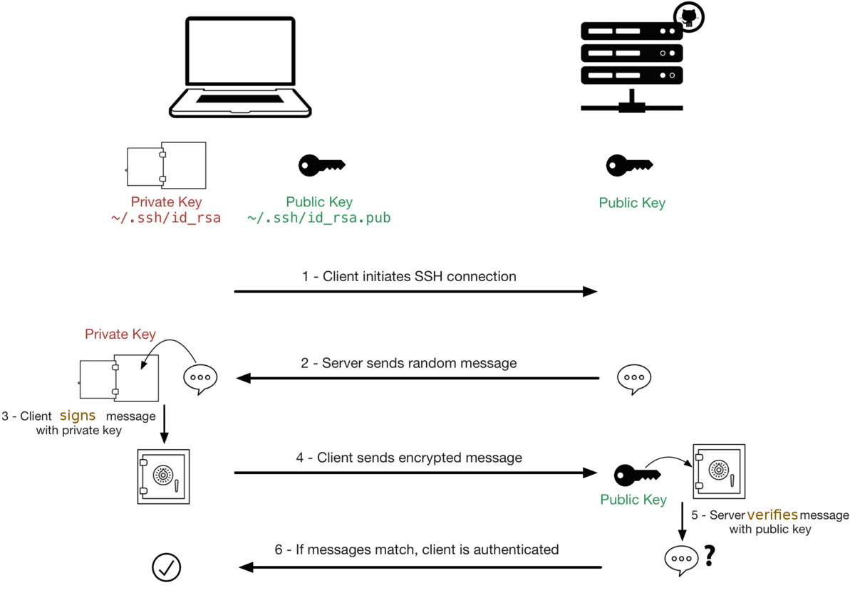
Public/Private Keys Cont.

Slide 12
Creating Key Pairs
To use this method, we need to do two things on our client machine:
Generate a public/private key pair:
ssh-keygen
Copy the public key to the SSH server:
ssh-copy-id username@servername
If you stored your keys in a non-default location, you can use -i to provide the path to the public key.
You’ll need your server username and password to copy the public key over to the server.
It’s important to remember which file is the public key! Your private key should never be transferred anywhere, unless you really know what you’re doing.

Slide 13
Why Use Key Pairs
This allows for faster, convenient login for users, but how does it help us as administrators?
The method from the previous slide requires the user know the password for their remote account to install their key. If you’re worried about security, there’s a second method.
As a sysadmin, you have the user generate their keys with ssh-keygen, and ask them to send you their public key. You can then install that key onto the remote user without ever needing to give them a password.
Not only does this ensure only the right person is logging in to their account, but it also allows you to solve unauthorized access.

Slide 14
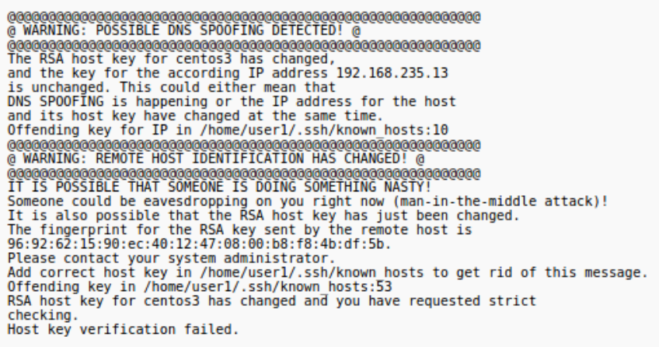
ARP Poisoning
A common type of attack, ARP Poisoning (aka DNS spoofing, a form of man-in-the-middle attack), can be used to redirect packets to a third destination while maintaining the illusion that the connection is secure.
If you ever see a warning message like this one when you try to connect via SSH, it could be a sign of a serious security breach.
This can also happen if the server OS has been reinstalled, so investigate further.
Tip: If you have reinstalled a VM/OS, you can get rid of this message by deleting the host key entry inside ~/.ssh/known_hosts

Slide 15
SSH Tunneling
In addition to CLI access, we can run graphical Linux (X window) applications over the network (between machines).
Some GUI applications are known to be insecure when run this way. Instead of running them directly, we can call them via SSH, through what’s called an SSH tunnel.
Using SSH, we can establish a secure, encrypted tunnel, and send the graphical information through that. For all practical purposes, this makes the information unreadable by third parties.
We’re going to use gEdit for our example GUI application.

Slide 16
Creating an SSH Tunnel
To do this, we must first create the tunnel:
ssh -X -C yourUsername@servername (or IP)
-X: enables the forwarding of X window information
-C: enables compression for better performance
Once you’re logged in, call the graphical application from the command line, and it’ll pop up on your computer from the server.
You can also do this all as one command:
ssh -X -C yourUsername@servername gedit
Obviously, the above only works if it’s in the server’s PATH search variable (aka you can call the program from anywhere on the system). Otherwise, use absolute pathing to call the app. (e.g. /usr/bin/gedit)

Slide 17
Summary
In this lesson you have learned how to configure the SSHD service.
While this will directly help protect your networks, the techniques you started to learn here will also apply to many other services you work with.

