Slide 1
OSL740
Configuring Firewalls
iptables

Slide 2
Introduction
In this lesson you will learn to configure a firewall on your Linux servers.
This will allow you to start to control the traffic that is allowed to reach your machines.

Slide 3
What is a Firewall
In short, a firewall is a utility that sits on your computer between your network connection and the rest of your system.
Any application, services, or other data that is sent or received by your computer goes through your firewall first. The dominant network protocol is TCP/IP, which means we’re dealing with packets. A firewall looks at these packets.
To be clear, the firewall doesn’t look inside packets, but just at the outside data like IP address and/or port destination, etc. The actual transmitted data is still secure and unread.

Slide 4
iptables
One of the first things you did during your labs (1-2) was to disable and remove firewalld and install iptables. iptables is the older version of the standard Linux firewall.
Recommendation: Fully uninstall firewalld. Certain processes and applications can reactivate firewalld without telling you. If both are set to start up, firewalld takes precedence. iptables will never start up!
yum remove firewalld

Slide 5
How iptables Works
In a firewall, a packet must pass through a series of rules (see next slide)
If a packet matches a rule, then an action is taken. Examples of actions are ACCEPT, DROP, REJECT.
If a packet doesn’t match any rules, it goes through the Default Policy.
You can section rules together in what are called chains manually, but we’re only going to deal with three predefined chains in the class:
INPUT: Packets coming into the current Linux server
OUTPUT: Packets leaving the current Linux server
FORWARD: Packets being routed (or passed between) Linux servers. The current server doesn’t read or use the packet, it forwards it to another server.

Slide 6
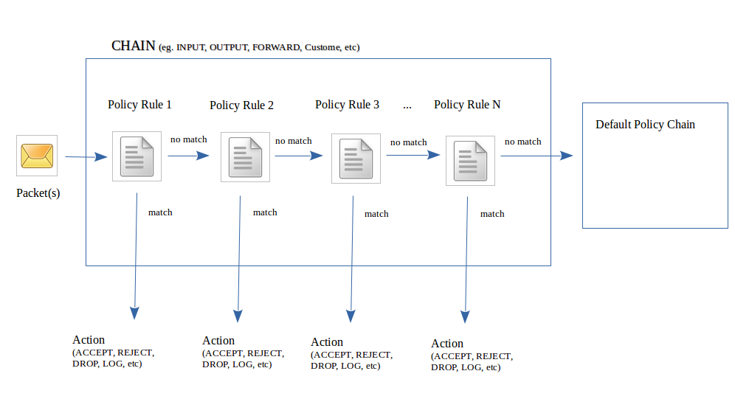
How iptables Works

Slide 7
Viewing iptables Rules
The iptables command is used to allow the Linux system administrator to set up policies in order to control access to the packets (tcp, udp, icmp, etc) that travel within a server.
Just as we’ve done with previous labs, it’s important to verify your current firewall configuration before making changes, as well as double-checking it after you’ve made them.
iptables –L - Lists all iptables rules (INPUT, OUTPUT, FORWARD, and any customized chains)
iptables -L –v - Verbosely lists all rules (includes total number of packets affected, etc)
iptables -L CHAIN-NAME - Lists all rules for that particular chain only. (INPUT, OUTPUT, etc)
iptables -L -v --line - Adds line numbers to the printed rules. Handy later.

Slide 8
Flushing iptables
While you can save and restore iptables settings, it’s sometimes useful to “flush” (completely clear) the firewall rules for all or a particular chain.
iptables –F : Clears the rules for ALL chains
iptables -F CHAIN-NAME : Clears the rules for a single chain
Important: Each default chain includes a default policy that you can modify manually. This policy is NOT changed back by an iptables flush.

Slide 9
Default Policies
Usually when setting policy rules with iptables, a general “overall” policy is set. This is the default policy.
A good way to think about setting policies is to have a “safety net” to take some sort of action to prevent un-handled packets from passing through the firewall by mistake.
Once a default policy is set, additional rules in the policy act as exceptions to this default.
An example would be an INPUT chain with a default policy of DROP, so no packets go into the server. We then put a rule for SSH, allowing connections that match SSH to go through, and then nothing else.

Slide 10
Setting Default Policies
Let’s set the default policy:
iptables -P INPUT DROP
This drops all incoming packets, regardless of port, destination, source, or protocol. Setting a default policy to drop everything makes it easier to specify the very few exceptions we want to make.
By contrast:
iptables -P INPUT ACCEPT
This would allow everything through. If we wanted to harden our system, we would have to specify every single possible combination of input types. That’s awful, so let’s not do that.

Slide 11
Creating Rules
When creating rules to add to your iptables there are a few things you might be concerned with:
Which chain does it go in?
We will only use INPUT, FORWARD, and OUTPUT. There are more, but you won’t use them nearly as often as these, and you’ll learn about them in later courses.
What traffic are you trying to match?
What do you want to do with this traffic?
We will only use ACCEPT, DROP, and REJECT. There are more, but again, you’ll learn about them in later courses.

Slide 12
Matching Packets
There are a number of options you can use to match specific traffic:
-s <address> - source ip address. Who sent the traffic.
-d <address> - destination ip address. Who is receiving the traffic.
-p <protocol> - the protocol used by the packet. E.g. tcp, udp, icmp, all.
--dport/--sport <port number> - the port the traffic is being sent to/from. Only available if you use -p and a protocol that uses ports.
-i <interface name> - the incoming interface.
-o <interface name> - the outgoing interface.
Note that both interface options are only available in certain chains (e.g. you can’t specify an outgoing interface in INPUT).

Slide 13
Matching Packets Cont.
The options to match packets can be combined as needed.
e.g. icmp traffic sent from a known network to one of your interfaces.
If you don’t need one of those options, just leave it out.
e.g. if you don’t care who sent the traffic, don’t put a -s option in your rule.
The art of iptables is learning which options to combine to match the traffic you want.

Slide 14
Writing Your Rule
Once you know about the traffic you want, and what you want to do with it, you put it together to create a rule.
iptables –I <CHAIN> [traffic matching options] –j <target>
where:
the chain is the chain to add it to.
one or more of the options to match specific traffic.
the target is the action you want to take with this traffic.

Slide 15
Rule Order
The order of rules matters. This is why ‘iptables -L -v --line’ is so useful. It gives you the order it which packets go down the list. They start from 1, and go down.
If a packet matches two places in a chain, once it hits the first match, the packet is jumped somewhere else. It’ll never hit that second match. Keep that in mind.
‘iptables -I chain-name #num’ allows you to specify exactly where in the chain you want to add your new rule.
You can use -A instead of -I to place a rule at the end of a chain.
If you make a mistake, you can delete a specific rule:
iptables -D INPUT 3

Slide 16
Saving Your Rules
Any rules you write only last until you reboot.
Unless you manually save them.
The iptables-save command outputs information about your current rules.
Redirect the output to /etc/sysconfig/iptables
The iptables service automatically reads rules from that file when it starts, so just save your desired configuration there.
Just make sure you make a backup copy of the original file first, so you can always revert back to it if you encounter problems.

Slide 17
Summary
In this lesson you have learned the basics of configuring a common firewall on Linux machines: iptables.
There is much more to learn about firewalls (and you will do so in later courses), but even the basics covered here will allow you to better protect the machines under your control.

