Slide 1
OSL740
Virtual Networking

Slide 2
Introduction
In this lesson you will learn about managing virtual networks, and a machine’s interfaces so that you can control how your VMs communicate with each other, and with the world outside your network.
Most of what you learn here will be applicable to ‘real’ physical networks too.

Slide 3
Virtual Networks
A Virtual Network (VN) is a way to create a network using software and protocols exclusively, bypassing the need for physical hardware such as Ethernet cables, physical network cards, etc.
This has two main uses:
Creating a virtual network between virtual machines to simulate a real network
Creating a virtual network on top of a physical network, or spanning many physical networks (Virtual Private Network – VPN)
Both are done to safely connect servers together by allowing us to specify any and all parts of the network (i.e. safely limit but allow sharing of information)

Slide 4
Virtual Networks & VMs
In lab 2, you created a virtual network in your c7host.
This is how your VMs have been communicating with each other, and with your c7host, and the outside world. Actually reaching the outside world that required the virtual network you created in VMware in lab 1.
The software that controls these networks created DHCP servers for you, so that your machines would get IP addresses, without us having to manually set them.

Slide 5
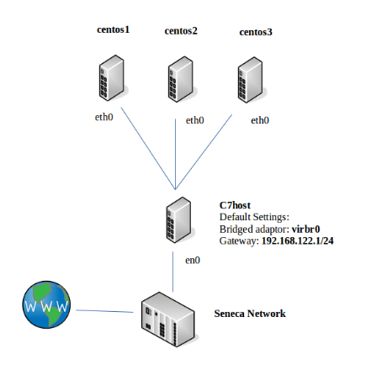
Current Network Setup

Slide 6
DHCP in Networks
Having the ip addresses of our machines assigned by the DHCP servers is convenient, but has a major drawback:
We have no control over what addresses they get.
Each DHCP server is dynamically assigning addresses from a pool of 254 (the default network size in both VMware and libvirtd). The addresses are also assigned for a limited duration – they could change from one boot to the next (even while a machine is running).

Slide 7
Static & Dynamic Addresses
As you have already experienced, dynamic addresses change.
This isn’t a problem if it is on a client machine. It will be the one starting almost all communication – reaching out to a server to access some resource.
But a server needs to be findable: It needs to be at the same address all the time.
Static addresses do not change. At least, not without an admin changing them.

Slide 8
Advantages of Static Addresses
You have noticed by now that every lab and assignment so far has asked you to provide the address of the machine you wanted to communicate with (i.e. run a script on).
This worked because you were in control of the machine and could look up its address.
This would not work if, for example, a web server kept moving.
In lab 6 you will configure your machines with static addresses.

Slide 9
CIDR Notation
We will use Classless Inter-Domain Routing (CIDR) standards to describe our network addresses (and each machine’s ip address).
This standard combines the machine’s own address with information that tells us the size of the network it is in.
Other courses will explain this in more detail.

Slide 10
CIDR Address
When you create a VPN, you are creating a network. This means you need to define your network ID. This is a combination of the subnet and starting IP address you’ve chosen.
For example: 192.168.245.0/24
If we break that down, it becomes:
Start IP : 192.168.245.1
End IP : 192.168.245.254
Subnet : 255.255.255.0

Slide 11
CIDR Address
The first IP address is usually the gateway for the VPN. Remember this!
Note1: the actual first address (in this case 192.168.245.0) is generally not used, except to refer to the network itself.
Note2: The highest address (e.g. 192.168.245.255) is a special address used to broadcast traffic to the entire network. Do not assign it to a machine.

Slide 12
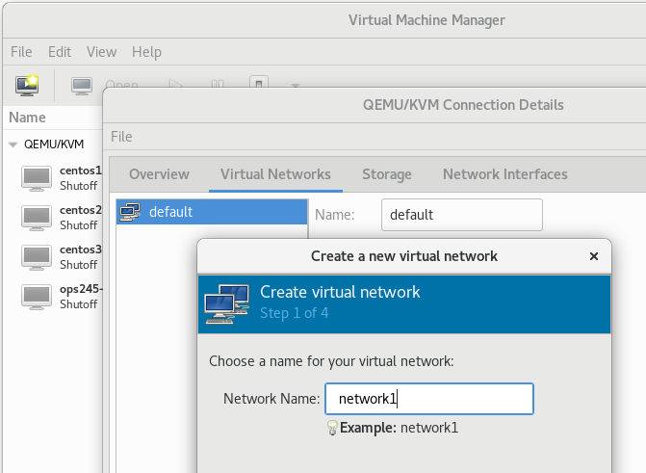
Time for a Demonstration!
Creating a virtual network in virt-manager.

Slide 13
Static Networks
Our brand new VPN, network1, has one important difference to the default. It has no DHCP server.
In our previous setup, when centos1, 2, or 3 would boot, the DHCP server on the default VPN would assign them their IP addresses and other network parameters.
Now that our VMs are part of the new network, this will never happen. They will boot and forever wait to receive their network addresses. They will have no access to each other, the network, or the Internet.

Slide 14
Configuring Static Addresses
To fix this, we must go inside each VM and configure these network parameters manually. This is called static network configuration.
When we’re done, each VM will boot already knowing its IP address, and that address won’t change.
This becomes incredibly useful in Lab 6 and beyond, as you’ll be connecting to these VMs over the network.

Slide 15
Static Addresses
A static address usually needs the following:
IP Address – The unique address for this machine.
Subnet – The network this address exists in.
Gateway – The address to send traffic to in order to reach places outside this network.
DNS – The address(es) to send DNS queries to, so our machines can convert between hostnames and ip addresses (and find servers we want to reach).

Slide 16
Interface Configuration Files
To permanently change the configuration for an interface, create (or modify) a file in /etc/sysconfig/network-scripts directory, called ifcfg-<interfacename> (e.g. ifcfg-eth0 or ifcfg-ens3).
The interface name will be something like eth0, ens3, ens33, etc.
This file contains a number of variables that control the behavior of the interface. We will only examine some of them.

Slide 17
Interface Configuration Parameters
HWADDR – The interface’s MAC address
DEVICE – The name the system gave the interface. Don’t confuse this with NAME.
BOOTPROTO – dhcp, none, or static
ONBOOT – yes|no – turn on when the machine boots?

Slide 18
Interface Configuration – Static Address
For a static address, set BOOTPROTO to static and:
IPADDR = <ip address>
PREFIX = <CIDR PREFIX> - the number of bits of the address that represent the network (16, 24 and etc).
GATEWAY = <ip address> - the ip address of the default gateway.
DNS[1-3] = <ip address> - up to three DNS servers to use.

Slide 19
Using New Interface Information
Once you have changed the configuration file, you need to tell the machine to use the new info.
ifdown <interfacename>; ifup <interfacename>
This will turn the interface off, then immediately back on again, making the system re-read the ifcfg file(s).

Slide 20
Network Troubleshooting Commands
Once your network is configured, you will need some commands to make sure it is working as expected (and to troubleshoot problems that may occur later):
ping – Send ICMP packets to determine if target is reachable.
ip a – Confirm IP addresses and interface settings.
arp –n – Print the Address Resolution Protocol (ARP) table. Maps MAC addresses to IP addresses for local network.
ss -nautp – determine ports available for communication.

Slide 21
Local Hostname Resolution
Now that we’ve set up our VMs with static IP addresses, you no longer have to look them up. Their addresses will never change.
Even better, we can now use local hostname resolution. Local hostname resolution lets us use the hostname of a VM instead of its IP address (centos1 instead of 192.168.235.11).

Slide 22
Configuring Local Hostname Resolution
On each machine (centos1-3 and c7host), use vi to edit /etc/hosts file. Add the following lines:
192.168.245.1 c7host
192.168.245.11 centos1
192.168.245.12 centos2
192.168.245.13 centos3
Save and quit, and you can now refer to each machine by their hostname. Try it out by sending ‘ping centos1’ from your centos2 VM.

Slide 23
Limitations of Local Hostname Resolution
One thing to keep in mind:
Local hostname resolution is only useful for small networks. As mentioned, you must add these entries to each machine on your network. The more devices you have, the larger the list, and the more devices need copies of this list.
Helpful for 4 machines, unhelpful for 2000.
Larger networks will instead use an internal DNS server for hostname resolution. This keeps a version of that table in a single, central location. (You’ll learn how to do this in other courses)

Slide 24
Summary
In this lesson you have learned how to create a Virtual Network.
You have also learned how to configure the network interfaces of machines under your control.
This will allow you control communication with your VMs.

