Slide 1
SEC520
Types of Attacks

Slide 2
Today's Objectives
Types of Attacks:
  Client-side Attacks:
    Phishing
    Malicious web code
    IP Spoofing
  Server-side Attacks:
    Database Injection
    Password Cracking

Slide 3
Types of Attacks
Client-side vs Server-side Attacks
There are many different types of attacks that a penetration tester can use on a targeted computer system. In this course, we will focus on the most command type of attacks.
Computer system attacks can be categorized to two general classifications of Attacks:
  Client-Based Attacks: where the user initiates an action to allow the attack to occur. Examples include Phishing, Malicious Code Payload, and IP Spoofing attacks.
  Server-Side Attacks: where the attack is focused on exploting a vulnerability of a running services on the computer server. Examples include OS / Application exploitation, Database Injection, and Password attacks.
  OS / Application attack was demonstrated in your lab #3 via Nessus and Metasploit.

Slide 4
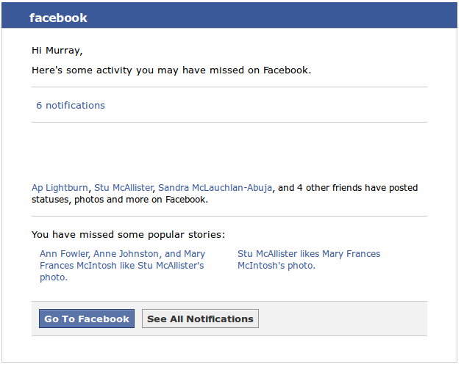
Types of Attacks
Phishing
Method to “trick” user to provide personal information, or go to a website that processes malicious code.
Human reaction is considered to be a serious weakness of any organization's security system. Training sessions are recommended to educate staff.
Packaging of phishing attacks are becoming more sophisticated due to growth of social media.

Slide 5
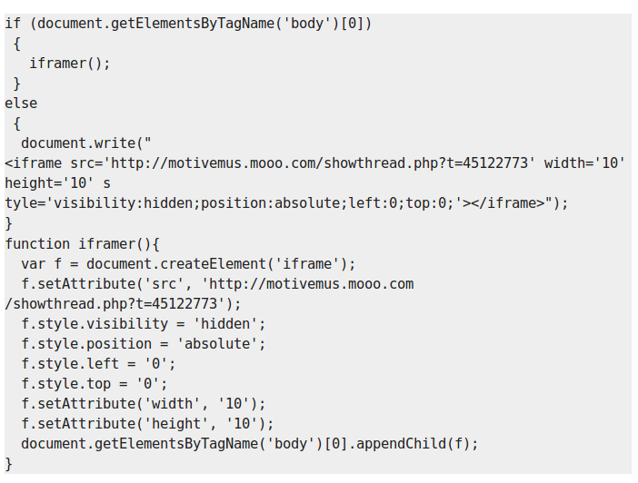
Types of Attacks
Malicious Payload
User directed to a website (link), that contains instructions to exploit an organization's server.
Code can be embedded into HTML (like PHP) to appear as harmless, but actually may gain access to a vulnerable web-browser.

Slide 6
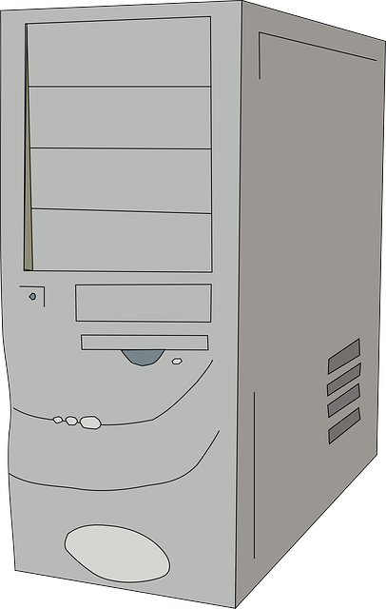
Types of Attacks
IP Spoofing
(Man in the Middle)
Capturing and forging a request header that provides a different IP address corresponding to the correct MAC address.
Once packet is “highjacked”, can be sent to destination IP address via “man in the middle” in order not to raise suspicion.
Server 2
Server 1
“Man in the Middle”

Slide 7
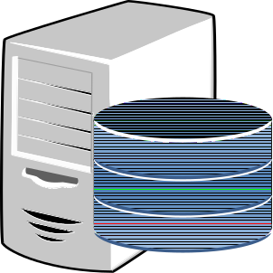
Types of Attacks
Database Injection
Various methods to gain access via database server (SQL, MySQL) including:
1. Exploiting weakness to insert or “inject” a malicious database command to gain access to database server.
2. Send “inject” malicious code as request payload.
3. Brute-force password scanner to crack an account.
Database Server
Web-based Form

Slide 8

Types of Attacks
Password Attacks
Penetration tester uses password cracking software to exploit account with weak password.
Researches and obtains root password in order to issue command su -
from exploited user's account.

Slide 9
Lab Time
Perform:
Lab 6: Types of Attacks

