Slide 1
SEC520
Penetration Testing (continued):
Exploiting Vulnerabilities

Slide 2
Today's Objectives
Vulnerability Testing: (Lab3 - part2)
  Purpose / Warning
  Techniques and Tools:
    Nessus
    Metasploit

Slide 3
Vulnerability Testing
Purpose of Vulnerability Testing:
  This stage becomes the “collection point” for all information collected in the reconnaissance, scanning, and enumeration stages.
  We can now research what OS and running processes
  (port #s) is the weakest link to gain access into the system.
  In order to save time, applications or frameworks have been created that contain a database of known exploits, and can automatically, and exploit the server' s weakness.

Slide 4
Vulnerability Testing
Warning!
  To date, any reconnaissance activity is considered to be “safe” for the penetration tester.
  The tester will “cross the line” when they start to scan ports, or use utilities that exploit vulnerabilities on a server to gain unauthorized access.
  If the tester does NOT have written permission, and possibly a signed “Rules of Engagement” contract prior to scanning / vulnerability testing, they may be subject to legal action or account suspension from their ISP!

Slide 5
Vulnerability Testing
Vulnerability Testing Tools:
  There are many applications can can be used for Vulnerability testing (both open-source and proprietory).
  In lab #3, we will be using two open-source applications:
    Nessus (local site exploitation)
    Metasploit (remote exploitation)

Slide 6
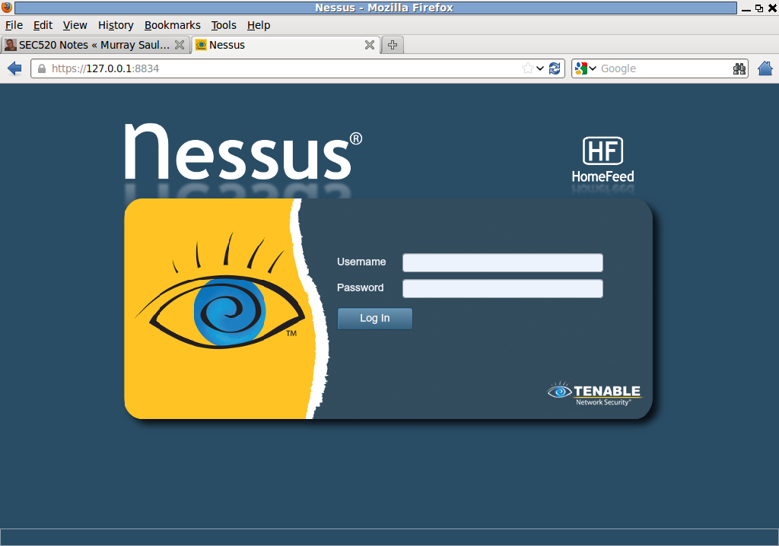
Vulnerability Testing
Testing Local Vulnerabilities - Nessus:
  This application is open-source.
  Tester must be connected to network locally.
  Nessus can perform scanning & enumeration, and provide a report that listing vulnerable ports for exploitation from a database of vulnerabilities.
  Full scans may increase the chances of detection from target network's IDS.
  Usually, a longer learning curve is associated with this application including the NASAL scripting tool.

Slide 7
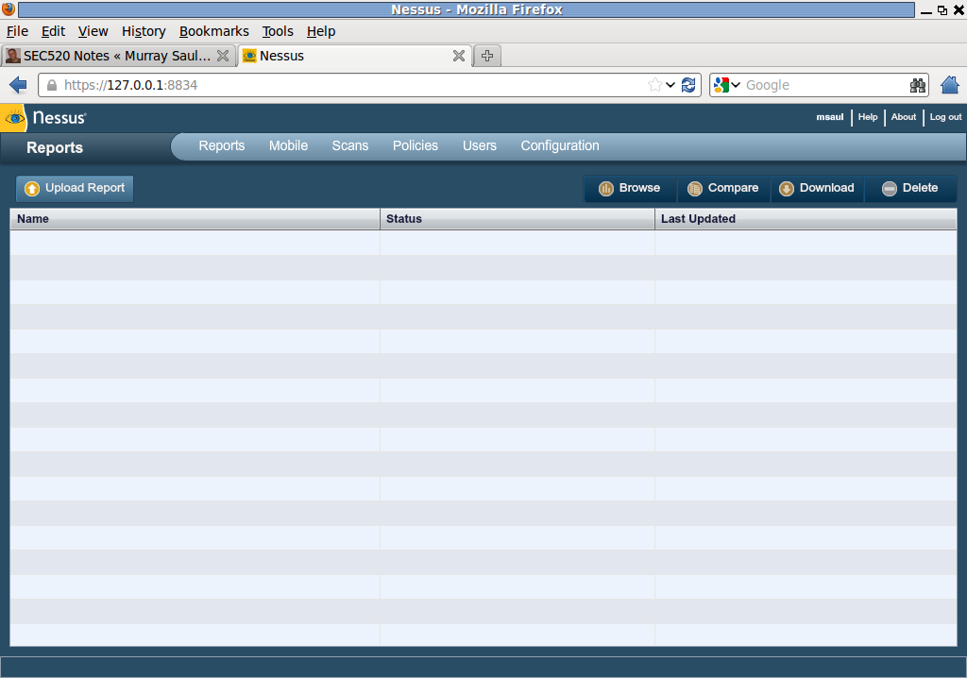
Vulnerability Testing
In Nessus, you create policies (classifications) for penetration testing.
When you perform the scan, it performs exploits in order to identify vulnerabilities.
Scanning profiles can be saved for later use...

Slide 8
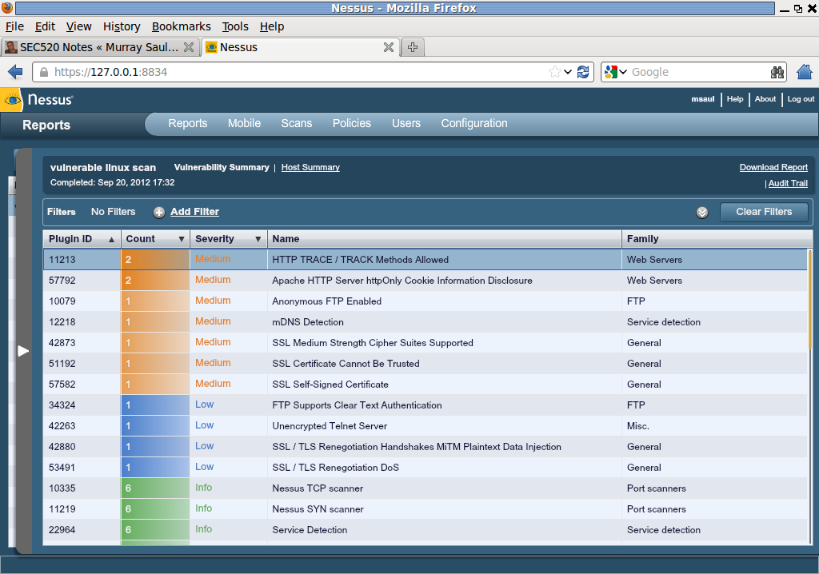
Vulnerability Testing
Reports can be generated for different servers (of different aspects of penetration testing).
Reports rank the vulnerabilities by high, medium, and low threats...

Slide 9
Vulnerability Testing
Testing Remote Vulnerabilities - Metasploit:
  This is an open-source application.
  This is referred to as a “framework” that supports many plugins for up-to-date exploits.
  This application can be used from remote networks.
  Also has ability to perform scanning & enumeration, and flagging vulnerabilities for exploitation.

Slide 10
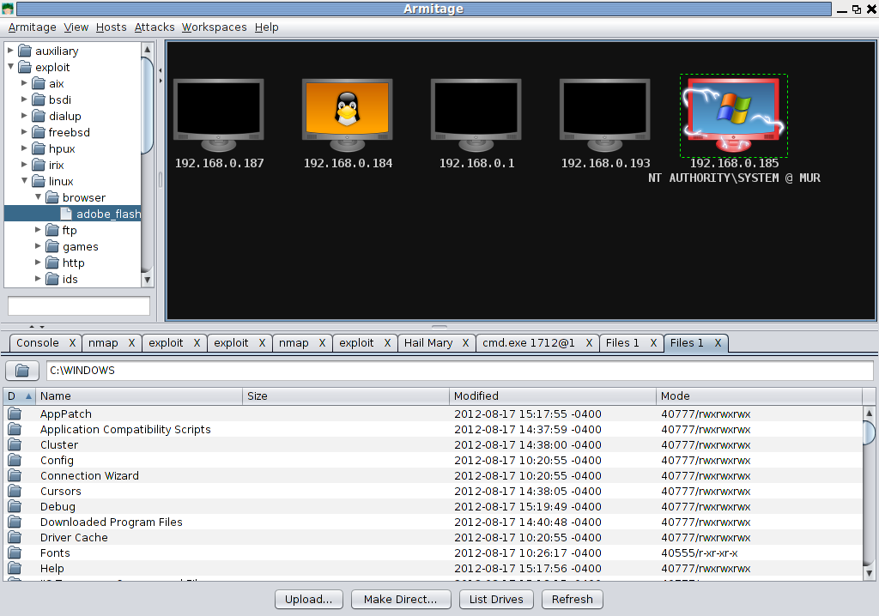
Vulnerability Testing
Metasploit uses a database of exploits, and sends a package to attempt gaining access to the system.
Once the system has been “cracked”
(Refer to the icon in the diagram!), the pentration tester can take screenshots, browse files, and even gain access to a command prompt!

Slide 11
Lab Time
Continue Working on:
Lab 3: Scanning, Enumeration & Vulnerability Testing
(Investigations 4 & 5)

