Slide 1
ULI101: Introduction to Unix / Linux and the Internet Week 11 lesson 2 positional parameters / command substitution / math operations testing CONDITIONS / control flow statements (logic / loops)
Photos and icons used in this slide show are licensed under CC BY-SA

Slide 2
Lesson 2 topics
Positional Parameters
Definition / Purpose / Usage / Demonstration
Command Substitution / Math Operations
Definition / Purpose / Usage / Demonstration
Control Flow Statements
Definition / Purpose
Exit Status $? / Testing Conditions (test) / Demonstration
Control Flow Statements (if, if-else, for) / Demonstration
Perform Week 11 Tutorial
Investigation 2
Review Questions (Questions Part A #3,4 , Part B Walk-Thru #2)

Slide 3
Positional parameters
arg1 arg2 arg3 … argN
A positional parameter is a variable within a shell program; its value is set from an argument specified on the command line that invokes the program.
Positional parameters are numbered and are referred to with a preceding ''$’’: $1, $2, $3, and so on.
Reference: http://osr600doc.xinuos.com/en/SDK_tools/_Positional_Parameters.html

Slide 4
Positional parameters
arg1 arg2 arg3 … argN
Assigning Values as Positional Parameters
There are two methods to assign values as positional parameters:
Use the set command inside a shell script with values as arguments.
Run a shell script with arguments (i.e. like a command).

Slide 5
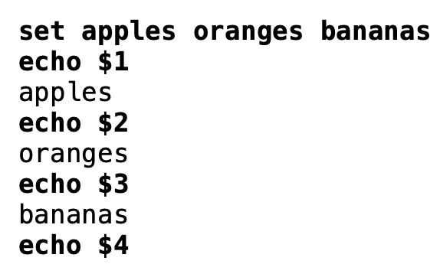
Positional parameters
arg1 arg2 arg3 … argN
Using the set command:
set apples oranges bananas
You place a dollar sign ($) prior to the number corresponding to the position of the argument.
Examples: echo $1 echo $2 echo $3

Slide 6
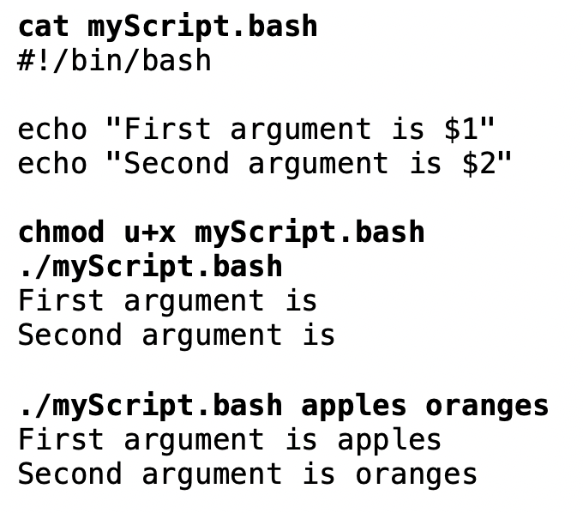
Positional parameters
arg1 arg2 arg3 … argN
Running a Shell Script with Arguments:
You would use positional parameters in your shell script that would expand the positional parameters with its stored value.
Here are the contents of the shell script called myScript.bash:
#!/bin/bash echo “First argument is $1” echo “Second argument is $2”
You would then issue the myScript.bash shell script with arguments that would be used within the shell script.
For Example: ./mySript.bash apples oranges

Slide 7
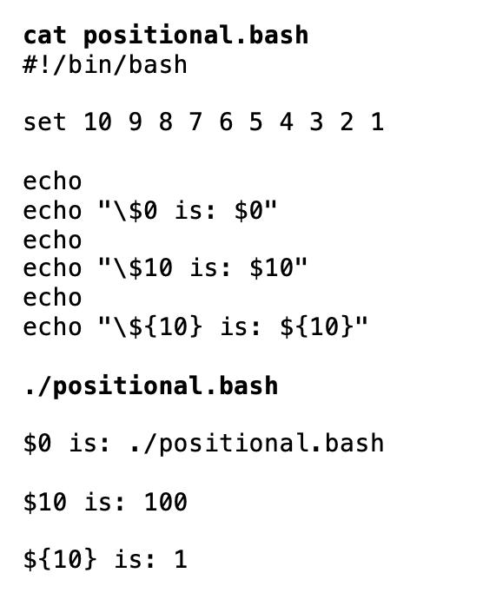
Positional parameters
arg1 arg2 arg3 … argN
The positional parameter $0 refers to either the name of shell where command was issued, or name of shell script file being executed.
If using positional parameters greater than 9, you need to include number within braces { }.
Examples: echo $0
echo $9
echo ${10}

Slide 8
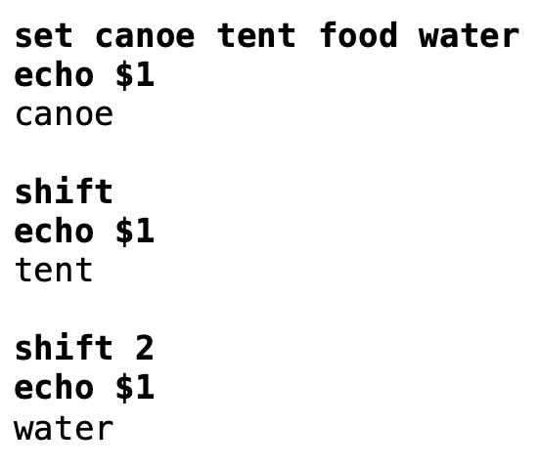
Positional parameters
arg1 arg2 arg3 … argN
The shift command can be used with positional parameters to move positional parameters to the left by one or more positions.
Examples: shift shift 2

Slide 9
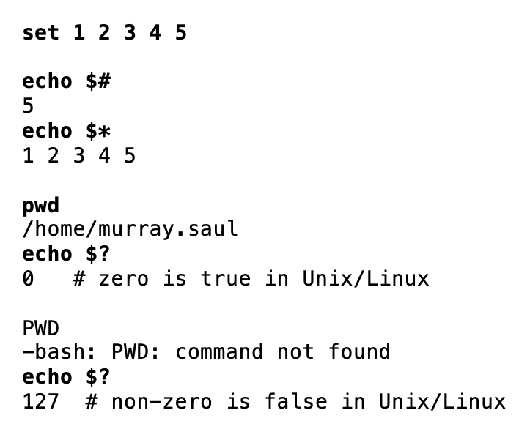
special parameters
$* $# $?
There are a group of special parameters that can be used for shell scripting.
A few of these special parameters and their purpose are displayed in the table below.
Parameter | Purpose
$* | Display all positional parameters.
“$*” | Containing values of all arguments separated by a single space
“$@” | Multiple double-quoted strings, each containing the value of one argument
$# | Represents the number of parameters (not including the script name)
$? | Exit Status of previous command (discussed in next lesson)

Slide 10

Positional and special parameters
Task:
Write a Bash shell script that accepts arguments from the shell script filename when executed (i.e., just like a regular Linux command).
The Bash Shell script will clear the screen and then display the following text (using special parameters):
Number of arguments are: (number of positional parameters)
The arguments are: (displays of all positional parameters)

Slide 11
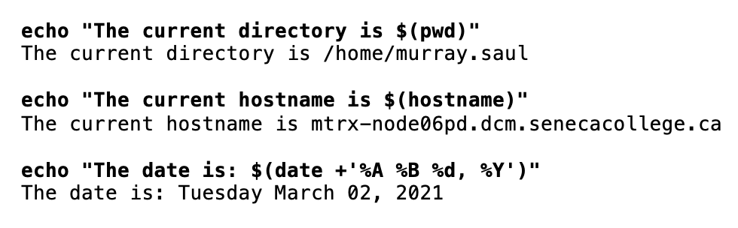
Command substitution
Command substitution is a facility that allows a command to be run and its output to be pasted back on the command line as arguments to another command.
Reference: https://en.wikipedia.org/wiki/Command_substitution
Usage:
command1 $(command2) or command1 `command2`
Examples:
file $(ls)
mail –s “message” $(cat email-list.txt) < message.txt
echo "The current directory is $(pwd)"
echo "The current hostname is $(hostname)"
echo "The date is: $(date +'%A %B %d, %Y')"

Slide 12
Command substitution
Task:
Write a Bash shell script that sets all files in your current directory as positional parameters.
Use command substitution to store all files in your current directory as positional parameters.
The Bash Shell script will clear the screen and then display the following text (using special parameters):
Number of files in current directory are: (number of positional parameters)
Here are the filenames: (displays of all positional parameters)

Slide 13
Math operations
Performing math calculations can be an important element in shell scripting.
A problem you may experience in shell scripting (as opposed to other programming languages) is that in shell scripting, all characters (including numbers) are stored as text.
This can create problems when performing math operations.
Demonstration:
num1=5;num2=10 echo “$num1+$num2” CLI Result: 5+10 echo “$num1-$num2” CLI Result: 5-10 echo “$num1*$num2” CLI Result: 5*10

Slide 14
Math operations
In order to make math operations work in a Linux shell or shell script, you need to convert numbers stored as text into binary numbers.
We can do this by using using a math construct consisting two pairs of round brackets (( ))
Examples:
num1=5;num2=10 echo “$(( $num1 + $num2))” CLI Result: 15 echo “$((num1-num2))” CLI Result: -5 ((product=num1*num2)) echo “$product” CLI Result: 50

Slide 15
Math operations
Additional math operators are shown below.
Examples:
num1=2;num2=3 echo $((num1/num2)) CLI Result: 0 echo $((num1%num2)) CLI Result: 3 echo $((num1**num2)) CLI Result: 8 echo $((num2++)) CLI Result: 4 echo $((num1--)) CLI Result: 1
Operator | Description
+ | Addition
- | Subtraction
* | Multiplication
/ | Division
% | Remainder
** | Exponentiation
++ | Increment (increase by 1)
-- | Decrement (decrease by 1)

Slide 16
MATH OPERATIONS
Task 1:
Write a Bash shell script that prompts the user for the sale price of an item and the number of items purchased.
The shell script will display the total amount (eg. price x number of items) of the sale.
For simplicity, you can assume prices are just integers.
Task 2:
Write a Bash shell script that prompts the user prompts the user for two numbers.
The shell script will then show the results from addition, subtraction, multiplication and division of those numbers.

Slide 17

Control flow Statements
So far, we have created Bash Shell Scripts that execute Linux commands in a fixed sequence.
Although those type of scripts can be useful, we can use control flow statements that will control the sequence of the running script based on various situations or conditions.
Control Flow Statements are used to make your shell scripts more flexible and allow them to adapt to changing situations.

Slide 18
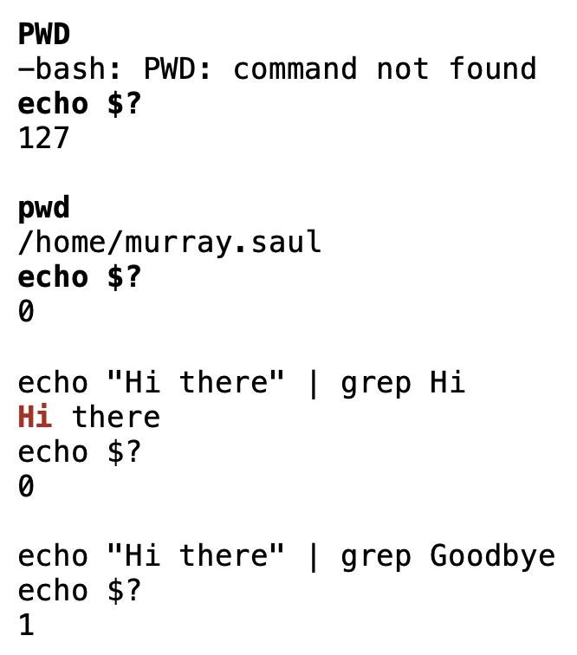
Control flow Statements
The $? (exit status) Special Parameter
The special parameter $? is used to determine the exit status of the previously issued Linux command or Linux pipeline command.
The exit status will either display a zero (representing TRUE) or a non-zero number (representing FALSE).
This method can be used with control-flow statements to change the sequence of your shell script execution. We will apply this when we discuss advanced shell scripting in two weeks.
Examples: PWD echo $? pwd echo $?

Slide 19
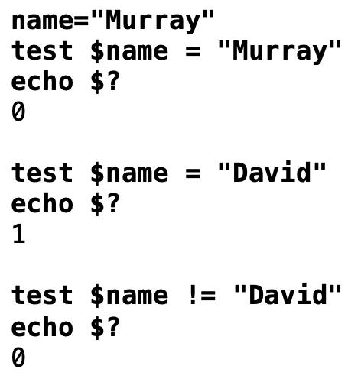
Control flow Statements
The test Linux Command
The test Linux command is used to test conditions to see if they are TRUE (i.e. value zero) or FALSE (i.e. value non-zero).
This method can also be used with control-flow statements to change the sequence of your shell script execution.
Examples: name=“Murray” test $name = “Murray” echo $? test $name = “David” echo $?

Slide 20
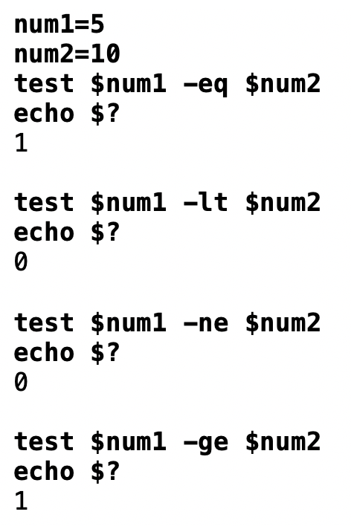
Control flow Statements
Numerical Comparisons with test Command
You CANNOT use the > or < symbols when using the test command since those are redirection symbols.
You need to use options when performing numerical comparisons. Refer to the table below for test options and their purposes.
Option | Purpose
-eq | Equal to
-ne | Not equal to
-lt , -le | Less than, Less than or equal to
-gt, -ge | Greater than, greater than or equal to

Slide 21
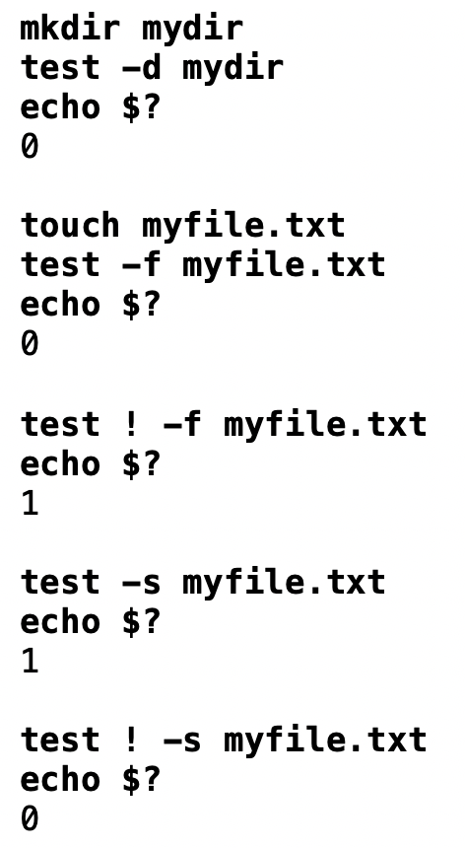
Control flow Statements
The test Linux Command: Additional Options
There are other comparison options that can be used with the test command such as testing to see if a regular file or if directory pathname exists, or if the regular file pathname is non-empty.
Refer to the table below for some of those additional options.
Option | Purpose
-f file_pathname | Regular filename exists
-d file_pathname | Directory filename exists
-s file_pathname | Regular filename is non-empty
-w file_pathname | file exists / write permission is granted

Slide 22
Control flow Statements - Logic
Logic Statements
A logic statement is used to determine which Linux commands to be executed based on the result of a test condition or command (i.e. TRUE if zero value) or FALSE ( if non-zero value).
There are several logic statements, but we will just concentrate on if statement and the if-else statements.

Slide 23
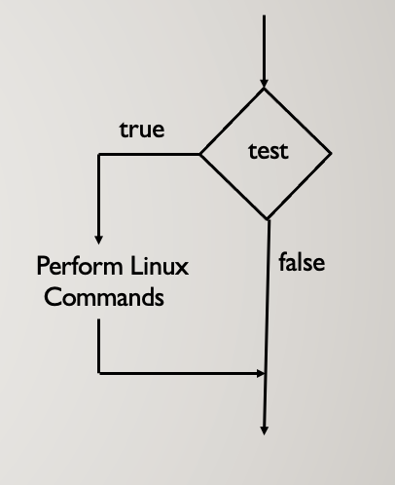
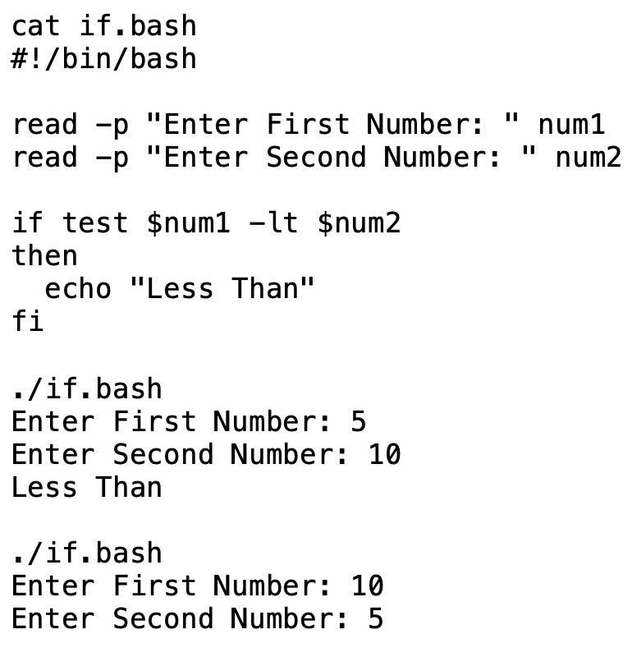
Control flow Statements - Logic
if Control Flow Statement
If the test command returns a TRUE value, then the Linux Commands between then and fi statements are executed.
If the test command returns a FALSE value, the if statement is by-passed.
Usage: if test condition then command(s) fi

Slide 24
Control flow Statements - Logic
Using [ ] to Represent test Command
A set of square brackets [ ] can be used to represent the test command.
NOTE: There must be spaces between the square brackets and the test condition.
Example: num1=5 num2=10 if [ $num1 –lt $num2 ] then echo “Less Than” fi

Slide 25
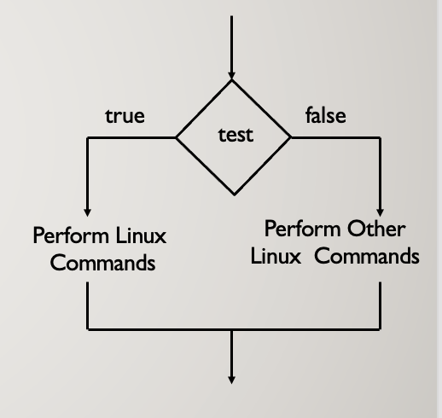
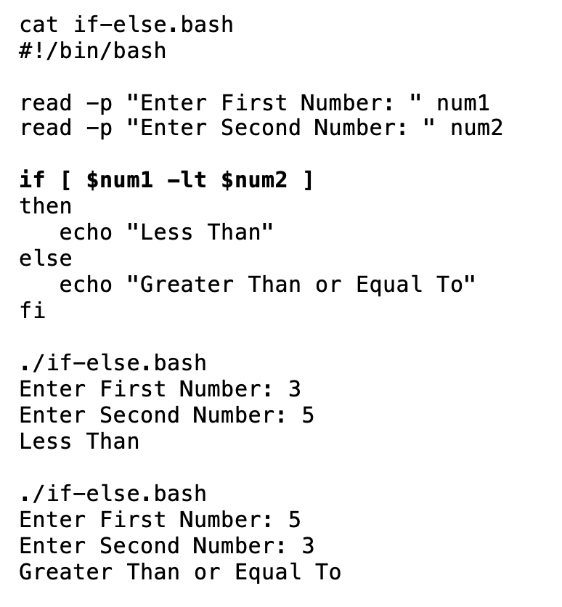
Control flow Statements - Logic
if-else Control Flow Statement
If the test condition returns a TRUE value, then the Linux Commands between the then and else statements are executed.
If the test returns a FALSE value, then the the Linux Commands between the else and fi statements are executed.
Usage: if test condition then command(s) else command(s) fi

Slide 26
Control flow Statements - Logic
Instructor Demonstration
Task 1:
Write a Bash shell script that will first set a variable called course to the value uli101 (lowercase).
The shell script will then clear the screen and prompt the user for the current course code.
Use logic that if the user’s entry does match the value contained in the variable course, the following text is displayed:
You are correct
Task 2:
Modify the previous Bash Shell script to display the alternative message if the user’s entry does NOT match the value (stored in the variable called course) then the following alternative text is displayed:
You are incorrect

Slide 27

Control flow Statements - Loops
Loop Statements (iteration)
A loop statement is a series of steps or sequence of statements executed repeatedly zero or more times satisfying the given condition.
Reference: https://www.chegg.com/homework-help/definitions/loop-statement-3

Slide 28
Control flow Statements - Loops
The for Loop
There are several loops, but we will look at the for loop using a list.
Usage:
for item in list
do
command(s)
done
The variable item will hold one item from the list every time the loop iterates (repeats) the commands between the do and done reserved words. A list can consist of a series of arguments (separated by spaces) or supplied by command substitution

Slide 29
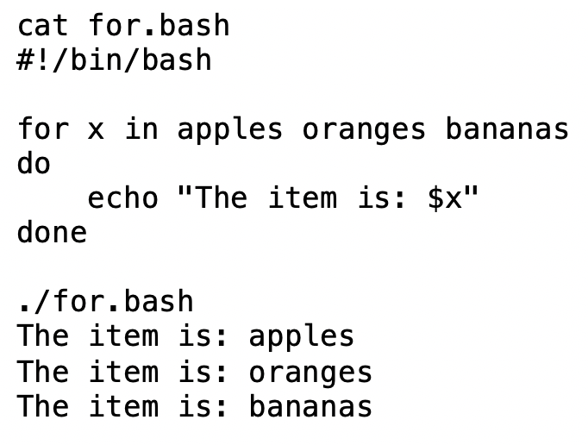
Control flow Statements - Loops
The for Loop
Example:
for x in apples oranges bananas
do
echo “The item is: $x” done

Slide 30
Control flow Statements - Loops
Task:
Write a Bash shell script that sets all files in your current directory as positional parameters. Use command substitution to store all files in your current directory as positional parameters.
The Bash Shell script will clear the screen and then display the following text (using special parameters). Use a for loop to display each filename on a SEPARATE line using a for loop:
Number of files in current directory are: (number of positional parameters)
Here are the filenames: (displays each positional parameters on a SEPARATE line)

Slide 31
homework
Getting Practice
Perform Week 11 Tutorial: (Due: Friday Week 12 @ midnight for a 2% grade):
INVESTIGATION 3: COMMAND SUBSTITUTION / MATH OPERATIONS
INVESTIGATION 4: USING CONTROL FLOW STATEMENTS IN SHELL SCRIPTS
LINUX PRACTICE QUESTIONS (Part A 3,4 , Part B Walk-Thru #2)

