Slide 1
ULI101: Introduction to Unix / Linux and the Internet Week 2: lesson 2 managing text files: USING Text editors to create & edit a text file managing text file content
Photos and icons used in this slide show are licensed under CC BY-SA

Slide 2
Lesson 2 topics
Creating Text Files
Purpose of a Text Editor
Using the nano Text Editor / Demonstration
Using the vi Text Editor / Demonstration
Managing / Manipulating Text Files
Linux Commands: touch, cat, more/less, cp, mv, rm, diff, file, find
Demonstration
Homework
Perform Tutorial 2: Unix / Linux File Management (Investigation 2) Perform LINUX PRACTICE QUESTIONS (9 – 16)

Slide 3
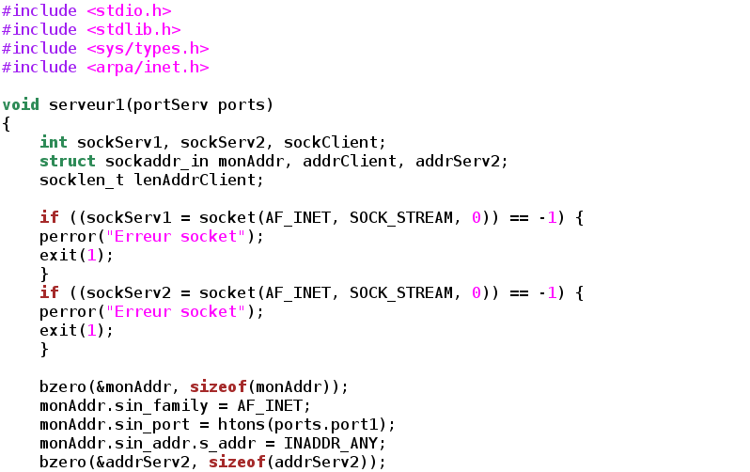
Creating Text Files
Text Editors
A Text Editor allows users to create, modify and save editing changes of text files.
Although programming students can use graphical IDE's to code and compile programs, students can create source code using a text editor and compile their source code in their Matrix account to generate executable programs.

Slide 4
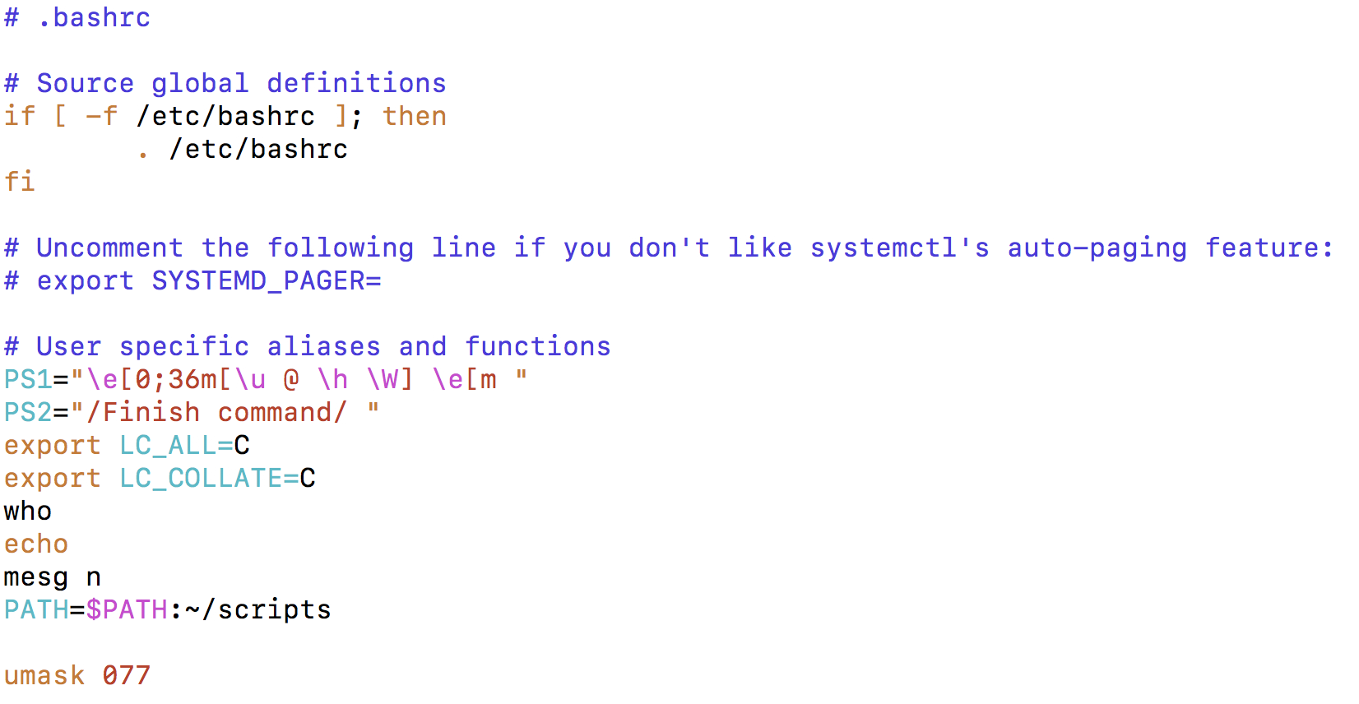
Creating Text Files
Text Editors
Networking and Tech Support students use a text editor to edit configuration files.
Throughout their program, students will become familiar with the process of installing, configuring, and running network services on their Linux servers.
Text editors are an important tools to help setup but also "tweak" or make periodic changes in networking services configuration.

Slide 5
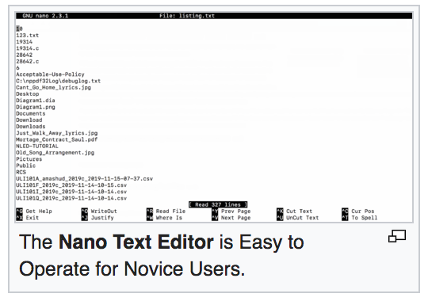
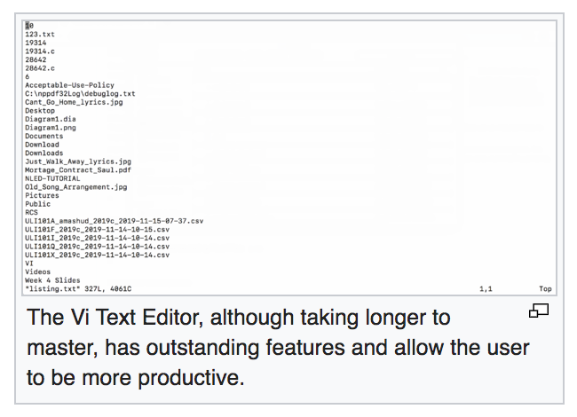
Creating Text Files
Text Editors
Regardless of the IT stream that they are in, it is useful for students to expose themselves to different text editors and then use one that they feel most comfortable working with.
The two most readily-available command line text editors in Linux are nano and vi.

Slide 6
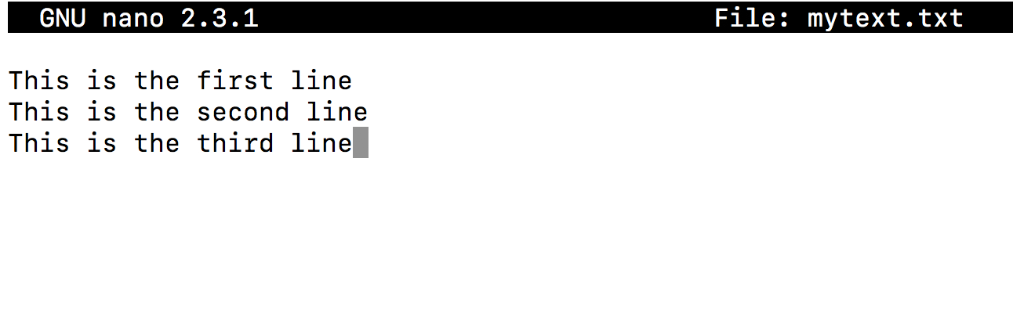
Creating Text Files
Nano Text Editor
The nano text editor is considered to be an easy-to-use text editor. When using the nano text editor, you are placed in INPUT mode, to enter text immediately.
Nano editing commands typically consist of the ^ symbol which represents the <ctrl> key followed by a character.
NOTE: There is no undo command in Nano!
The table on the right list a few Nano commands and their purpose. Refer to week 2 notes for a nano reference sheet.
NOTE: In the Nano reference sheet, the letter M represents the <esc> key
Key Combination | Purpose
<ctrl><space> , <esc><space> | Move forward / backward one word
<ctrl>a , <ctrl>e | Move to beginning / end of line
<ctrl>k | Cut line
<esc>6 | Copy Line
<ctrl>u | Paste Cut / Copied Text
<ctrl>g | Display help screen
<ctrl>x | Save and exit editing session

Slide 7

Managing Directories
Instructor Demonstration
Your instructor will demonstrate how to create and edit a text file using the nano text editor.

Slide 8
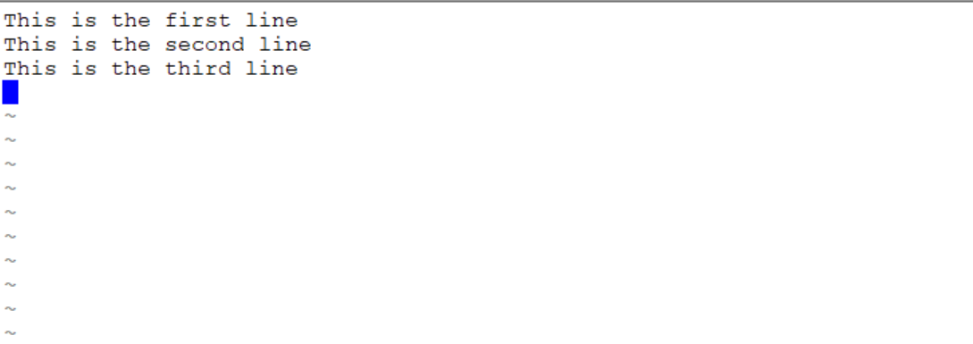
Creating Text Files
vi Text Editor
The vi (vim) text editor (although taking longer to learn) has outstanding features to increase coding productivity.
The major different between nano and vi is that vi starts in COMMAND LINE mode. You need to issue letter commands to perform text editing or press colon “: ” to enter last line mode to issue more complex commands.
To make it easier to learn how to use this text editor, an online tutorial was created (two decades ago) to provide you "hands-on" experience in command editing techniques.
To run this tutorial, issue the following command in Matrix: /home/jason.carman/vi-tutorial
You can refer to your week 2 notes for a vi command reference sheet.
Key Combination | Purpose
i | Enter INSERT mode
<esc> | Return to COMMAND mode
B , W | Move forward / backward one word
0 , $ | Move to beginning / end of line
dd | Cut line
yy | Copy Line
p , P | Paste below / above line
:help | Display help screen
:x | Save and exit editing session

Slide 9
Managing Directories
Instructor Demonstration
Your instructor will demonstrate how to create and edit a text file using the vi text editor.

Slide 10

Managing text files
Purpose
It is essential for students in this course not only to create text files but also to learn how to manage text files.
Students need to learn how to create empty files, copy files for backup purposes, move or rename incorrectly spelled filenames, edit files as well as view text file contents without the danger of editing or corrupting those files.
Students also need to learn how to remove files, check for differences between a couple of files as well as obtain information regarding the status of a file and information regarding the file’s content.

Slide 11
Managing text files
Text File Management Commands
Here are common text file management commands:
Linux Command | Purpose
touch | Create empty file(s) / Updates Existing File's Date/Time Stamp
cat | Display text file's contents without editing (small files)
more , less | Display / Navigate within large text files without editing
head , tail | View lines at top/bottom of file
grep | Display lines in file that match a pattern
cp | Copy text file(s)
mv | Move / Rename text files
rm | Remove text file(s)
diff | Displays differences between 2 files

Slide 12
Managing text files
Text File Management Commands
Here are some additional text file management commands:
Linux Command | Purpose
sort | Display contents of file in sorted order
uniq | Display identical adjacent lines only once
file | Gives info about the contents of the file (e.g. file with no extension)
find | To find files matching specified characteristics: find . -name "file*” lists pathname of any filenames beginning with "file", from the current directory and any subdirectories find . -size +50k lists pathname of any files larger than 50 kb, from the current directory and any subdirectories find . -mmin -5 lists files modified less than 5 minutes ago

Slide 13
Managing Directories
Managing Manipulating Text Files
Your instructor will demonstrate how to manage / manipulate text files:
Create empty files
View small and large text files
Sort files
Display matched pattern file content
Remove duplicate lines
Compare files for differences
Obtain file information / List file pathnames

Slide 14
HOMEWORK
Getting Practice
Perform the online tutorial Tutorial2: Unix / Linux File Management (Due: Friday Week 3 @ midnight for a 2% grade):
INVESTIGATION 2: MANAGING TEXT FILES
LINUX PRACTICE QUESTIONS (Questions 9 – 16)

