Slide 1
ULI101: Introduction to Unix / Linux and the Internet Week 8: lesson 1 Linking files
Photos and icons used in this slide show are licensed under CC BY-SA

Slide 2
Lesson 1 topics
Linking Files
i-nodes
Hard Links / Demonstration
Symbolic Links / Demonstration
Perform Week 8 Tutorial
Investigation 1
Review Questions (Questions 1 – 2)

Slide 3

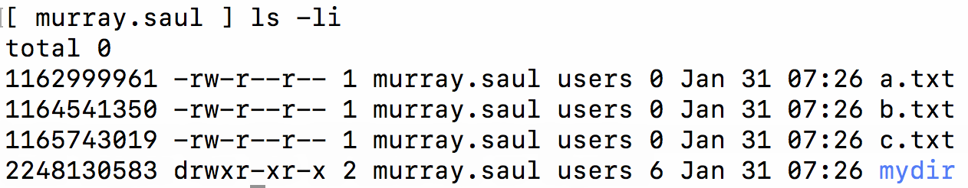
Linking files
inode (index) Number of a File:
The i-node number is like a ”finger-print” which is unique for each file on the Unix / Linux file system.
The i-node is an index (data structure) that provides information about the file such as if the file is a directory or regular file, etc.
Referring to the diagram below, issuing the ls command using the -i option displays the i-node number for each file. You can see that each file has its own unique i-node number in the file system.

Slide 4
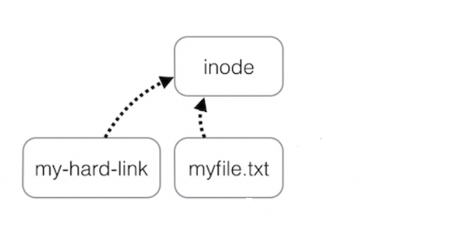
Linking files
Hard Links
A Hard link is a reference to the same index on a file system. It does this by creating a file that shares the same i-node number with the other file.
An advantage of using hard links is that if one hard link remains (even if original file has been removed), the data in that hard-linked file is NOT lost. Also, any change to each file will be reflected in any hard-linked file which is useful for backups.
Limitations of hard links are that they take-up extra space, you cannot hard link directories. Also, you cannot hard link files from other Unix/Linux servers (since the i-node number may already be used by the other Unix/Linux server).

Slide 5
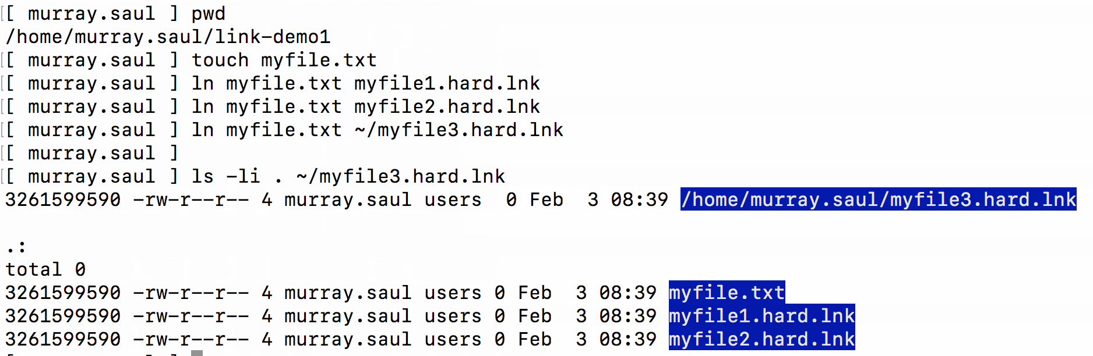
Linking files
Hard Links
Examples:
touch myfile.txt ln myfile.txt myfile1.hard.lnk ln myfile.txt myfile2.hard.lnk ln myfile.txt ~/backups/myfile.hard.lnk ls –li myfile*

Slide 6

Linking files
Instructor Demonstration
Your instructor will now demonstrate how to create Hard Links.

Slide 7
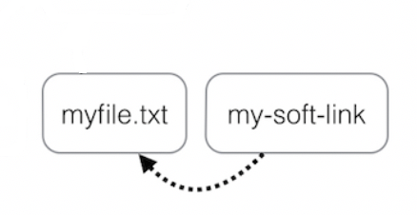
Linking files
Symbolic Links
A Symbolic Link is an indirect pointer to a file and are also known as a soft link or symlink. The symbolic link file contains the pathname to the original file.
An advantage of using symbolic links is they act as shortcuts to other files (in fact, the symbolic linked file only contains the pathname to the original file). Also, you can create symbolic links on different Unix/Linux servers, and that you can create symbolic links for directories.
A limitation of using symbolic links is that they are NOT good for backup purposes since a symbolic link can point to a nonexistent file (referred to as a "broken link").

Slide 8
Linking files
Hard Links vs Symbolic Links
Hard Link | Symbolic Link
inode: 1110214466 / \ / \ / \ ~/very/long/path/file1.txt ~/file2.txt | inode: 1110214466 | | V ~/very/long/path/file1.txt | | V ~/file2.txt

Slide 9
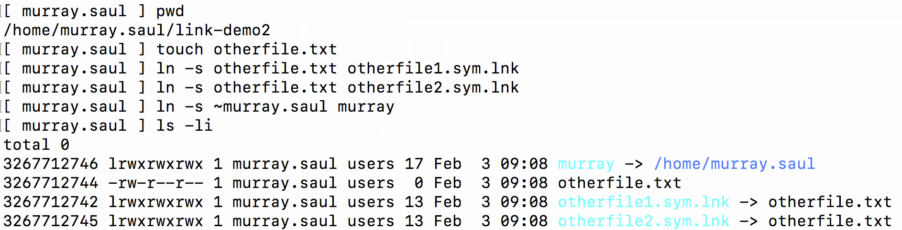
Linking files
Symbolic Links
Examples:
touch otherfile.txt ln -s otherfile.txt otherfile1.sym.lnk ln -s otherfile.txt otherfile2.sym.lnk ln -s otherfile.txt ~/backups/otherfile.sym.lnk ls –li otherfile*

Slide 10
Linking files
Instructor Demonstration
Your instructor will now demonstrate how to create Symbolic (Soft) links.

Slide 11
HOMEWORK
Getting Practice
Perform Week 8 Tutorial: (Due: Friday Week 9 @ midnight for a 2% grade):
INVESTIGATION 1: LINKING FILES
LINUX PRACTICE QUESTIONS (Questions 1 – 2)

