Slide 1
ULI101: Introduction to Unix / Linux and the Internet Week 9: lesson 2 extended regular expressions Linux commands that use regular expressions
Photos and icons used in this slide show are licensed under CC BY-SA

Slide 2
Lesson 2 topics
Extended Regular Expressions
Definition / Purpose
Extended Regular Expressions Symbols
Instructor Demonstration
Other Linux Commands That Use Regular Expressions
man , more , less , vi , sed , awk
Perform Week 9 Tutorial
Investigation 2
Review Questions (Extended Regular Expressions, Parts A and B)

Slide 3

Extended Regular expressions
Extended Regular Expressions
Extended Regular Expressions consist of additional special characters that “extend” the capability of regular expressions.
We will discuss three types of extended regular expressions:
Repetition: {min, max} , ? , +
Grouping: ( )
Or Condition: |

Slide 4
Extended Regular expressions
AAAA
Repetition
The extended regular expression symbol consists of the minimum and/or maximum number of repetitions contained within braces { }
Usage:
{min,max}
Examples: a{2,5} 2 to 5 occurrences of the character a [0-9]{1,} 1 or more occurrences of a number [0-9]+ (shortcut method) [a-z]{0,1} zero or 1 occurrence of a lowercase letter [a-z]? (shortcut method)

Slide 5
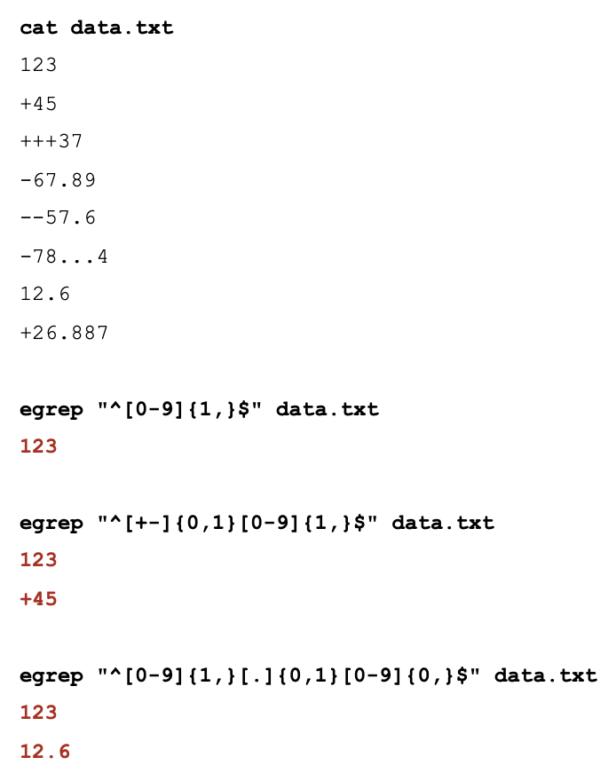
Extended Regular expressions
AAAA
Repetition Extended Regular Expression Example
If you issue the grep command without options with extended regular expressions, the command will NOT work.
When using the grep command with extended regular expressions you need to use egrep or grep –E
Examples: egrep “^[0-9]{1,}$” data.txt egrep “^[+-]{0,1}[0-9]{1,}$” data.txt egrep “^[0-9]{1,}[.]{0,1}[0-9]{0,}$” data.txt
grep –E “^[0-9]{1,}$” data.txt grep –E “^[+-]{0,1}[0-9]{1,}$” data.txt grep –E “^[0-9]{1,}[.]{0,1}[0-9]{0,}$” data.txt

Slide 6
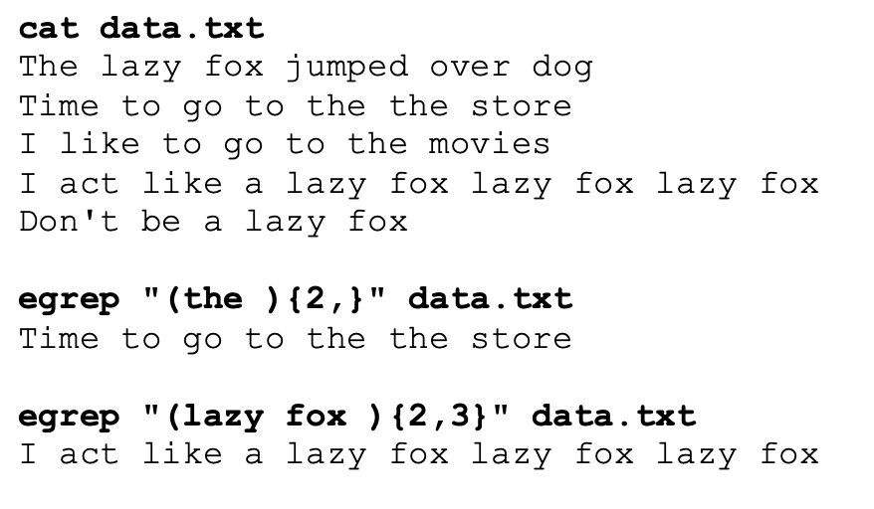
Extended Regular expressions
(pattern)
Grouping
If you want to search for repetition for a group of characters, a word, or a phase, you can enclose them within brackets ( )
Examples: egrep “(the ){2,}” data.txt egrep “(lazy fox ){2,3}” data.txt

Slide 7
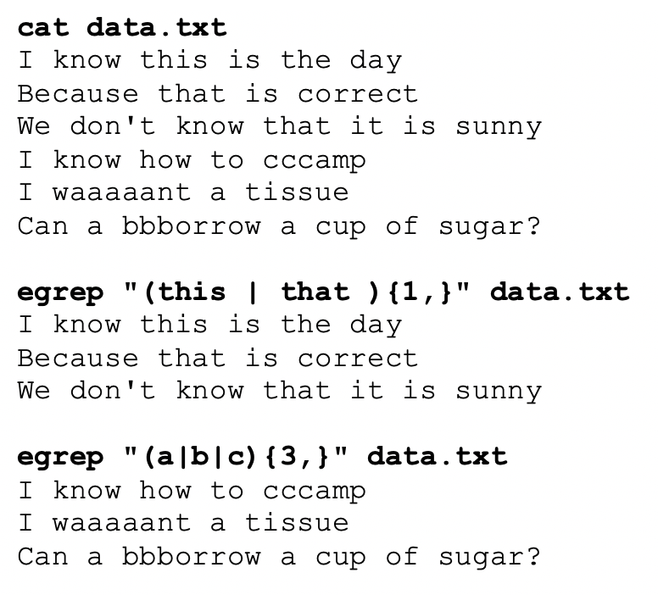
Regular Expressions
(this |that )
Or Condition
The | symbol is used as the “or” symbol to provide alternatives within a group.
Examples: egrep “(this | that ){1,}” data.txt egrep “(a|b|c){3,}” data.txt

Slide 8

Regular Expressions
Instructor Demonstration
Your instructor will demonstrate examples of using Extended Regular expressions with the egrep command.

Slide 9

Regular Expressions
Other Linux Commands that Use Extended Regular Expressions
There are other Linux commands / utilities in addition to grep or egrep that use regular expressions.
You have already used a few of these commands like: man, more, less, and vi.
Other commands like sed and awk will be taught in a future lesson.

Slide 10
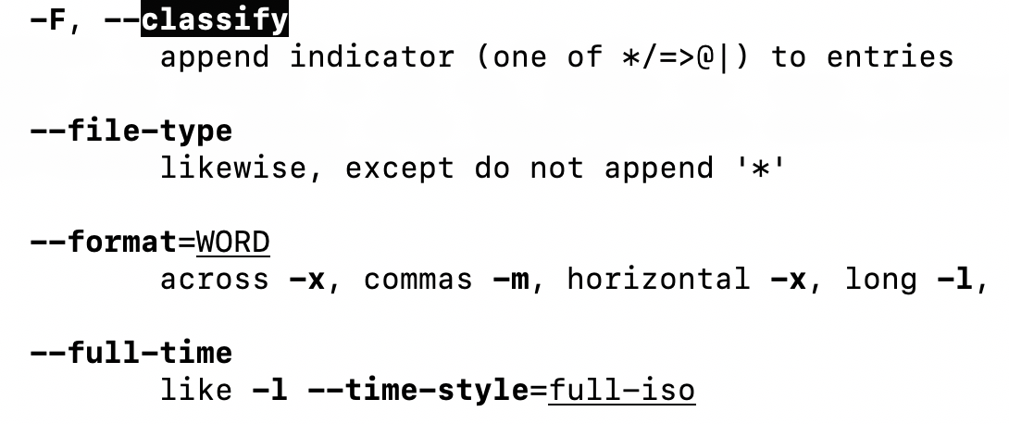
Regular Expressions
Other Linux Commands that Use Extended Regular Expressions
man , more , less
When searching for patterns using the man, more, or less commands, you specify a regular expression with a forward slash /
Example with man ls command: /classify

Slide 11
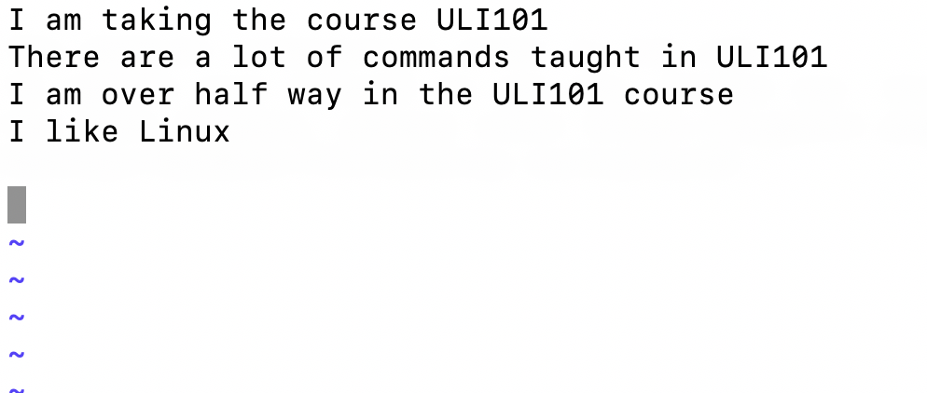
Regular Expressions
Other Linux Commands that Use Extended Regular Expressions
vi
The vi text editor use regular expressions to search and manipulate (edit) text within a text document.
Examples: /pattern – search for pattern in text file :%s/uli101/ULI101/g – search and replace text globally (all lines)

Slide 12
Regular Expressions
Using Regular Expressions with Linux Commands other than grep
awk , sed
The awk and sed Linux utilities are used to manipulate text, from files or via Linux pipeline commands.
You will learn how to use these commands in a later lesson.

Slide 13
Regular Expressions
Instructor Demonstration
Your instructor will demonstrate examples of using Extended Regular Expressions with the man, more, less and vi utilities.

Slide 14
HOMEWORK
Getting Practice
Perform Week 9 Tutorial: (Due: Friday Week 10 @ midnight for a 2% grade):
INVESTIGATION 2: EXTENDED REGULAR EXPRESSIONS
INVESTIGATION 3: OTHER COMMANDS THAT USE REGULAR EXPRESSIONS
LINUX PRACTICE QUESTIONS (Extended Regular Expressions, Parts A and B)

