Slide 1
ULI101: Introduction to Unix / Linux and the Internet
Week 3: Lesson 1 Advanced File Management
Photos and icons used in this slide show are licensed under CC BY-SA

Slide 2
Lesson 1 topics
File Pathname Types
Absolute File Pathnames
Relative File Pathnames
Relative-to-home File Pathnames
Demonstration
Perform Week 3 Tutorial
Investigation 1

Slide 3

FILE PATHNAME TYPES
Purpose of File Pathnames
As previously mentioned, a pathname is a fully-specified location of a unique filename within a file system. The concept of a pathname relates to every operating system including: Unix, Linux, MS-DOS, MS-Windows, Apple-Macintosh, etc.
Last week, we used a pathname from our home directory to create and manipulate directories and text files. There are different types of pathnames that we can use to access a directory or text file.
For Example: /home/userid/uli101/cars.txt (absolute pathname) samples/cars.txt (relative pathname) ~/cars.txt (relative-to-home pathname)
These types of file pathnames can make it more efficient (i.e. less keystrokes for users to type)

Slide 4
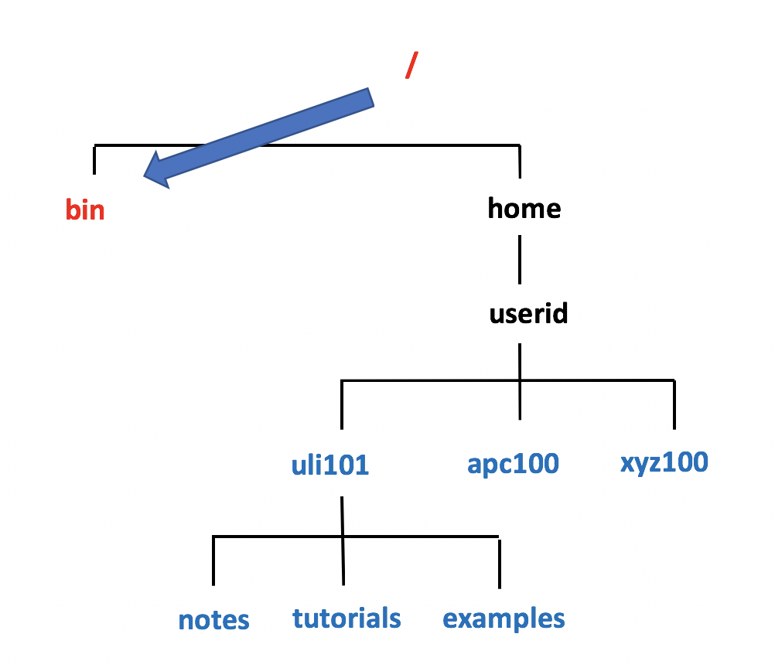
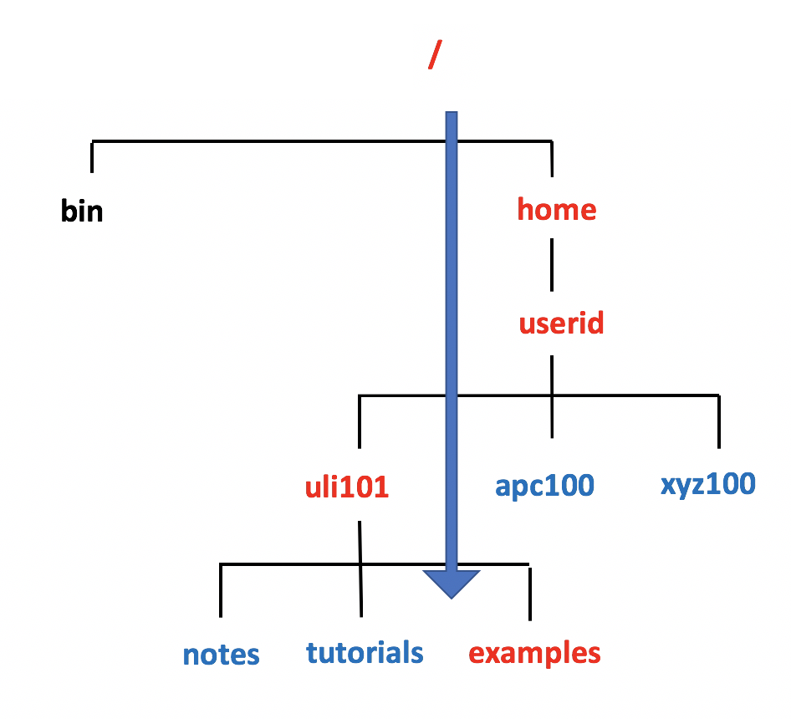
FILE PATHNAME TYPES
Absolute Pathnames
An absolute pathname is a path to a file or directory always beginning from the root directory (i.e. / ).
This type of pathname is referred to as absolute because the pathname always begins ABSOLUTELY from the root directory regardless of your current directory location.
In other words, this type of pathname requires that you always provide the FULL pathname starting with the root directory.
Remember the Rhyme: “If it is ABSOLUTE, it begins with ROOT!”

Slide 5
FILE PATHNAME TYPES
Absolute Pathnames
Advantages of using Absolute Pathnames:
Useful if you do NOT know your current directory location
Helps you to understand the FULL layout of pathname
Examples: /bin /home/userid/uli101/examples

Slide 6
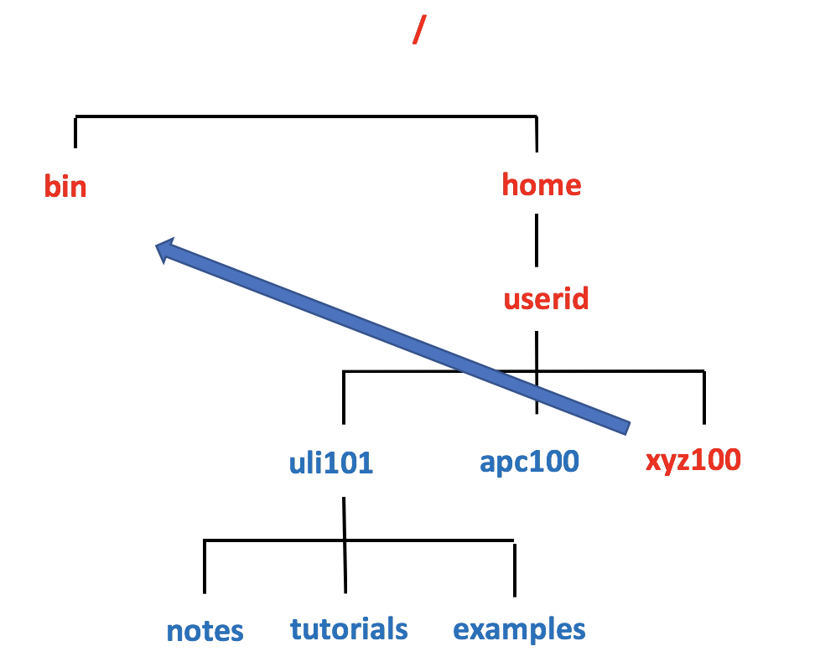
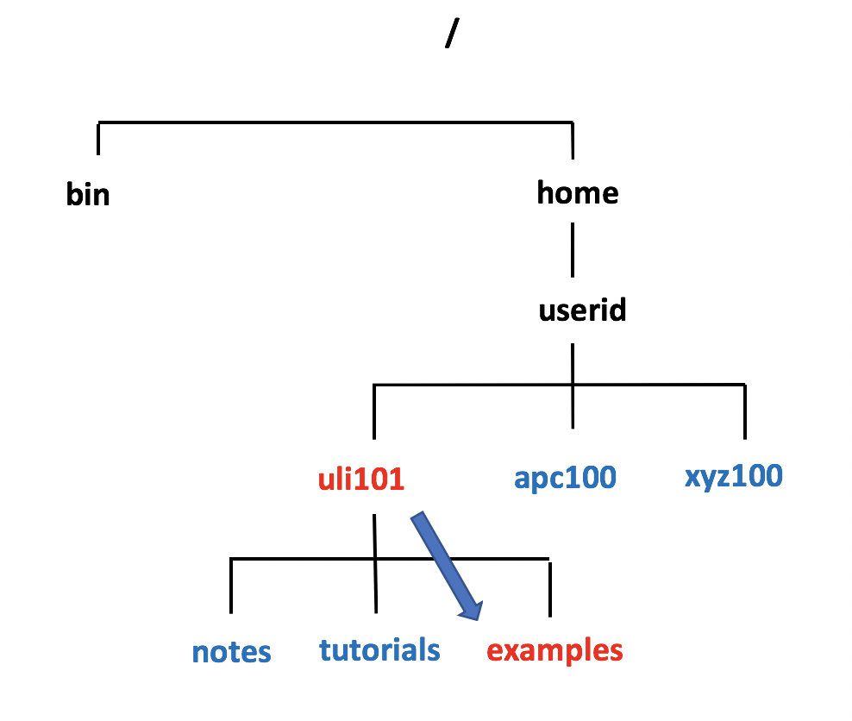
FILE PATHNAME TYPES
Relative Pathnames
A relative pathname is a path to a file or directory that begins from your current directory.
This is called a relative pathname because it is used to locate a specific file RELATIVE to your current directory.
NOTE: In order to use relative pathnames, it is absolutely necessary that you know the location of your current directory!

Slide 7
FILE PATHNAME TYPES
Relative Pathnames
Relative Pathname Symbols:
. A period "." represents the current directory .. Two periods ".." represents the parent directory (i.e. one directory level up)
Advantages of using Relative Pathnames:
Possibly a shorter pathname (less typing)
Examples: ../../../bin examples ./examples

Slide 8
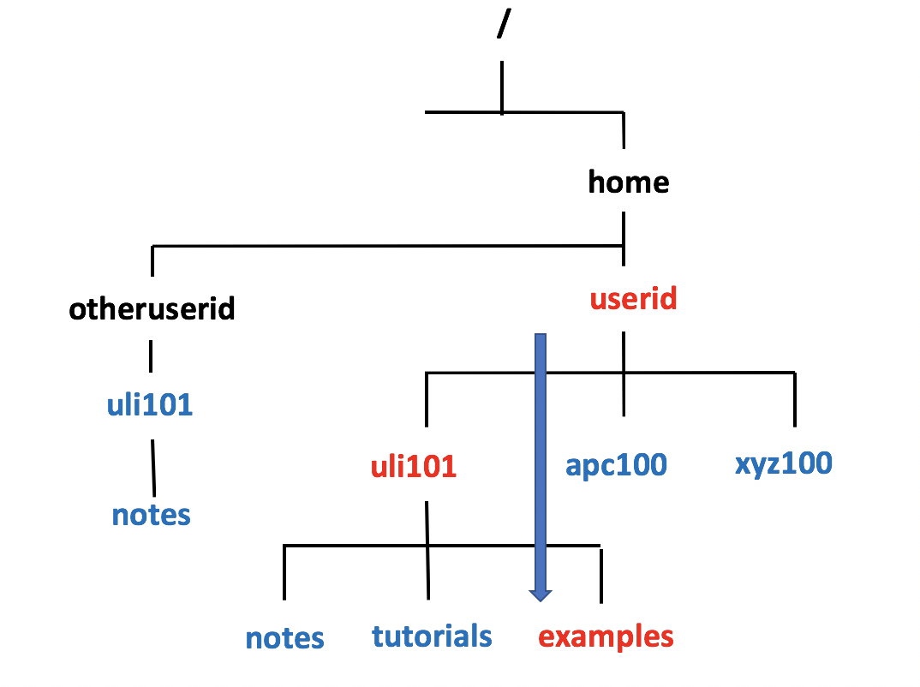
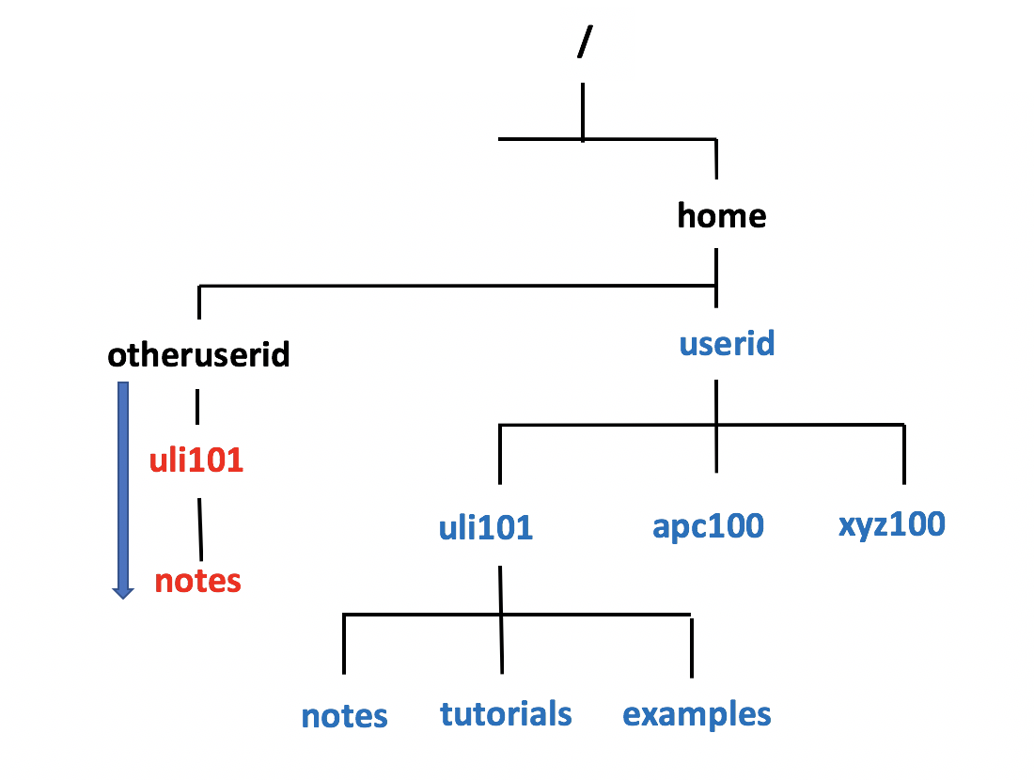
FILE PATHNAME TYPES
Relative-to-home Pathnames
A relative-to-home pathname begins with the tilde character ( i.e. ~) to represent the current user’s home directory.
The tilde character ~ stores the path of the current user’s home directory ( i.e. ~ = /home/current-user-id ).
Advantages of using Relative-to-Home Pathnames:
Possibly a shorter pathname (less typing)
You can place a username IMMEDIATELY after the tilde character to represent another user’s home directory (for example: ~jane = /home/jane)
Examples: ~/uli101/examples ~/uli101/notes ~murray.saul/uli101/notes

Slide 9

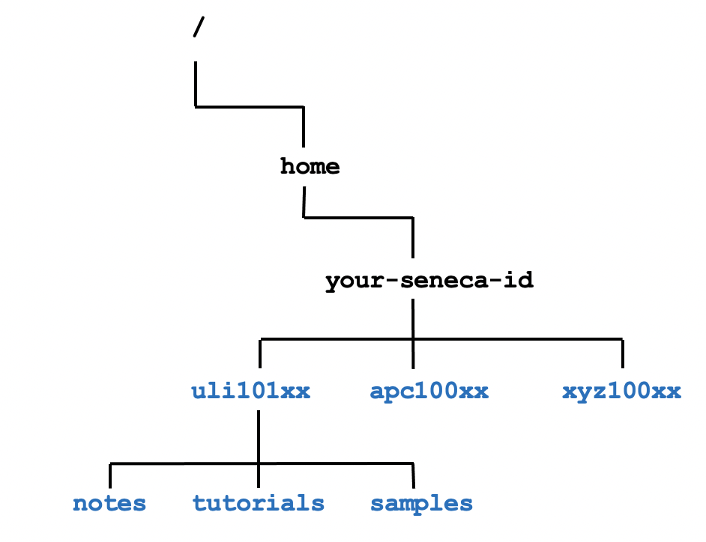
FILE PATHNAME TYPES
Instructor Demonstration
Your instructor will now demonstrate how to issue Unix / Linux commands using absolute, relative and relative-to-home pathnames for directory / file management:
Creating / Removing Directories
Moving Files / Directories
Copying Files / Directories
Listing Directory Contents
Removing Regular Files

Slide 10
HOMEWORK
Getting Practice
Perform online Tutorial 3: Advanced File Management / Quoting Special Characters (Due: Friday Week 4 @ midnight for a 2% grade):
INVESTIGATION 1: ABSOLUTE / RELATIVE / RELATIVE-TO-HOME PATHNAMES
LINUX PRACTICE QUESTIONS (Questions 1 – 8)

