Slide 1
ULI101: Introduction to Unix / Linux and the Internet
Week 3: Lesson 2 filename expansion quoting special characters
Photos and icons used in this slide show are licensed under CC BY-SA

Slide 2
Lesson 1 topics
File Name Expansion
Purpose
Special characters for Filename Expansion: * , ? , [ ] , [! ]
Demonstration
Quoting Special Characters
Purpose
Backslash \ , Single Quotes ‘’, Double Quotes “”
Demonstration
Perform Week 3 Tutorial
INVESTIGATIONS 2 and 3
LINUX PRACTICE QUESTIONS (Questions 9 – 13)

Slide 3
Filename expansion
Filename Expansion
This command displayed below is inefficient: it requires a LOT of typing and requires that the user know all the filenames within the current directory. ls a.txt b.txt c.txt 1.txt 2.txt 3.txt abc.txt work.txt a.txt b.txt c.txt 1.txt 2.txt 3.txt abc.txt work.txt
Filename expansion is the use of special characters to allow the shell to match files that share the same characteristics to help save the user save time when issuing Unix / Linux file management commands.
You can use a special character to indicate to the Bash shell to match all files that end with the extension ".txt":
ls *.txt a.txt b.txt c.txt 1.txt 2.txt 3.txt abc.txt

Slide 4
Filename expansion
Common File Expansion Symbols
Filename Expansion Symbol | Purpose
* | Asterisk (*) to represent 0 or more characters
? | Question mark (?) to represent exactly one character (any character)
[ ] | Square brackets ([ ]) to represent and match for the character enclosed within the square brackets. It represents ONLY ONE character: it's like a Question Mark (?) but with conditions or restrictions
[! ] | Square brackets containing an exclamation mark immediately after the open square bracket ([! ]) to represent and match and OPPOSITE character for the character enclosed within the square brackets.

Slide 5
Filename expansion
How Does File Expansion Work? (Process of “Globbing”)
File Globbing is a feature provided by the UNIX/Linux shell to represent multiple filenames by using special characters called wildcards with a single file name. A wildcard is essentially a symbol which may be used to substitute for one or more characters. Therefore, we can use wildcards for generating the appropriate combination of file names as per our requirement. Reference: https://www.linuxnix.com/10-file-globbing-examples-linux-unix/

Slide 6
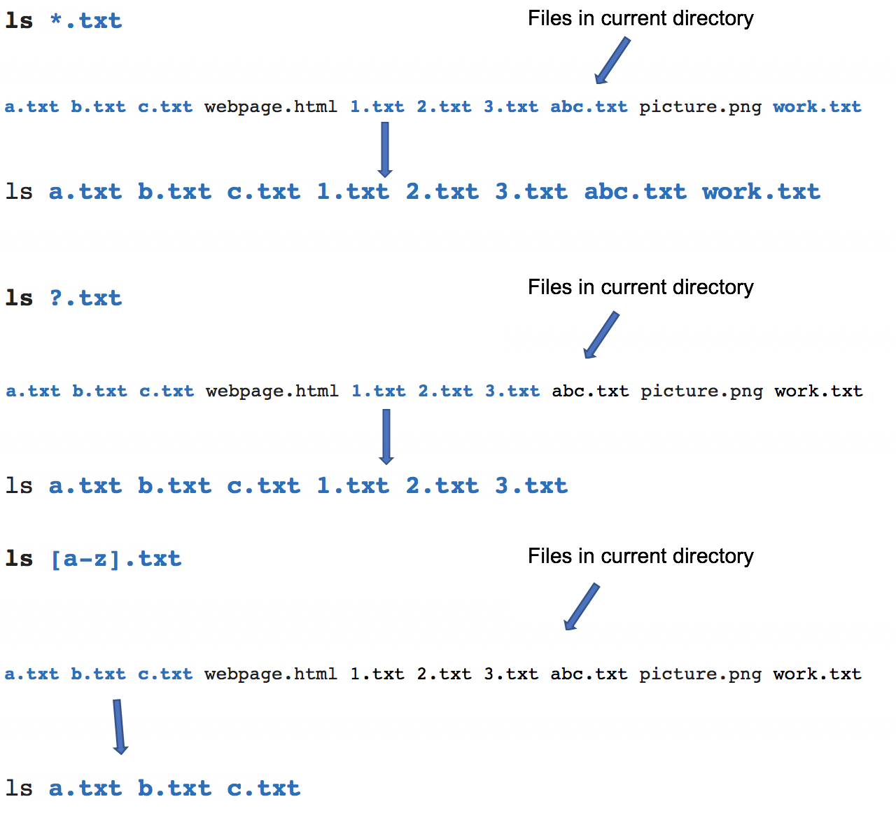
Filename expansion
How Does this Work? (Globbing)
As shown in the diagram on the right, when the ls command is issued with a filename expansion symbol (like *), the Bash shell searches for all files in the current directory that match files that end with the extension ".txt”.
The shell replaces *.txt with all the files that end with the extension .txt in the current directory and runs that command.
You do not see that happen in the shell… it is a process that occurs "behind the scenes”. Instead, you only see the results of the command.

Slide 7

Filename expansion
Instructor Demonstration
Your instructor will now demonstrate how to issue Unix / Linux commands using various filename expansion symbols for file management:
Creating / Removing Directories
Moving Files / Directories
Copying Files / Directories
Listing Directory Contents
Removing Regular Files

Slide 8
Command History
Command History:
The ~/.bash_history file stores recently executed command lines. There are several techniques using the ~/.bash_history file to run previously-issued commands.
Examples:
<up> or <down> move to previous or next command in Bash shell prompt
fc –l display last 16 commands
history | more display all stored commands
!# re-executes command by command number (obtained from history command)
!abc re-executes last command beginning with string ”abc”

Slide 9

Quoting special characters
Quoting Special Characters
As discussed in the above section, there are some special characters that the shell uses to perform an operation; for example, the filename expansion symbols: *, ?, [ ] or [! ]
There are methods to instruct the Linux shell to ignore that special character and use only as regular text.
These 3 methods to make those special characters act like text characters (referred to "quoting" special characters). These methods are displayed in the next slide.

Slide 10
Quoting special characters
Quoting Special Characters (Methods)
The most common filename expansion symbols are displayed below:
Quoting Method | Example
Place the character \ before a special character (works for ALL special characters) | echo \*
Contain Special character within single quotes ‘ ’ (work for ALL special characters) | echo '* hello *'
Contain special characters within double-quotes “ ” NOTE: Double quotes works for most special characters, but not all special characters (such as $variable-name - variables are discussed later in this course) | echo "* hello *"

Slide 11
Quoting special characters
Instructor Demonstration
Your instructor will now demonstrate how to issue Unix / Linux commands quoting special characters, their uses and their consequences:
Displaying Text
Creating / Removing Directories
Listing Directory Contents
Removing Regular Files

Slide 12
HOMEWORK
Getting Practice
Perform the online tutorial Tutorial 3: Unix / Linux File Management (Due: Friday Week 4 @ midnight for a 2% grade):
INVESTIGATION 2: FILENAME EXPANSION
INVESTIGATION 3: QUOTING SPECIAL CHARACTERS
LINUX PRACTICE QUESTIONS (Questions 9 – 13)

