Slide 1
ULI101: Introduction to Unix / Linux and the Internet Week 5: Lesson 2 PIPELINE COMMANDS MULTIPLE / MULTILINE COMMANDS
Photos and icons used in this slide show are licensed under CC BY-SA

Slide 2
Lesson 2 topics
Redirection – Part 2
Purpose of Pipeline Commands
Linux Pipeline Command Syntax: |
tee Command
Multiple / Multi-Line Commands
Multiple Linux Commands using Semicolon ”;” and Grouping: ( )
Issuing Large Linux Commands over Multiple Lines
Perform Week 5 Tutorial
Investigations 2 and 3
Review Questions (Questions 5 – 12)

Slide 3
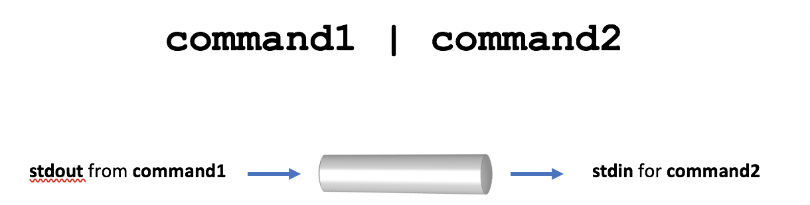
Pipeline commands
Pipeline Commands use a meta symbol “|” (called a pipe) to allow a command’s standard output to be redirected into the standard input of other commands WITHOUT having to use temporary files.
Therefore, a few simple commands can be combined to form a more powerful pipeline command.
Examples: ls -al | more ls | sort -r ls | sort | more ls -l | cut -d" " -f2 | tr 'a-z' ‘A-Z" ls | grep Linux | head -5

Slide 4
Pipeline commands
Filters
Commands to the right of the pipe symbol are referred to as filters.
They are called filters since those commands are used to modify the stdout of the previous command.
Many commands can be "piped" together, but these commands (filters) must be chained in a specific order, depending on what you wish to accomplish.

Slide 5

Pipeline commands
Instructor Demonstration
Your instructor will now demonstrate how to issue Pipeline Commands.

Slide 6
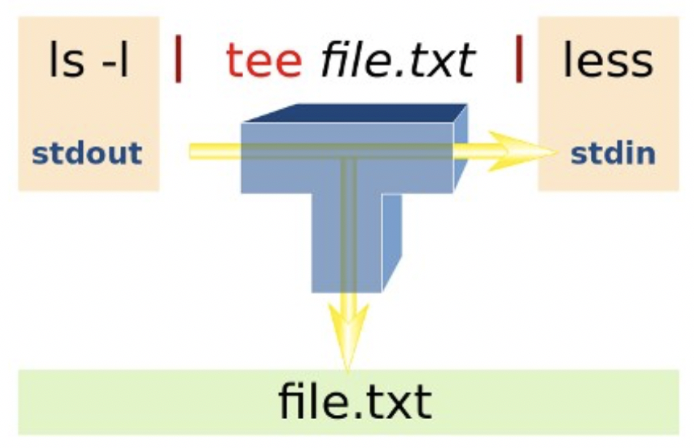
Pipeline commands
The tee utility can be used to split the flow of standard output between a text file and the terminal screen.
The tee option -a can be used to add content to the bottom of an existing file as opposed to overwriting the file's previous contents.
The reason for the name "tee" is that the splitting of the flow of information resembles a capital T.
Examples: ls | tee unsorted.txt | sort ls | grep Linux | tee matched.txt | more ls | head -5 | tee -a

Slide 7
Pipeline commands
Instructor Demonstration
Your instructor will now demonstrate how to use the tee command within a Pipeline Command.

Slide 8
Multiple / multi-line commands
There are ways that multiple commands can be run within a single command line.
You can separate commands by using the semi-colon character “;”.
Example: sleep 5; ls
Multiple commands can also be grouped by using parentheses to force commands to be run together (for example, to redirect stdout to a file)
Example: (echo "Who is logged in:"; who) > whoson (Note: all command output is sent to a file)
command1;command2;command3

Slide 9
Multiple / multi-line commands
Commands may also be spread-out over multiple lines, making it easier (for humans) to interpret a long command.
You can add a backslash quoting symbol "\" at the end of a line. The \ symbol “quotes-out” the meaning of the ENTER key as text (i.e. new-line) as instead of running the command.
Example: echo "This will be split over multiple \ lines. Note that the shell will realize \ that a pipe requires another command, so \ it will automatically go to the next line” \ | tr '[a-z]' '[A-Z]’
command1 | \ command2 | \ command3

Slide 10
Multiple / multi-line commands
Instructor Demonstration
Your instructor will now demonstrate how to issue Multiple Commands / Multi-Line Linux Commands:
Multiple Linux Commands using semicolon “;”
Multiple Linux Commands using Grouping ( )
Mult-Line Linux Commands using Backslash \

Slide 11
HOMEWORK
Getting Practice
Perform the online Tutorial 5 (Due: Friday Week 6 @ midnight for a 2% grade):
INVESTIGATION 2: REDIRECTION USING PIPES
INVESTIGATION 3: ISSUING MULTIPLE UNIX/LINUX COMMANDS
LINUX PRACTICE QUESTIONS (Questions 6 – 12)

