Slide 1
ULI101: Introduction to Unix / Linux and the Internet Week 6 LESSON 1: transferring files between computers ISSUING REMOTE COMPUTER COMMANDS ON LOCAL COMPUTERS
Photos and icons used in this slide show are licensed under CC BY-SA

Slide 2
Lesson 1 topics
Transferring Files Between Computers: SSH Suite of Utilities:
Purpose / Using the scp utility / Using the sftp utility
Issuing commands on remote computers from local computers (ssh [Linux Command(s)])
Demonstration
Mail Utility:
Purpose / Using the mail utility
Sending Messages / File Attachments
Demonstration
Perform Week 6 Tutorial (Due first Friday AFTER reading week)
Investigations 1, 2 & 3
Review Questions (Questions 1 – 12)

Slide 3

Transferring files between unix / Linux servers
It is important to learn how to transfer files from your Matrix account to other computers. Reasons for Transferring Files from Matrix:
Backup your work in case of accidental deletion
Save space on your Matrix account
You will learn different methods to securely transfer files between your Matrix Linux account and other computers.

Slide 4
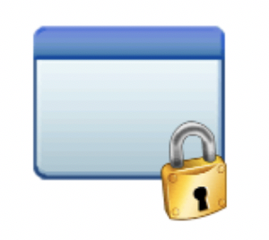
Transferring files between unix / Linux servers
The ssh Linux command is a suite (collection) of utilties to allow the user to securely connect among Unix / Linux servers, as well as securely copy and transfer files among Unix/Linux servers.
There are two additional utilities in addition to the ssh utility to allow secure transfer of files between computers:
scp (secure copy)
sftp (secure file transmission protocol)
SSH / SCP / SFTP

Slide 5
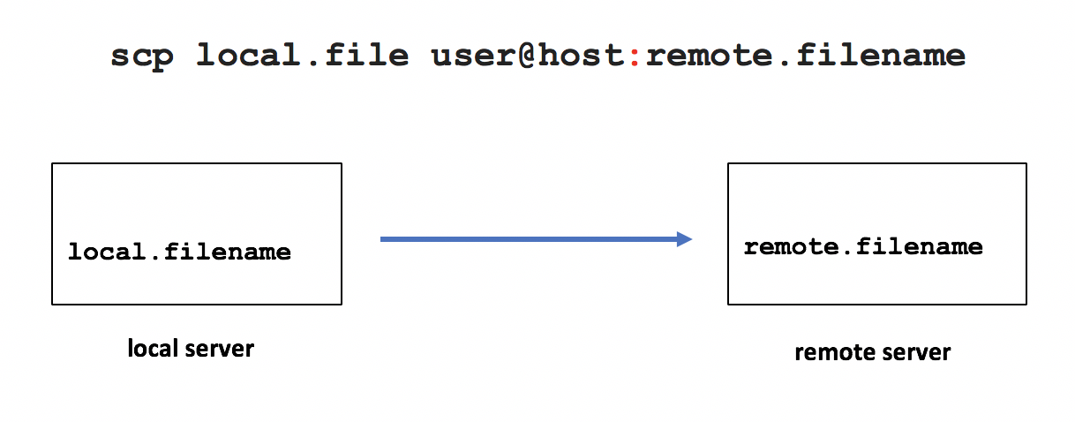
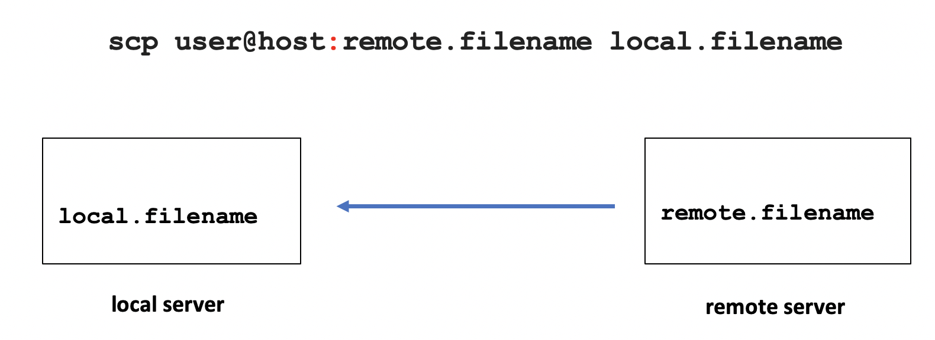
Transferring files between unix / Linux servers
Secure Copy (scp)
Usage:
scp local.file user@host:destination-pathname scp local.file user@host: scp user@host:file-pathname local-pathname
The usage for the scp command is like the cp command with the addition of host names.
The most common mistake that students make is forgetting to add the colon character ":" after the remote hostname.
The username in the command can be omitted if the username is the same on both servers. Multiple file and recursive directory copy (i.e. option -r) is supported.
(Note: This command is case-sensitive. –r is supported, but –R is not.)

Slide 6

Transferring files between unix / Linux servers
Instructor Demonstration
Your instructor will now demonstrate using the scp command.

Slide 7
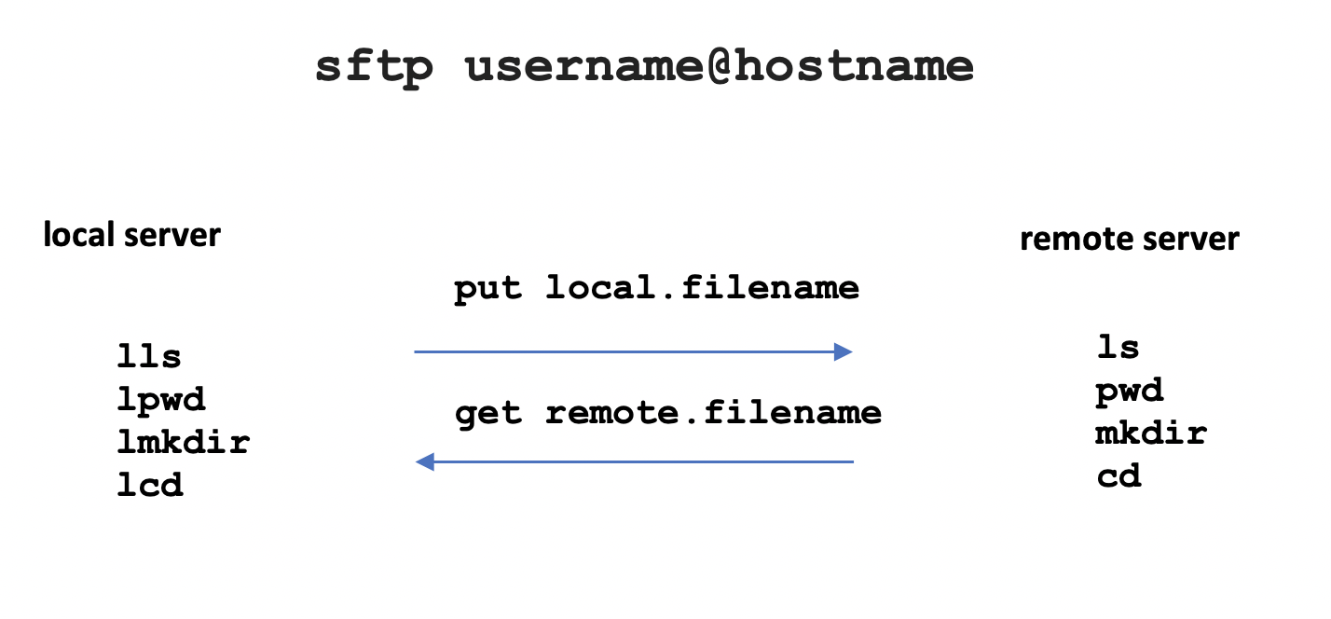
Transferring files between unix / Linux servers
Secure File Transmission Protocol (sftp) sftp is a utility to connect to a shell that allows a user to issue ftp commands to access and transfer files between servers.
FTP is an acronym for File Transfer Protocol that provides a set of rules on how to convert data that is transferred between computer servers (both identical and different operating systems).

Slide 8
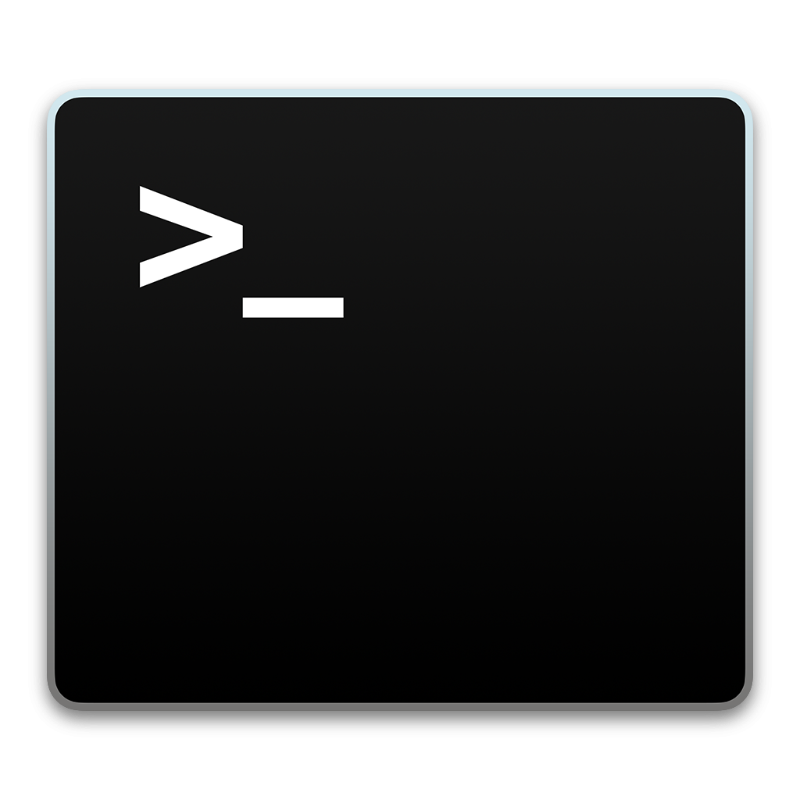
Transferring files between unix / Linux servers
Secure File Transmission Protocol (sftp)
When you login via the sftp command, the sftp command prompt appears. This prompt acts like the Bash shell prompt, but with a limited number of commands.
The table below displays common FTP commands for transferring files between servers.
Operation | Local Server | Remote Server
Display current working directory | lpwd | pwd
Display directory contents | lls | ls
Create Directory | lmkdir | mkdir
Change directory location | lcd | cd
Upload file to remote server | put
Download file to local server | get

Slide 9
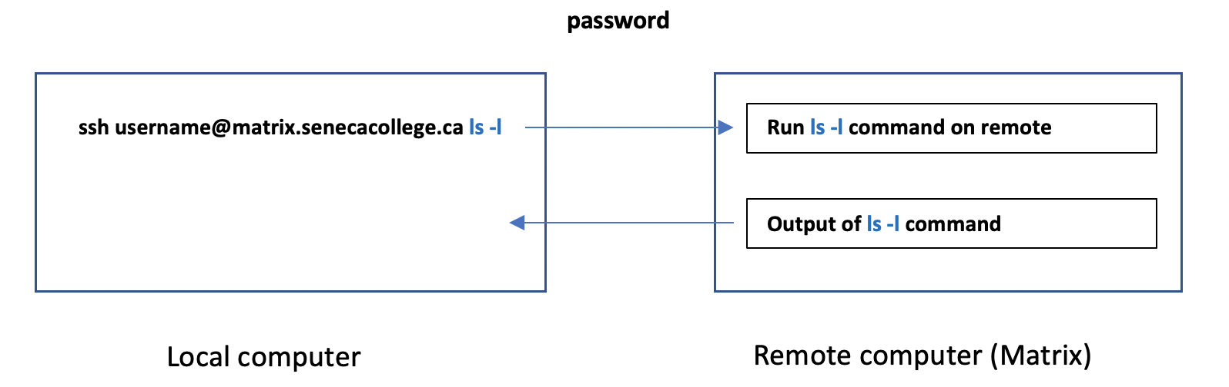
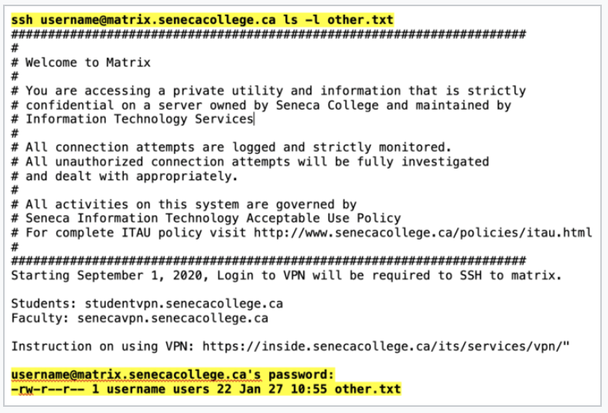
Verifying copied / transferred files
Running Remote Matrix Commands on your Local Computer
You can use the ssh command to issue Unix/Linux commands on a remote server without logging into a remote session. ssh username@matrix.senecacollege.ca ls -l
You will be prompted for your Matrix account password, then the contents of your home directory in your remote Matrix account will be displayed, although you will remain on your local computer.

Slide 10
Transferring files between unix / Linux servers
Instructor Demonstration
Your instructor will now demonstrate using the ssh command to issue commands on your remote Matrix server to verify files have been properly copied / transferred files between computers..

Slide 11
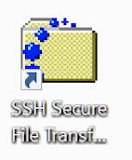
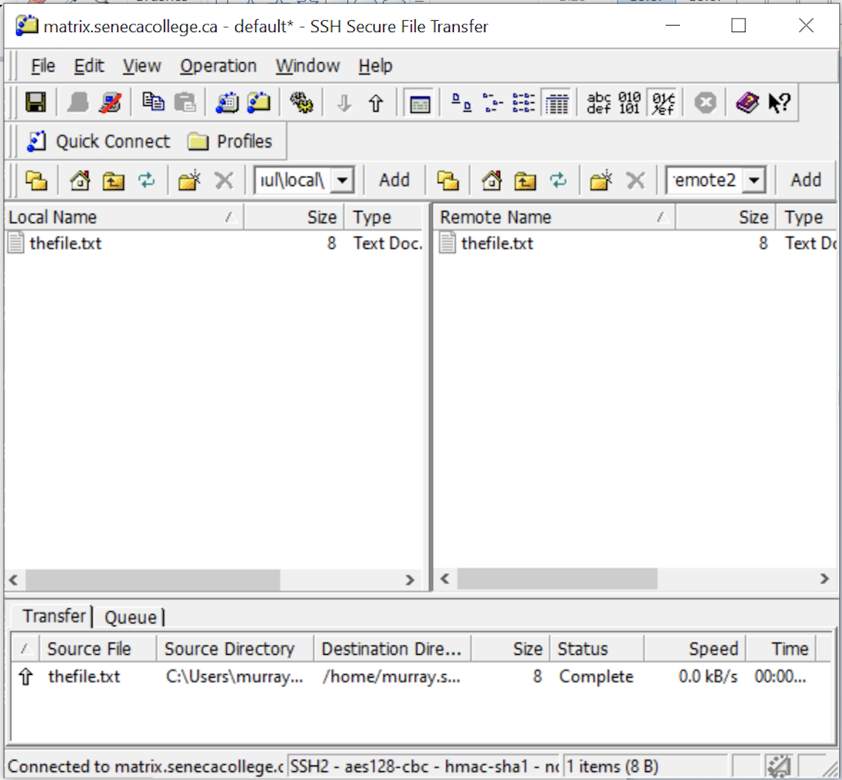
Transferring files between unix / Linux servers
Graphical SFTP Application
Although it is important to learn how to use command-line sftp and is considered coverage for quizzes, midterm and final exams, there are graphical sftp applications to make it more ”user-friendly”.
NOTE: Based on issues with the implementation of the Seneca VPN, you cannot connect to your Matrix account unless you run the graphical SSH Client application via MyApps at a Seneca computer lab.
You can refer to Online Tutorial 1 INVESIGATION1 to run the graphical SSH Client application via MyApps at Seneca.

Slide 12
Transferring files between unix / Linux servers
Instructor Demonstration
Your instructor will now demonstrate using the sftp command and the Secure Shell graphical SFTP application (if at Seneca computer lab).

Slide 13

Transferring files between unix / Linux servers
UNIX Mail (mail)
The Matrix server is also an email server that can allow you to send emails messages to other email accounts.
NOTE: In order to use the mail command on a Linux computer at home, you must first install and run an email server and have the appropriate mail client application installed.

Slide 14
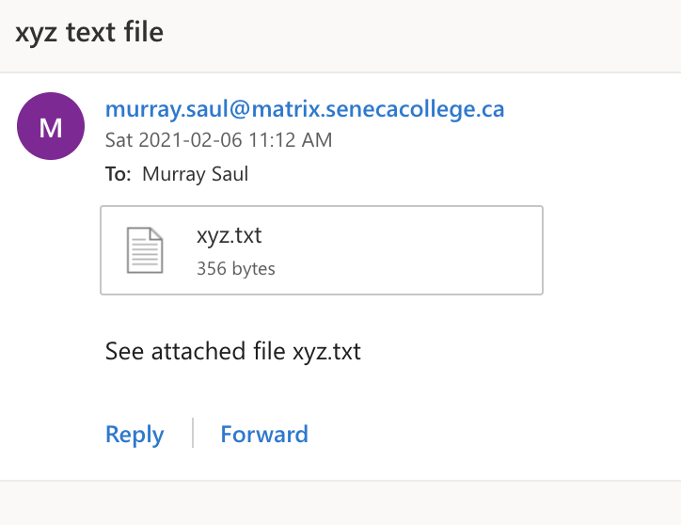
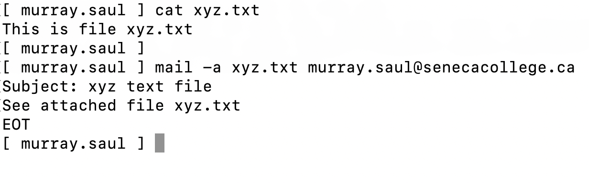
Transferring files between unix / Linux servers
UNIX Mail (mail) Steps to Send an Email Message:
Type: mail username@hostname and press ENTER
Enter subject line and press ENTER
Type the body of the message and then when finished, press ctrl+d to send message
NOTE: You can use the mail command with the -a option to specify a file to send as an attachment to your email message.
Example: mail recipient@hostname -a filename

Slide 15
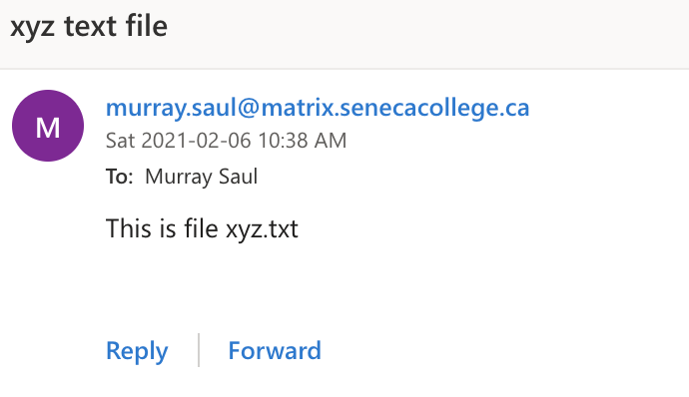
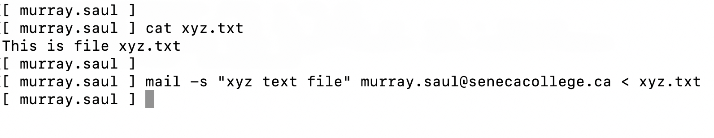
Transferring files between unix / Linux servers
UNIX Mail (mail)
Alternative Method to Send Email with Attachment Use the -s option in the command to specify the subject line of the command and use stdin redirection to send a text file as the body of the message.
NOTE: You would have to use this method since you have used stdin redirection to attach the file’s so you can’t input the subject line from the terminal! You should notice that the contents of the file are displayed in text in the email message as opposed to a file attachment.
Example: mail -s "your subject line" recipient@hostname < filename

Slide 16
Transferring files between unix / Linux servers
Instructor Demonstration
Your instructor will now demonstrate using the mail command.

Slide 17
HOMEWORK
Getting Practice
Perform Week 6 Tutorial: (Due: Friday Week 8 @ midnight for a 2% grade):
INVESTIGATION 1: USING SECURE COPY
INVESTIGATION 2: USING SECURE FILE TRANSMISSION CONTROL PROTOCOL
INVESTIGATION 3: USING THE MAIL COMMAND TO SEND FILE ATTACHMENTS
LINUX PRACTICE QUESTIONS (Questions 1 – 12)

