Slide 1
Database Integration
Seneca Conference Management System
By Bo Li

Slide 2
Background
Website needs to store various information about users, lecture/meeting sessions
Database structure has been finalized (maybe)
Need to optimized communication among design, business and database layers

Slide 3
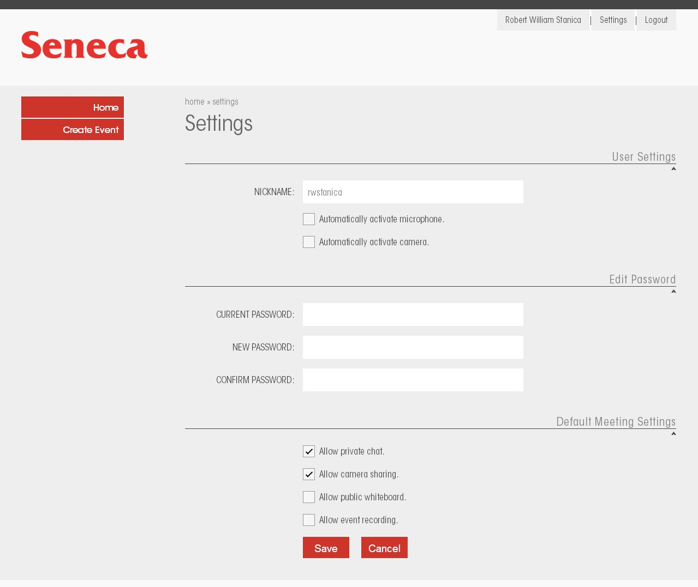

Slide 4
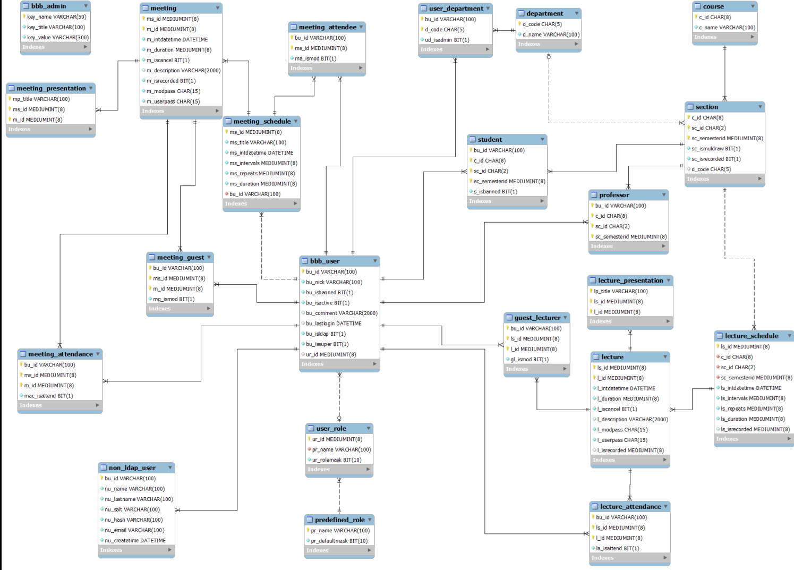

Slide 5

Division of Labour
Design Layer
(Ystallone Alves)
HTML5, CSS, JQuery
Business Layer
(Robert William Stanica)
Java, JavaScript, JSP
Database Layer
(Me)
Java, MySQL

Slide 6
The Mission (db Layer)
Limit number of db connections while retain connection quality
Complete encapsulation of SQL statements; separate them from Design/Business layers

Slide 7
Design: Database Connection
mySQL DB can only handle a certain number of connections (default: 100-150), can be manually increased
../mysql/my.cnf, change max_connections
Vendors sometimes also impose connection limit

Slide 8

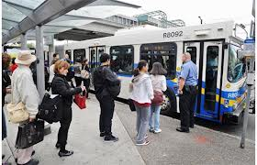
Design: Database Connection
We want to avoid 2 scenerios:
1) Too many DB accessing objects share the same connection
2) Each object opens up its own DB connection (possibly > MAX connection)

Slide 9
Design: Database Connection
The ideal scenerio is a limited number of connections that are evenly distributed among the accessing objects:
To accomplish this: Connection Pool + Session Bean

Slide 10
Design: Connection Pool
A collection of already opened connection
Can be made from scratch, but better to use a library
We use BoneCP
Also need to make DBConnection static
Notes:
The idea is to open up multiple numbers of connections at once, store them somewhere (a pool), and each time an accessing object needs a connection, it grab an already made connection from the pool.

Slide 11
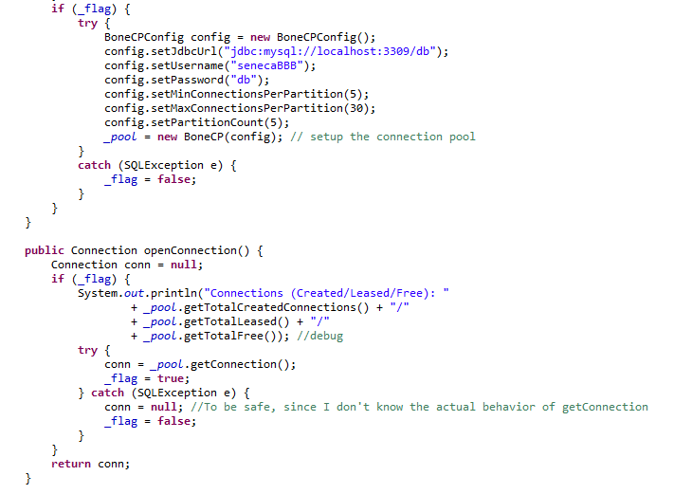

Slide 12
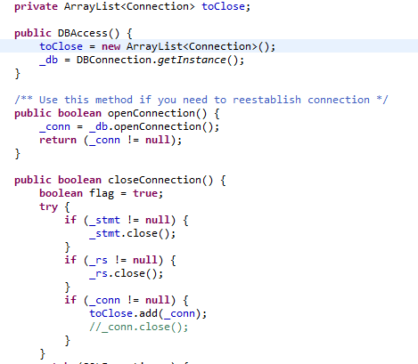
Issue:
Beyond MAX Connection
What happens if connection pool reaches its limit?
Notes:
Question is now what happens if the connections get more than max,
I don’t really know anything about stress testing
So all I did was put all connections in an arraylist instead of closing them

Slide 13
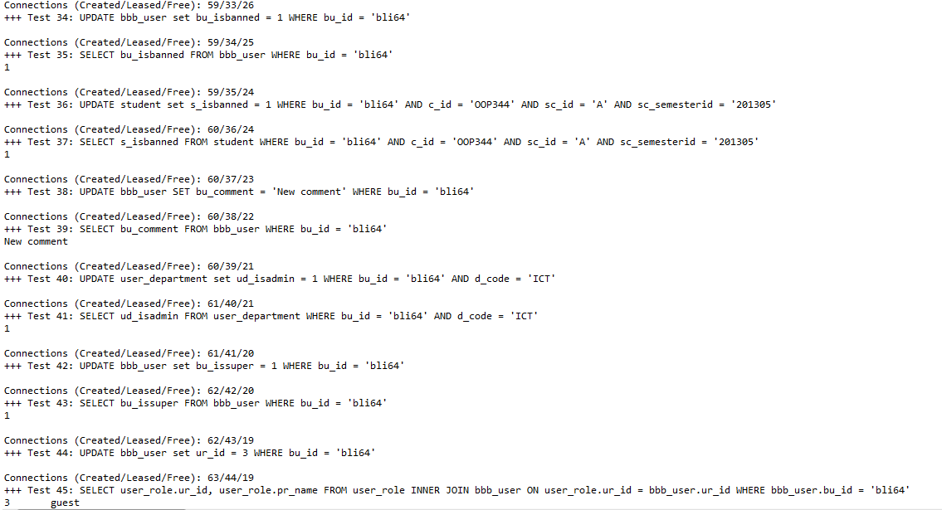

Slide 14
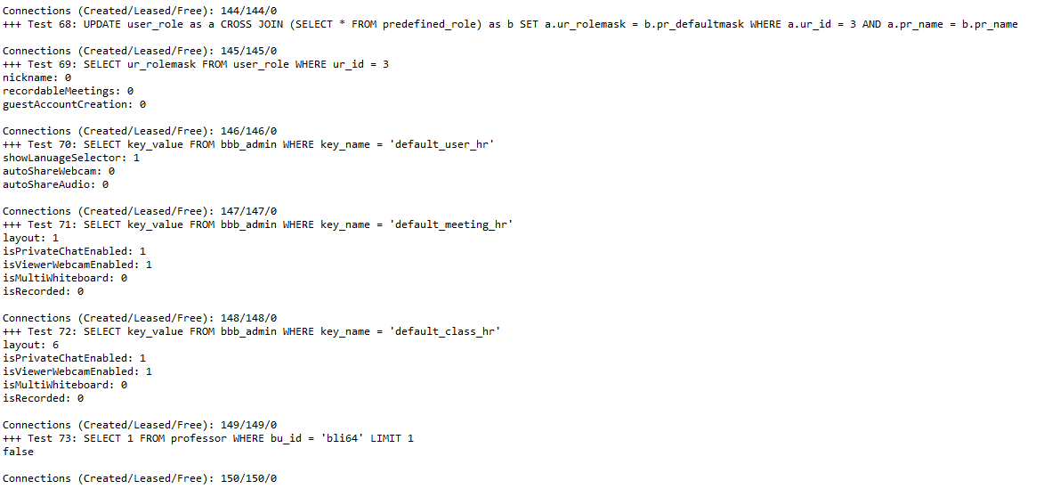

Slide 15
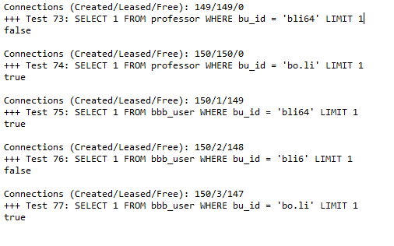

Slide 16
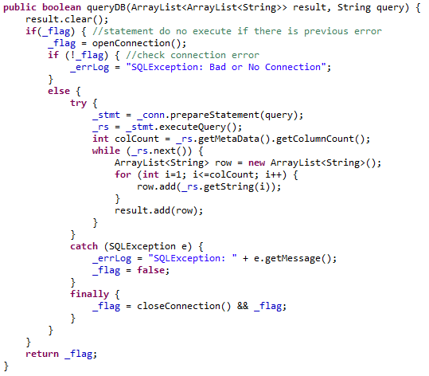
Design: Free up connection
minimize the time each accessing object can hold on to connection
Notes:
Terminology is confusing, openConnection is not really open connection, and close is simliar

Slide 17
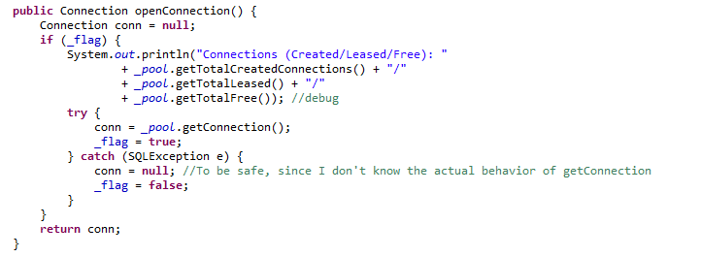

Slide 18
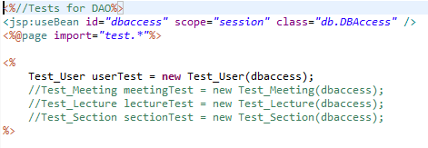
Session Bean

Slide 19
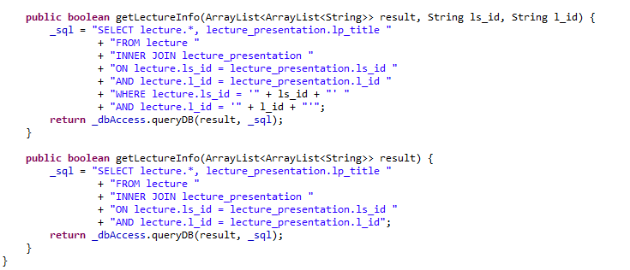
Encapsulation
Wrap SQL statements inside Java Methods

Slide 20
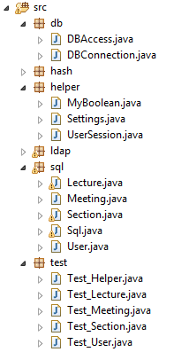
Summary
Business Layer
SQL classes
Assemble SQL statements
Wrap them in Java methods
DBAccess
One per session
Query/Update Database
DBConnection
Static
Creates one single Connection Pool

Slide 21
Thank you!

