Slide 1
Cyclistic Bike-Share Analysis Case Study Data Analysis
Mphatso Senezio

Slide 2
Introduction
Cyclistic, a bike-share company established in 2016, operates a fleet of 5,824 bikes across 692 stations in Chicago. With options for single-ride passes, full-day passes, and annual memberships, the company caters to both casual riders and annual members. Financial analyses show that annual members are more profitable than casual riders. Director of Marketing Lily Moreno aims to convert casual riders into annual members to drive growth. To support this, the team will analyze bike trip data to understand usage patterns and inform targeted marketing strategies.

Slide 3
Business Task (Ask)
In my role as a junior data analyst at Cyclistic, I was tasked with answering a key business question: “How do annual members and casual riders use Cyclistic bikes differently?” This question was crucial because understanding the differences in bike usage between these two groups would help tailor marketing strategies to convert casual riders into annual members. To address this question, I needed to gather comprehensive data on bike usage, ensure its quality, and analyze it to uncover meaningful insights.

Slide 4
Data Collection, Organization, and Integrity (Prepare)
To begin with, I gathered the data required for this analysis from Divvy’s official source. The data included ride details for several months, covering a wide range of bike trips. I ensured that this data met the ROCK criteria—Reliable, Original, Comprehensive, Current, and Cited. It was sourced directly from Divvy and was up-to-date, covering the most recent months of bike trip data.
I organized the data by downloading and combining multiple CSV files from August 2023 through July 2024. Each file represented a month’s worth of bike trip data. The data was structured with various attributes, including ride IDs, bike types, timestamps, and station information. I verified the data’s integrity by checking for any issues or inconsistencies that might affect the analysis. This step was crucial to ensure that the data was ready for the next stages of processing and analysis.

Slide 5
Data Cleaning and Transformation (Process)
In the data preparation phase, I focused on cleaning and transforming the dataset to ensure its readiness for analysis. I performed the following steps:
Loading and Combining Data: I used R to load and combine the monthly datasets into a single data frame. This provided a comprehensive view of bike usage over the specified period.
Cleaning the Data: I identified and resolved issues related to station IDs and names. By creating lookup tables and resolving duplicates, I ensured that all station names were correctly matched and filled in where missing.
Handling Missing and Invalid Data: I filtered out rows with missing or invalid data. This included removing rides with zero or negative lengths and optionally removing rides with durations of 10 seconds or less to ensure only meaningful data was included.
Creating New Columns: I added new columns to enhance the dataset:
ride_length: Calculated as the difference between ended_at and started_at.
day_of_week: Extracted from the start timestamp to analyze usage patterns by day.
Final Checks: I reviewed the cleaned dataset to ensure it was free of errors and ready for analysis. This included calculating summary statistics such as the mean, maximum, and mode of ride lengths and days of the week.
# Print the results print(paste("Mean ride length:", mean_ride_length))
## [1] "Mean ride length: 998.094906117663"
print(paste("Max ride length:", max_ride_length))
## [1] "Max ride length: 413473"
print(paste("Mode day of the week:", mode_day_of_week))
## [1] "Mode day of the week: Wednesday"
Through these steps, I prepared a clean, comprehensive dataset that was suitable for analyzing bike usage patterns between annual members and casual riders. This ensured that the insights derived from the analysis would be accurate and reliable.

Slide 6
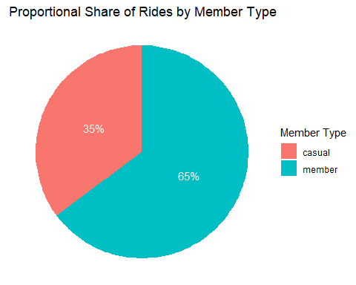
Descriptive Analysis(Analyze)
Now that the data has been cleaned and transformed, it’s time to analyze it to uncover meaningful insights. Here’s how the analysis was conducted, the findings, and their implications:
1. Proportional Share of Rides by Member Type
To understand the distribution of rides between casual riders and annual members, I calculated the proportional share of rides by member type. The results showed that annual members account for approximately 64.8% of the rides, while casual riders make up 35.2%. This distribution highlights that while annual members contribute to a larger portion of the rides, casual riders still represent a significant segment.
## # A tibble: 2 × 3 ## member_casual total_rides proportion ## <chr> <int> <dbl> ## 1 casual 1486099 0.352 ## 2 member 2740010 0.648
A pie chart below was created to visually represent the proportional share of rides. This chart clearly illustrates the dominance of annual members in the bike-share program.

Slide 7
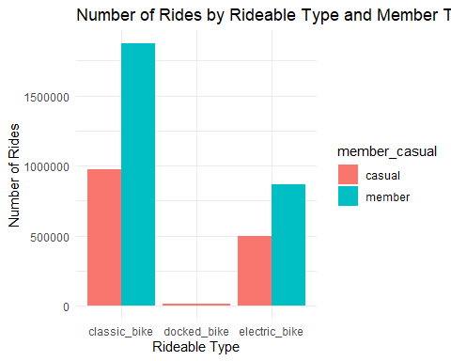
2. Analysis of Short Rides
Short rides, defined as those with a duration of less than 60 seconds, were analyzed to understand their prevalence among different member types. The analysis revealed that casual riders had a higher count of short rides (16,130) compared to annual members (30,724). This suggests that casual riders may be engaging in more short trips, which could reflect different usage patterns compared to annual members.
## # A tibble: 2 × 2 ## member_casual count ## <chr> <int> ## 1 casual 16130 ## 2 member 30724
3. Rideable Type Analysis by Member Type
The distribution of rideable types (classic bikes, docked bikes, and electric bikes) was analyzed by member type. The results showed that annual members predominantly use classic bikes (1,872,074 rides) and electric bikes (867,936 rides), while casual riders favor classic bikes (973,720 rides) and electric bikes (496,948 rides). The presence of docked bikes in casual rides suggests they are used more for specific types of trips or locations.
## # A tibble: 5 × 3 ## member_casual rideable_type ride_count ## <chr> <chr> <int> ## 1 casual classic_bike 973720 ## 2 casual docked_bike 15431 ## 3 casual electric_bike 496948 ## 4 member classic_bike 1872074 ## 5 member electric_bike 867936
A bar chart was created to display the number of rides by rideable type and member type. This chart helps in understanding which bike types are preferred by each group.

Slide 8
Summary of Analysis
Proportional Share of Rides: Annual members account for a majority of the rides (64.8%), indicating they are the primary users of the bike-share service.
Short Rides Analysis: Casual riders have a higher count of short rides compared to annual members, suggesting a difference in usage patterns.
Rideable Types: Both casual riders and annual members prefer classic and electric bikes, with annual members showing a higher overall usage of these types.
These insights reveal distinct usage patterns between casual riders and annual members, providing a foundation for targeted marketing strategies aimed at converting casual riders into annual members. Understanding these patterns will help tailor promotions and improve member engagement.

Slide 9
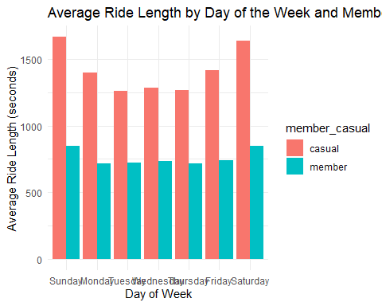
Analyzing Trends and Insights
In this section, I delved into the various trends and insights derived from the Cyclistic bike-share data. This analysis aims to uncover patterns in bike usage that could inform strategic decisions for enhancing user experience and optimizing service delivery.
1. Average Ride Length by Day of the Week
Casual riders consistently have longer ride lengths compared to annual members across all days.
On Sundays, casual riders have an average ride length of approximately 1666 seconds, whereas annual members have an average of about 846 seconds.
This indicates that casual riders might be using the bikes for longer trips, possibly for leisure or exploration, while annual members might be using them for shorter, more frequent trips.
A bar plot below illustrates these differences, highlighting the variation in average ride length between casual and annual members throughout the week.
## Don't know how to automatically pick scale for object of type <difftime>. ## Defaulting to continuous.

Slide 10
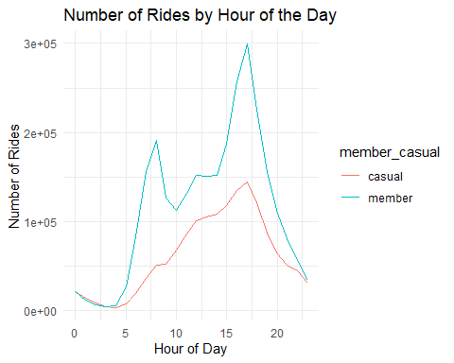
2. Number of Rides by Hour of the Day
The hourly ride analysis indicates that bike usage peaks during the late morning and early evening hours for both member types.
Casual riders have a consistent number of rides throughout the day but show significant peaks around 8-9 AM and 5-6 PM.
Annual members also exhibit peaks at these times but generally have a more consistent usage pattern throughout the day.
## # A tibble: 48 × 3 ## hour_of_day member_casual ride_count ## <int> <chr> <int> ## 1 0 casual 21825 ## 2 0 member 21168 ## 3 1 casual 14501 ## 4 1 member 11993 ## 5 2 casual 8588 ## 6 2 member 6605 ## 7 3 casual 4643 ## 8 3 member 4397 ## 9 4 casual 3485 ## 10 4 member 5756 ## # ℹ 38 more rows

Slide 11
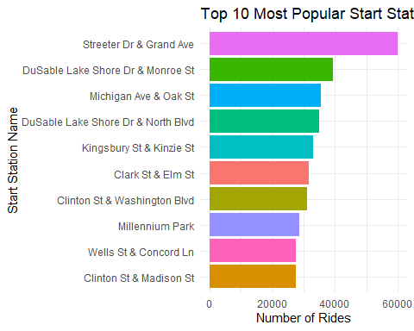
3. Most Popular Start and End Stations
The analysis identified the top 10 most popular start and end stations. The most frequented start station is “Streeter Dr & Grand Ave,” and the most frequented end station is the same location. These stations serve as key hubs for bike-share activity.
Start Stations: A bar plot shows the top start stations.

Slide 12
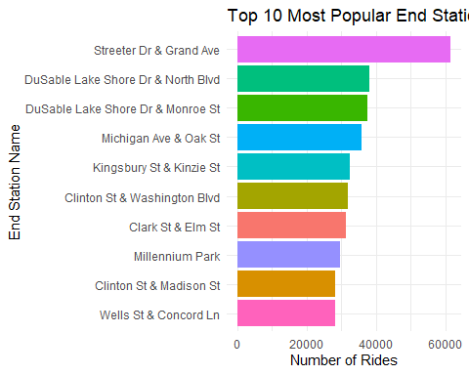
End Stations: A similar bar plot displays the top end stations.

Slide 13
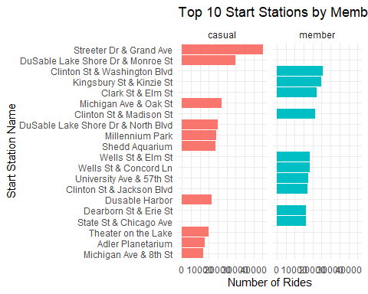
4. Top Stations by Member Type
Breaking down popular start and end stations by member type revealed differences in preferences. For instance, annual members favor stations closer to their residences or regular routes, while casual riders might use different stations depending on their specific trip needs.

Slide 14
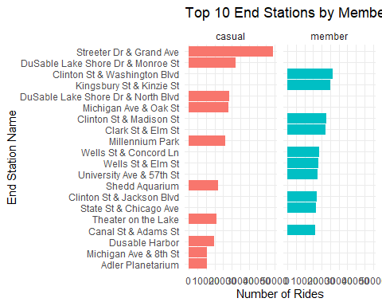

Slide 15
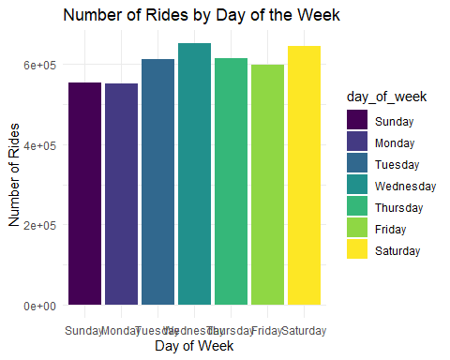
5. Ride Frequency by Day of the Week
The analysis of ride frequency by day of the week shows that bike usage is relatively high on weekdays, peaking in midweek. Saturdays and Sundays also see high usage, which could be indicative of leisure or recreational rides during the weekends.

Slide 16
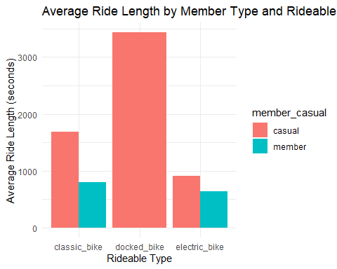
6. Member vs. Casual Usage Patterns
The analysis showed that casual riders have longer average ride durations for classic and docked bikes compared to annual members. Annual members have shorter ride durations across all bike types, suggesting more frequent but shorter trips.
A bar plot illustrates average ride duration by rideable type and member type.
## Don't know how to automatically pick scale for object of type <difftime>. ## Defaulting to continuous.

Slide 17
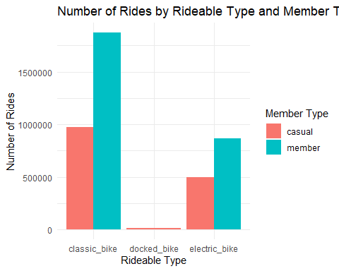
7. Bike Usage by Type and Member Type
The analysis of ride counts by rideable type and member type shows distinct patterns in bike utilization:
Classic Bikes: Annual members used classic bikes significantly more (1,872,074 rides) compared to casual riders (973,720 rides).
Electric Bikes: Electric bikes were more popular among casual riders (496,948 rides) than annual members (867,936 rides).
Docked Bikes: Docked bikes had a relatively low usage overall, with casual riders using them 15,431 times.

Slide 18
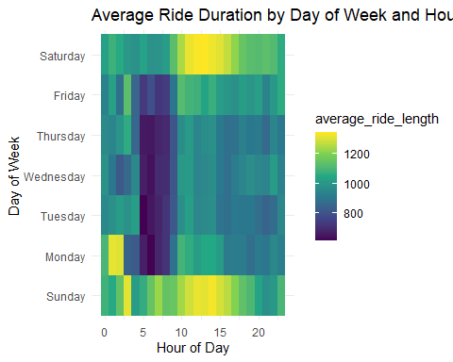
The visualization of this data using a bar chart reveals that classic bikes are preferred by annual members, while casual riders lean more towards electric bikes. This suggests that classic bikes are a staple for long-term users, while casual riders may seek the added convenience of electric bikes.
8. Average Ride Duration by Day of Week and Hour
The analysis of average ride duration by day of week and hour of the day provides insights into when riders take longer trips. For example:
Ride durations vary significantly across different hours of the day and days of the week.
Longer rides tend to occur during certain hours, indicating potential peak usage times or periods when riders may have more leisure time.

Slide 19
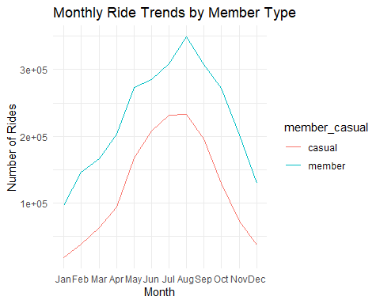
The heatmap visualization highlights these patterns, with brighter colors representing longer ride durations. This information can help optimize bike availability and identify times when additional support might be needed.
9. Monthly Ride Trends
Monthly ride trends reveal fluctuations in bike usage over the year:
Ride counts increase in warmer months, with May showing the highest number of rides.
There is a noticeable seasonal pattern, with casual riders showing greater variability across months compared to annual members, who maintain more consistent usage throughout the year.
The line graph demonstrates these trends, emphasizing the importance of adjusting marketing strategies and service levels according to seasonal demand.

Slide 20

10. Average Ride Duration by Rideable Type
The comparison of average ride duration across different bike types and member categories shows:
Classic bikes generally have a higher average ride duration compared to electric bikes.
Casual riders tend to take longer trips on both classic and electric bikes compared to annual members.
This bar chart indicates that classic bikes are associated with longer rides, suggesting that they might be preferred for extended journeys.
## Don't know how to automatically pick scale for object of type <difftime>. ## Defaulting to continuous.

Slide 21
start_station_name | station_rides | unique_bikes
Streeter Dr & Grand Ave | 60023 | 60021
DuSable Lake Shore Dr & Monroe St | 39309 | 39309
Michigan Ave & Oak St | 35455 | 35454
DuSable Lake Shore Dr & North Blvd | 34916 | 34916
Kingsbury St & Kinzie St | 33038 | 33038
Clark St & Elm St | 31727 | 31727
Clinton St & Washington Blvd | 31150 | 31150
Millennium Park | 28542 | 28541
Wells St & Concord Ln | 27620 | 27613
Clinton St & Madison St | 27470 | 27470
11. Station Utilization
The analysis of station utilization reveals the most popular bike stations:
The top station, “Streeter Dr & Grand Ave,” had the highest number of rides (60,023).
Other highly utilized stations include “DuSable Lake Shore Dr & Monroe St” and “Michigan Ave & Oak St.”
The data shows that certain stations experience significantly higher usage, which can inform decisions about station maintenance and placement of additional resources.
Top 10 Most Utilized Stations

Slide 22
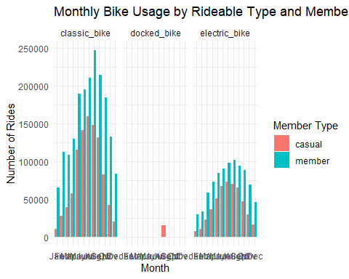
Bike usage by time of year, rideable type, and member type
Analyzing the data on bike usage by time of year, rideable type, and member type, several key insights emerge that can shape our understanding of rider behavior:

Slide 23
Seasonal Preferences: The data shows that usage of both classic and electric bikes increases significantly during the warmer months (May to September). This trend is consistent across both casual riders and members, with peak usage observed in July and August.
Rideable Type Trends: Classic bikes are the most popular type among both casual riders and members throughout the year. However, electric bikes see a notable increase in usage during the colder months (January to March), particularly among members, suggesting that the convenience and speed of electric bikes may be more appealing during less favorable weather conditions.
Member vs. Casual Riders: Members consistently account for a higher number of rides compared to casual riders across all months and bike types. However, casual riders show a relatively higher usage of electric bikes during peak summer months, indicating that they might be more willing to pay a premium for a faster ride during the busiest periods.
Impact of Winter: During the winter months (November to February), bike usage declines sharply, with a more pronounced drop in casual rider numbers. Members, however, continue to use both classic and electric bikes, albeit at lower rates, suggesting a higher level of commitment or necessity among this group.
Conclusion:
These insights suggest that marketing efforts to convert casual riders to members could focus on highlighting the year-round benefits of membership, particularly the accessibility of electric bikes during winter. Additionally, promoting the advantages of classic bikes during the summer could help attract more casual riders during peak periods.

Slide 24
Final Conclusion
From the analysis, it is clear that there are significant differences in the way annual members and casual riders use Cyclistic bikes. Annual members take shorter rides on average and are more consistent in their usage throughout the week. Casual riders, on the other hand, tend to have longer ride durations and a higher concentration of rides during weekends and late hours. The classic bikes are most popular among both user types, but casual riders also have a notable preference for electric bikes.

Slide 25
Application of Insights
Cyclistic can leverage these insights to design targeted marketing strategies and improve service offerings. By understanding the patterns of usage, Cyclistic can offer tailored promotions to casual riders that encourage them to become annual members. Additionally, the company can optimize the availability of bike types according to the preferences and peak times of different rider groups.

Slide 26
Next Steps
Targeted Marketing Campaigns: Develop and launch marketing campaigns that highlight the benefits of membership, particularly focusing on how it suits the casual riders’ usage patterns.
Service Optimization: Adjust bike availability and station resources to cater to the peak usage times and preferences identified in the analysis.
Further Data Collection: Consider collecting more detailed data on ride purpose and user demographics to refine the marketing strategies further.

Slide 27
Top Three Recommendations
Launch Weekend Membership Deals: Since casual riders are more active during weekends, Cyclistic could introduce special weekend membership plans or promotions to incentivize casual riders to commit to a membership.
Promote Electric Bikes with Membership: Electric bikes are popular among casual riders. Cyclistic could promote memberships that offer exclusive benefits for electric bike usage, such as reduced rates or priority access.
Increase Marketing During Late Hours: The data shows that casual riders have a higher usage rate during late hours. Cyclistic could focus on marketing efforts during these hours, perhaps with special offers that appeal to late-night riders.

Slide 28
Overall Conclusion
In this case study, I analyzed the usage patterns of annual members and casual riders of Cyclistic, a bike-share company in Chicago. The analysis involved cleaning and manipulating a large dataset to uncover key insights, such as the differences in ride duration, bike preferences, and peak usage times between the two groups. The findings revealed that while annual members tend to use bikes more consistently, casual riders are more likely to take longer rides, especially on weekends and late at night. Based on these insights, I have proposed three recommendations aimed at converting casual riders into loyal members through targeted marketing and optimized service offerings.

