Slide 1
Intern Seeker
Through ICT to a better life & society

Slide 2


Introduction
We provide general information
of companies
in this section.
This section will provide users about experience of internship students.

Slide 3


Users can view CV forms, then save and apply.
You can see their memorable and enjoyable moments .

Slide 4
Objectives
To solve problems for intern seekers in searching companies
To support intern seekers for right choice
To obtain a company which provides the opportunity and new experiences

Slide 5
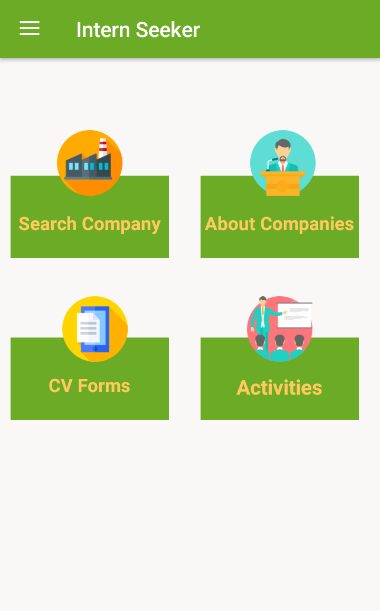
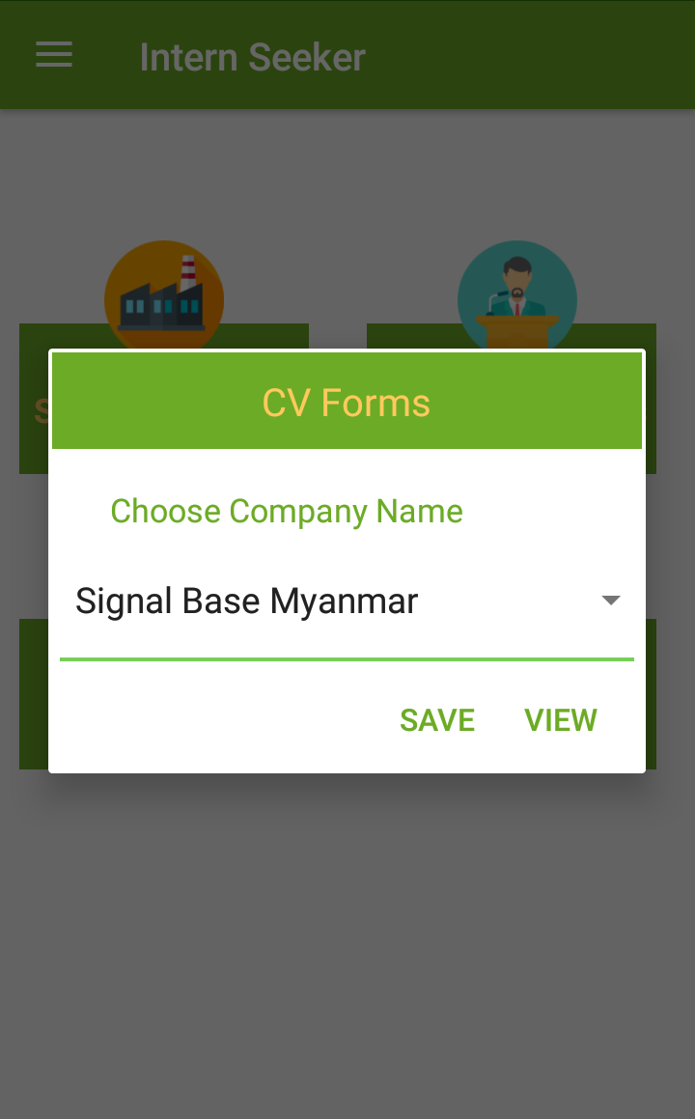
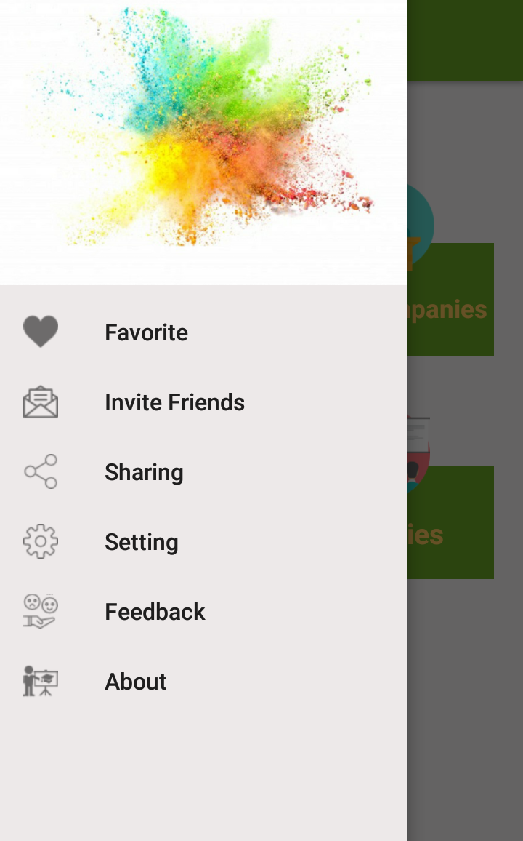
Features
Four different functions include
Share & invite friends about app
t/
To view CV forms

Slide 6
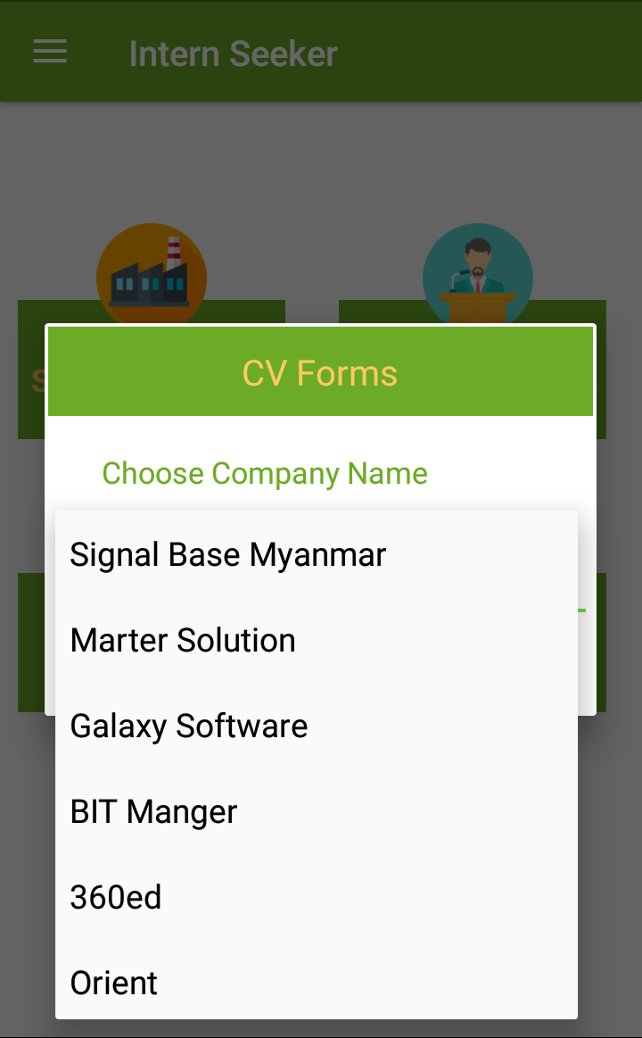
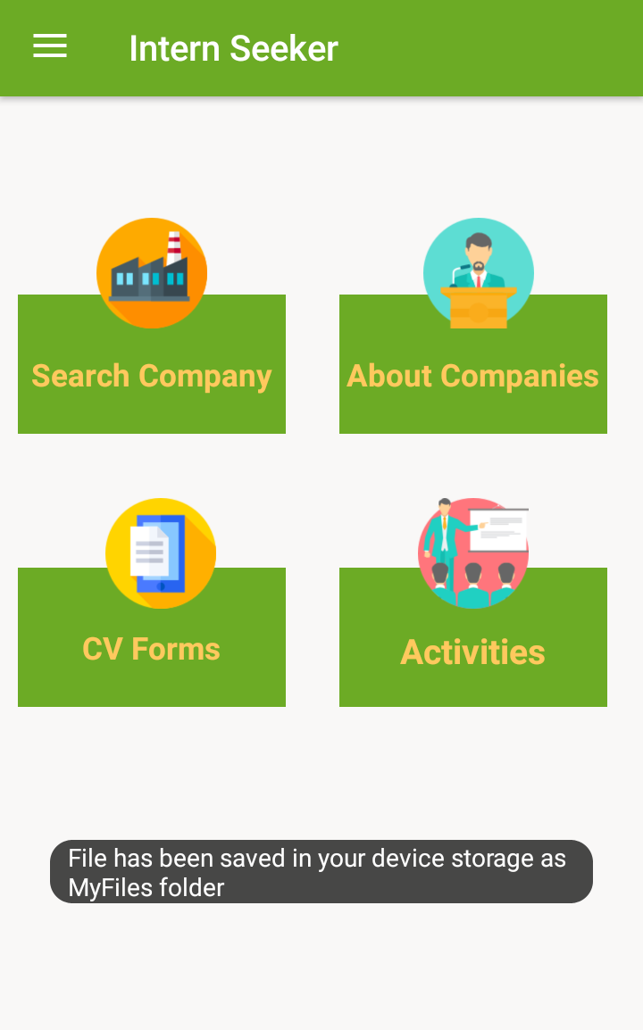
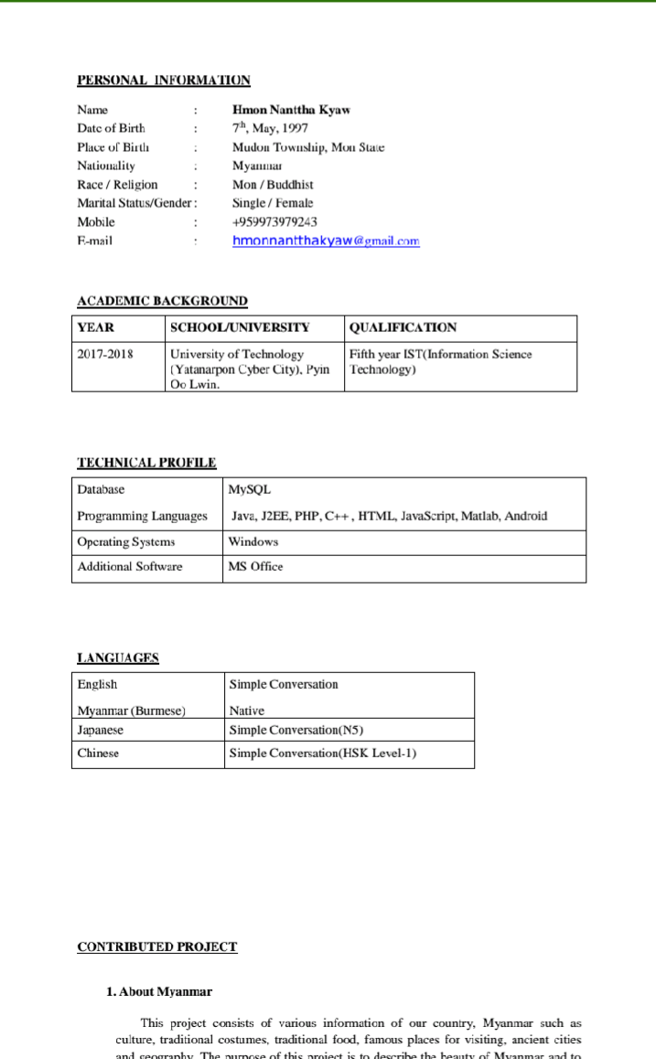
Choose company you want to apply
After saving to your storage
SS
Standard form for IST students

Slide 7
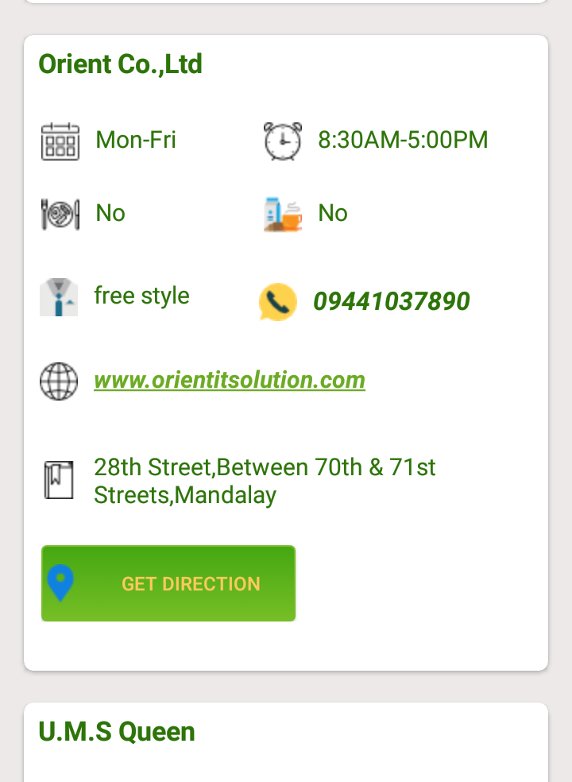
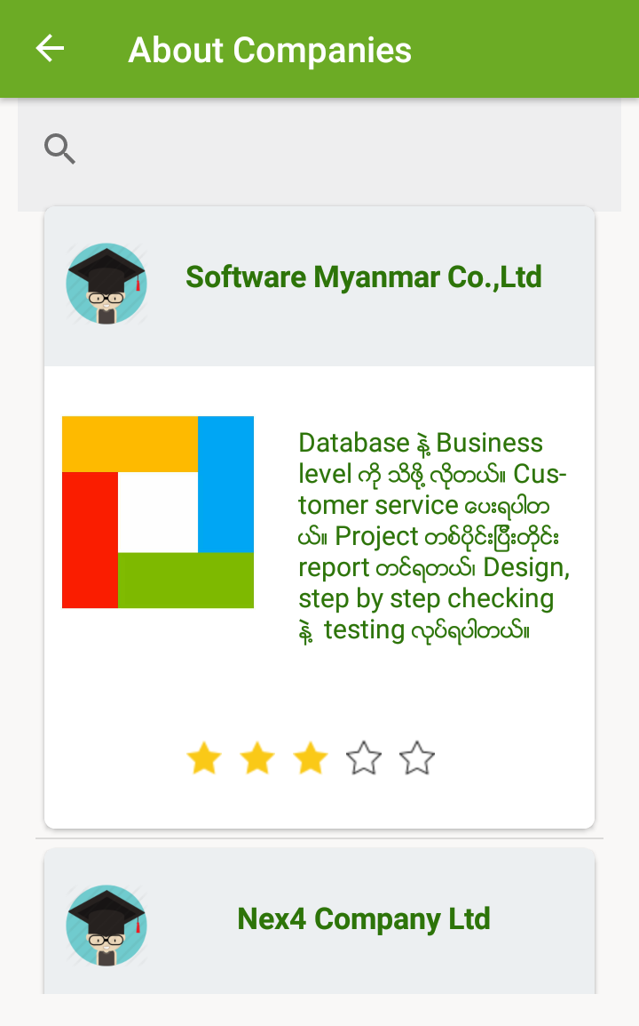
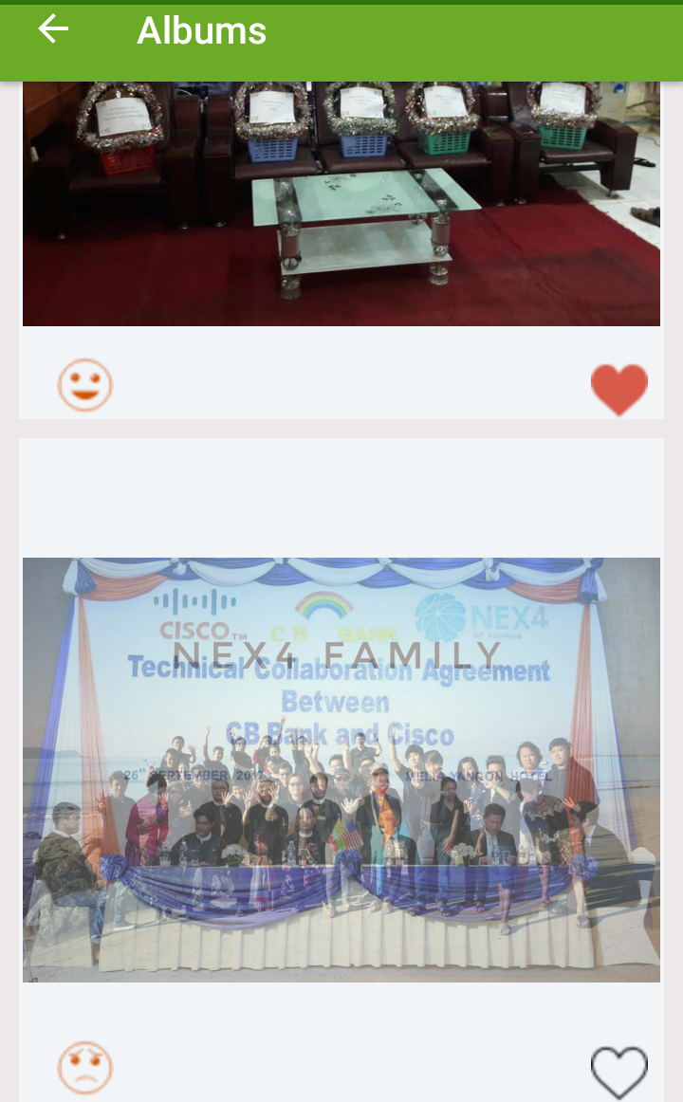
Get information of each company
Briefly describe about company & can also search
Activities of company

Slide 8
What problems have our students for choosing their intern company..?
Some Students don’t receive enough knowledge and experiences. So by using our app, we believe that students can choose the right company for themselves.
We have provided company partners in one app for more convenient
Target
IST students from UT(YCC) who discovers company for their interns

Slide 9
Application Summary
In conclusion, users can
Search company by name
Invite, share to their beloved friends
Know advantages and disadvantages of companies
Save sample forms
View company’s activities
We have tried the best for our IST students to apply intern in their future.
There are still needs in our app, but we are trying to become better.

Slide 10
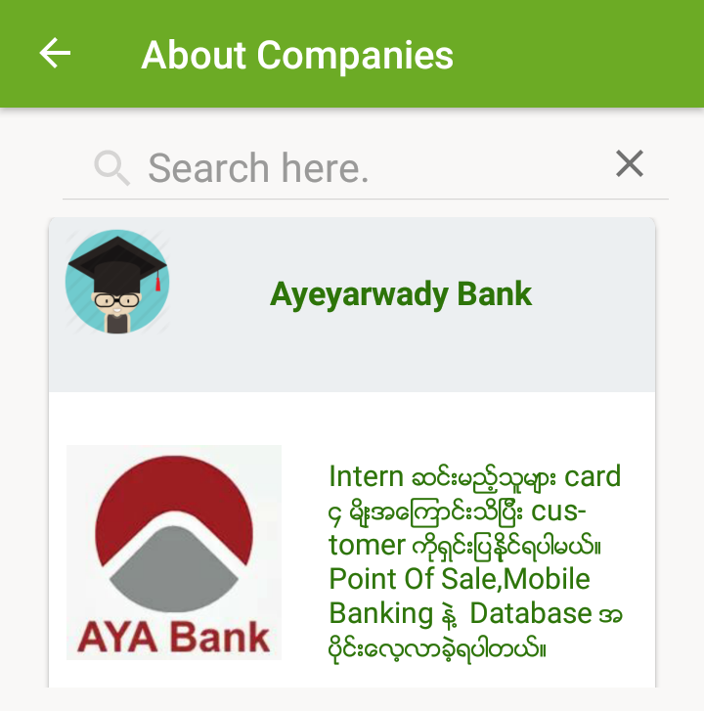



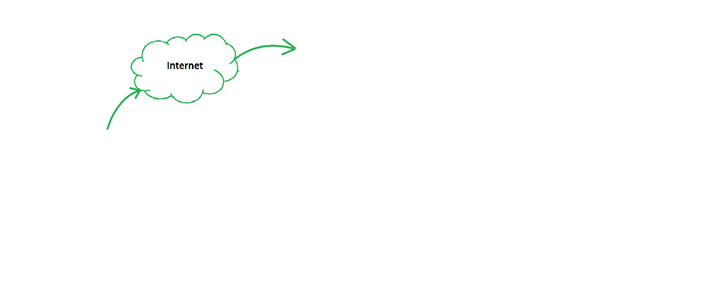

Future plan
Insert new company
Use app
Right Carrier
Delete

Slide 11




Developed By
Seng Nu Pan
5IST-6
Hnin Su Nyein
4IST-38
Hmon Nathar Kyaw
5IST-4
Su Yati Myint
4IST-60

Slide 12
Thank You

Slide 13
Question & Answer?

