Slide 1
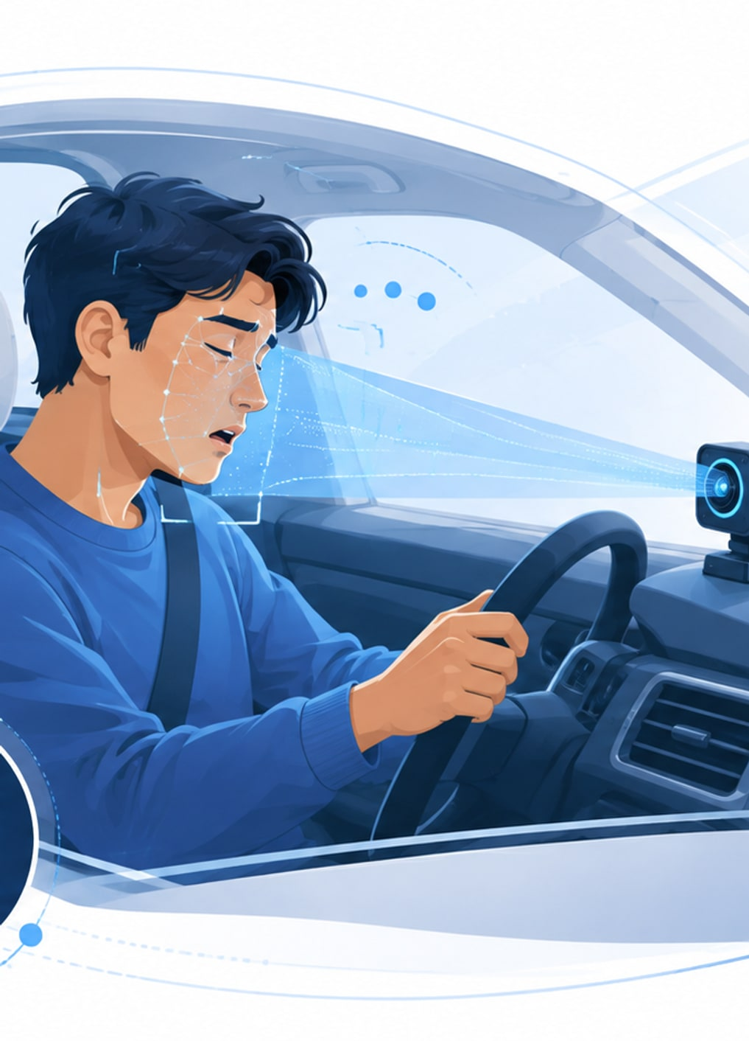
IoT: Technology and Application
Drowsy Guard
A low-cost IoT system for driver drowsiness detection
An ESP32-S3 vision device that watches for closed eyes, long blinks, yawning and head nodding, then speaks a warning - on the device, with no cloud and no internet.
Programme
Master of IT Engineering (MITE), Cohort 19
Institution
Royal University of Phnom Penh - evening, weekdays
Lecturer
Dr. Chey Chan Oeurn
Team Seng Phirum (leader) · Seang Chanviwath · Suon Mesa · Theng Rathrongroeung · Lov Kimheng
Research proposal presentation · August 2026
Notes:
Drowsy Guard - MITE Cohort 19 research proposal. One sentence framing: many older vehicles in Cambodia have no driver monitoring at all, and a USD 27 device that runs entirely offline can retrofit one. Say up front that this is a research prototype, not a certified safety device.

Slide 2
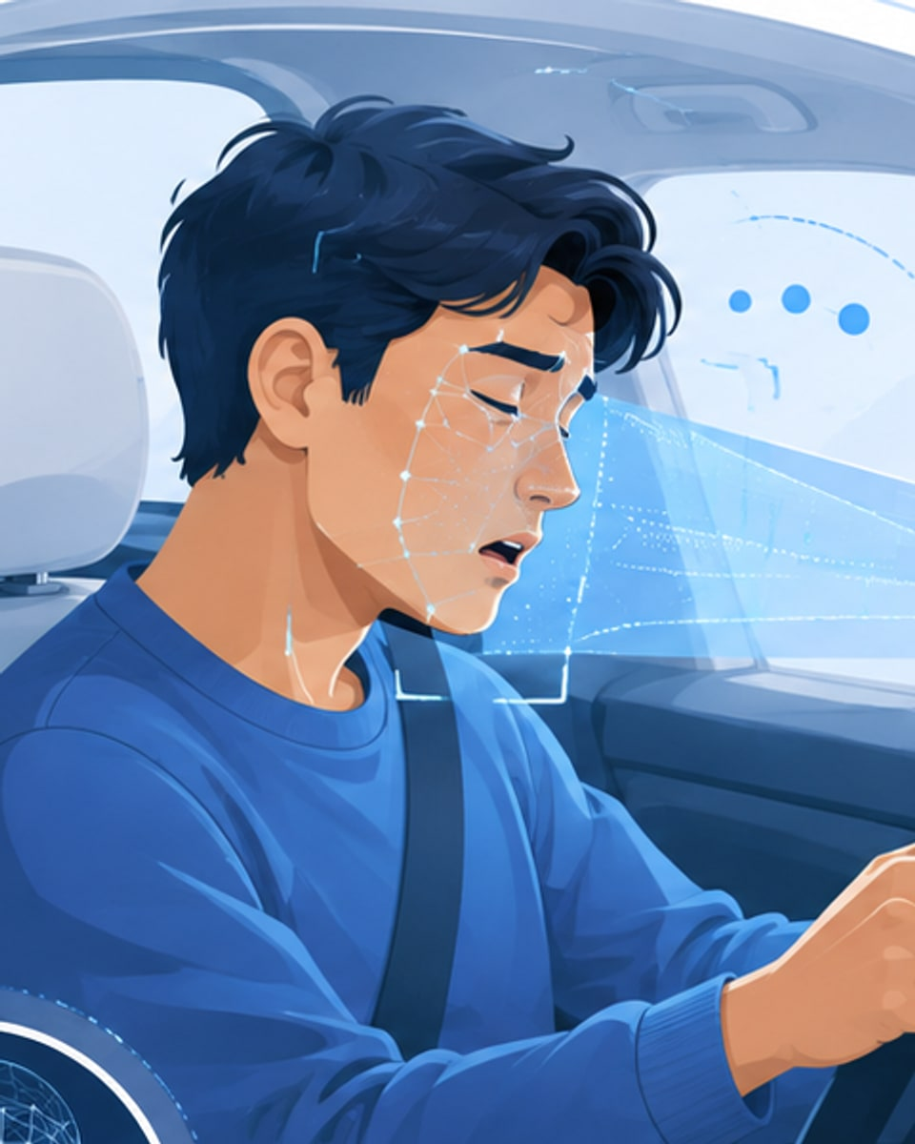




Concept - four visible signs, confirmed over time
A single closed-eye frame is not drowsiness. Every sign is measured as a duration.
Eye closed
≥ 1.0 s
Sustained closure - a blink that never comes back.
microsleep
Long / slow blink
> 0.4 s
The eyelid slows down before the driver does.
per blink
Yawning
≥ 1.2 s
Mouth held open far longer than speech or chewing.
mouth open
Head nodding
0.3 - 1.5 s
Down-and-back, against the driver’s own baseline.
per nod
One sign is never enough. Risk fuses all four - PERCLOS 55% · long blink 20% · yawn 15% · head nod 10% - and a sneeze suppresses the alert instead of firing it.
Notes:
The whole design rests on this slide: drowsiness is a duration, not a frame. Thresholds shown are the literature-informed defaults now in the firmware (MICROSLEEP_MIN_S 1.0, BLINK_MAX_S 0.4, YAWN_MIN_S 1.2, NOD 0.3-1.5 s). They are unit-tested on synthetic traces but not yet tuned on labelled video - say so if asked. Sneeze detection exists to SUPPRESS a false alert: a sneeze shuts the eyes for about a second with a head jerk, and would otherwise read as a microsleep.

Slide 3






Flow - how one alert is made
Five steps, all of them on the device. Nothing in the alert path touches the network.
01
02
03
04
05
See
Find
Measure
Confirm
Warn
The OV5640 captures the driver’s face at 240 × 240.
Face plus five landmarks. Detect every 3rd frame, track in between.
Eye model every frame → PERCLOS. Yawn, nod and roll come from the landmarks.
Risk must hold ≥ 0.72 for 8 frames in a row. One frame never alerts.
A spoken warning names the cause: Drowsy, Microsleep, Yawning or HeadNod.
The alert never needs the internet. Capture, inference and warning all run on the ESP32-S3.
Wi-Fi is diagnostics only: risk, PERCLOS, event log and a speaker self-test in a browser.
Measured on hardware: 19.7 fps with no face in view, 10.7 - 13.6 fps while a face is tracked.
Notes:
Walk left to right once, then make the two points that matter to a reviewer. 1) Step 4 is the research contribution: a temporal filter, not a single-frame alarm. Risk >= 0.72 sustained for 8 consecutive frames, then a 60-frame cooldown. 2) The preview is deliberately never load-bearing - if Wi-Fi dies, diagnostics degrade, safety does not.

Slide 4
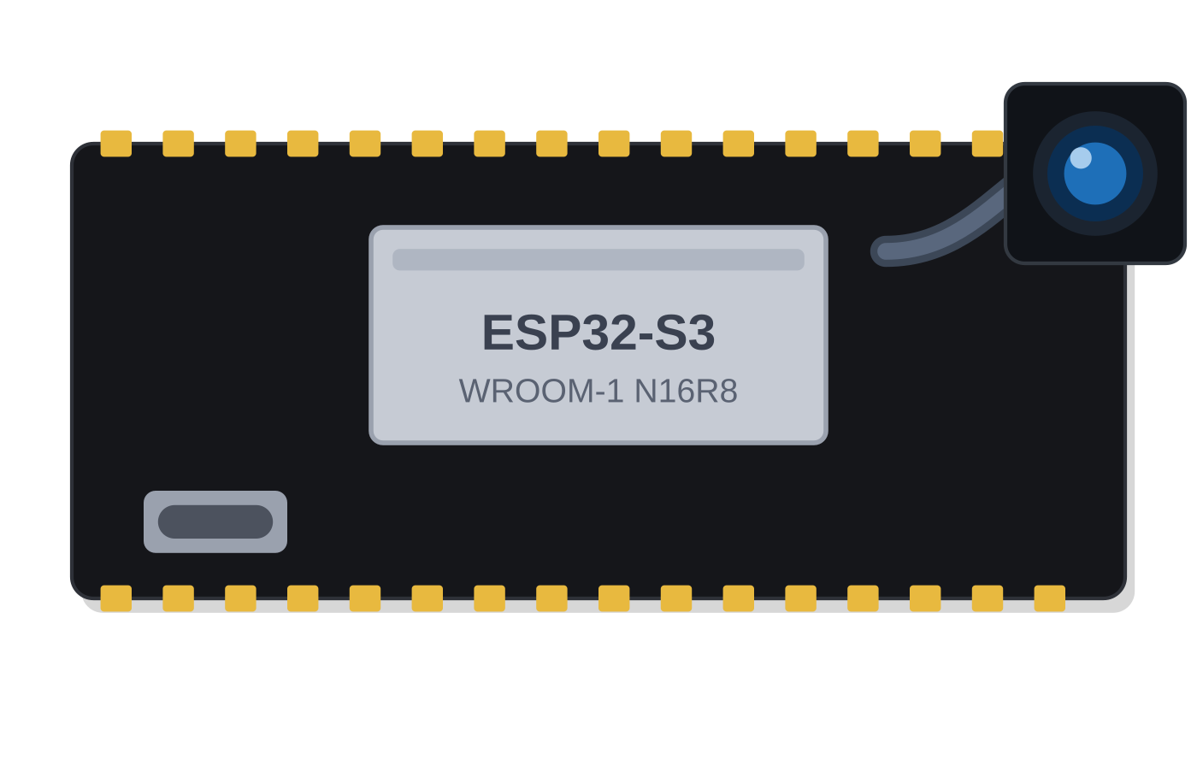
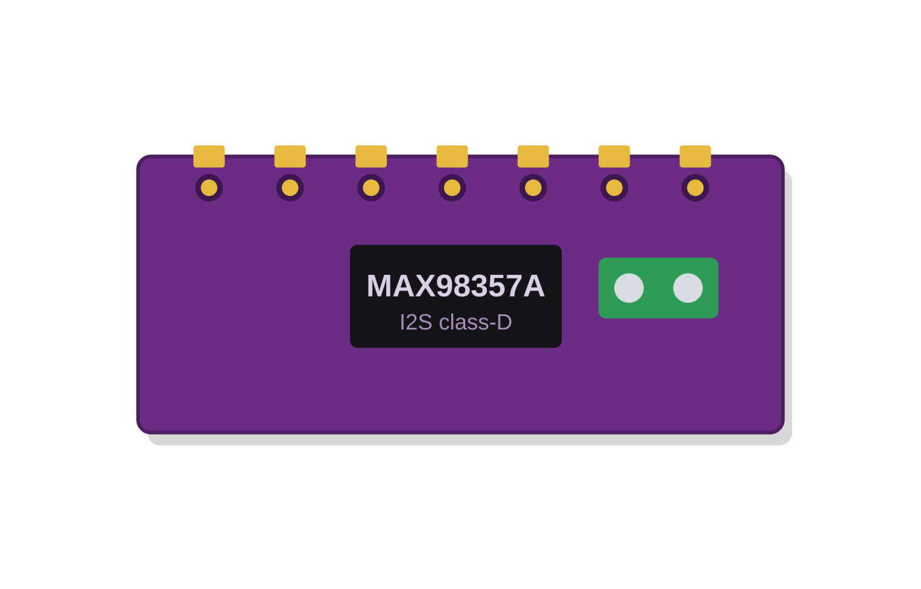
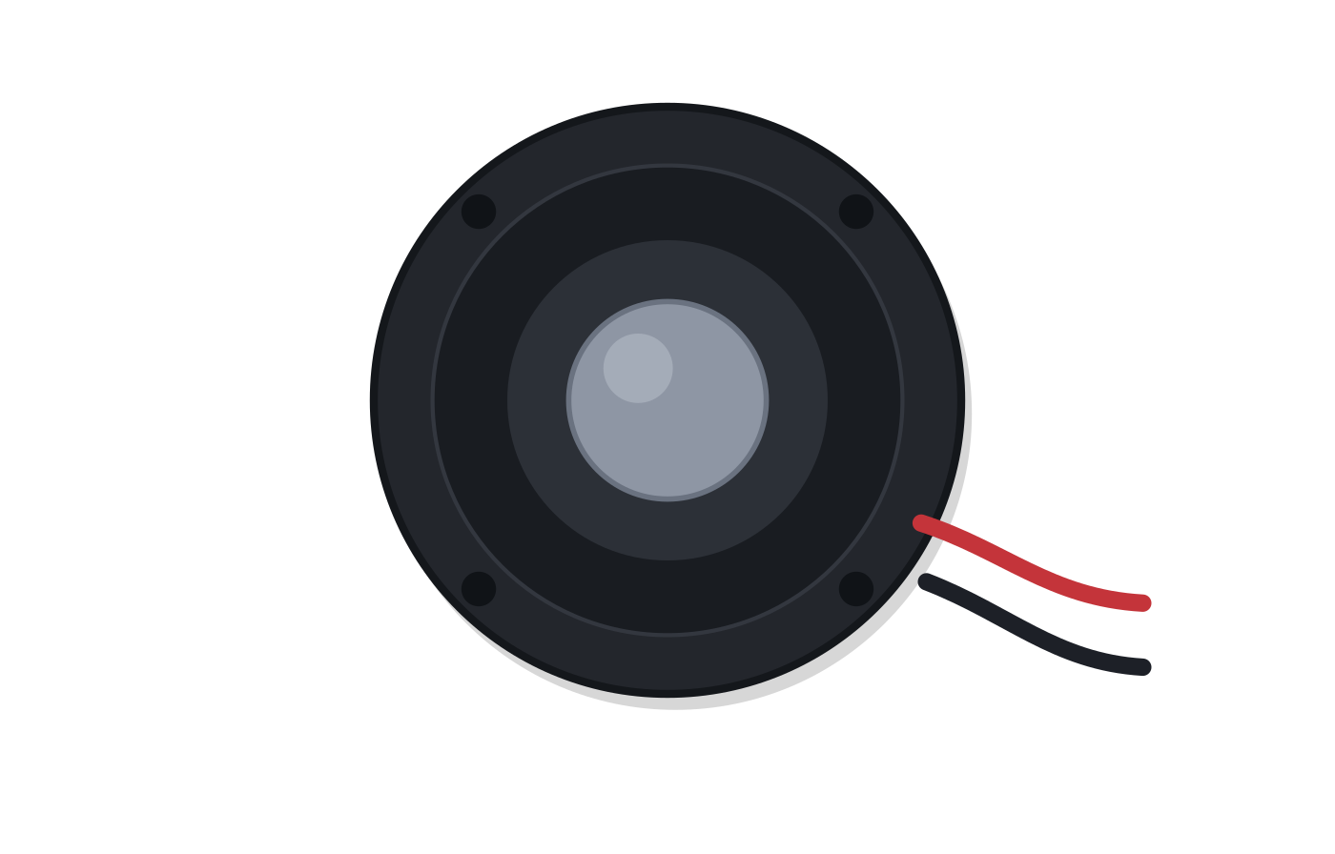
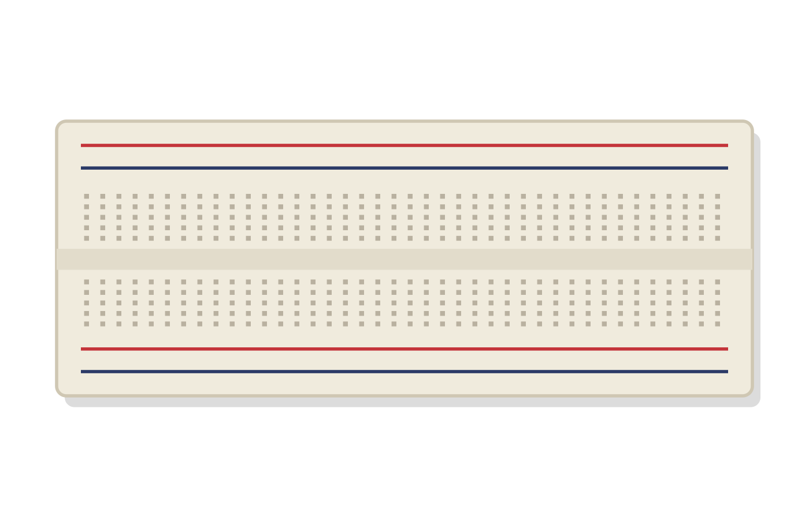
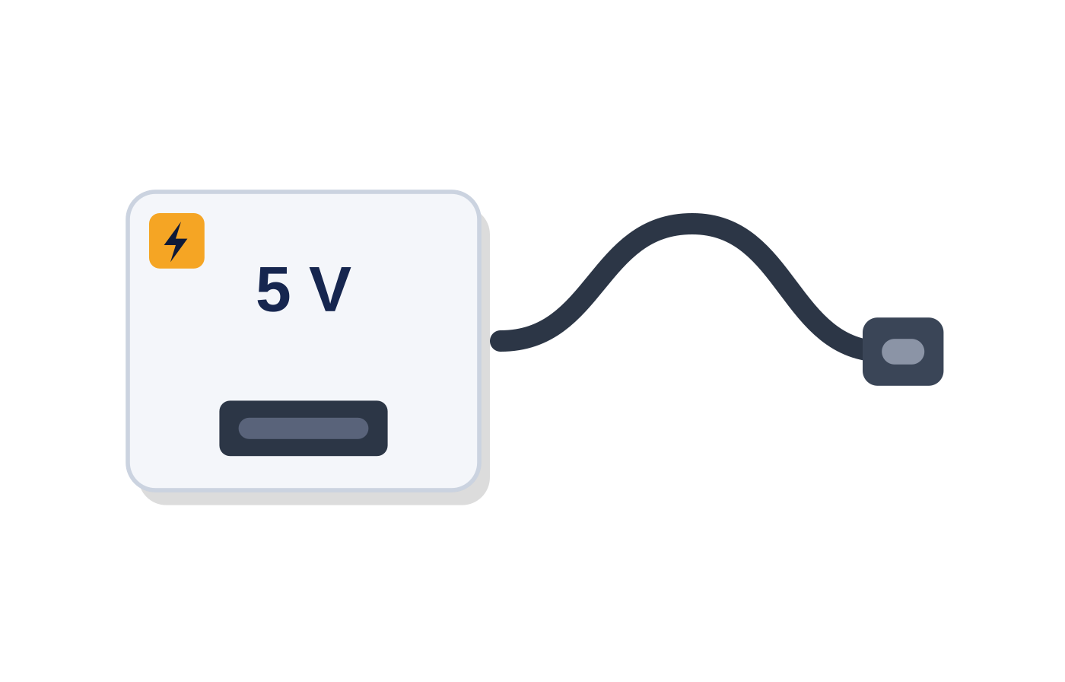
Equipment - five parts, about US$ 27
Everything is off-the-shelf and locally available. No custom board, no cloud subscription.
ESP32-S3 N16R8
camera board
MAX98357A
I2S amplifier
Speaker
4 Ω / 3 W
Breadboard
+ jumper wires
5 V USB supply
+ USB-C cable
Edge AI, Wi-Fi and the OV5640 sensor, all on one board.
Turns the decision into sound the driver can actually hear.
The only output the driver perceives - there is no screen.
MB102, 830 tie-points. Solderless, so the build can be redone in minutes.
Bench power and firmware flashing over one cable.
$7.50
$2.00
$0.75
$3.50
$3.50
US$ 27.25
complete research prototype. The five parts above come to US$ 17.25; the balance is an inline USB power meter and enclosure / mount materials for the tests. Laptop and phone are excluded - the team already owns them.
Cost basis: Appendix A of the project proposal.
Notes:
The cost is part of the argument, not a footnote: the target is a retrofit for older vehicles that have no driver monitoring, so the whole device has to stay inside a price a driver would pay. One honest note if asked: the board was advertised with an OV3660 and shipped with an OV5640. Same DVP pin map as the ESP32-S3-EYE, so the wiring and the published frame budget carried over unchanged.

Slide 5
Where it is now - first hardware run
Flashed to the board on 23 August 2026. These are measured numbers, not estimates.
19.7 fps
10.7 - 13.6
15.7 ms
Frame rate, no face in view
fps while tracking a face
One eye inference, on the board
39 ms
20 / 20
0.00 - 0.22
Full-frame face detection
Detections found, score 1.00
PERCLOS at rest - first live reading
Live preview screenshot
Face box, eye and mouth landmarks, risk bar,
PERCLOS and the event log at 192.168.4.1
[ drop the captured screenshot here ]
Working on hardware: 8 MB PSRAM, camera, I2S chime, its own Wi-Fi access point, face detector and live landmark overlay. Not yet exercised: an alert firing end to end, the cues against a real yawn or nod, and heap behaviour over hours. The open gap: the eye model runs, but scores AUC 0.62 on visible-light eyes. Accuracy is the remaining problem.
Notes:
Be precise about what is proven and what is not - a reviewer will ask. Proven: the board boots and the pipeline runs at a usable frame rate with the eye model bound. Two real bugs were only findable on hardware: the sensor is mounted upside down, so vflip left the frame horizontally mirrored, which reversed the eye pair and inverted every vertical cue - the yawn cue had never been able to fire. Fixed; the detection gate now reports ok on every detection. ACTION: replace the dashed panel with the live screenshot before presenting.

Slide 6

Conclusion - the effort now goes into the model
The team keeps its effort on training the lightweight on-device model. Camera, audio, Wi-Fi and face tracking are proven - every remaining risk in this project sits inside one small model.
Keep it light, by necessity
Train it in the right domain
Judge it per driver
The eye model is 11,250 parameters and 46 KB, and runs in 15.7 ms on the board. The most accurate public drowsiness models are 70 - 343 MB - they simply cannot run on an ESP32-S3. Small is the constraint, so small has to be made accurate.
The base model was trained on infrared eyes and scores only AUC 0.62 on our visible-light crops. Grayscale, histogram equalisation and CLAHE did not recover it. The next step is fine-tuning on visible-light eye-state labels, split by subject.
Never on an average. An earlier whole-face model looked strong at 0.81 overall but fell to 0.57 on drivers it had never seen - it had learned who the driver was, not whether the eyes were shut. Subject-independent splits only, from here on.
The targets that decide whether it worked
F1 ≥ 0.80
Recall ≥ 0.85
≤ 1 false alert / hour
Alert within 2 s
≥ 10 fps on device
Drowsy Guard is a research prototype, not a certified automotive safety device. It is not a substitute for rest.
Notes:
Close on the commitment: the team keeps pushing on training the light model, because that is the only thing between this and a working alarm. The three points are the method, not a wish list: keep the model small enough for the board, train it in visible light rather than infrared, and validate per driver on held-out subjects. End with the honest boundary - research prototype, controlled conditions only, no drowsy driving on public roads.

