Slide 1
MODULE 3
STATISTICS WITH R

Slide 2
Summary Statistics
To calculate mean – mean()
> mean(c(1,2,3,4,5,NA))
[1] NA
> mean(c(1,2,3,4,5,NA),na.rm=TRUE)
[1] 3
To calculate minimum – min()
To calculate maximum – max()
To calculate median – median()
To calculate percentile – quantile()
To calculate inter quartile range – IQR()
To get statistical summary – summary()

Slide 3
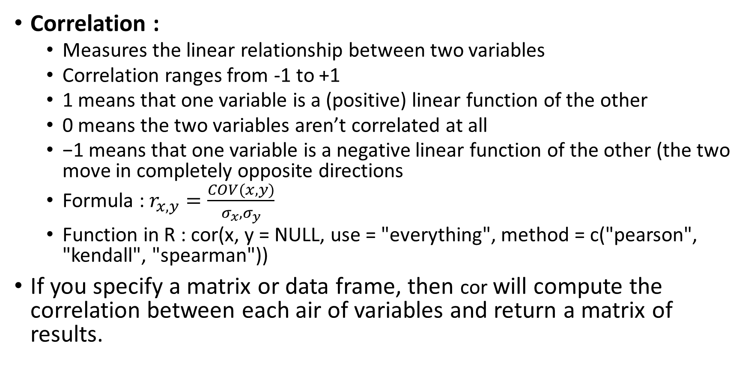
Correlation and Covariance
Correlation :
Measures the linear relationship between two variables
Correlation ranges from -1 to +1
1 means that one variable is a (positive) linear function of the other
0 means the two variables aren’t correlated at all
−1 means that one variable is a negative linear function of the other (the two move in completely opposite directions
Formula : $r_{x,y}=\frac{COV(x, y)}{σ_{x}, σ_{y}}$
Function in R : cor(x, y = NULL, use = "everything", method = c("pearson", "kendall", "spearman"))
If you specify a matrix or data frame, then cor will compute the correlation between each air of variables and return a matrix of results.

Slide 4
Correlation and Covariance
The use argument specifies how the function should treat NA values. If you want an error raised when values are NA, choose use="all.obs“
If you would like the result to be NA when an element is NA, choose use="everything".
To omit cases where values are NA, choose use="complete.obs". To omit cases where values are NA, but return NA if all values are NA, specify use="na.or.complete".
To omit pairs where at least one value is NA, choose use="pairwise.complete.obs".

Slide 5
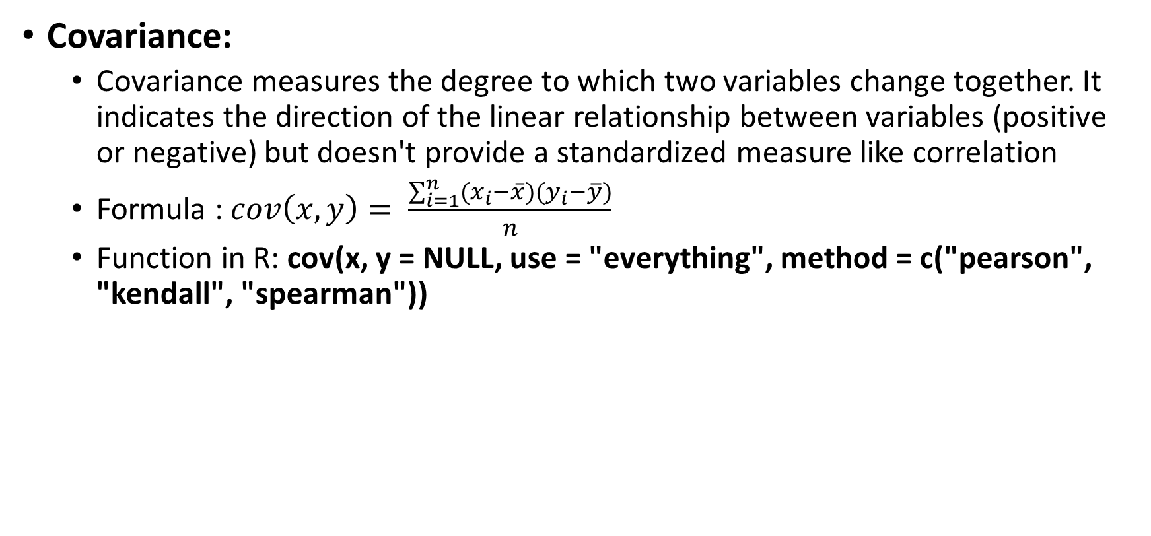
Correlation and Covariance
Covariance:
Covariance measures the degree to which two variables change together. It indicates the direction of the linear relationship between variables (positive or negative) but doesn't provide a standardized measure like correlation
Formula : $cov\left(x,y\right)= \frac{\sum_{i=1}^{n}{{(x}_{i}−\overline{x})(y_{i}−\overline{y})}}{n}$
Function in R: cov(x, y = NULL, use = "everything", method = c("pearson", "kendall", "spearman"))

Slide 6
Statistical Testing
Statistical testing is used in hypothesis testing
In hypothesis testing we evaluate two mutually exclusive statements on a population using a sample of data
They can be used to:
Determine whether a predictor variable has a statistically significant relationship with an outcome variable.
Estimate the difference between two or more groups

Slide 7
Statistical Testing
Steps in hypothesis testing:
Make Initial assumption (H0)
Collect data
Gather Evidence to reject or not reject the null hypothesis

Slide 8
Statistical Testing
Statistical tests assume a null hypothesis of no relationship or no difference between groups.
Then they determine whether the observed data fall outside of the range of values predicted by the null hypothesis.
Statistical tests work by calculating a test statistic –a number that describes how much the relationship between variables in your test differs from the null hypothesis of no relationship.
It then calculates a p value (probability value).
The p-value estimates how likely it is that you would see the difference described by the test statistic if the null hypothesis of no relationship were true.

Slide 9
Statistical Testing
If the value of the test statistic is more extreme than the statistic calculated from the null hypothesis, then you can infer a statistically significant relationship between the predictor and outcome variables.
If the value of the test statistic is less extreme than the one calculated from the null hypothesis, then you can infer no statistically significant relationship between the predictor and outcome variables.
For a statistical test to be valid, your sample size needs to be large enough to approximate the true distribution of the population being studied

Slide 10
Statistical Testing
How to determine which statistical test to use?
1. Whether your data meets certain assumptions
Statistical tests make some common assumptions about the data they are testing:
Independence of observations (a.k.a. no autocorrelation): The observations/variables you include in your test are not related (for example, multiple measurements of a single test subject are not independent, while measurements of multiple different test subjects are independent).
Homogeneity of variance: the variance within each group being compared is similar among all groups. If one group has much more variation than others, it will limit the test’s effectiveness.
Normality of data: the data follows a normal distribution (a.k.a. a bell curve). This assumption applies only to quantitative data

Slide 11
Statistical Testing
How to determine which statistical test to use?
If your data do not meet the assumptions of normality or homogeneity of variance, you may be able to perform a nonparametric statistical test, which allows you to make comparisons without any assumptions about the data distribution.
If your data do not meet the assumption of independence of observations, you may be able to use a test that accounts for structure in your data (repeated-measures tests or tests that include blocking variables).

Slide 12
Statistical Testing
2. The types of variables that you are dealing with
Quantitative vs categorical variables
Data is a specific measurement of a variable –it is the value you record in your data sheet. Data is generally divided into two categories:
Quantitative data represents amounts
Categorical data represents groupings
A variable that contains quantitative data is a quantitative variable; a variable that contains categorical data is a categorical variable. Each of these types of variables can be broken down into further types.
Quantitative variables
When you collect quantitative data, the numbers you record represent real amounts that can be added, subtracted, divided, etc. There are two types of quantitative variables: discrete and continuous.

Slide 13
Statistical Testing

Slide 14
Statistical Testing
Categorical variables
Categorical variables represent groupings of some kind. They are sometimes recorded as numbers, but the numbers represent categories rather than actual amounts of things.
There are three types of categorical variables: binary, nominal, and ordinal variables.

Slide 15
Statistical Testing
For Discrete Data
The two statistical tests which are most commonly used to analyze discrete variables are the chi-square test (including the chi-square test with Yates’ correction) and Fisher’s exact test.
CHI-SQUARE Test:
For these tests, degrees of freedom are used to determine if a certain null hypothesis can be rejected based on the total number of variables and samples within the experiment. As with any statistic, the larger the sample size, the more reliable the results.

Slide 16
Statistical Testing
For example, consider an imaginary coin with exactly a 50/50 chance of landing heads or tails and a real coin that you toss 100 times. If this coin is fair, then it will also have an equal probability of landing on either side, and the expected result of tossing the coin 100 times is that heads will come up 50 times and tails will come up 50 times.
In this case, χ2 can tell us how well the actual results of 100 coin flips compare to the theoretical model that a fair coin will give 50/50 results. The actual toss could come up 50/50, or 60/40, or even 90/10. The farther away the actual results of the 100 tosses are from 50/50, the less good the fit of this set of tosses is to the theoretical expectation of 50/50, and the more likely we might conclude that this coin is not actually a fair coin

Slide 17
Statistical Testing
For Continuous variable
Much of the statistical analysis in medical research, however, involves the analysis of continuous variables (such as cardiac output, blood pressure, and heart rate) which can assume an infinite range of values
As with discrete variables, the statistical analysis of continuous variables requires the application of specialized tests.
In general, these tests compare the means of two (or more) data sets to determine whether the data sets differ significantly from one another.
One-sample t-test
Paired t-test
ANOVA

Slide 18


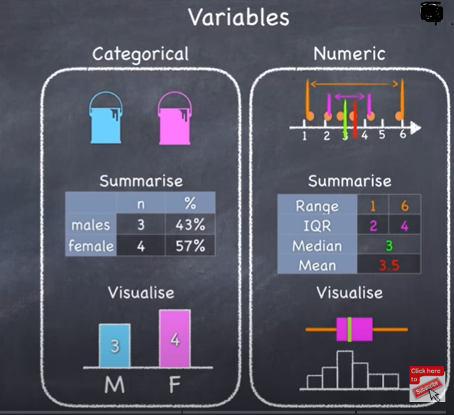

Statistical Testing

Slide 19
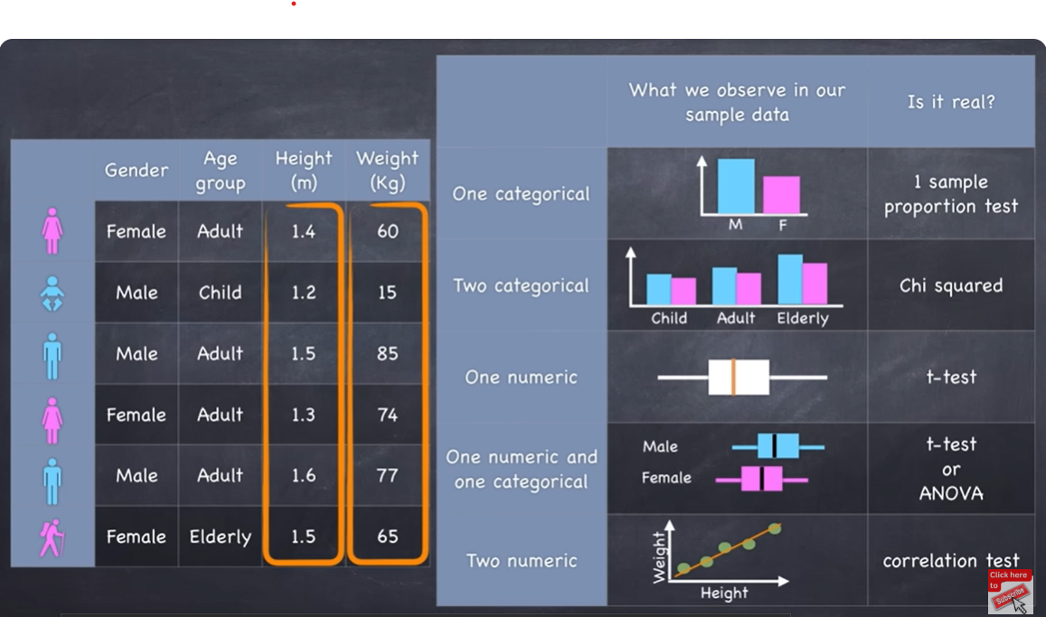
Statistical Testing

Slide 20
Statistical Testing
One sample t-test
The One Sample t-test, or student’s test, compares the mean of a vector against a theoretical mean
Formula :
- m refers to the mean
- Mu refer to the theoretical mean
- s is the standard deviation
- n the number of observations
To evaluate the statistical significance of the t-test, you need to compute the p-value. The p-value ranges from 0 to 1

Slide 21
Statistical Testing
A p-value lower than 0.05 means you are strongly confident to reject the null hypothesis, thus Ha is accepted.
A p-value higher than 0.05 indicates that you don’t have enough evidences to reject the null hypothesis.
Example:
Suppose you are a company producing cookies. Each cookie is supposed to contain 10 grams of sugar. The cookies are produced by a machine that adds the sugar in a bowl before mixing everything. You believe the machine does not add 10 grams of sugar for each cookie. If your assumption is true, the machine needs to be fixed. You stored the level of sugar of thirty cookies.

Slide 22
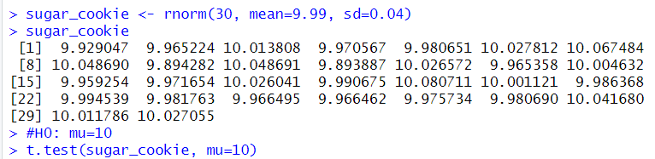
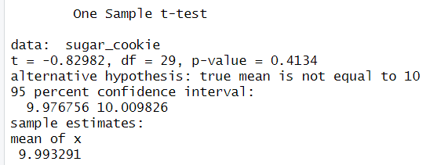
Statistical Testing

Slide 23
Statistical Testing
Two sample t-test
Also known as Independent sample t-test
Compares the means of two independent groups. (Independent means the observations in a group is not related to the observations in the other group)
Assumptions
The data in each group should be approximately normally distributed
The variances of the two groups should be approximately equal

Slide 24
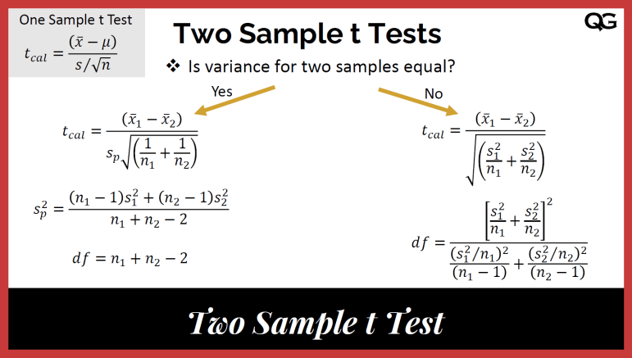
Statistical Testing

Slide 25

Statistical Testing
$α=0.05$
$H0 : μ_{A }=μ_{B}$
$HA: μ_{A }≠μ_{B}$
$t= \frac{{\overline{X}}_{A}−{\overline{X}}_{B}}{\sqrt{\frac{S_{A}^{2}}{n_{A}}}+\frac{S_{B}^{2}}{n_{B}}}$=

Slide 26
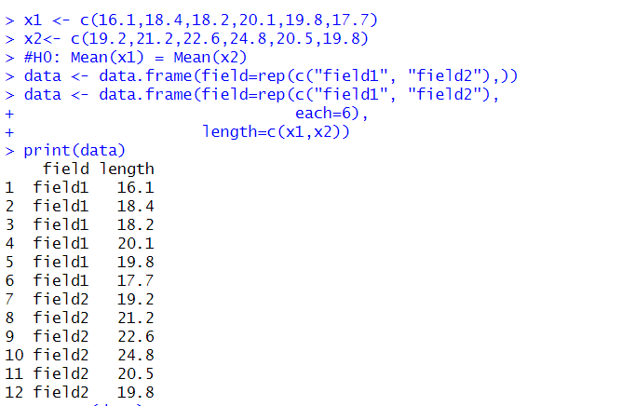
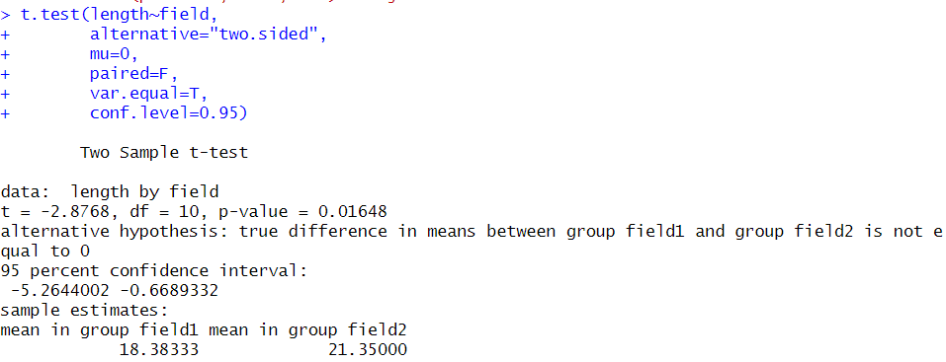
Statistical Testing
Example:

Slide 27
Statistical Testing
Paired t-test
The Paired T-test, or dependent sample t-test, is used when the mean of the treated group is computed twice.
The basic application of the paired t-test is:
A/B Testing: Compare two variants
Case Control Studies: Before/after treatment

Slide 28
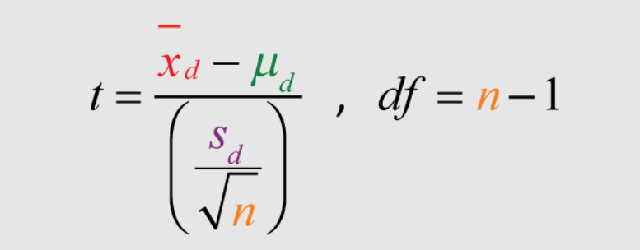
Statistical Testing

Slide 29
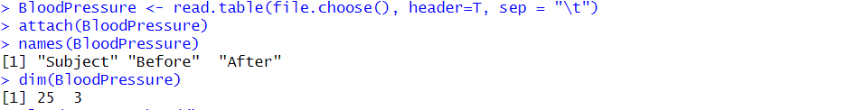
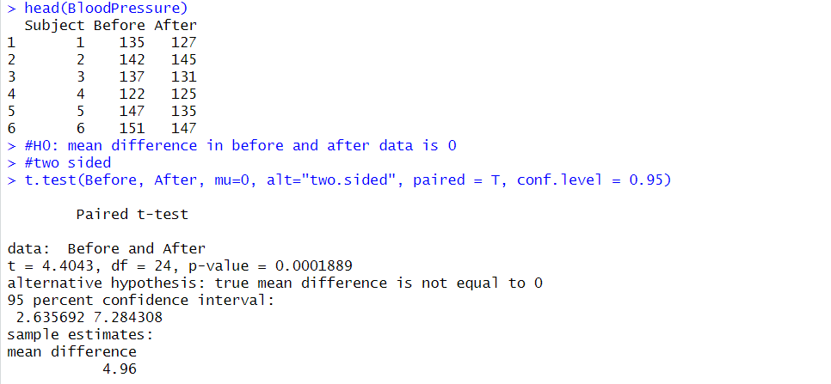
Statistical Testing

Slide 30
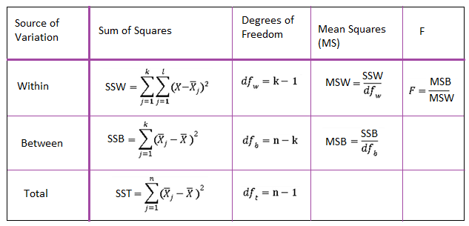
Statistical Testing
ANOVA
ANOVA (Analysis of Variance) is a statistical test to determine whether two or more population means are different. In other words it is used to compare two or more groups to see if they are significantly different.
In practice, however
Student t-test is used to compare 2 groups
ANOVA generalizes the t-test beyond 2 groups, so it is used to compare 3 or more groups

Slide 31
Statistical Testing
ANOVA
Although ANOVA is used to make inference about means of different groups, the method is called “analysis of variance”. It is called like this because it compares the “between” variance (the variance between the different groups) and the variance “within” (the variance within each group).
If the between variance is significantly larger than the within variance, the group means are declared to be different

Slide 32
Statistical Testing
Key Concepts:
Factors: These are the categorical independent variables that define the groups (e.g., different types of fertilizer, different teaching methods).
Levels: These are the specific categories within a factor (e.g., fertilizer A, fertilizer B, fertilizer C).
Dependent Variable: This is the continuous variable that you're measuring (e.g., crop yield, test scores).
Null Hypothesis (H0): The means of all groups are equal.
Alternative Hypothesis (Ha): At least one group mean is different from the others.

Slide 33
Statistical Testing
Types of ANOVA
One-Way ANOVA:
Used when you have one factor with multiple levels.
Example: Comparing the average crop yield of three different fertilizer types.
Two-Way ANOVA:
Used when you have two factors.
It allows you to examine the main effects of each factor and the interaction effect between them.
Example: Comparing crop yield based on fertilizer type and planting density.

Slide 34

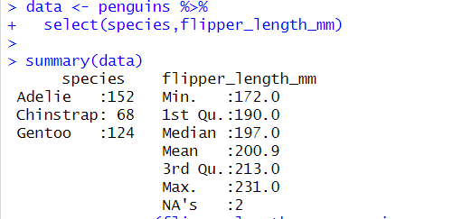
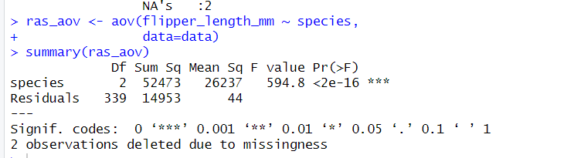
Statistical Testing
Example: One way ANOVA
Data for the present article is the penguins dataset
ANOVA in R can be done using aov() function

Slide 35
Statistical Testing
Given that the p-value is smaller than 0.05, we reject the null hypothesis, so we reject the hypothesis that all means are equal.
Therefore, we can conclude that at least one species is different than the others in terms of flippers length (p-value < 2.2e-16).

Slide 36
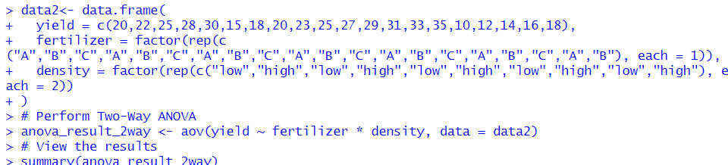
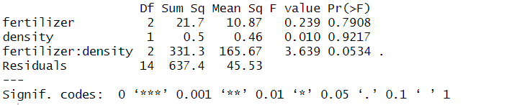
Statistical Testing
Example: Two way ANOVA:

Slide 37
Normal Distribution
Generally, it is observed that the collection of random data from independent sources is distributed normally
We get a bell shape curve on plotting a graph with the value of the variable on the horizontal axis and the count of the values in the vertical axis
The center of the curve represents the mean of the dataset.
It has four inbuilt functions:
1.dnorm()
2.qnorm()
3.pnorm()
4.rnorm()

Slide 38
We use the following functions in the given parameters
x is a vector of numbers.
p is a vector of probabilities
n is the no.of observations (sample size)
Here, mean is the mean value of the sample data with a default value of zero
Sd is the standard deviation with the default value of 1
dnorm()
The dnorm() function of R calculates the height of the probability distribution at each point for a given mean and standard deviation. The probability density of the normal distribution is:
dnorm(x, mean, sd)

Slide 39
qnorm():
qnorm() function is the inverse of pnorm() function. It takes the probability value and gives output which corresponds to the probability value. It is useful in finding the percentiles of a normal distribution.
qnorm(p, mean, sd)

Slide 40
pnorm():
pnorm() function is the cumulative distribution function which measures the probability that a random number X takes a value less than or equal to x
pnorm(x, mean, sd)

Slide 41
Problem
Assume that the test scores of a college entrance exam fits a normal distribution. Furthermore, the mean test score is 72, and the standard deviation is 15.2. What is the percentage of students scoring 84 or more in the exam?
Solution
We apply the function pnorm of the normal distribution with mean 72 and standard deviation 15.2. Since we are looking for the percentage of students scoring higher than 84, we are interested in the upper tail of the normal distribution.
> pnorm(84, mean=72, sd=15.2, lower.tail=FALSE)
[1] 0.21492
Answer : The percentage of students scoring 84 or more in the college entrance exam is 21.5%.

Slide 42
rnorm():
rnorm() function in R programming is used to generate a vector of random numbers which are normally distributed.
rnorm(n, mean, sd)

Slide 44
Power Tests
In statistics, a power test is crucial for determining the probability that a statistical test will detect an effect when there is a true effect to be detected
It helps us understand the likelihood of avoiding a Type II error (a false negative)
When designing an experiment, it’s often helpful to know how much data you need to collect to get a statistically significant sample (or, alternatively, the maximum significance of results that can be calculated from a given amount of data).
R provides a set of functions to help you calculate these amounts.

Slide 45
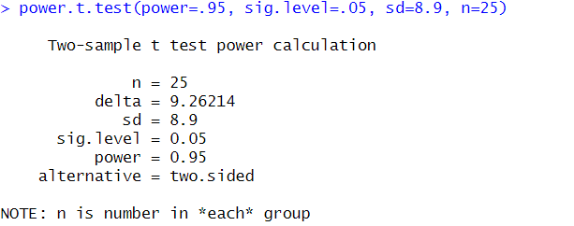
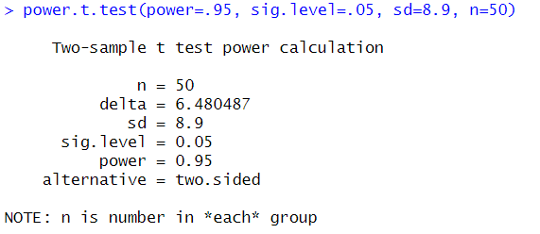
Power Tests
Need for Power Test:
Avoiding Type II errors
Study planning and Design
Resource Optimization
Interpreting non-significant results
Use of Power tests:
Power
Effect Size:
Significance level
Sample size

Slide 46
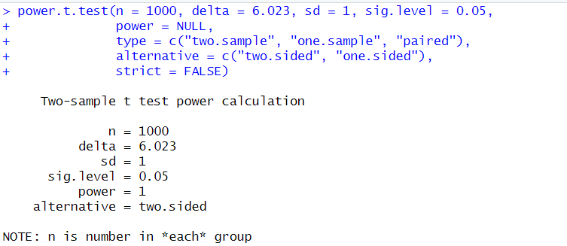

Power Tests
t-Test Design:
If you are designing an experiment where you will use a t-test to check the significance of the results, then you can use the power.t.test function to help design the experiment:
This function will calculate either n, delta, sig.level, sd, or power

Slide 47

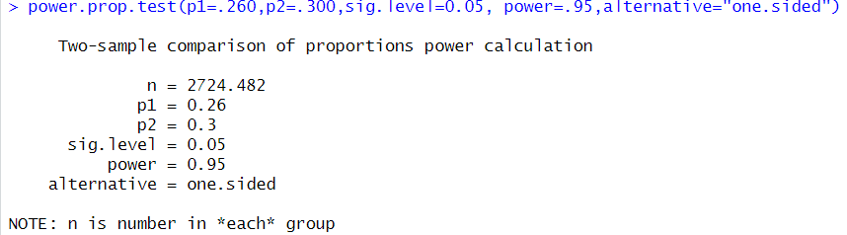
Power Tests
Proportion Test Design:
If you are designing an experiment where you will be measuring a proportion (using prop.test), you can use the power.prop.test function:
This function will calculate either n, p1, p2, sig.level, or power, depending on the input. You must specify at least four of these parameters: n, p1, p2,sig.level, power. The remaining argument must be null; this is the value that the function calculates.

Slide 48
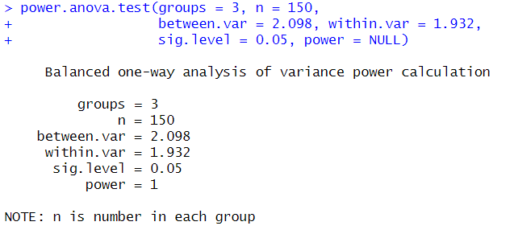

Power Tests
ANOVA Test Design:
If you are designing an experiment where you will be using ANOVA, you can use the power.anova.test function:
This function will calculate either groups, n, sig.level, between.var, power, within.var, or sig.level, depending on the input. You must specify exactly six of these parameters, and the remaining argument must be null; this is the value that the function calculates.

Slide 49
Probability Distributions
Distribution:
The possible values a variable can take and how frequently they occur
Notation:
Y : represents the actual outcome of an event
y: represents one of the possible outcomes
P(Y=y)
Eg: Y – the no.of marbles we draw from a jar , y=5, then P(Y=5)
Since p(y) represents the probability of the possible outcome, it is called the probability function
Probability distributions (or probabilities) measures the likelihood of an outcome depending on how often it features in the sample space

Slide 50
Types of Probability Distributions
Discrete Distributions:
The distributions having a finite number of outcomes such as rolling a die or picking a card is called discrete distribution
Continuous Distribution:
The distribution which has infinitely many outcomes like recording time and distance in track and field

Slide 51
Discrete Distributions:
1. Uniform Distribution: All outcomes are equiprobable such as tossing a coin or picking a card
2. Bernoulli Distribution: Events with only two possible outcomes – Like the Yes or No outcomes
3. Binomial Distribution: The events with only two possible outcomes but conducted in many iterations
Eg: Flipping a coin has only two possible outcome, but if we do it 10 times, we get different result at each iteration
4. Poisson Distribution: We use it when we want to test how unusual an event frequency is for a given interval

Slide 52
Continuous Distribution:
1. Normal Distribution: The means of sufficiently large samples of a data population are known to resemble the normal distribution.
2. Student’s T- distribution: when we have a limited number of samples to observe the normal distribution
3.Chi-squared Distribution: Asymmetric and only contains non-negative values

Slide 53
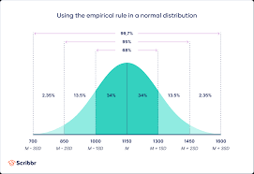
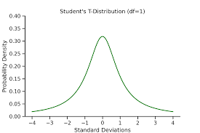
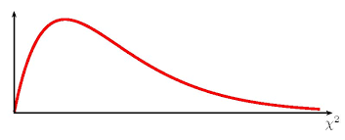

Slide 54
Binomial Distribution
The binomial distribution is a discrete probability distribution. It describes the outcome of n independent trials in an experiment.
Each trial is assumed to have only two outcomes, either success or failure
If the probability of a successful trial is p, then the probability of having x successful outcomes in an experiment of n independent trials is as follows.

Slide 55
Binomial Distribution
Example: Suppose there are twelve multiple choice questions in an English class quiz. Each question has five possible answers, and only one of them is correct. Find the probability of having four or less correct answers if a student attempts to answer every question at random.
Solution: Since only one out of five possible answers is correct, the probability of answering a question correctly by random is 1/5=0.2. We can find the probability of having exactly 4 correct answers by random attempts as follows.
we can use the cumulative probability function for binomial distribution pbinom

Slide 56
Poisson Distribution
The Poisson distribution is the probability distribution of independent event occurrences in an interval.
If λ is the mean occurrence per interval, then the probability of having x occurrences within a given interval is:
Example : If there are twelve cars crossing a bridge per minute on average, find the probability of having seventeen or more cars crossing the bridge in a particular minute
Solution: The probability of having sixteen or less cars crossing the bridge in a particular minute is given by the function ppois.

Slide 57
Hence the probability of having seventeen or more cars crossing the bridge in a minute is in the upper tail of the probability density function.
Inference: If there are twelve cars crossing a bridge per minute on average, the probability of having seventeen or more cars crossing the bridge in a particular minute is 10.1%.

