Slide 1
MODULE 4
DATA VISUALIZATION

Slide 2
R Graphics
R includes two different packages for plotting data: graphics and lattice
The graphics package contains a wide variety of functions for plotting data
The lattice package contains an alternative set of functions for plotting data
Lattice graphics are well suited for splitting data by a conditioning variable.

Slide 3
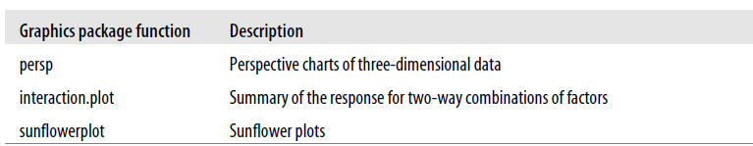
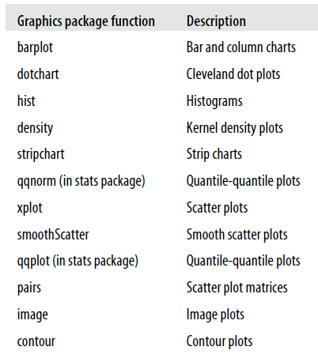
R Graphics
R includes tools for drawing most common types of charts, including bar charts, pie charts, line charts, and scatter plots.
R can also draw some less familiar charts like quantile-quantile (Q-Q) plots, mosaic plots, and contour plots

Slide 4
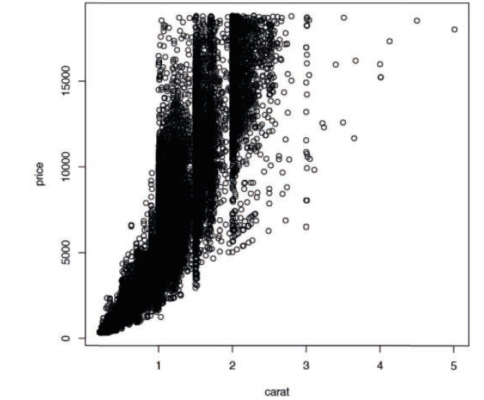
Scatter plots
It is frequently good to see two variables in comparison with each other; this is where the scatterplot is used
Every point represents an observation in two variables where the x-axis represents one variable and the y-axis another
Using the formula notation
> plot(price ~ carat, data=diamonds)
by simply specifying the x and y variables without the formula interface
> plot(diamonds$carat, diamonds$price)

Slide 5
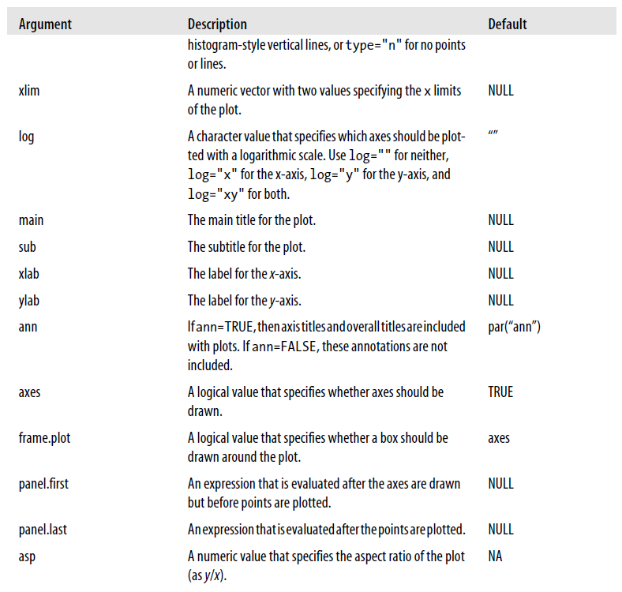
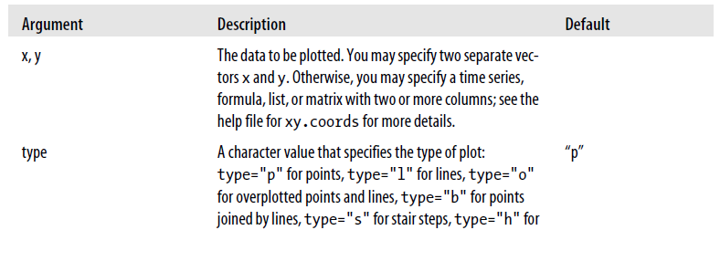
Scatter plot
plot(x, y = NULL, type = "p", xlim = NULL, ylim = NULL, log = "",
main = NULL, sub = NULL, xlab = NULL, ylab = NULL, ann = par("ann"), axes = TRUE, frame.plot = axes, panel.first = NULL, panel.last = NULL, asp = NA, ...)

Slide 6
Scatter plots
Using matplot function: Used to plot the columns of a matrix
matplot(x, y, type = "p", lty = 1:5, lwd = 1, pch = NULL, col = 1:6, cex = NULL, bg = NA, xlab = NULL, ylab = NULL, xlim = NULL, ylim = NULL, ..., add = FALSE, verbose = getOption("verbose"))
If we have a large number of data to plot, then we prefer the function smoothScatter
smoothScatter(x, y = NULL, nbin = 128, bandwidth, colramp = colorRampPalette(c("white", blues9)), nrpoints = 100, pch = ".", cex = 1, col = "black", transformation = function(x) x^.25, postPlotHook = box, xlab = NULL, ylab = NULL, xlim, ylim, xaxs = par("xaxs"), yaxs = par("yaxs"), ...)

Slide 7
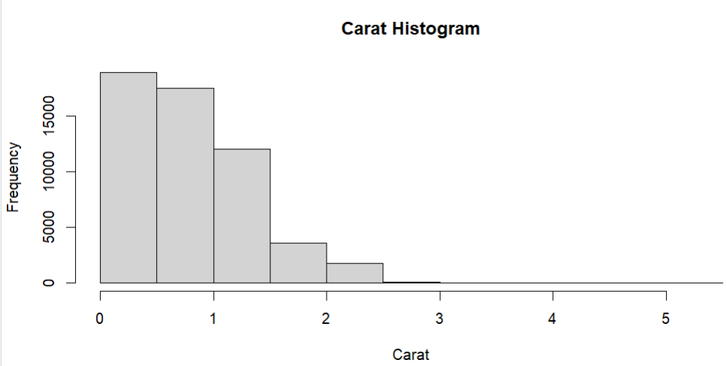
Base Histograms
The most common graph of data in a single variable is a histogram
This shows the distribution of values for that variable
> hist(diamonds$carat, main="Carat Histogram", xlab="Carat")

Slide 8
Plotting Time Series
data<- read.csv("C:\\Users\\soorya\\Documents\\archive (1)\\ daily-minimum-temperatures-in-me.csv")
head(data)
rdate<- as.Date(data$Date, "%m/%d/%y")fix(rdate)
plot(data$Daily.minimum.temperatures ~rdate, type="l", col="red", axes=T, xlab="date", ylab = "temparature", main="daily minimum temaparature")

Slide 9
barplot
Use barplot
rainfall_data <- c(180,178,123,238,219)
month <- c("Jun", "Jul", "Aug", "Sep", "Oct")
barplot(rainfall_data, xlab="Month", ylab="rainfall", main="Rainfall variance in monsoon", col="grey",names.arg=month, border= "red")

Slide 10
Pie charts
Use pie function to plot pie charts
slices <- c(10,12,4,16,8)
lbls<- c("Mango", "Orange", "Banana", "Apple", "Kiwi")
pie(slices, labels = lbls, main = "Pie chart of fruits")

Slide 11
Heatmap
heatmap(x, Rowv=NULL, Colv=if(symm)"Rowv" else NULL, distfun = dist, hclustfun = hclust, reorderfun = function(d,w) reorder(d,w),
add.expr, symm = FALSE, revC = identical(Colv, "Rowv"), scale=c("row", "column", "none"), na.rm = TRUE, margins = c(5, 5), ColSideColors, RowSideColors, cexRow = 0.2 + 1/log10(nr), cexCol = 0.2 + 1/log10(nc),
labRow = NULL, labCol = NULL, main = NULL, xlab = NULL, ylab = NULL, keep.dendro = FALSE, verbose = getOption("verbose"), ...)

Slide 12
Contours
contour(x = seq(0, 1, length.out = nrow(z)), y = seq(0, 1, length.out = ncol(z)), z, nlevels = 10, levels = pretty(zlim, nlevels), labels = NULL, xlim = range(x, finite = TRUE), ylim = range(y, finite = TRUE), zlim = range(z, finite = TRUE), labcex = 0.6, drawlabels = TRUE, method = "flattest", vfont, axes = TRUE, frame.plot = axes, col = par("fg"), lty = par("lty"), lwd = par("lwd"), add = FALSE, ...)

Slide 13
Histograms
To plot distributions we can use histogram and boxplot
random_numbers <- rnorm(1000, mean = 0, sd = 1)
hist(random_numbers, main = "Histogram of Random Numbers", xlab = "Values", ylab = "Frequency", col = "skyblue", border = "black")

Slide 14
Boxplot
boxplot(x, ..., range = 1.5, width = NULL, varwidth = FALSE, notch = FALSE, outline = TRUE, names, plot = TRUE, border = par("fg"), col = NULL, log = "", pars = list(boxwex = 0.8, staplewex = 0.5, outwex = 0.5), horizontal = FALSE, add = FALSE, at = NULL)

Slide 15
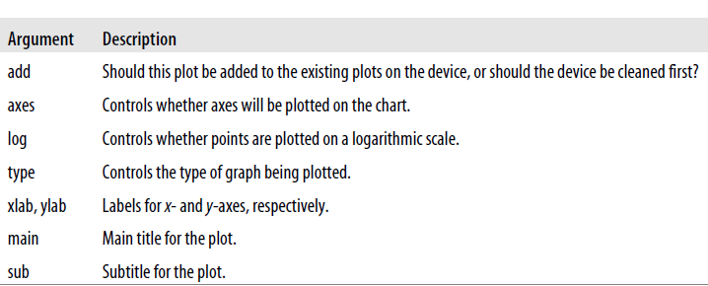
Customizing Charts
Many ways to customize charts in R
The most intuitive is through arguments to a charting function
Another way to customize charts is by setting session parameters
It is also possible to write your own charting functions from scratch
Common Arguments to Chart Functions

Slide 16
Graphical Parameters
par() - The par function sets the graphics functions for a specific graphics device.
These new settings will be the defaults for any new plot until you close the device.
> my_graphics_params <- function () {
par(some graphics parameters)
}
You can check or set the values of these parameters for the active device through the par function
> par("bg")
[1] "transparent"

Slide 17
Graphical Parameters
Annotation –
Titles and axis labels are called chart annotation. You can control chart annotation with the ann parameter. (If you set ann=FALSE, then titles and axis labels are not printed.)
Margins –
R allows you to control the size of the margin around a plot.
The whole graphics device is called the device region. The area where data is plotted is called the plot region.
Use the mai argument to specify the margin size in inches
use mar to specify the margin in lines of text
To control the margins around titles and labels, use the mgp parameter
To check the overall dimensions of a device (in inches), you can use the read-only parameter din.
R maximizes the use of available space out to the margins (pty="m"), but you can easily ask R to use a square region by setting pty="s"

Slide 18
Graphical Parameters
Multiple plots –
You can plot multiple charts using the standard graphics functions by setting the mfcol parameter for a device
> par(mfcol=c(3,2))
If a matrix of subplots is being drawn on a graphics device, you can specify the next plot location using the argument mfg=c(row, column, nrows, ncolumns).
Text properties
Text size –
The parameter ps specifies the default point size of text
A second parameter, cex, specifies a default scaling factor for text.

Slide 19
Plotting Multiple Figures
>png("~/Documents/book/current/figs/multiplefigs.1.pdf",
+ width=4.3,height=6.5,units="in",res=72)
> par(mfcol=c(3,2))
> pie(c(5,4,3))
> plot(x=c(1,2,3,4,5),y=c(1.1,1.9,3,3.9,6))
> barplot(c(1,2,3,4,5))
> barplot(c(1,2,3,4,5),horiz=TRUE)
> pie(c(5,4,3,2,1))
> plot(c(1,2,3,4,5,6),c(4,3,6,2,1,1))
> dev.off()

Slide 20
Graphical Parameters
Text properties –
Typeface
The font is specified through the family argument
the text style is specified through the font argument
You can specify the style for the axis with font.axis, for labels with font.lab, for main titles with font.main, and for subtitles with font.sub.
Alignment and spacing
To control how text is aligned, use the adj parameter.
To change the spacing between lines of text, use the lheight parameter.
Rotation
To rotate each character, use the crt parameter. To rotate whole strings, use the srt parameter.

Slide 21
Graphical Parameters
Line properties
You can also change the way the lines are drawn.
To change the line end style, use lend
To change the line join style, use ljoin and lmiter
Line type is specified by lty and line width by lwd
To change the way boxes are drawn around plots, use the bty parameter
Colors
You can change the default background color with bg and the default foreground color with fg
The default plotting color is specified by col. Use col.axis to change the color of axes, col.lab to change the color of labels, col.main to change the color of the main title, and col.sub to change the color of the subtitle
To get a list of valid color names, use the colors function. To specify a color using RGB components, use a string of the form "#RRGGBB", where RR, GG, and BB are hexadecimal values specifying the amount of red, green, and blue, respectively.
To view or change a color palette, use the palette function

Slide 22
Graphical Parameters
Axes
The argument lab controls how axes are annotated. To change the style of axis labels, use las.
To change the margin for the axis title, labels, and lines, use mgp.
You can specify the size of tick marks in lines of text with tcl, or as a fraction of the plot area with tck
To change the minimum and maximum tick mark locations, use xaxp and yaxp. To change the way intervals are calculated, use xaxs and yaxs. To remove the x-axis or y-axis, use xaxt="n" or yaxt="n".
change the orientation of axis labels with the las parameter.
Points
You can change the symbol used for points with the pch argument.
To get a list of point types, use the points function.

Slide 23
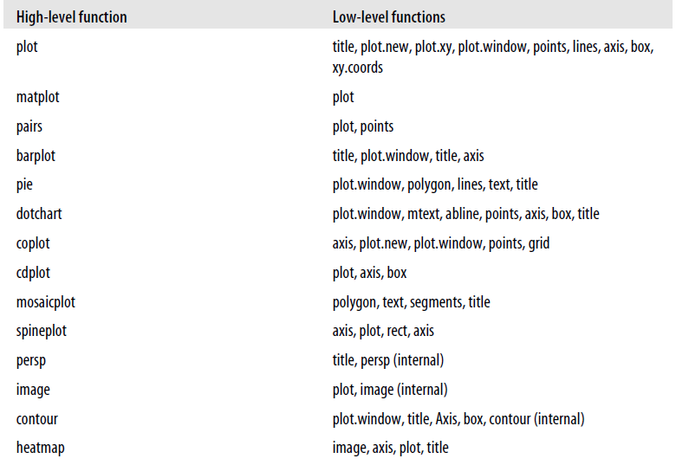
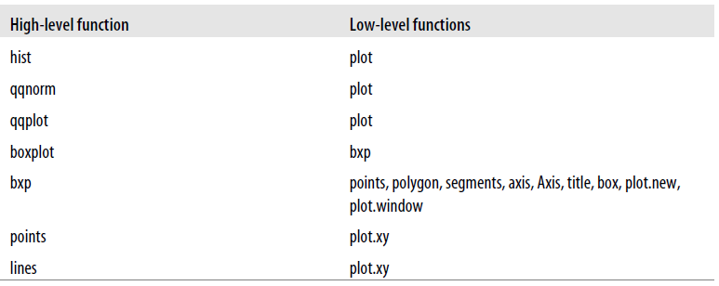
Basic Graphic Functions

Slide 24
Basic Graphic Functions
Points
You can plot points on a chart using the points function
points(x, y = NULL, type = "p", ...)
You can also add points to an existing matrix plot with matpoints:
matpoints(x, y, type = "p", lty = 1:5, lwd = 1, pch = NULL, col = 1:6, ...)
Lines
lines(x, y = NULL, type = "l", ...)
The lines function plots a set of line segments on an existing plot
matlines (x, y, type = "l", lty = 1:5, lwd = 1, pch = NULL, col = 1:6, ..)
Curve
To plot a curve on the current graphical device, you can use the curve function
curve(expr, from = NULL, to = NULL, n = 101, add = FALSE, type = "l", ylab = NULL, log = NULL, xlim = NULL, ...)

Slide 25
Basic Graphic Functions
text
You can use the text function to add text to an existing plot
text (x, y = NULL, labels = seq_along(x), adj = NULL, pos = NULL, offset = 0.5, vfont = NULL, cex = 1, col = NULL, font = NULL, ...)
abline
To plot a single line across the plot area, you can use the abline function:
abline(a = NULL, b = NULL, h = NULL, v = NULL, reg = NULL, coef = NULL, untf = FALSE, ...)
you can also specify multiple arguments, and abline will plot all of the specified lines
> # plot a grid of lines between 1 and 10:
> abline(h=1:10,v=1:10)
If you just want to plot a grid on a plot, you might want to use the grid function instead:
grid(nx = NULL, ny = nx, col = "lightgray", lty = "dotted", lwd = par("lwd"), equilogs = TRUE)

Slide 26
Basic Graphic Functions
Polygon
To draw a polygon, you can use the polygon function
polygon(x, y = NULL, density = NULL, angle = 45, border = NULL, col = NA, lty = par("lty"), ..
The x and y arguments specify the vertices of the polygon. For example, the following expression draws a 2 × 2 square on a graph centered at (3, 3):
> polygon(x=c(2,2,4,4),y=c(2,4,4,2))
For the special case where you just need to draw a rectangle, you can use the rect function:
rect(xleft, ybottom, xright, ytop, density = NULL, angle = 45, col = NA, border = NULL, lty = par("lty"), lwd = par("lwd"), ...)

Slide 27
Basic Graphic Functions
Segments
To draw a set of line segments connecting pairs of points, you can use the segments function:
segments(x0, y0, x1, y1, col = par("fg"), lty = par("lty"), lwd = par("lwd"), ...)
This function draws a set of line segments from each pair of vertices specified by (x0[i],y0[i]) to (x1[i], y1[i])
Legend
The legend function adds a legend to a chart:
legend(x, y = NULL, legend, fill = NULL, col = par("col"), lty, lwd, pch, angle = 45, density = NULL, bty = "o", bg = par("bg"), box.lwd = par("lwd"), box.lty = par("lty"), box.col = par("fg"), pt.bg = NA, cex = 1, pt.cex = cex, pt.lwd = lwd, xjust = 0, yjust = 1, x.intersp = 1, y.intersp = 1, adj = c(0, 0.5), text.width = NULL, text.col = par("col"), merge = do.lines && has.pch, trace = FALSE, plot = TRUE, ncol = 1, horiz = FALSE, title = NULL, inset = 0, xpd, title.col = text.col)

Slide 28
Basic Graphic Functions
Title
To annotate a plot, use the title function:
title(main = NULL, sub = NULL, xlab = NULL, ylab = NULL, line = NA, outer = FALSE, ...)
This function adds a main title (main), a subtitle (sub), an x-axis label (xlab), and a y-axis label (ylab). Specify a value of line to move the labels outward from the edge of the plot
Specify outer=TRUE if you would like to place labels in the outer margin.
Axis
To add axes to a plot, use the axis function
axis(side, at = NULL, labels = TRUE, tick = TRUE, line = NA, pos = NA, outer = FALSE, font = NA, lty = "solid", lwd = 1, lwd.ticks = lwd, col = NULL, col.ticks = NULL, hadj = NA, padj = NA, ...)

Slide 29
Basic Graphic Functions
Box
The box function can be used to draw a box around the current figure region
This can be useful when plotting multiple figures within a graphics device:
box(which = "plot", lty = "solid", ...)
The which argument specifies where to draw the box. Values for which include “plot,” “figure,” “inner,” and “outer”)
Mtext
The mtext function can be used to add text to a margin of a plot:
mtext(text, side = 3, line = 0, outer = FALSE, at = NA, adj = NA, padj = NA, cex = NA, col = NA, font = NA, ...)
Use the side parameter to specify where to plot the text (side = 1 for bottom, side = 2 for left, side = 3 for top, and side = 4 for right).
The line argument specifies where to write the text, in terms of “margin lines” (starting at 0 for closest to the plot area).

Slide 30
Basic Graphic Functions
Trans3d
To add lines or points to a perspective plot (from persp), you might find the function trans3d convenient:
trans3d(x,y,z, pmat)
This function takes vectors of points x, y, and z and translates them into the correct screen position
The argument pmat is a perspective matrix that is used for translation.
The persp function will return an appropriate perspective matrix object for use by trans3d.

Slide 32
LATTICE GRAPHICS

Slide 33
Lattice Graphics
Lattice graphics look different from standard R graphics, are created with different functions, and have different options
Lattice functions make it easy to do some things that are hard to do with standard graphics, such as plotting multiple plots on the same page or superimposing plots
The lattice package is an implementation of Trellis graphics in R
Lattice graphics consist of one or more rectangular drawing areas called panels
The data assigned to each panel is referred to as a packet
Lattice functions work by calling one or more panel functions, which actually plot the packets within panels
To change the appearance of a plot, you can specify arguments to the plotting function or change the panel function.

Slide 34
Lattice Graphics
Some of the most common plots in lattice include
Xyplot()
Splom()
Cloud()
Stripplot()
bwplot()
Dotplot()
Barchart()
Histogram()
Densityplot()
Qqmath()
Qq()

Slide 35
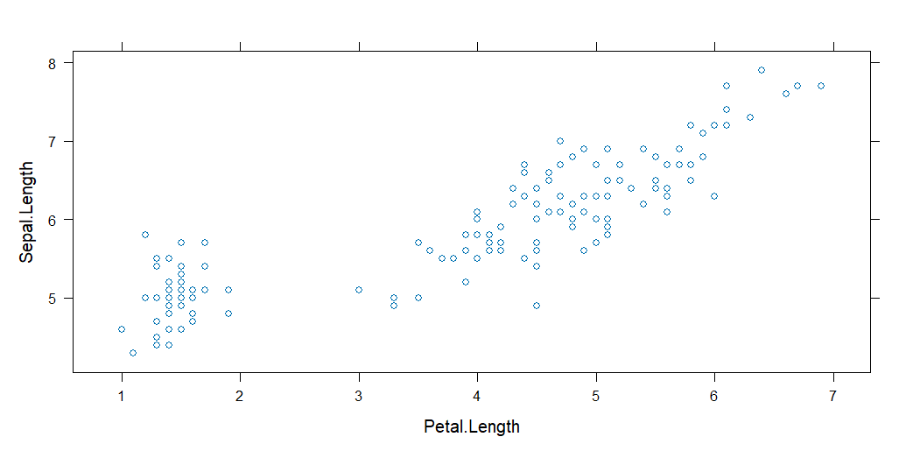
Lattice Graphics
xyplot()
One of the most commonly used functions
The xyplot() function is usually used to create a scatter plot using the lattice package in R.

Slide 36
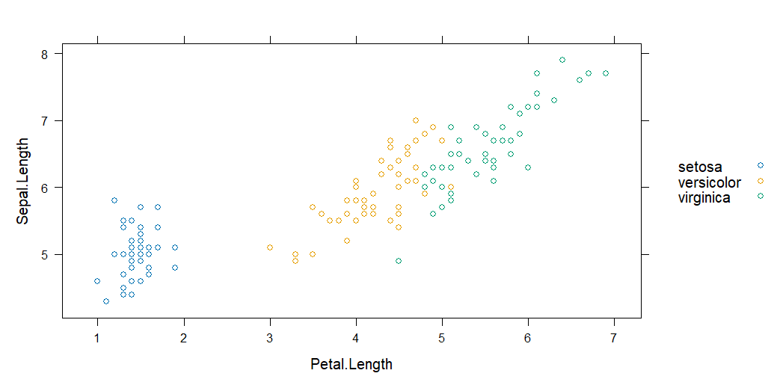
Lattice Graphics
xyplot()
To make the plot more meaningful, we can use different colors to the data points according to their categories by using the argument group

Slide 37
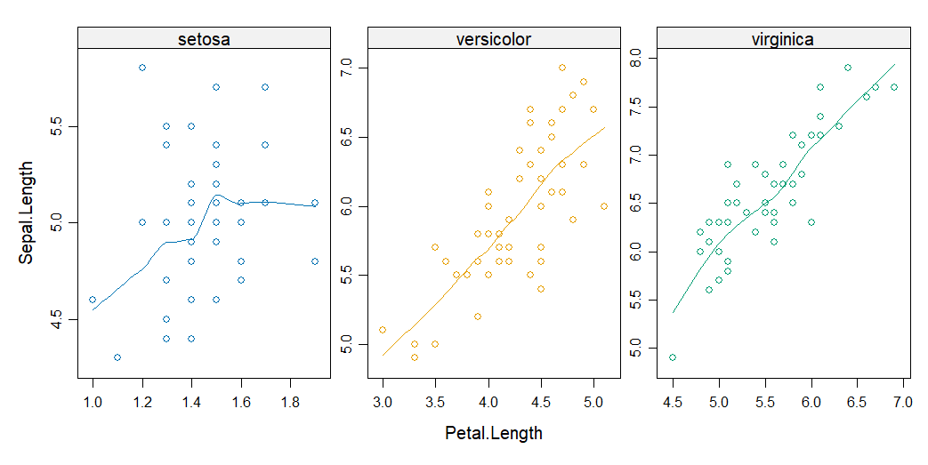
Lattice Graphics
xyplot()
Lattice plot is known for its ability to create plots in multiple panels.
We can generate multiple graphs such that each graph represents a single group.

Slide 38
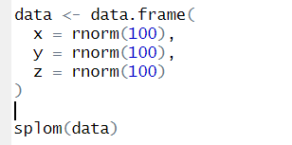
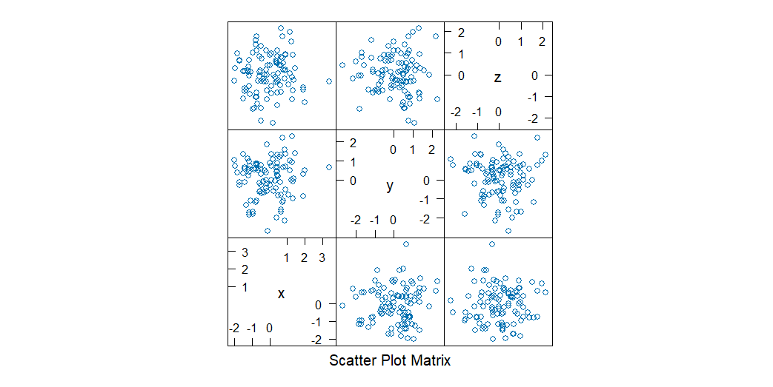
Lattice Graphics
splom()
The splom() function in R , short for ‘ scatter plot matrix’ is a part of the lattice package, which provides an easy way to create a matrix of scatterplots for exploring relationship between multiple variables

Slide 39
Lattice Graphics
cloud()
To create 3D scatter plots using the Lattice package, we can use the predefined function cloud().

Slide 40
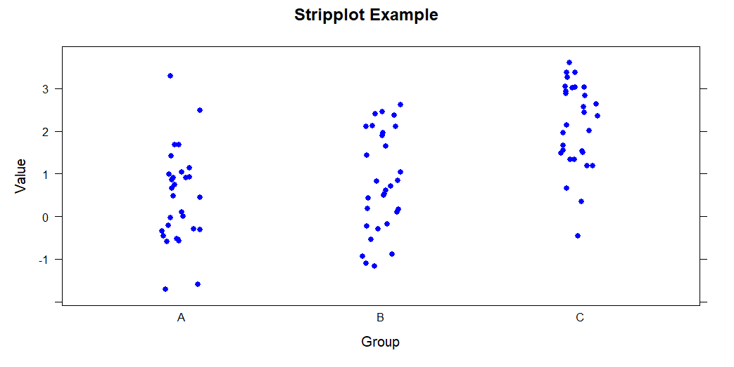
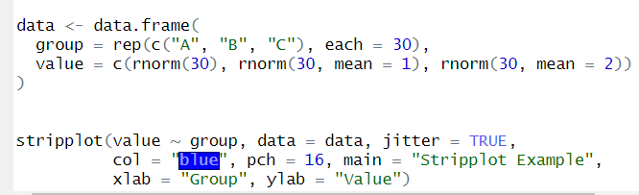
Lattice Graphics
stripplot()
The stripplot() function in R, also known as a stripchart or dot plot, is used to create a one-dimensional scatterplot of the data points along a single axis
It's particularly useful for visualizing the distribution of a continuous variable or comparing the distribution of multiple groups.

Slide 41
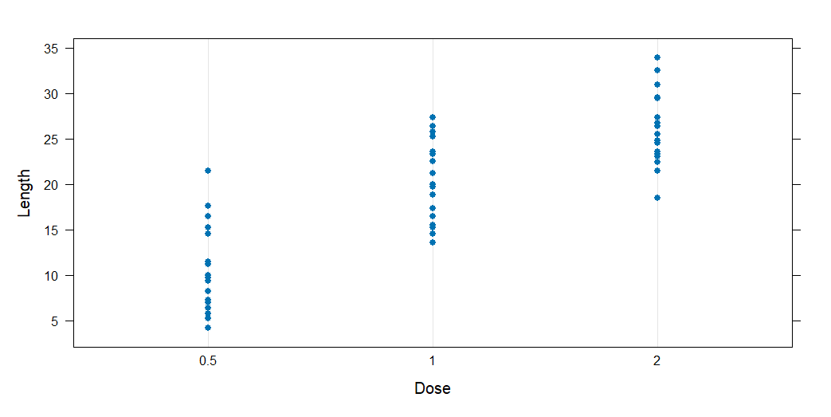
Lattice Graphics
Dot plots
To generate a dotplot you will have to use the dotplot() function.

Slide 42

Lattice Graphics
bwplot() - Boxplots
In order to plot Boxplots using the Lattice Package, we should use bwplot() function

Slide 43
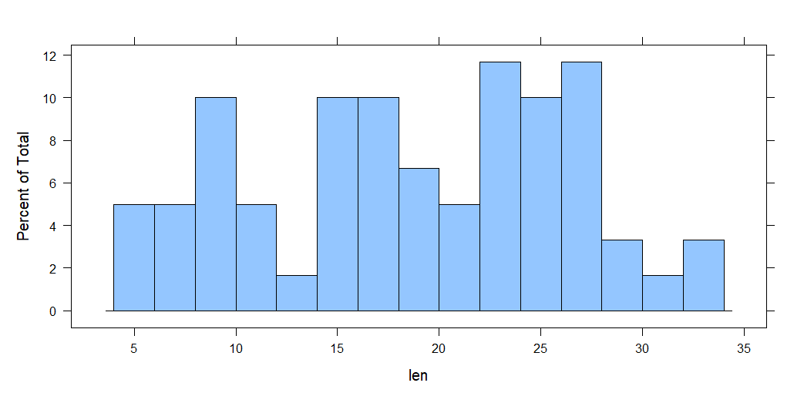
Lattice Graphics
Histograms
Lattice offers other options to visualize the data such as the histograms. We use the pre-defined function histogram() to create histograms in R just as follows:

Slide 44
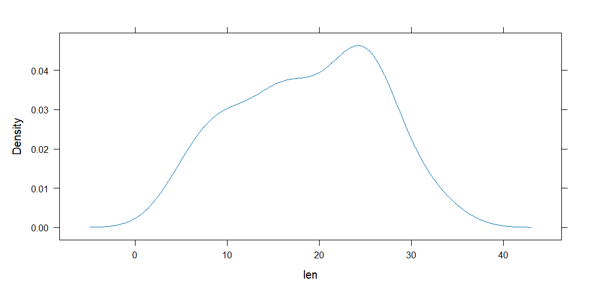
Lattice Graphics
Density plots
Density plots can be created in R using the densityplot() function which is also accessible through the Lattice package.

Slide 45
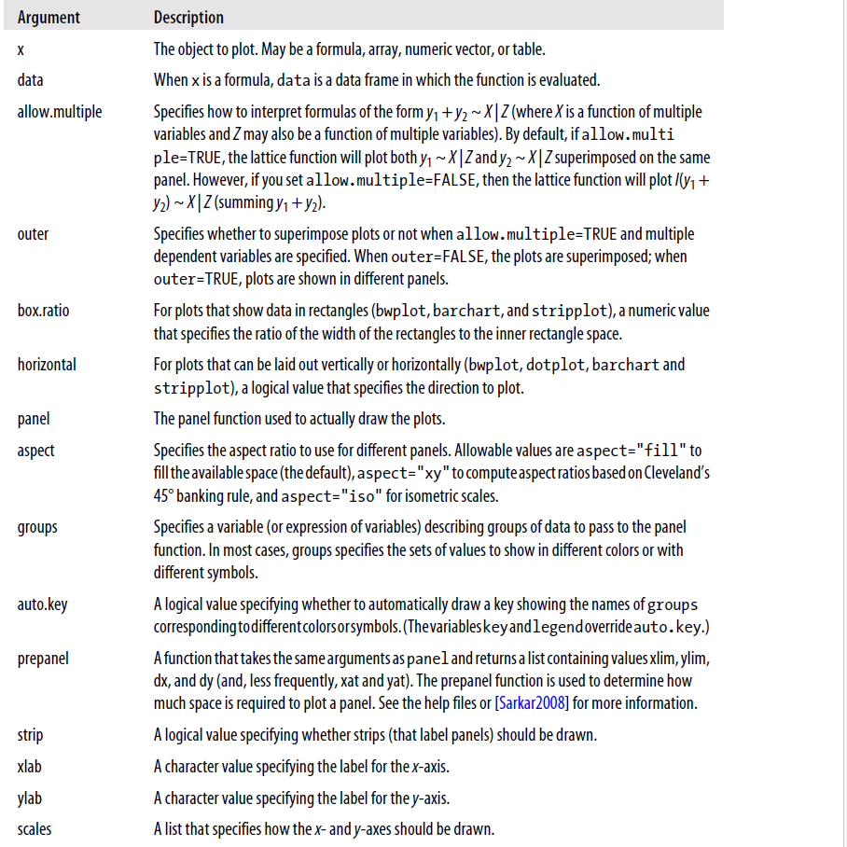
Customizing Lattice Graphics
Common Arguments to lattice functions

Slide 46
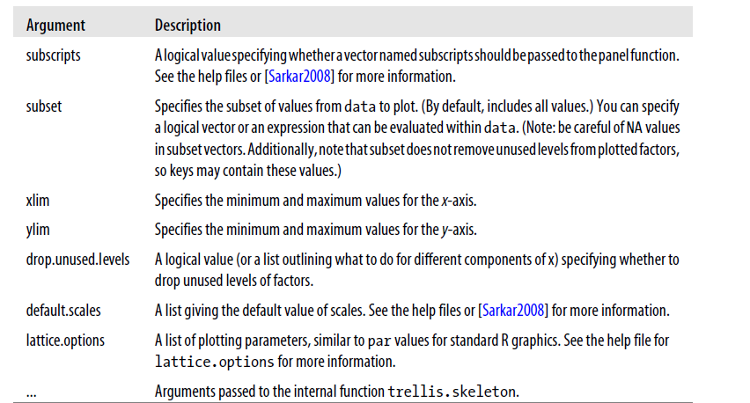
Customizing Lattice Graphics
Common Arguments to lattice functions

Slide 47
Customizing Lattice Graphics
Controlling how axes are drawn:
You can control how axes are drawn in the lattice package by named values in the argument scales
You may specify a single list for x- and y-axes or specify a list of lists with separate x- and y-axes
Example
To shrink all text by 50% and just plot the x-axis as a base 2 logarithm, use the argument :
scales=list(cex=.5, x = list(log = 2))

Slide 48
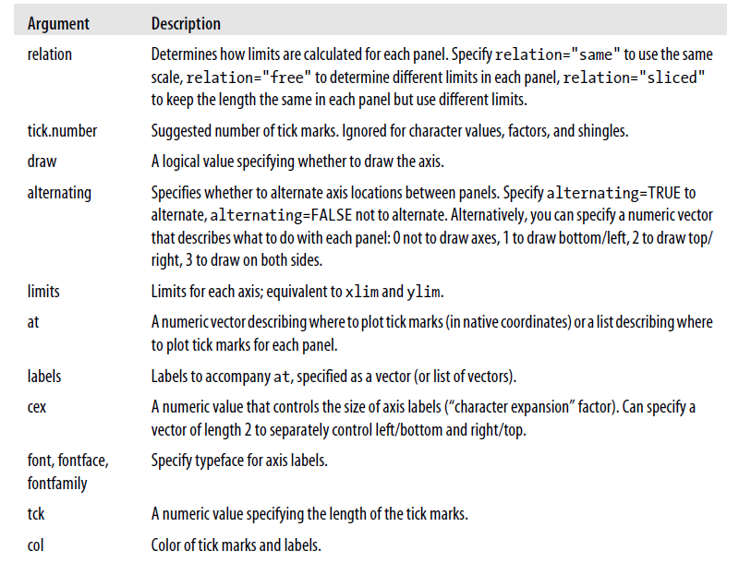
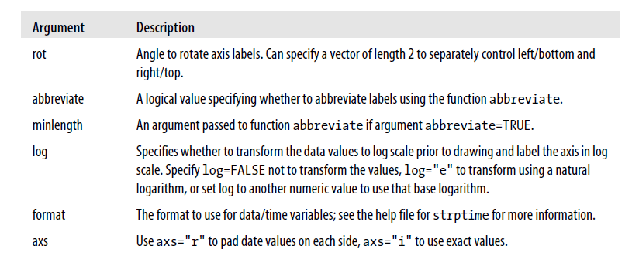
Customizing Lattice Graphics
Controlling how axes are drawn:

Slide 49
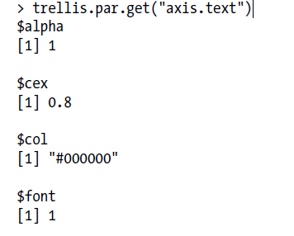
Customizing Lattice Graphics
Parameters
To check the value of a setting, use the function trellis.par.get
Example

Slide 50
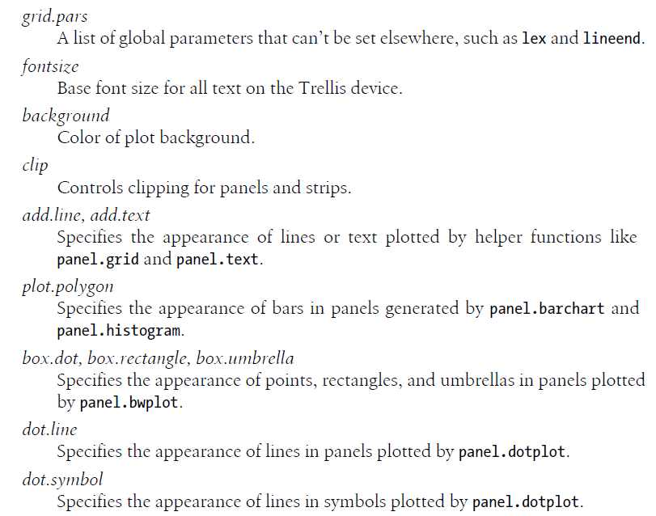
Customizing Lattice Graphics
Parameters

Slide 51
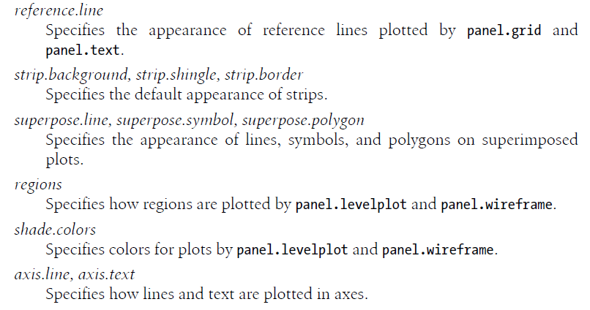
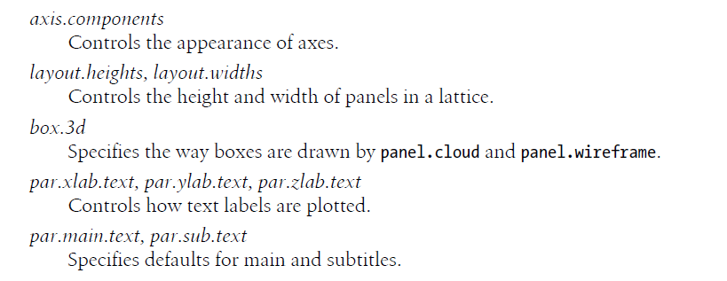
Customizing Lattice Graphics
Parameters

Slide 52
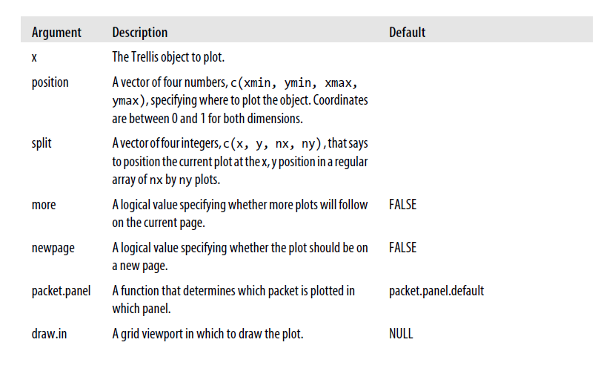
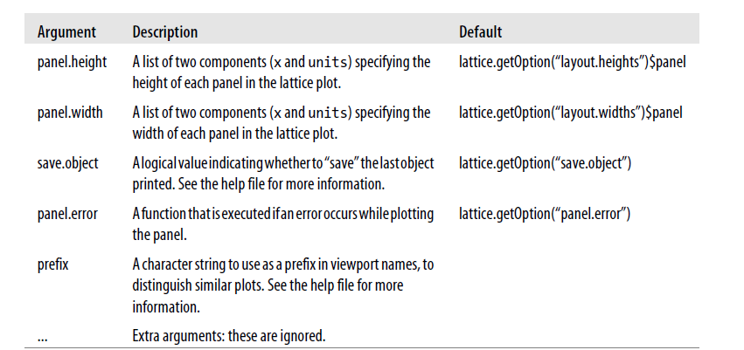
Customizing Lattice Graphics
Plots.trellis
lattice functions do not plot results; they return lattice objects
To plot a lattice object, you need to call print or plot on the lattice object
It’s possible to control how lattice objects are printed through arguments to plot.trellis.

Slide 53
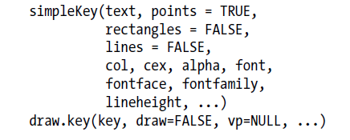
Customizing Lattice Graphics
simpleKey
To customize the way that keys (or legends) are drawn for plots with multiple groups of variables, you may specify a custom function to the key argument, or you may use the auto.key argument to automatically draw a key using the simpleKey function.
If you specify autoKey=TRUE, then simpleKey is called with the default arguments to generate the key

