Slide 1
Module 2
Introduction to Stream Computing

Slide 2
Module contents
Introduction to Stream Computing
Introduction to stream concepts – Streaming data architecture, Stream data model, Sampling techniques for efficient stream processing, Filtering streams – Bloom filter, Count distinct problem – Flajolet martin algorithm, Estimating moments, Counting oneness in a window – DGIM Algorithm

Slide 3
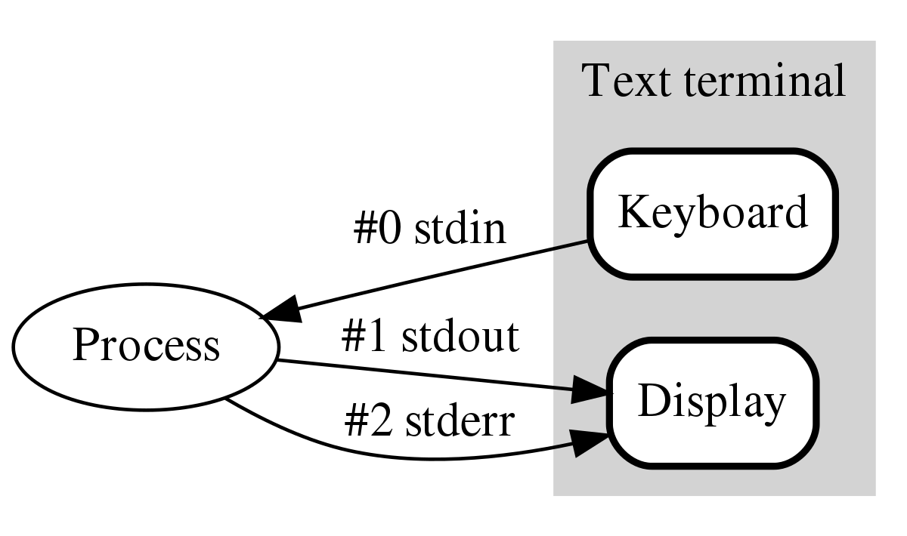
Stream
Stream Refers to a sequence of data elements or symbols made available over time.
Data stream transmits from a source and receives at the processing end in a network
A continuous stream of data flows between the source and receiver ends, and which is processed in real-time.

Slide 4
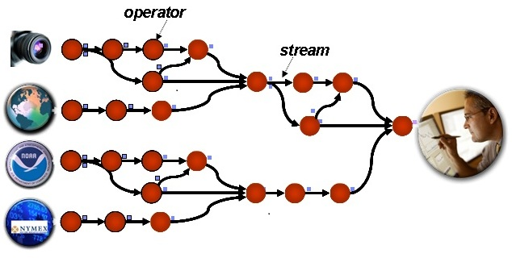
Big Data Stream Computing- Features
Stream computing is a way to analyze and process Big Data.
High rate of receiving data.
Processing is done in real time to gain current insights to take appropriate decisions or to predict new trends in the immediate future.
Implements in a distributed clustered environment.

Slide 5
Stream processing is a method of data management that involves continuously receiving and promptly analyzing, filtering, transforming, or enhancing a continuous data stream in real time.
After undergoing processing, the data is then directed towards an application, data store, or another stream processing engine.
Stream processing services and architectures are growing in popularity because they allow enterprises to combine data feed from various sources.
Sources can include transactions, website analytics, connected devices, operational databases, weather reports and other commercial services.

Slide 6
Reasons for using Stream Processing
Certain data arrives in an uninterrupted flow of events.
For batch processing, data is stored, stop data collection at some time, and processing occurs.
Subsequently, the next batch is initiated.
In contrast, streaming effectively manages continuous data streams.
Stream processing seamlessly aligns with time series data such as traffic sensors, health sensors, transaction logs, activity logs, and more.

Slide 7
Batch processing collects data and processes it all at once, while stream processing handles data as it comes in, spreading the processing over time.
This allows stream processing to work with less hardware than batch processing
Sometimes data is very large, making it impossible to store. Stream processing enables handling of large, continuous data and keeps only the important parts.

Slide 8
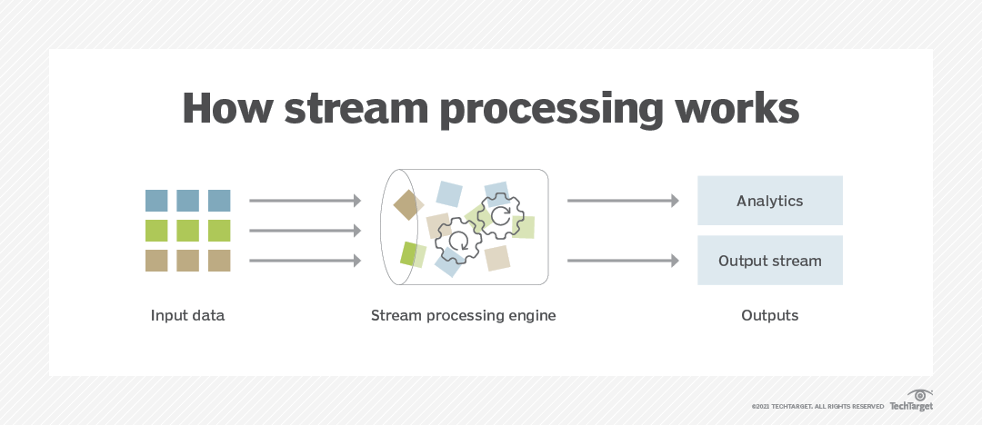

Slide 9
Stream computing Domains
Financial sectors
Business intelligence
Risk management
Marketing management
Search engines
Social network analysis

Slide 10
Examples of Data Stream Applications
Making data-driven marketing decisions in real time.
It requires the use of data from trends analyses of real-time sales, and analysis of social media, and the sales distribution.
Monitoring and detection of potential failures of system using network management tool.
Monitoring of industrial or manufacturing machinery in real time.
A sensor network or IoT controlled by another entity, or a set of entities
Watching online video lectures, and rewinding or forwarding them.

Slide 11
Popular Stream Processing Frameworks:
Apache Spark
Apache Storm
Apache Samza
Apache Flink
Amazon Kinesis Streams
Apache Apex
Apache Flume

Slide 12
Issues in stream Processing
Stream often deliver elements very rapidly.
Efficient algorithm is needed.
Important to store the data.
Data can be complex types- Documents, Images, time series.

Slide 13
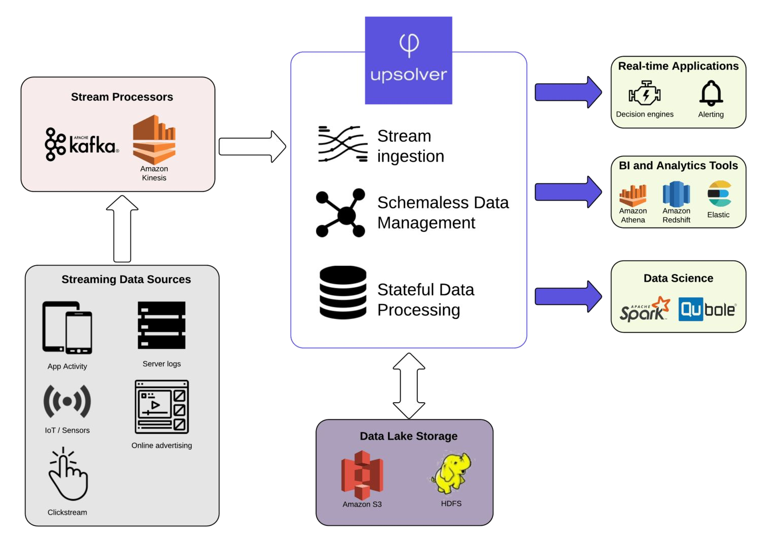
Streaming Data Architecture

Slide 14
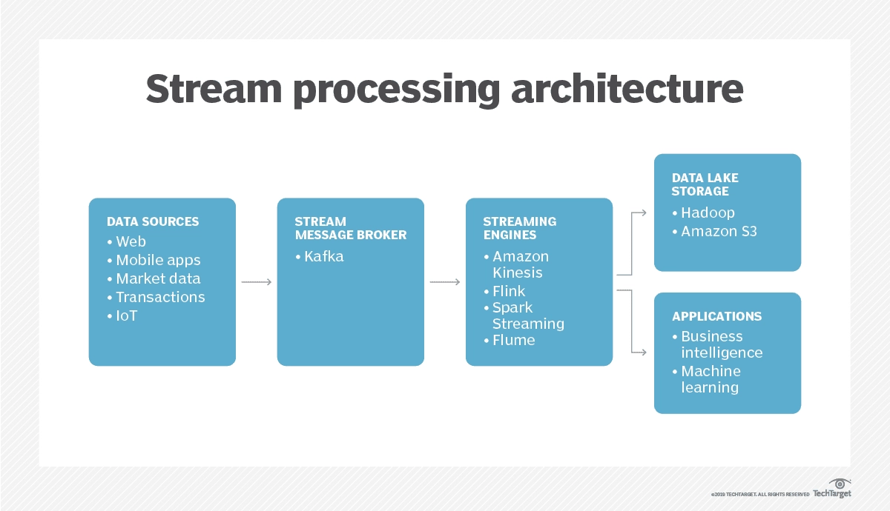
Streaming Data Architecture

Slide 15
Architecture Components
A streaming data architecture is a set of software components designed to handle large streams of raw data from various sources.
Different components of streaming data architecture are:
Data Sources
The Message Broker / Stream Processor
Batch and Real-time ETL Tools (Streaming Engine)
Data Analytics Applications
Streaming Data Storage

Slide 16
Architecture Components
2. The Message Broker / Stream Processor
This element takes data from a source, called a producer, translates it into a standard message format, and then streams it for consumption by other components such as data warehouses, and ETL tools, among others.
The first generation of message brokers, such as RabbitMQ and Apache ActiveMQ, relied on the Message Oriented Middleware (MOM) paradigm.
Two popular stream processing tools are Apache Kafka and Amazon Kinesis.

Slide 17
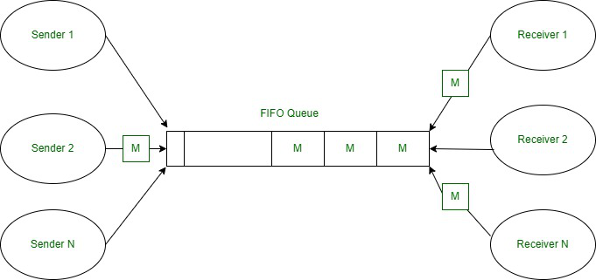
Message Oriented Middleware (MOM)

Slide 18
Communication Infrastructure:
Facilitates communication and data exchanges between applications.
Uses communication channels.
Message Broker Functionality:
Acts as a proxy between two applications.
Communication through queues designates it as a point-to-point broker.
Publish/Subscribe Mode:
Broadcasting a single message to multiple applications.
Broker operates in Publish/Subscribe mode.

Slide 19
3. Batch and Real-time ETL Tools (Streaming Engine)
Data streams from one or more message brokers must be aggregated, transformed, and structured before data can be analyzed with SQL-based analytics tools.
This would be done by an ETL tool or platform that receives queries from users, fetches events from message queues, then applies the query to generate a result.
Other processes such as performing additional joins, aggregations, and transformations can also run concurrently with the process.
The result may be an action, a visualization, an API call, an alert, or in other cases, a new data stream.

Slide 20
ETL Tools
Extract, transform, and load (ETL) is the process of combining data from multiple sources into a large, central repository called a data warehouse.
ETL uses a set of business rules to clean and organize raw data and prepare it for storage, data analytics, and machine learning

Slide 21
4. Data Analytics Applications
Once streaming data is prepared for consumption by the stream processor and processing tool, it needs to be analyzed to provide value.
There are many different approaches to streaming data analytics
Analytics Tool | Streaming Use Case | Example Setup
Cassandra | Low latency serving of streaming events to apps | Kafka streams can be processed and persisted to a Cassandra cluster. You can implement another Kafka instance that receives a stream of changes from Cassandra and serves them to applications for real-time decision making.

Slide 22
Analytics Tool | Streaming Use Case | Example Setup
Amazon Athena | Distributed SQL engine | Streaming data is saved to S3. You can set up ad hoc SQL queries via the AWS Management Console, Athena runs them as serverless functions and returns results.
Amazon Redshift | Data warehouse | Amazon Kinesis Streaming Data Firehose can be used to save streaming data to Redshift. This enables near real-time analytics with BI tools and dashboards you have already integrated with Redshift.
Elasticsearch | Text search | Kafka Connect can be used to stream topics directly into Elasticsearch. If you use the Avro data format and a schema registry, Elasticsearch mappings with correct data types are created automatically. You can then perform rapid text search or analytics within Elasticsearch.

Slide 23
5. Streaming Data Storage (Data Lake Storage)
With the advent of low cost storage technologies, most organizations today are storing their streaming event data.
Here are several options for storing streaming data, and their pros and cons.
Streaming Data Storage Option | Pros | Cons
In a database or data warehouse – for example, PostgreSQL or Amazon Redshift | Easy SQL-based data analysis. | Hard to scale and manage. If cloud-based, storage is expensive.
In the message broker – for example, using Kafka persistent storage | Agile, no need to structure data into tables. Easy to set up, no additional components. | Data retention is an issue since Kafka storage is up to 10x more expensive compared to data lake storage. Kafka performance is best for reading recent (cached) data.
In a data lake – for example, Amazon S3 | Agile, no need to structure data into tables. Low cost storage. | High latency, makes real time analysis difficult. Difficult to perform SQL analytics.

Slide 24
Data Stream Model
The Data Stream Model is a computational model used to analyze and process continuous streams of data.
With stream model data is considered to be infinite and unbounded, and algorithms are designed to make decisions and perform computations based on this continuous flow of data.
The data stream model is commonly used in various applications such as monitoring systems, network traffic analysis, sensor data processing, financial market analysis, and more.
There are different ways of modeling data stream, querying, processing and management.

Slide 25
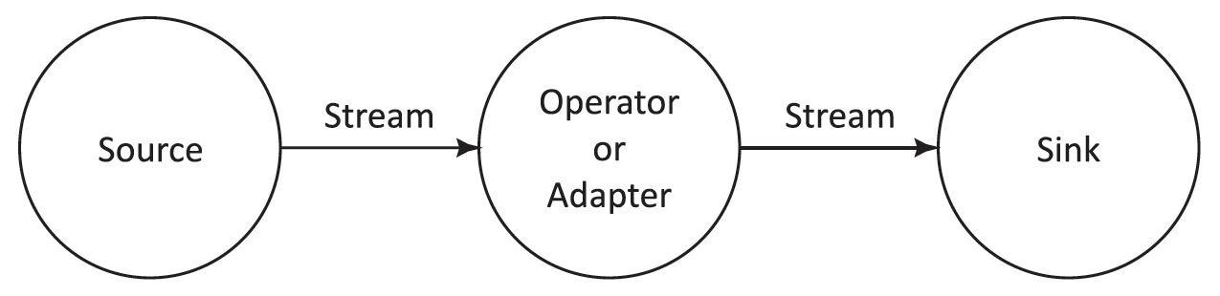
Graph-based stream data model
It involves representing the data stream and its transformations using a graph structure.
In this model, each node in the graph represents an operator or adapter, while the edges represent the flow of data between them.
Each node in the graph performs specific data transformations or computations on incoming data streams before passing them to subsequent nodes.
These transformations may include filtering, aggregation, enrichment, or joining of data streams.

Slide 26
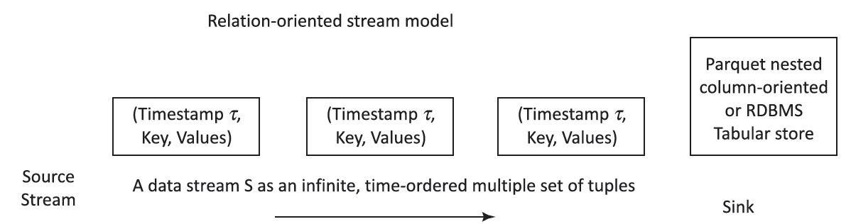
Relation-oriented stream-tuples model
Relation-oriented stream tuples model
This model specifically designed for representing and processing streaming data as tuples organized into relations, similar to relational databases.
In this model, streaming data is represented as a sequence of tuples, where each tuple corresponds to a single data event or record.

Slide 27
An unbounded and time-ordered sequence of data items (relational tuples) in the data stream model
The receiving software receives the sequences in order and sees the data items only once.
Each tuple consists of a set of attributes, like a row in a database table.
One of the attributes in the tuple schema is a timestamp, usually represented by t.
Data Source may a RDBMS row-oriented storage tables or Parquet tables
Parquet nested column-oriented data stream transfer data to Data sink
Parquet is nested hierarchical columnar-storage concept.

Slide 28
Object-based data stream model
Its framework for representing and processing streaming data in the form of objects or entities, each with its own attributes and behaviors.
In this model, streaming data is viewed as a sequence of objects that evolve over time, and data processing operations are performed on these objects as they arrive in the stream.
Examples: Cougar and Tribeca object- based data stream
Cougar models sensors’ data as a stream of objects
Tribeca models the network monitoring data as a stream of objects

Slide 29
XML-based data stream model
Its a model for representing and processing streaming data using XML (eXtensible Markup Language) as the data format.
In this model, streaming data is structured as a sequence of XML documents, with each document containing hierarchical data organized into elements and attributes.
Example: NiagaraCQ, an XML-based data stream model
Performs operations over millions of simultaneous queries by dynamically grouping them according to their structural similarities.

Slide 30
Example -XML Document
<?xml version="1.0" encoding="UTF-8"?>
<bookstore>
<book category="Fiction">
<title>The Great Gatsby</title>
<author>F. Scott Fitzgerald</author>
<price>15.99</price>
</book>
<book category="Non-Fiction">
<title>Thinking, Fast and Slow</title>
<author>Daniel Kahneman</author>
<price>12.99</price>
</book>
</bookstore>
XML documents are commonly used for representing and exchanging structured data between different systems and platforms.

Slide 31
Window-based data stream model
Its a model for processing and analyzing streaming data by dividing it into finite, contiguous subsets called windows.
Window means a time window during which the data stream is looked at an instance.
Each window represents a temporal segment of the data stream, and data processing operations are applied to the contents of these windows.
Stream data direction can be towards fixed window, sliding window or landmark window-sinks (end-points)

Slide 32
Sampling Techniques
Sampling is the practice of selecting an individual group from a population to study the whole population.
Let’s say we want to know the percentage of people who use iPhones in a city,
One way to do this is to call up everyone in the city and ask them what type of phone they use.
The other way would be to get a smaller subgroup of individuals and ask them the same question, and then use this information as an approximation of the total population.

Slide 33
Every sampling type comes under two broad categories:
Probability sampling - Random selection techniques are used to select the sample.
Non-probability sampling - Non-random selection techniques based on certain criteria are used to select the sample.

Slide 34
Reservoir Sampling Method
A random sampling method, choosing a sample of limited data items from a list containing a very large number of items, randomly.
Choose k samples from a list of n items, where n is either a very large or unknown number.
Given a stream of numbers, and need to write an efficient function to randomly select k numbers where 1 <= k <= n.
Let the input array be stream[].
Create an array reservoir[] of maximum size k.
Randomly select an item one by one from stream[0..n-1].
If the selected item is not previously selected, then put it in reservoir[].
continue steps c & d until reservoir[] array full.

Slide 35
Sliding window Sampling Method
In sliding window model of sampling only the most “recent” elements remain active and the rest are discarded.
There are two equally important types of the sliding windows model
Windows with fixed size (e.g., where items arrive one at a time, and only the most recent n items remain active for some fixed parameter n),
Timestamp-based windows (e.g., where many items can arrive in “bursts” at a single step and where only items from the last t steps remain active, again for some fixed parameter t).

Slide 36
Filtering Streams
Data filtering is the process of choosing a smaller part of your data set and using that subset for viewing or analysis.
Filtering may be used to:
Look at results for a particular period of time.
Calculate results for particular groups of interest.
Exclude erroneous or "bad" observations from an analysis.
Train and validate statistical models.
Filtering requires to specify a rule or logic to identify the cases need to be included in our analysis.

Slide 37

The stream processing application needs to filter the stock transaction data for IBM transaction records.
We need to use the Filter operator to extract relevant information from potentially large volumes of data.
As shown below , the input for the Filter operator is all the transactions, the output is only the IBM transactions.

Slide 38
Filtering Streams - Examples
Web crawling - Based on user interest.
Spam Mail settings.

Slide 39
Bloom Filter
A Bloom filter is a probabilistic data structure used to test whether an element is a member of a set or not.
It provides a space-efficient way to represent a large set of elements and is particularly useful in scenarios where memory usage is a concern and false positives are acceptable.
For example,
checking availability of username is set membership problem, where the set is the list of all registered username.
It might tell that given username is already taken but actually it’s not.
Bloom filters never generate false negative result, i.e., telling you that a username doesn’t exist when it actually exists.

Slide 40
Bloom Filter
The bloom filter consists of
An array of N bits initially all 0s
Collection of hash functions h1,h2,h3… Each maps “key” values to N buckets.
A set S of M key values.

Slide 41
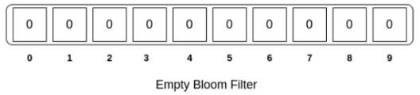
Suppose we use k hash functions, h1, h2, ..., hk.
Pass two strings through these hash functions, and compute their hashes.
If all the hashes are identical for both strings, there is a very high probability that both strings are the same.
On the other hand, even if one hash does not match, we can say that the strings are different.
Bloom filter is an array that stores 0s and 1s,each cell represents a bit,the number below the bit is its index for a bloom filter of size 10.

Slide 42
In order to add an element, we need to pass it through k hash functions.
Bits are set at the index of the hashes in array.
For example,
we want to add the word “coding”.
After passing it through three hash functions, we get the following results.
h1(“coding”) = 125
h2(“coding”) = 67
h3(“coding”) = 19

Slide 43
Suppose that the size of our bloom filter is, m = 10.
We need to take mod of 10 for each of these values so that the index is within the bounds of the bloom filter.
125%10 = 5
67%10 = 7
19%10 = 9
Therefore, indexes at 5,7 & 9 have to be set to 1.

Slide 44
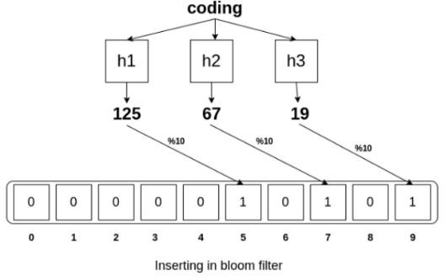

Slide 45
Testing membership of an item in Bloom filter
If we want to test the membership of an element, we need to pass it through
same hash functions.
If bits are already set for all these indexes, then this element might exist in the set.
However, even if one index is not set, we are sure that this element is not present in the set.

Slide 46
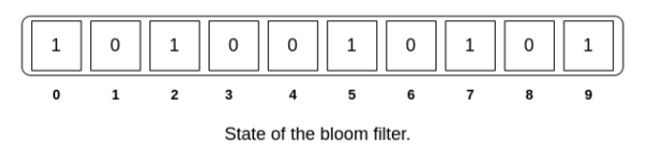
Suppose we wish to add word “music” to the filter after the word “coding”.
Music has the hash output {290, 145, 2} and the indexes {0, 5, 2} are set to 1.
Let’s we want to check the membership of “cat” in our set.

Slide 47
We pass “cat” through the same hash functions and will get the following results.
h1(“cat”) = 233 mod 10=3
h2(“cat”) = 155 mod 10=5
h3(“cat”) = 9 mod 10=9
By checking the indexes {3, 5, 9} for 1,we can see that, indexes 5 and 9 are set to 1, 3 is not,thus we can conclude with 100% certainty that “cat” is not present in the set.

Slide 48
Now let’s, we want to check the existence of word “gaming” in our set, pass it through same hash functions and will get the following results.
h1(“gaming”) = 235 mod 10=5
h2(“gaming”) = 60 mod 10=0
h3(“gaming”) = 22 mod 10=2
By checking the indexes {5,0,2} for 1,we can see that all of these indexes are set to 1. However, we know that “gaming” is not present in the set. it is a case of false positive.
We can predict the probability of these false positives, by considering n = number of elements, m = length of the bloom filter, k = number of hash functions.

Slide 49
Example
Suppose we want to create a Bloom filter to check for the membership of elements in a set of fruits, and we have a filter size of 10 .We'll use two hash functions to map each fruit to multiple positions in the filter.
Initialization: Initially, all bits in the filter are set to 0.
Hash Functions: Define two simple hash functions:
Hash Function 1: Take the ASCII value of the first character of the fruit name and modulo it by 10.
Hash Function 2: Take the ASCII value of the second character of the fruit name and modulo it by 10.

Slide 50
Insertion: Let's insert three fruits into the Bloom filter: "apple", "banana", and "orange".
For "apple":
Hash Function 1: 'a' has ASCII value 97 % 10 = 7.
Hash Function 2: 'p' has ASCII value 112 % 10 = 2.
Set the bits at positions 7 and 2 to 1.
For "banana":
Hash Function 1: 'b' has ASCII value 98 % 10 = 8.
Hash Function 2: 'a' has ASCII value 97 % 10 = 7.
Set the bits at positions 8 and 7 to 1.
For "orange":
Hash Function 1: 'o' has ASCII value 111 % 10 = 1.
Hash Function 2: 'r' has ASCII value 114 % 10 = 4.
Set the bits at positions 1 and 4 to 1.

Slide 51
Membership Test: Now, let's test for the membership of some fruits.
Is "apple" in the set?
Hash Function 1: 97 % 10 = 7 (bit is set).
Hash Function 2: 112 % 10 = 2 (bit is set).
Both bits are set, so we report "apple" might be in the set (possible false positive).
Is "grape" in the set?
Hash Function 1: 'g' has ASCII value 103. 103 % 10 = 3 (bit is not set).
Hash Function 2: 'r' has ASCII value 114. 114 % 10 = 4 (bit is set).
One bit is not set, so we report "grape" is definitely not in the set (no false negatives).

Slide 52
While our Bloom filter allows for false positives, it guarantees no false negatives.
However, the probability of false positives increases as the number of elements inserted into the filter grows.
Adjusting the filter size and number of hash functions can help manage this probability.

Slide 53
Bloom Filter Applications
Bloom filters can be used as the first layer of filtering.
They can be helpful where we want to know if something is definitely not present or possibly present somewhere.
Facebook uses bloom filters to avoid one-hit wonders. One-hit wonders are web objects requested by users just once.
Medium uses Bloom filters in its Recommendation module to avoid showing those posts that the user has already seen.

Slide 54
Count Distinct Problem
The Count Distinct Problem is a common computational problem that involves determining the number of unique elements in a dataset or a stream of data. (cardinality estimation problem).
The elements might represent IP addresses of packets passing through a router, unique visitors to a web site, elements in a large database.
This problem arises in various domains such as database management, data analytics, and network traffic analysis.
It has applications in tasks like
How many different words are found in a web page.
How many different pages does a customer request.
Recent logins

Slide 55
The Flajolet-Martin Algorithm
The Flajolet-Martin Algorithm is a probabilistic algorithm used for estimating the number of distinct elements, proposed by Philippe Flajolet and G. Nigel Martin in 1985.
Key concepts
Probabilistic Counting: Algorithm uses probabilistic counting techniques to estimate the cardinality of a dataset without storing all individual elements. it approximates the cardinality using randomized sampling methods.
Hash Functions: The algorithm employs hash functions to map each element in the dataset to a range of values. These hash functions are chosen to have certain desirable properties to ensure accurate estimation.
The algorithm provides only an approximation of the cardinality and may introduce some level of error, particularly for small datasets or in cases where the hash functions do not provide a sufficiently uniform distribution of values.

Slide 56
Algorithm
Selecting a hash function:
Choose a hash function h such that each element in the set is mapped to a string.
Calculating trailing zeros:
For each element x in the set:
Calculate r(x), which represents the length of trailing zeros in the hashed value h(x).
Finding maximum trailing zeros:
Find R, such that R is the maximum value of r(x) among all elements in the set.
Calculating distinct elements:
Calculate the number of distinct elements as 2^{R}

Slide 57
Stream: 4, 2, 5 ,9, 1, 6, 3, 7
h(x) = (x + 6) mod 32
h(4) = (4) + 6 mod 32 = 10 mod 32 = 10 = (01010)
h(2) = (2) + 6 mod 32 = 8 mod 32 = 8 = (01000)
h(5) = (5) + 6 mod 32 = 11 mod 32 = 11 = (01011)
h(9) = (9) + 6 mod 32 = 15 mod 32 = 15 = (01111)
h(1) = (1) + 6 mod 32 = 7 mod 32 = 7 = (00111)
h(6) = (6) + 6 mod 32 = 12 mod 32 = 12 = (01110)
h(3) = (3) + 6 mod 32 = 9 mod 32 = 9 = (01001)
h(7) = (7) + 6 mod 32 = 13 mod 32 = 13 = (01101)
Trailing zero's : {1, 3, 0, 0, 0, 1, 0, 0}
R = max [Trailing Zero] = 3
Output = 2^{R} = 2³= 8

Slide 58
Tutorial
Suppose our stream consists of the integers 3,1,4,1,5,9,2,6,5. Hash functions are,
1. (2x+1) mod 32
Treat the result as a 5-bit binary integer and estimate the number of distinct elements in the string.
Suppose our stream consists of the integers 3,1,4,1,5,9,2,6,5. Hash functions are,
2. (3x+7) mod 16
Treat the result as a 5-bit binary integer and estimate the number of distinct elements in the string.

Slide 59
Tutorial
Consider a stream consists of the binary digits
101011110010001100
count the number of ones in recent 18 bits using DGIM algorithm
https://www.youtube.com/watch?v=Z_MLrbI1s2E

Slide 60
Counting oneness in a window -DGIM algorithm
How many 1s are there in the last k bits of window with size N, where k<=N
DGIM Algorithm designed to find the number 1’s in a data set.
This algorithm uses O(log²N) bits to represent a window of N bit.
Algorithm allows to estimate the number of 1’s in the window with and error of no more than 50%.
Each bit that arrives has a timestamp for the position at which it arrives.
if the first bit has a timestamp 1, the second bit has a timestamp 2 and so on.. the positions are recognized with the window size N (the window sizes are usually taken as a multiple of 2).
The windows are divided into buckets consisting of 1’s and 0's.

Slide 61
Counting oneness in a window -DGIM algorithm
The DGIM algorithm is a method used for estimating the number of 1's in a sliding window of a data stream, specifically focusing on binary data.
It's useful when we have a large amount of data and need to perform computations on a sliding window without storing all of the data.
Data Structure:
The DGIM algorithm uses a data structure called buckets, which are essentially bins that store information about the position and timestamp of 1's in the data stream.
Sliding Window:
It maintains a sliding window of fixed size.
As the data stream moves, new elements enter the window, and old elements exit.

Slide 62
Bucket Organization:
The buckets are organized into different sizes: 1, 2, 4, 8, ..., up to the size of the window.
Each bucket represents a time range during which the corresponding 1 occurred.
Bucket Merging:
To keep the memory usage manageable, the DGIM algorithm merges buckets of the same size when the number of buckets exceeds a certain threshold.
This involves merging the timestamp information of the merged buckets while keeping track of the count of 1's accurately.
Counting 1's:
To estimate the number of 1's in the sliding window, the algorithm looks at the buckets with the largest sizes first.
It adds up the counts of 1's represented by these buckets and applies a correction factor for buckets that overlap with the end of the window.

Slide 63
Rules for forming the buckets
The right side of the bucket should always start with 1. (if it starts with a 0,it is to be neglected)
E.g. · 1001011 → a bucket of size 4 ,having four 1’s and starting with 1 on it’s right end.
Every bucket should have at least one 1, else no bucket can be formed.
All buckets should be in powers of 2.
The buckets cannot decrease in size as we move to the left. (move in increasing order towards left)

Slide 64
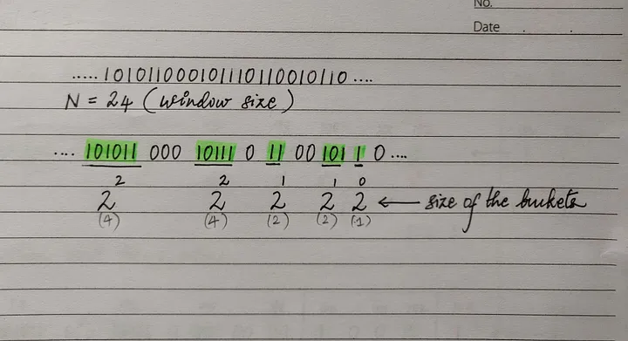

Slide 65
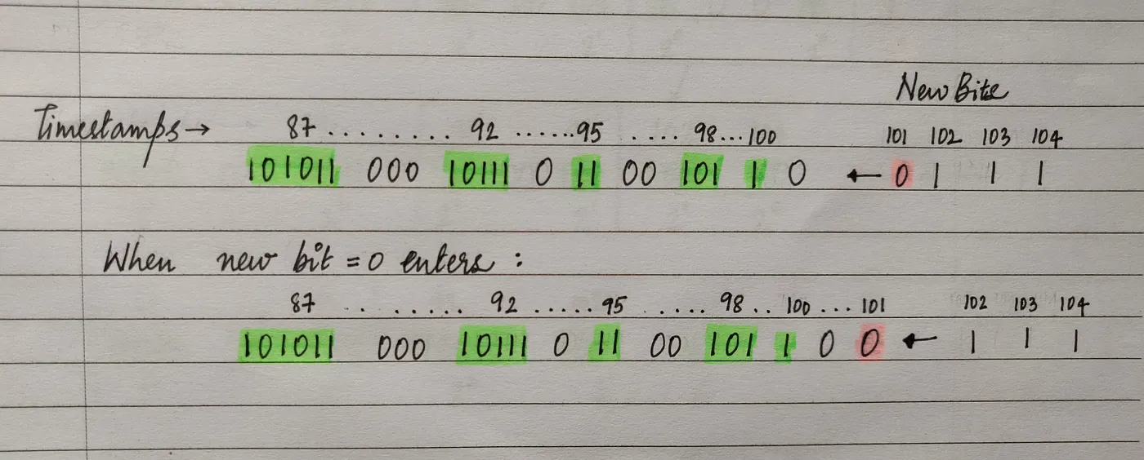
In the given data stream let us assume the new bit arrives from the right ( new bit = 0).
After the new bit ( 0 ) arrives with a timestamp 101, there is no change in the buckets

Slide 66
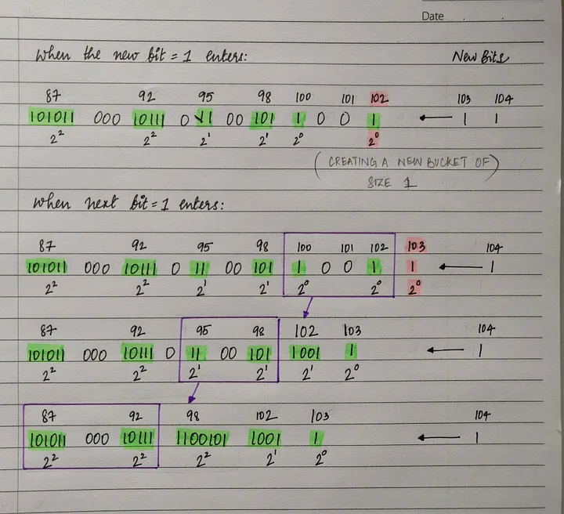
When new bit=1 comes create a new bucket with the current timestamp and size 1.
When 3 buckets are of same size need to combine the leftmost(earliest) two buckets,
this can be done by replacing them(leftmost two buckets) by one bucket of twice the size.
The timestamp of the new bucket is the timestamp of the rightmost of the two buckets.

Slide 67
Now, sometimes combining two buckets of size 1 may create a third bucket of size 2.
If so, we combine the leftmost two buckets of size 2 into a bucket of size 4.
You can continue if current timestamp- leftmost bucket timestamp of window < N (=24 here) E.g. 103–87=16 < 24 so I continue, if it greater or equal to then I stop.
Query
How many 1’s are there in the last 20 bits?
Counting the sizes of the buckets in the last 20 bits, we say, there are 11 ones.

Slide 68
Explain in detail the algorithm used for counting the number of ones in a window.
Consider there is a window of length N=24 on a binary system. Find the total
number of ones in the last 20 bits, when 0111 enters into the given stream
....101011000101110110010110.... The new bit enters from the right side and time
stamp of first new bit is 100.

Slide 69
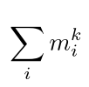
Moments
Estimating moments is a generalization of the problem of counting distinct elements in a stream.
Computing "moments," involves calculation of the distribution of frequencies of different elements in the stream.
Suppose a stream consists of elements chosen from a universal set, assume the universal set is ordered so we can speak of the i^{th} element for any i.
Let m_{i} be the number of occurrences of the i^{th} element for any i, then the k^{th}-order moment of the stream is the sum over all i of (m_{i})^{k}

Slide 70
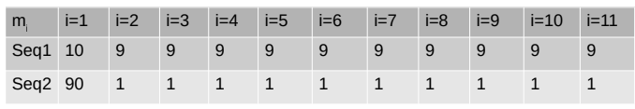
The 0th order moment is the number of distinct elements in the stream
The 1st order moment is the length of the stream
Calculate 0th,1st and 2nd order moments ?

Slide 71
Estimating Moments
Suppose we do not have enough space to count all m_{i} for all elements in the stream, we can still estimate the second moment of the stream using limited amount of space.
The more space we use the more accurate the result will be .
We estimate (approximate) second moment of stream by considering and computing some random number of samples.

Slide 72
Method for Estimating Moments - The Alon-Matias-Szegedy Algorithm for Second Moments
Assume that we know n, the length of the stream.
We will sample s random positions in the stream.
For each sample we will identify X.element and X.count
X.element = element in that position
X.count ← 1 (initially)
When we see X.element again, X.count ← X.count + 1
Estimate second moment as n(2 × X.count - 1)

Slide 73
Example: a,b,c,b,d,a,c,d,a,b,d,c,a,a,b n = 15
m_{a}= 5, m_{b} = 4, m_{c}= 3, m_{d}= 3
second moment calculated as = 25+16+9+9
= 59

Slide 74
Suppose we sample s=3 variables X1, X2, X3
Suppose we pick the 3rd, 8th, and 13th position at random
X1.element=c, X2.element=d, X3 .element=a
X1.count=3, X2.count=2, X3 .count=2 (we count forwards only!)
Estimate n(2 × X.count – 1),
first estimate = 15(6-1) = 75,
Second estimate 15(4-1) = 45,
third estimate 15(4-1) = 45
Average of estimates = 55≃59

Slide 75
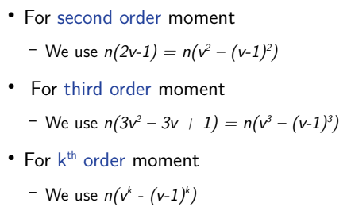
Higher order moments
Consider v as X.count

Slide 76
Importance of Estimating Moments
These are very useful in statistics because they tell you much about your data.
The method of moments is a technique for estimating the parameters of a statistical model.
It works by finding values of the parameters that result in a match between the sample moments and the population moments

Slide 77
Applications of Estimating Moments
It has applications in various disciplines, prominently in engineering, computer science, physics, and finance.
Specifically, it allows for a robust parameter estimation of various types of distributions, enabling decision-making.
Engineering: In system design and control, the Method of Moments plays a significant role in predictive model building and system behaviour estimation.
The method is used to estimate the parameters of the model which best fits the observed system data.

Slide 78
Computer Science: In computer vision and machine learning, the method is employed in the estimation of shape parameters for image segmentation and object recognition.
Physics: In statistical and quantum physics, it is employed for deriving information about the type of inter-particle interactions occurring in a system.
Finance: Method of Moments finds a home in econometrics too, assisting in estimating financial risk by providing measures of skewness and kurtosis for security returns.

Slide 79
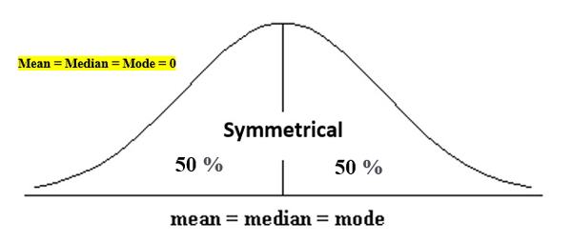
Skewness and Kurtosis are used to describe the spread and height of your normal distribution.
Skewness is used to denote the horizontal pull on the data, tells you how spread out the data is.
Kurtosis is used to find the vertical pull or the peak's height.
Normal distribution

Slide 80
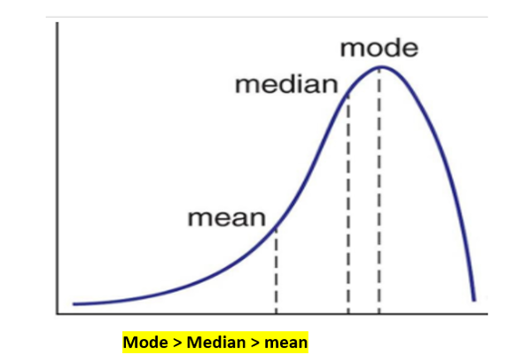
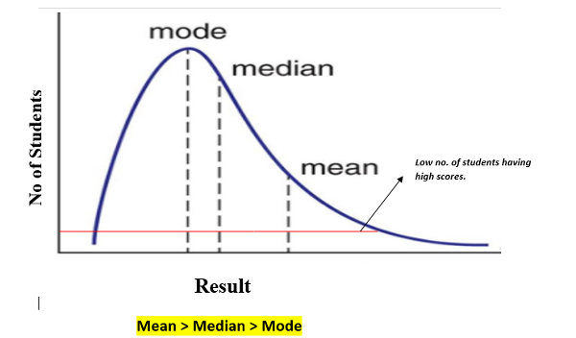

Slide 81
Section 4.5 Exercise 4.5.1 : Compute the surprise number (second moment) for the stream 3, 1, 4, 1, 3, 4, 2, 1, 2.
What is the third moment of the stream

Slide 82
https://pandeyusolution.wordpress.com/estimating-moments/
https://www.studysmarter.co.uk/explanations/engineering/engineering-mathematics/method-of-moments/

