Slide 1
Design, Build, and Enrich Knowledge Base Based on Machine Learning
Sponsored by DXC Technology
Jonathan Lawrence, Jeremy Ramilo, and Jacob Wilson with Chandra Kamalakantha

Slide 2
Project Organization
Team Members: Sponsor:
Jeremy Ramilo - Team Leader Chandra Kamalakantha
Jonathan Lawrence
Jacob Wilson

Slide 3
Project Overview
Our project was to design, build, and implement a system that could return articles based on a user submitted ticket.
Luckily for us, the ticketing system was implemented by a previous group, so we were tasked with returning a list of articles related to the keyword entered into the system by a DXC employee.
While our project was intended to include machine learning our sponsor decided that a deterministic algorithm would be more appropriate for our project.

Slide 4

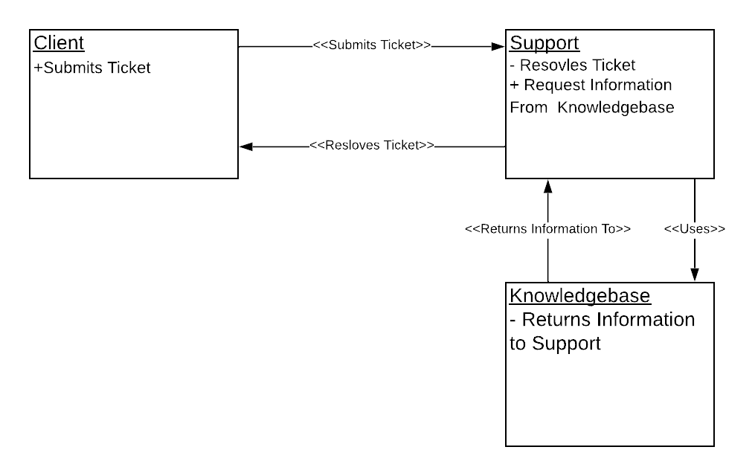
Architecture and Design
We decided early on that Amazon Web Services was the best environment to use for our project, because of its many services such as AWS Lambda, AWS API Gateway, and DynamoDB.
Logical View of System Architecture

Slide 5
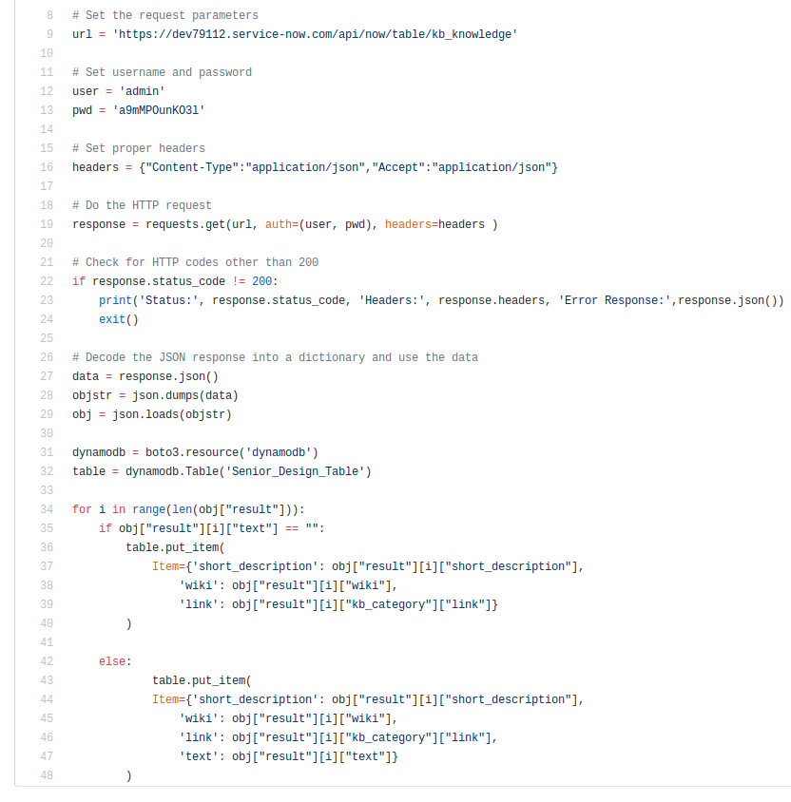
Implementation - Database
Before we could begin implementing our project, we had to populate our database with articles. We wrote a Python script to pull the articles from ServiceNow, a cloud computing company.

Slide 6
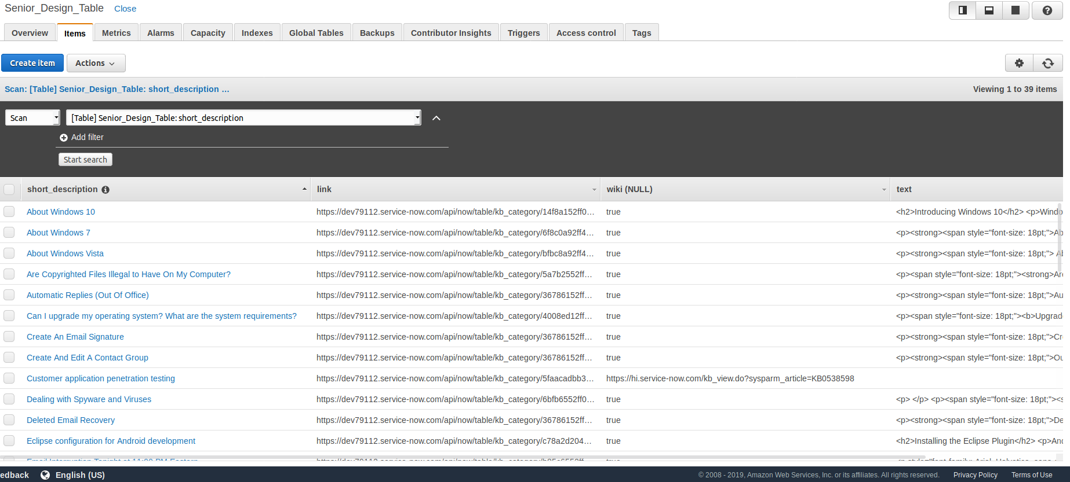
Implementation - Database
We decided to use DynamoDB for our database implementation. We made the decision to use DynamoDB for our database because we decided on a NOSQL data for our project, it is easy to use, and can be easily integrated with other Amazon Web Services.

Slide 7

Implementation - Search Algorithm: How it Works
Our algorithm reads in a string entered by a DXC employee
All punctuation and special characters are removed from the string along with any stop words such as “and”, “the”, “it”, etc
The string is then split into a list of its individual words
The algorithm queries our database for articles with titles containing one or more of the significant words.
Each article is weighted by adding one weight point for each significant word it is related to.
Following this the algorithm returns the articles in order with articles with the highest weight appearing first to the user, and articles with a lower weight appearing later to the user.
Our implementation was designed with extendability in mind.
It will support any future growth to the knowledge base database.

Slide 8

Implementation - Lambda
We decided to use Lambda to implement and run our search algorithm. Lambda is a serveless event driven computing service. This event driven design is perfect for a system based around a user entering keywords like ours.

Slide 9
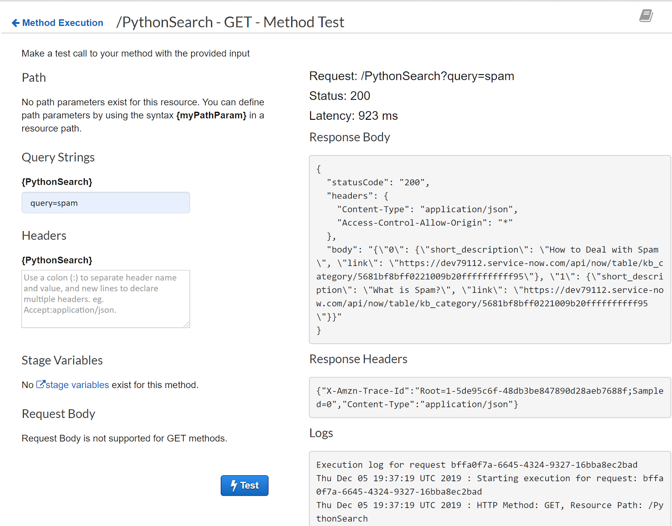
Implementation - API Gateway
Used Amazon’s API Gateway to create a REST API for our project.
Added the necessary resources and created a mock endpoint to implementation.
Added permissions for our lambda function to be invoked via the API.
Crafted a GET method that uses query parameters to set the search term from the user.
Can be reused later in developing web applications

Slide 10
Implementation - Future Work
A GUI would be good feature to implement in the future to make our project more usable for the DXC employees. Our sponsor said it was unnecessary, but we would still like to add one so that our project is easier to use and visualize.

Slide 11
Demo

Slide 12
References
[1] S. W. Ambler, “UML Use-Case Diagrams,” The Elements of UML™ 2.0 Style, pp. 33–46.
[2] “AWS General Reference: Reference Guide,” AWS General Reference , no. 1.0, 2019.

