Slide 1
AIBI Computer Vision for Manufacturing
Group 9
Nathan DiGilio, Jacob Dzikowski, Collin Miller, Daniel Pora
Version 4.0
Notes:
Welcome everyone. This is the senior design presentation 2 for the AIBI Computer Vision for Manufacturing. I am Collin, etc.

Slide 2
Outline
Overview & Broader Impact
Progress Update & Changes
Requirements Review
System Design
Testing Overview
Challenges & Action Plans
Algorithm Analysis
Lessons & Skills Gained
Requirements Satisfaction
Team Logs
Live Demo & Questions
Notes:
Here is an outline of where this presentation is heading. We plan on having time at the end for any questions or clarifications, so please hold questions until the end if possible.

Slide 3





Overview
Notes:
We are going to start with a little recap of what we talked about last time starting with the background of the sponsor.

Slide 4
Sponsor
AIBI Solutions
Spin-off of KMD Technology Solutions
KMD has been developing since 2003
KMD noticed problems that AI could help with
AIBI: Created to offer unique AI solutions
Notes:
AIBI Solutions is a spin-off of KMD Technology Solutions that specialized is AI solutions that do not need the cloud. This way, the AI runs on the infrastructure and avoids security risks
KMD Technology Solutions has been developing since 2003, but noticed problems that AI could supplement if not solve.
AIBI was then created to offer those unique AI solutions to manufacturers who cannot use cloud-based solutions

Slide 5
Needs
Keep production accurate, traceable and fully accountable
Manual tracking often leads to mistakes
Strict data protection rules makes it difficult to use cloud
Companies need solutions that run on-premises
Notes:
Our solution needs to be accurate, traceable, and fully accountable
Since our system will be scanning the QR codes, this will remove the human error that comes with manual scanning
This process also takes time to complete by hand.
This solution must be more accurate than hand tracking and completely on premises

Slide 6
Objectives
Develop a computer vision system for QR detection and process verification
Operate on local systems
Enhance workflow efficiency
QR code detection
Automatically detect and extract data
Removes the need for manual scanning
Process Verification
Ensure each step is completed in the correct order
Alert supervisors about deviations
Notes:
Our system will have 2 main components: QR detection and process verification
The QR detection will automatically identify and extract data from QR codes without requiring a worker to manually scan them. This will help improve efficiency and accuracy by reducing the chance of human error
Our design will handle multiple QR codes at once, for example, a sheet with QR codes and run entirely on local systems
The process verification ensures that each step for a process is completed in the correct order. If one is missed or performed out of sequence, the system will immediately alert a supervisor
This feature helps maintain workflow integrity and ensures consistent, high-quality production without adding unnecessary complexity to the process
Together, these two components enhance manufacturing efficiency, reliability, and security while keeping the system lightweight and easy to use on-site

Slide 7
Broader Impact
Individuals
Real-time feedback reduces operator errors and improves safety
Organizations
Automated audit trails and compliance documentation for manufacturers
Society
Proves AI/CV can be deployed on-premises in regulated industries
All data stays local — full privacy and compliance
Notes:
Recap of broader impact
Enables on-premises semantic AI which means that there will be no cloud usage or manual labeling.
Could be expanded to include real time safety monitoring, training feedback, and automated auditing
This also promotes data privacy, compliance, and ownership while modernizing workflows

Slide 8
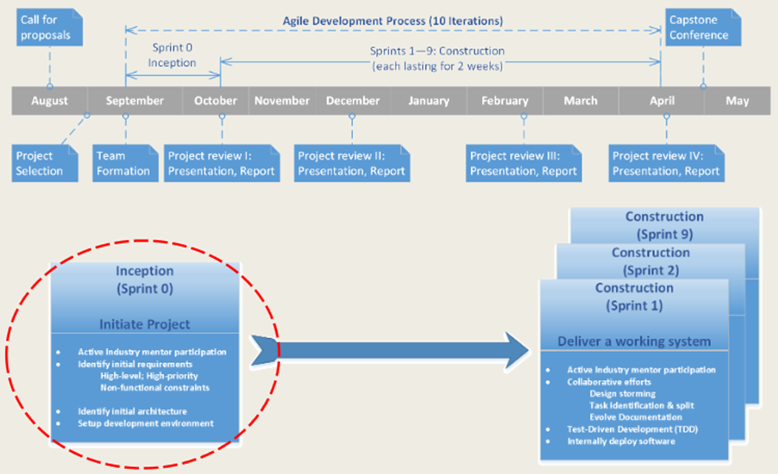
Where Are We?
Completed Sprint 4 — both subsystems functional
Migrated step validation: Streamlit → PySide6 desktop app
21 automated tests passing (11 new this sprint)
54 test design + 54 execution cards
2D data matrix support in progress
Notes:
We still have been trying to have our weekly meetings with both our faculty advisor, prof. Liaw and our industry mentor, Mr. DiGilio. For the QR scanning portion, we are at about 82% implementation. Although this seems high, we are currently only 56% done with entire project andwe are still gathering requirements for the second part. The QR scanning is a simpler task that we were able to figure out really quick so we can have something to show you today. We are still missing some big requirements that have to deal with KMD integration like External Interoperability Requirement 1 which is to integrate with KMD. We will be outputting the data from our scans into a form that Mr. DiGilio is currently making

Slide 9
Changes Since Presentation 3
Step validation UI: Streamlit → PySide6 (native desktop)
Camera release + multi-video upload for training
Auto-start monitoring with progress bar
DINOv2 embedding visualization tool
11 new unit tests for AUTO test-case coverage
System + acceptance test cases added (8.2.4, 8.2.5)
Notes:
One of the biggest changes we made is that we will not be scanning barcodes. We will only be dealing with QR codes.
I also went in and fixed the issues with our use case diagram
Finally, I went in and split the system requirements up to make them more specific and more importantly, testable.

Slide 10
What's New in Sprint 4
QR Scanning
2D data matrix support, directional scanning improvements
Step Verification
End-to-end: training, monitoring, violation logging
Native PySide6 app with threaded camera workers
Training Workflow
3-phase: Record → Review → Augment
Testing
21 automated tests, all AUTO IDs implemented
Notes:
So what is happening now?
We decided to focus on the first part of our project which is the QR code scanning, this is much more doable than part two and will not take up as much time to complete
We plan on tackling the Process Verification when the QR scanning portion is complete
We took a tour of the facility,
The tour broadened our scope with what we actually have to do.
This did give us a good understanding on everything. The lighting in the facility is great for the scanning. Camera position will definitely be a challenge

Slide 11
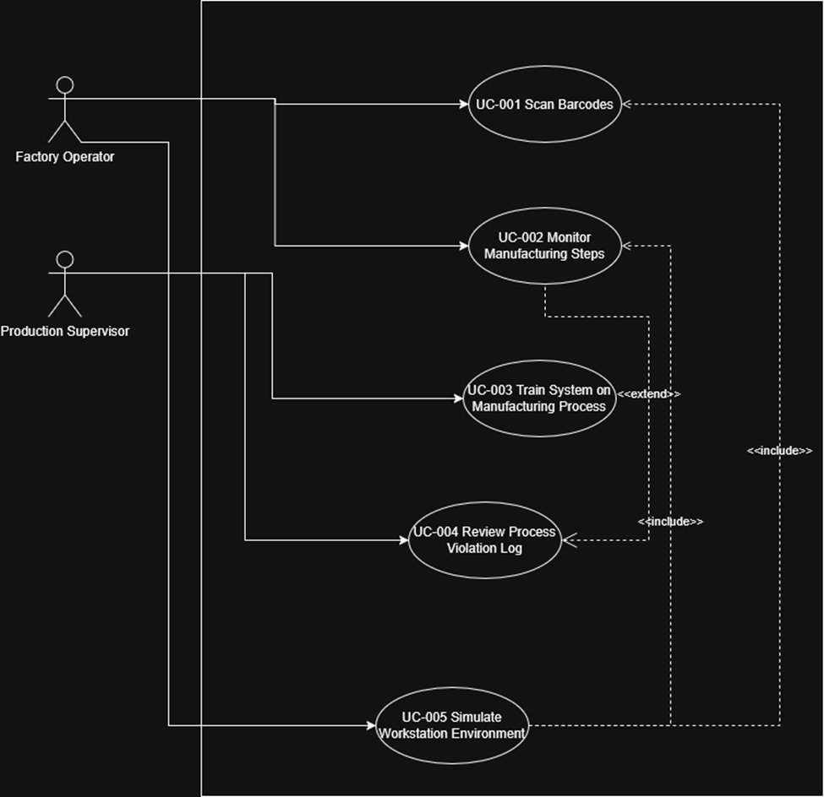
Requirements Review
Notes:
To get into our use case diagram, it has been mainly unchanged. We did remove Senior Design students as a main actor and also added a border to the system.

Slide 12
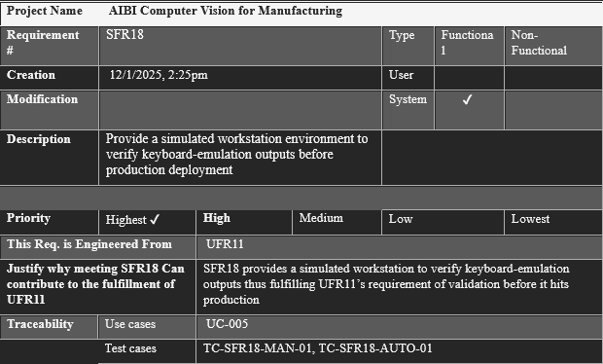
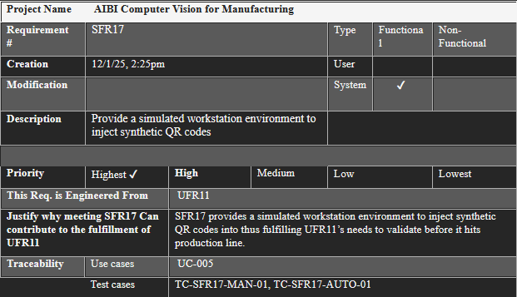
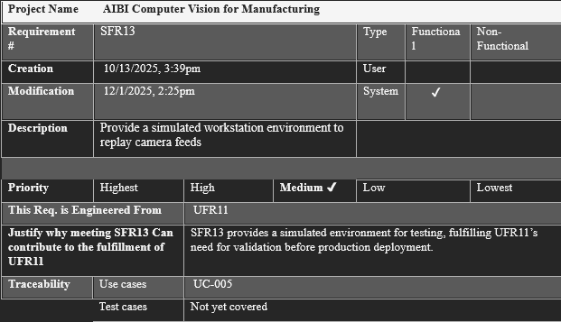
Requirements Changes in v4.0
Notes:
The three main system requirements I want to go over are System functional 13, 17, and 18. These were originally all one requirement under System Functional 13. We made SFR 17 and 18 highest priority mainly for testing and to potentially show our client our system.

Slide 13
Preliminary System Design
Notes:
In this section I will be talking about the whats and hows of our system. I’ll start by talking about the general WHAT our system is going to look like through our package diagram, this should give us a nice overview of some of the high-level details of our system. Following this, I will then go a little bit lower in level and talk more in detail of the structure through the class design. Then, I’ll swap over to our activity diagram, which will focus on the HOW our system will behave.

Slide 14
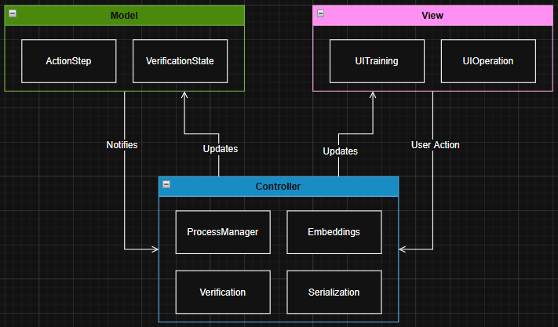
Architectural Design
QR Scanning: MVC Pattern
Controller → DecodeQr → Parse → OutputData
Step Verification: Signal/Slot Threading
MainWindow → TrainingWidget / OperationWidget
QThread workers emit frames/results via signals
Why PySide6? Streamlit couldn't handle real-time camera + threading
Notes:
So, first, starting with our package diagram. You can see our entire system is in the AIBI CV package, in here we have 5 internal packages [list out] and we have the 2 external [list out].
So, I’ll start by talking about the Camera package. In this package we have our CameraController which initializes our CameraScanner here. Our CameraScanner is the main orchestrator of our system. It will first open our camera with the VideoCapture Package from cv2, then it will start scanning for QR codes. The scanner will then use the QRDecode package to detect and decode any visible QR codes. We have 3 different strategies to detecting and decoding QR codes but I will talk about this soon. We then take the QR code data and parse it into a JSON format using the Parse package. Once parsed, we will then output that data via the DataOutput package.
The QR codes will be displayed through the ResultDisplay module, and while going through this whole process we will be capturing system information, like exceptions and scanned codes through our logging system.

Slide 15
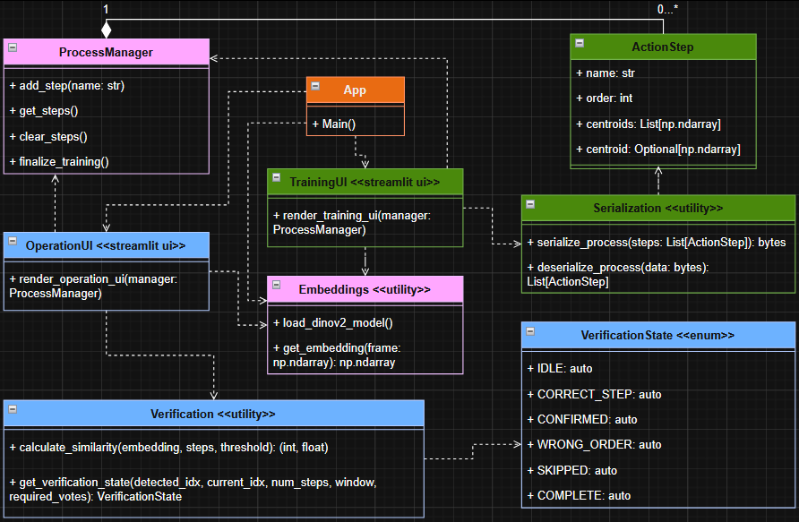
Structural Design
QR Subsystem
Camera, DecodeQr, Parse, OutputData, ConfigManager
Step Verification Subsystem
ProcessManager, ActionStep, VerificationState
embeddings.py — DINOv2 inference
verification.py — similarity + state machine
workers/ — CameraWorker, OperationWorker
widgets/ — TrainingWidget, OperationWidget
Notes:
For our structural design, we went with a class diagram. We designed the system to be as modular as we can make it so that new features can be added quick and easy if needed. We also wanted to go for something that would be easy to debug and maintain. We accomplished this by dependency injection through the main Camera class, in here all of our dependencies are set through its constructor. With dependency injection brings loose coupling which is exactly what we want for system. Loose coupling lets that easy swap of features or components we were talking about.
In our DecodeQR class we have the 3 alternatives we were talking about. When trying to decode a QR code, we start by trying to detect multiple qr codes with PYZBAR. If this fails we try to get multiple with OPENCV, then if this fails we try to only detect one with OPENCV. Using this fallback method, we decrease our odds of a failed scan.
Dan: Your role is to go into more detail about the structure of the system. I went over the high level structure, now you will talk more about the details of it. In the previous slide I set you up to talk about our different strategies/fall-backs for qr decoding, so do that. You can also talk about the dependency injection, and how this promotes loose coupling which is good in our system because different things can be swapped out easily.

Slide 16
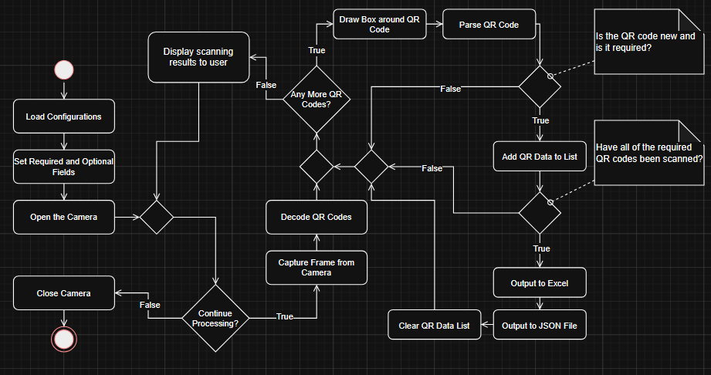
Activity Diagram
Notes:
Now I will be talking about the HOW of our system. Here we have our activity diagram, this basically defines the behavior of our system.
I’ll start by talking about some of the main portions of this diagram, then I’ll go into more detail.
So, at the start we initialize required variables, and then you can see here, we hit our first decision node. This node is the main processing loop in our system, basically in this loop we go through each frame and check for detected QR codes. So, from here, and all of this, to here we are processing the QR codes.
At this decision node, we are checking to see if any qr codes were found, if there were, then we will process them, if not we scan again.
So now we have the basics down, lets go into detail.
At the start we are loading all of our configurations, with the required fields, the fields are the expected QR codes for the station. Then we open the camera. Now we start the loop, so we capture the current frame and decode any qr codes detected. If none were found then we scan again, but if there were, we draw a box around it and parse it.
Then we check if it is one of the codes required for the station, we also check if it’s a new code and not just a duplicate. If these cases pass then we will add it to our list.
We will then check if all of the required codes the station have been scanned, if yes, we will output that data to Excel and store it in a JSON file. All the scanned codes will then be cleared, and the process will start over.
And the only way for the loop to break, is if the user quits the process.
Now that we know a little more of our system, lets talk about the challenges faced.

Slide 17
Design Alternatives
UI: Streamlit vs. PySide6 vs. Electron
PySide6: native threading, no browser, real-time camera
Model: OpenCLIP vs. MobileCLIP vs. DINOv2
DINOv2: open-source, strong features, no labels needed
Verification: Single-frame vs. Sliding-window
Sliding window: 7/10 consensus eliminates jitter
Notes:
For our behavioral diagram, we decided to do an Activity diagram because it best designs our system. Being a flowchart like diagram, the activity diagram is very easy to understand, which helps get our point across.
We could’ve done a sequence diagram, but our system does not really have the complexity required for it.
However, we didn’t do a State Diagram because our system does not have well defined states.

Slide 18
Test Cases
Notes:
In this section Collin and I are going to be talking about the whats and hows of our system. I’ll start by talking about the general WHAT our system is going to look through our package diagram, this should give us a nice overview of some of the high-level details of our system. Collin will then go a little bit lower in level and talk more in detail of the structure through his class design. Then, I’ll swap over to our activity diagram, which will focus on the HOW our system will behave.

Slide 19
Test Cases
54 test design cards / 54 execution cards
21 automated tests passing (pytest)
Suites:
Unit — QR decode, parse, config
Integration — end-to-end workflows, simulation
System — deployed workstation, MES/ERP, step verification
Acceptance — operator and supervisor UAT
Notes:
"This slide gives us an overview of the testing structure our project. We've organized the tests into five main Test Suites to ensure comprehensive coverage.“
break
"The first three are System/Manual Functional, Usability and Operator Workflow, and System-Level Non-Functional. These focus on testing the core features and how the user interacts with the system, as well as high-level performance and requirements.“
break
"The next two, Automated Functional and Automated Non-Functional, are designed to be run without human intervention, covering both feature correctness and areas like performance or security.“
break
"Overall, these suites utilize two main types of test execution: Manual tests, which an operator performs directly, and Automated tests, which are scripted."

Slide 20
UI Design
Training Mode (PySide6 — 3 phases):
1. Record: Live camera capture or video file upload
2. Review: Draggable segment list with thumbnails, reorder, rename, delete
3. Augment: Add more videos to already-trained steps, merge embeddings
Operation Mode (PySide6):
Progress bar showing Step X / Y completion
Live video feed with annotated state overlay
Real-time status bar: state + confidence percentage
Start / Stop / Restart controls
[INSERT SCREENSHOTS OF BOTH MODES HERE]
Notes:
"This is our initial manual test, TC-SFR1-MAN-01, focusing on the most basic functional requirement: Live Camera Detection.“
-
"What it tests: Does the live camera view detect all visible QR codes? This validates the core computer vision capability.“
-
"Test Data Input: We use physical, printed QR codes placed within the camera's field of view.“
-
"Expected Result: The system's output or user interface must show all visible codes.“
-
"Traceability: This case ties back to a foundational user requirement, UFR1, and multiple system functional requirements, SFR1, SFR15, and SFR16, all related to the visibility and detection of codes."

Slide 21
Challenges & Action Plans
Hard-coded hyperparameters — threshold, window, confidence have no validation
→ Move to config.yaml with ranges; add argparse validators
Silent QR exception handling — camera failures look like empty frames
→ Add structured logging before returning empty results
No camera recovery — USB disconnect forces full monitoring restart
→ Implement exponential-backoff retry with reconnecting indicator
Missing deployment validation — no pre-flight check for workstations
→ Create tools/validate_deployment.py for configs, camera, model, I/O
Incomplete audit trail — error states not logged structurally
→ Add errors[] array to run-record schema with typed timestamps
Notes:
"Moving to data output, TC-SFR4-MAN-01 verifies the system's ability to format data correctly.“
-
"What it tests: Does a real scanning event produce a correct JSON record? This is critical for downstream systems.“
-
"Test Data Input: A live scan event using known, verifiable QR codes.“
-
"Expected Result: A single JSON record must be created that contains all necessary data and metadata associated with the scan event.“
-
"Traceability: This supports UFR1 and UFR4, confirming the correct data is output, and system requirements SFR4 and SFR11 regarding data structure and output format."

Slide 22
Algorithm: DINOv2 Embedding Pipeline
Pseudocode:
function GET_EMBEDDING(frame):
img ← resize(frame, 256) → center_crop(224)
tensor ← normalize(img, ImageNet μ/σ)
embedding ← DINOv2_ViTS14(tensor) // 384-dim vector
return L2_normalize(embedding)
function TRAIN_STEP(frames[1..n]):
for each frame_i: e_i ← GET_EMBEDDING(frame_i)
centroid ← L2_normalize( mean(e_1, ..., e_n) )
return centroid
Complexity:
Time: O(d) per frame inference (d=384). O(S·n·d) to train S steps, n frames each.
Space: O(S·d) to store all step centroids.
Notes:
"TC-SFR5-MAN-01 addresses a common integration method: Keyboard Emulation.“
"What it tests: Does the system's keyboard-emulation feature output the correct decoded text to a target application, simulating a traditional scanner?“
"Test Data Input: A live scan while a simple text field, like a Notepad field, is in focus.“
"Expected Result: Exactly correct keystroke output must appear, confirming the emulation is accurate and reliable.“
"Traceability: This is traced to user requirement UFR9 (the need for easy data entry) and system requirements SFR5 and SFR18, verifying the correct output mechanism."

Slide 23
Algorithm: Sliding-Window Verification
Pseudocode:
function VERIFY(embedding, steps, window, threshold):
best_idx ← argmax_s( dot(embedding, steps[s].centroid) )
if similarity(best_idx) < threshold: return IDLE
window.append( (now(), best_idx) )
prune entries older than window_duration
votes ← count(window, best_idx) / len(window)
if votes >= required_fraction:
if best_idx == current_step: return CONFIRMED
if best_idx < current_step: return WRONG_ORDER
if best_idx > current_step: return SKIPPED
return CORRECT_STEP // still accumulating
Complexity:
Time: O(S) per frame for similarity. O(W) for window pruning. Total: O(S + W).
Space: O(W) for sliding window entries.
Notes:
"Here, with TC-SFR15-MAN-01, we test the system's robustness in real-world conditions.“
break
"What it tests: The ability to perform live multi-code decoding under typical manufacturing floor lighting. Lighting conditions are a major variable for CV systems.“
break
"Test Data Input: A printed QR sheet containing multiple codes with known values.“
break
"Expected Result: All codes must decode correctly, validating the system's image processing and decoding algorithms under stress.“
break
"Traceability: This is a key validation for UFR1 (basic function) and SFR15 (performance under environmental conditions)."

Slide 24
Lessons Learned
Start modular — our monolithic Streamlit app had to be fully rewritten
when we hit threading limitations. A modular architecture from the
start would have saved weeks of refactoring.
Mock data ≠ real conditions — controlled test images worked perfectly,
but real factory lighting, camera angles, and partial occlusion
caused unexpected failures during on-site testing.
Test early, trace everything — writing test cases late revealed gaps
in requirement coverage. Building traceability from day one keeps
the project honest and auditable.
Communicate proactively — information flows through multiple layers
(manufacturer → KMD → AIBI → team). We learned to ask specific
questions early rather than wait for answers to trickle down.
Notes:
"TC-SFR16-MAN-01 is a verification test focused on completeness of output.“
break
"What it tests: Does the system's output include all visible QR codes when multiple codes are present in the view?“
break
"Test Data Input: A live multi-code scan event.“
break
"Expected Result: The output must precisely match the count and content of the visible codes, ensuring no codes are dropped during processing.“
break
"Traceability: This reinforces UFR1 and specifically system requirement SFR16, which governs multi-code handling."

Slide 25
Skills Learned
Deep learning deployment
Loading, caching, and optimizing DINOv2 for real-time inference
on edge hardware — directly applicable to production ML systems
Qt / PySide6
Building multithreaded desktop apps with signal/slot architecture,
threaded camera workers, and responsive UIs
Computer vision pipelines
OpenCV preprocessing, DINOv2 embedding extraction, cosine similarity
matching, and sliding-window consensus — end-to-end CV system design
Requirements engineering
Full traceability: user needs → system requirements → use cases →
test cases → execution reports — a discipline for future roles
Notes:
"Switching to our automated suite, TC-SFR1-AUTO-01 tests the core detection algorithm on a static input.“
break
"What it tests: Does the QR detection function return all codes in a static image? This isolates the algorithm from live camera feed variables.“
break
"Test Data Input: A multi-QR test image with a known number (N) of codes.“
break
"Expected Result: The automated detect_qr_codes() function must return N codes, and their decoded payloads must match the known ground truth.“
break
"Traceability: This directly supports UFR1 and system requirements SFR1, SFR15, and SFR16, all essential for accurate code reading."

Slide 26
Requirements Satisfaction
QR Scanning (Part & Material Tracking):
UFR1 Detect/decode multiple QR codes — Met
UFR4 Structured JSON output with metadata — Met
UFR5 Keyboard emulation to target apps — Met
UFR9 Configurable workstation behavior — Met
Step Verification (Worker-Step Tracking):
UFR2 Monitor steps in correct sequence — Met
UFR3 Supervisor trains system on processes — Met
UFR6 Real-time visual feedback and alerts — Met
UFR8 Intuitive training UI for non-technical users — Met
Non-Functional:
Security — All data stays on-premises — Met
Performance — Real-time inference < 1s per frame — Met
Usability — Operators complete workflows after brief onboarding — Met
Notes:
"TC-SFR2-AUTO-01 verifies the system's business logic for data handling.“
break
"What it tests: The crucial step of field mapping—does the system correctly assign the decoded values to their logical fields?“
break
"Test Data Input: A decoded QR list combined with the system's workstation mapping configuration file.“
break
"Expected Result: The resultant mapped JSON must contain the correct field-value assignments, validating the configuration logic.“
break
"Traceability: This is key for UFR2 (using the data) and system requirements SFR2 and SFR4 (data processing and output)."

Slide 27
Test Results Summary
Automated Test Results (pytest):
test_unit_requirements.py .......... 10 passed
test_auto_coverage.py ........... 11 passed
Total: 21 passed, 0 failed
Test Coverage by Category:
Functional: SFR1-SFR18 — all AUTO cases implemented
Non-Functional: PPSR2, PPSR5, PDSR1-4, ODSR1, OOSR4, EISR3-6 — covered
System tests: MAN cases executed on deployed workstation
Acceptance tests: UAT with operator and supervisor stakeholders
[INSERT SCREENSHOT OF PYTEST OUTPUT HERE]
Notes:
"Finally for functional automation, TC-SFR11-AUTO-01 ensures data compatibility.“
break
"What it tests: Does the final JSON output match the published schema? This is vital for integration with other enterprise systems.“
break
"Test Data Input: JSON outputs from multiple workflows within the system.“
break
"Expected Result: All outputs must validate successfully against the predefined schema.“
break
"Traceability: This validates user requirement UFR7 (reliable data format) and system requirement SFR11 (standardized data output)."

Slide 28
Challenges, Algorithms & Reflections
(Section Divider)
Notes:
"Our only automated non-functional test presented here, TC-PDSR1-AUTO-01, addresses a key security and deployment requirement.“
break
"What it tests: Does the system store data locally? This means no external endpoints should be contacted.“
break
"Test Data Input: A configuration inspection script to examine system files and network settings.“
break
"Expected Result: The inspection must confirm that all endpoints are local; there should be no external URLs configured for data storage or transfer.“
break
"Traceability: This directly supports user requirements UFR10 and UFR7 (security and data control) and the specific design requirement PDSR1 (Protected Data Storage Requirement 1)."

Slide 29
Challenges

Slide 30
Original Challenges (Addressed)
Facility security — limited access to real data
Simulation harness for offline testing
DINOv2 loading latency (~5s)
Pre-load with async progress dialog
QR detection in poor lighting
3-tier fallback: pyzbar → OpenCV multi → single
Step detection jitter
Sliding-window voting (7/10 consensus)
Monolithic app.py
Refactored into widgets, workers, models

Slide 31
Team Member Logs

Slide 32
Nathan DiGilio
Date | Task | Duration
3/16/2026 | Advisor meeting, group work/discussion | 2 hours
3/22/2026 | Enhanced training/verification with segment handling | 4 hours
3/26/2026 | Mentor meeting, group work/discussion | 2 hours
4/5/2026 | Refactored step validation into modular widgets/workers | 5 hours
4/6/2026 | Advisor meeting. Auto-start + progress bar | 4 hours
4/13/2026 | Camera release, preview behavior, run logging | 4 hours
4/15/2026 | Embedding visualizer, 11 new unit tests, Parse fix | 5 hours
4/17/2026 | Fasenmeyer poster, group discussion | 4 hours
4/19/2026 | 2D data matrix fixes, report updates | 5 hours

Slide 33
Jacob Dzikowski
Report 4
3/16/2026 | Advisor meeting, group work/discussion | 2 hours
3/25/2026 | Integration tests for simulation pipeline | 3 hours
3/26/2026 | Mentor meeting, group work/discussion | 2 hours
4/1/2026 | Debugged buffer flush race in simulation | 4 hours
4/6/2026 | Advisor meeting, group work/discussion | 2 hours
4/8/2026 | Mentor meeting, group work/discussion | 2 hours
4/10/2026 | Performance acceptance benchmarks | 3 hours
4/13/2026 | Advisor meeting, group work/discussion | 2 hours
4/15/2026 | Fasenmeyer poster — technical background | 3 hours
4/17/2026 | Poster finishing touches, group discussion | 4 hours
4/19/2026 | Updated report sections 8.2 and 8.3 | 4 hours
 |  | Total: 31 hours

Slide 34
Collin Miller
Date | Task | Duration
3/16/2026 | Advisor meeting, group work/discussion | 2 hours
3/25/2026 | Worker-step verification testing, occlusion issue | 3 hours
4/3/2026 | Adjusted embedding window for occlusion recall | 4 hours
4/6/2026 | Advisor meeting, group work/discussion | 2 hours
4/10/2026 | Per-operator filtering for supervisor reports | 3 hours
4/13/2026 | Advisor meeting, group work/discussion | 2 hours
4/15/2026 | Fasenmeyer poster — results and evaluation | 3 hours
4/17/2026 | Poster finishing touches, group discussion | 4 hours
4/19/2026 | Pair programming on 2D data matrix | 5 hours

Slide 35
Dan Pora
Date | Task | Duration
3/16/2026 | Advisor meeting, group work/discussion | 2 hours
3/24/2026 | MES/ERP interop testing, whitespace bug | 3 hours
4/2/2026 | Fixed payload whitespace, re-ran 200 scans | 4 hours
4/6/2026 | Advisor meeting, group work/discussion | 2 hours
4/8/2026 | Mentor meeting, group work/discussion | 2 hours
4/11/2026 | Security acceptance test, traffic capture | 3 hours
4/13/2026 | Advisor meeting, group work/discussion | 2 hours
4/15/2026 | Fasenmeyer poster — architecture diagram | 3 hours
4/17/2026 | Poster finishing touches, group discussion | 4 hours
4/19/2026 | Report 9.3, deployment validation review | 4 hours

Slide 36
Demo

Slide 37
Questions?

Slide 38
Thank you

