Slide 1
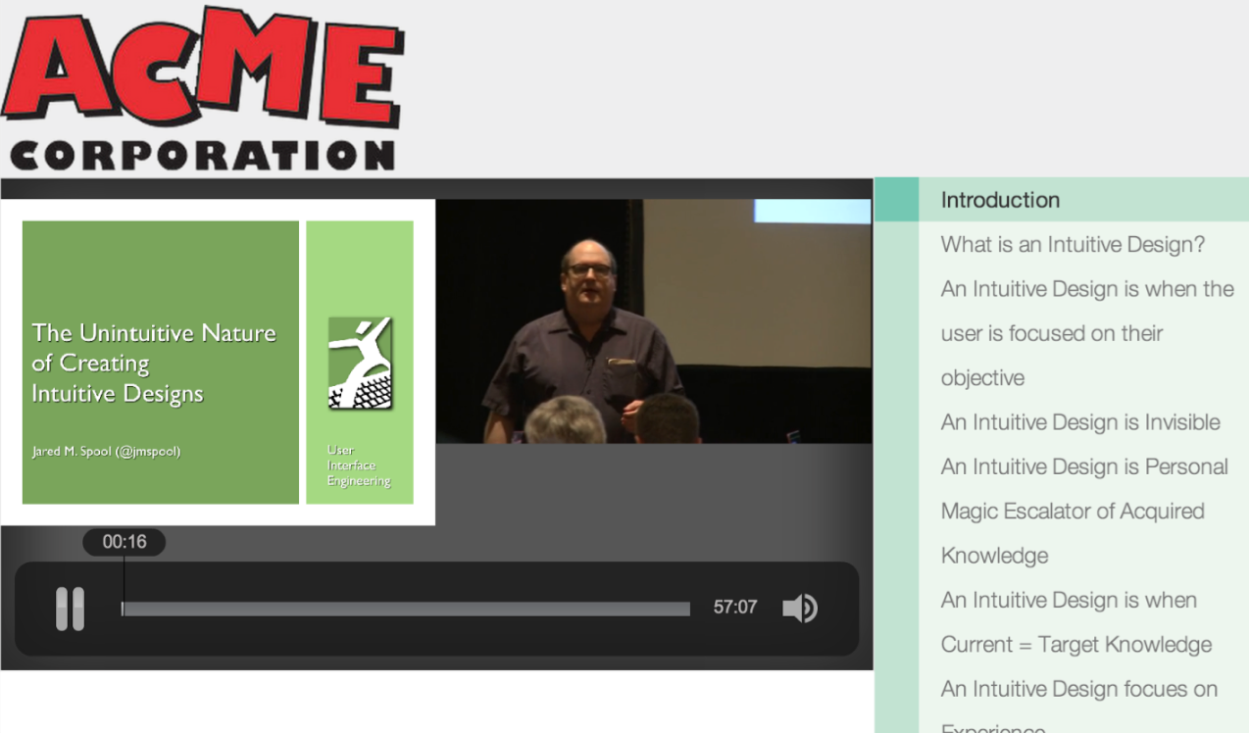
Knowledge Vision Design Wizard
Branding
ComboPlayer
Navigator
Footnotes
Attachments
Question
Transcript
Social Media
Presentation Info
Notes:
- The workspace would contain the example template elements that would change as you went through the wizard. Or if you already uploaded all the requisite elements (your slide, your video), your stuff would show up in the design wizard workspace
- Everything you change in the fields would change in the underlying html file for the template

Slide 2
Knowledge Vision Design Wizard
Branding
ComboPlayer
Navigator
Footnotes
Attachments
Question
Transcript
Social Media
Presentation Info
Logo
Upload
Orientation
Left
Background Color
Font
Calibri
Primary Color
Secondary Color
Notes:
This is the place where your choices will effect the entire presentation
Imagine that when you change the colors in branding – it will auto-update the color fields for the other elements of the presentation, but you can always customize the colors for each element separately as you go through the wizard
The colors will open up in the color picker that I saw somewhere when I was poking around the website

Slide 3
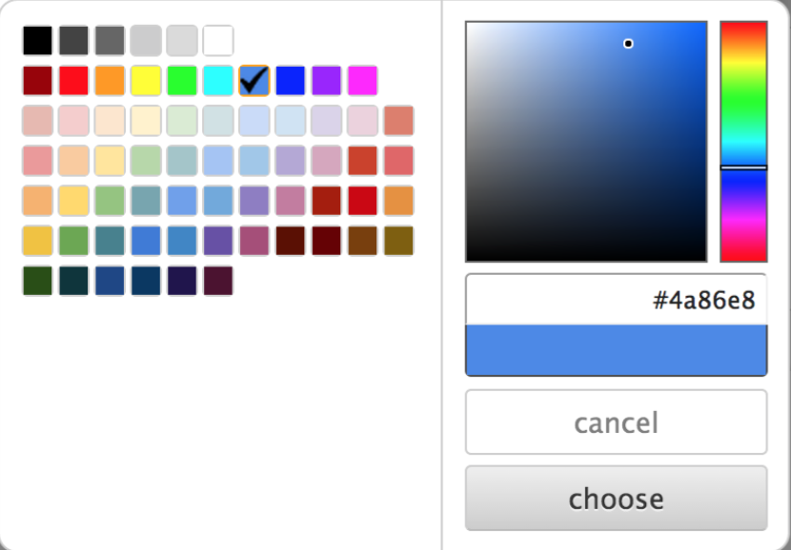
Knowledge Vision Design Wizard
Branding
ComboPlayer
Navigator
Footnotes
Attachments
Question
Transcript
Social Media
Presentation Info
Logo
Upload
Orientation
Left
Background Color
Font
Calibri
Primary Color
Secondary Color
Notes:
Imagine that when you change the colors in branding – it will auto-update the color fields for the other elements of the presentation, but you can always customize the colors for each element separately as you go through the wizard
The colors will open up in the color picker that I saw somewhere when I was poking around the website

Slide 4
Knowledge Vision Design Wizard
Branding
ComboPlayer
Navigator
Footnotes
Attachments
Question
Transcript
Social Media
Presentation Info
Responsive
Yes
Orientation
Left
Zoom-Control
Yes
Dimensions
16:9
Background
Upload
Full-screen
Yes
Value
Combo
Border
Notes:
Responsive will default to yes
Dimensions will default to 16:9 and then they can change it. I think it would be good to have a certain subset of default ratios for them to choose from.
Value is for the different player control types – combo, fixed, video, none
Orientation is either left or right, defaulting to left (will lock the other things in as well)

Slide 5
Knowledge Vision Design Wizard
Branding
ComboPlayer
Navigator
Footnotes
Attachments
Question
Transcript
Social Media
Presentation Info
Chapters
No
Background
Orientation
Left
Thumbnail
No
Border
Playlist
No
Notes:
- Toggles whether or not you want them

Slide 6
Knowledge Vision Design Wizard
Branding
ComboPlayer
Navigator
Footnotes
Attachments
Question
Transcript
Social Media
Presentation Info
Include:
No
Background
Border
Notes:
- My thoughts on the extra elements are as follows: there is space for 3 positions so

Slide 7
Knowledge Vision Design Wizard
Branding
ComboPlayer
Navigator
Footnotes
Attachments
Question
Transcript
Social Media
Presentation Info
Include:
No
Background
Border

Slide 8
Knowledge Vision Design Wizard
Branding
ComboPlayer
Navigator
Footnotes
Attachments
Question
Transcript
Social Media
Presentation Info
Include:
No
Background
Border

Slide 9
Knowledge Vision Design Wizard
Branding
ComboPlayer
Navigator
Footnotes
Attachments
Question
Transcript
Social Media
Presentation Info
Include:
No
Background
Border

Slide 10
Knowledge Vision Design Wizard
Branding
ComboPlayer
Navigator
Footnotes
Attachments
Question
Transcript
Social Media
Presentation Info
Include:
No
Color:

Slide 11
Knowledge Vision Design Wizard
Branding
ComboPlayer
Navigator
Footnotes
Attachments
Question
Transcript
Social Media
Presentation Info
Title:
Fill in title here

