Slide 1

California Public Library Broadband Project Update
Jarrid Keller-California State Library
Joe Ford- Joe Ford & Associates
Diane Satchwell-SCLC
Wayne Walker-Califa
Sherilyn Evans-CENIC

Slide 2
Today's Topics
Agenda
Partners in Broadband
How Far We’ve Come
Who Is Connecting?
How Does Contracting Work?
What Are the Costs?
One-Time Grants
Equipment Discounts
FY 2016/2017 Process
Questions

Slide 3




Partners in Broadband
California State Library
Program management and oversight.
SCLC
Fiscal Agent and grant monitors for the grant program.
Working on process to extend their services to Grant Applicants for equipment purchasing and contracting.
Califa
Aggregator for statewide broadband project.
Entity coordinating bulk equipment purchases to take advantage of consortium pricing for network equipment.
CENIC
Owner and Operator of CalREN-The Libraries Network

Slide 4



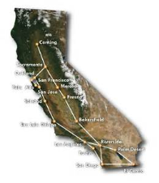


How Far We’ve Come
Feb 2014
July 2014
Nov 2014
Dec 2014
Feb 2015
July 2015
$ 2.25 Million
CENIC Membership
E-Rate Consortium Formed
Aggregator Selected
Grant Partner Selected
Libraries Begin Connecting to CalREN
$ 1.0 Million
One-Time Grants

Slide 5
Who Is Connecting To CalREN?
Received 88 LOAs in Nov 2014
Libraries Connecting
30+/- Contracts in Progress

Slide 6
How Does Contracting Work?
CENIC contracts with “last-mile” providers and with Califa as the aggregator.
Califa contracts with libraries as the entity holding the contracts for broadband service.
Libraries pay Califa monthly for telecom services.

Slide 7
What Are the Costs? They Vary
Costs are based on the vendor responses to E-rate 470 process; libraries need to have a Letter of Agency (LOA).
E-rate discounts apply, as well as CTF discounts. E-rate can apply to one-time & recurring costs; CTF only applies to recurring.
Installation costs factored in, can be E-rate discounted. In-building costs (installation and equipment) may be grant-eligible.
Discounts for network hardware also exist, both from E-rate and from CENIC bulk-rate purchase program.
Monthly costs after discounts can go as low as $125 for 1 Gbps.
What are Libraries Paying?

Slide 8
Grant Program Update
$ 1.0 Million
Governor’s Budget
$ 1.8 Million
One-Time
$ 800 K
CLSA One-Time

Slide 9
One-Time Grants: 3 Areas
Technology Funding
$ 1.8 Million
FY 14/15
Architectural And Building Funding
Consulting: Equipment Configuration

Slide 10
One-Time Grants: Phase 1
PHASE 1 GRANTS

Slide 11
Grant Program Eligibility Requirements
Participate as a public library in the California Library Services Act.
Participated in the statewide broadband needs assessment in the 2013-2014 fiscal year.
Submitted a Letter of Agency to the California State Library by Oct. 31, 2014.
Participated in engineering calls with Corporation For Education Network Initiatives In California representatives in November and December 2014.
Remain in the California Public Library E-rate consortium and sign contracts to connect to the California Research and Education Network in Fiscal Year 2015-2016 or in 2014-2015.
Program Eligibility

Slide 12
Grant Fiscal Agent
SCLC serves as fiscal and administrative agent for $1.8 Million grant funds for one-time equipment grants in support of CPL Broadband Project.
Sends grant funds to awarded applicants.
Extends equipment purchasing services to grantees that choose to use SCLC’s services.
All equipment necessary to connect to CalREN will be purchased by CALIFA.
SCLC as
Grant Aggregator

Slide 13
One-Time Grants: Phase 2
PHASE 2 GRANTS
Grants for connecting in Fiscal Year 2016/2017
More Info Available in Fiscal Year 2015/2016

Slide 14
Bulk Equipment Purchases
CENIC is extending its equipment bulk purchasing discount to the Library Community. This new discount program is now available to CENIC’s Charter Associate members, including the California K-12 system, California’s Community Colleges, the California State University, the University of California, California’s public libraries, and other private CENIC member institutions.
CENIC designated Califa as partner for discounts.
Libraries have an opportunity to take advantage of reduced rates for network equipment.
Any library can take advantage of this program, including libraries not participating in grants or the broadband program.

Slide 15

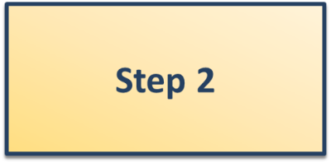
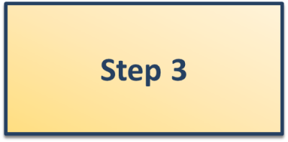



How Equipment Purchase Works-Non Grant
Library submits equipment request to Califa.
Califa collects all equipment requests and advertises equipment RFQ.
Authorized partners respond to RFQ with discounted pricing.
Califa sends pricing to Library requesting equipment.
Library confirms order and sends funds to Califa.
Califa makes purchase on behalf of library.
Equipment shipped to Library.

Slide 16
How Equipment Purchase Work-Grant Funds
Library submits equipment request to SCLC.
Califa collects all equipment requests and advertises equipment RFQ.
Authorized partners respond to RFQ with discounted pricing.
Califa sends pricing back to SCLC who contacts the Library requesting equipment.
Library confirms order and sends funds to SCLC if required.
SCLC sends funds to Califa and Califa makes purchase on behalf of library.
Equipment shipped to Library.

Slide 17
Equipment Requests Due
APRIL 6th

Slide 18
FY 2016/2017 Process: Projected
August 2015-Submit LOA’s
November 2015-Form 470 Submitted.
December 2015-Design and Review
March 2016-Sign Contracts
July 2016-Connecting
Timeline

Slide 19
Questions?
To Find Out More:
http://www.library.ca.gov/lds/broadband.html
Thank you!

