Slide 1
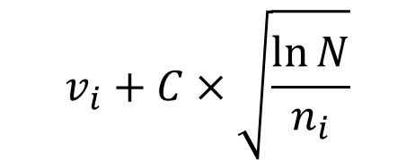
- Confidence interval in statistics is the interval that we know the true mean is in that interval. We don't know the exact value but we're confident it is within that range.
- The upper bound is the highest possibility in that range, it is equal or greater than the max value of the set/interval. (lowest value greater than the mean)
Optimal Decision ---> Upper Bound
$$v_{i}+C×\sqrt{\frac{\ln{N}}{n_{i}}}$$

Slide 2
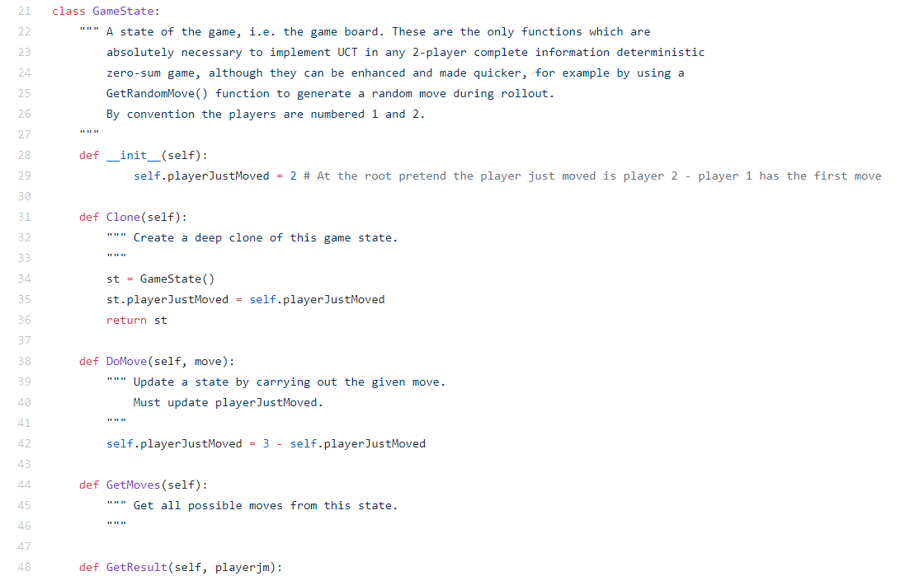
UCT = MCST + UBC

