Slide 1
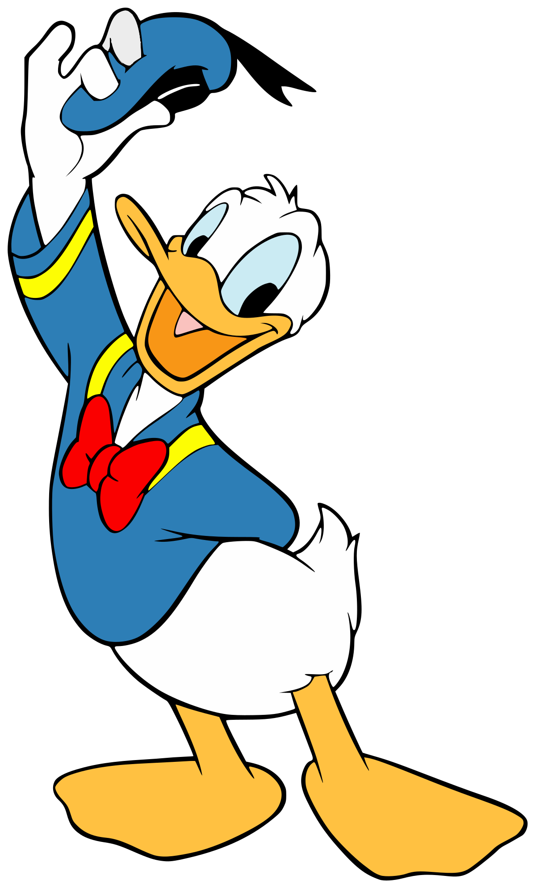
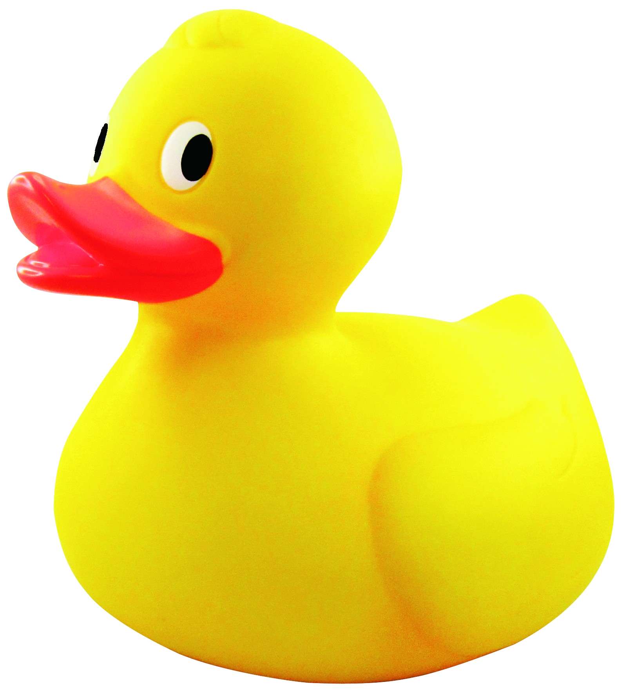
Strategy design pattern
Strategy is a behavioral design pattern that lets you define a family of algorithms, put each of them into a separate class, and make their objects interchangeable.

Slide 2
If inheritance isn’t so straight forward then Strategy pattern helps to loose strict binding of methods to specific class

Slide 3
Ducks are more complicated as it seems
This is an obvious way how we would like to make Duck class simple and clean but we can’t squeeze all ducks into one subclass.
Duck class
Swim()
Fly()
Quack()
Mallard duck
Swim() - true
Fly() - true
Quack() -true
Donald Duck
Swim() - true
Fly() - false
Quack() - ???
Rubber duck
Swim() - true
Fly() - false
Quack() -false
So we need different approach.

Slide 4
Strategy pattern
Strategy pattern shows us such way where we separate methods into new behavior classes.
interface
IFlyBehavior
Fly()
FlyWithWings
Fly()
{
do some fly
with wings
}
FlyWithNoWings
Fly()
{
do NO
flying
}
FlyWeDontKnowJet
Fly()
{
do some flying
we not aware jet
}
And no crazy IF construction to distinct different behaviors

Slide 5
Strategy pattern - code
public interface IFlyBehaviour
{
void Fly();
}
public class FlyWithWings : IFlyBehaviour
{
public void Fly()
{
Console.WriteLine("I'm flying!");
}
}
public class FlyWithNoWings : IFlyBehaviour
{
public void Fly()
{
Console.WriteLine("I can't fly!");
}
}
public class FlyWithAirplane : IFlyBehaviour
{
public void Fly()
{
Console.WriteLine("I fly only on airplane!");
}
}
public interface IQuackBehaviour
{
void Quack();
}
public class Quacky : IQuackBehaviour
{
public void Quack()
{
Console.WriteLine("Quack");
}
}
public class MuteQuack : IQuackBehaviour
{
public void Quack()
{
Console.WriteLine("Enjoy the silence");
}
}
public class Speak : IQuackBehaviour
{
public void Quack()
{
Console.WriteLine("I speak");
}
}

Slide 6
Strategy pattern - code
public abstract class Duck
{
private readonly IFlyBehaviour _flyBehaviour;
private readonly IQuackBehaviour _quackBehaviour;
protected Duck(IFlyBehaviour flyBehaviour, IQuackBehaviour quackBehaviour)
{
_flyBehaviour = flyBehaviour;
_quackBehaviour = quackBehaviour;
}
public void PerformFly()
{
_flyBehaviour.Fly();
}
public void PerformQuack()
{
_quackBehaviour.Quack();
}
public abstract void Display();
}
public class MallardDuck : Duck
{
public MallardDuck() : base(new FlyWithWings(), new Quacky()) { }
public override void Display()
{
Console.WriteLine("I'm Mallard Duck");
}
}
public class RubberDuck : Duck
{
public RubberDuck() : base(new FlyWithNoWings(), new MuteQuack()) { }
public override void Display()
{
Console.WriteLine("Take me to bath because i'm rubber Duck");
}
}
public class DonaldDuck : Duck
{
public DonaldDuck() : base(new FlyWithAirplane(), new Speak()) { }
public override void Display()
{
Console.WriteLine("My name is Donald Duck");
}
}

Slide 7
Strategy pattern – code & result
static void Main(string[] args)
{
var ducks = new List<Duck>();
ducks.Add(new MallardDuck());
ducks.Add(new RubberDuck());
ducks.Add(new DonaldDuck());
foreach (var duck in ducks)
{
duck.Display();
duck.PerformQuack();
duck.PerformFly();
Console.WriteLine("----------------------");
}
Console.ReadKey();
}
I'm Mallard Duck
Quack
I'm flying!
----------------------
Take me to bath because i'm rubber Duck
Enjoy the silence
I can't fly!
----------------------
My name is Donald Duck
I speak
I fly only on airplane!
----------------------

Slide 8
Thanks everyone!
Code aviable at:
https://github.com/SeniorSSS/DesignPatterns/tree/master/Strategy
Author: Janis Strazdins

