Slide 1

The Observer design pattern
Observer is a behavioral design pattern
that allows one objects to notify other objects about changes in their state.

Slide 2
Problem
There is a mouse in the house.
Cat wants to catch it.
Elephant wants to avoid it.
Dog don’t give a f#ck.

Slide 3
So how to do it without all of them staring into the wall???

Slide 4

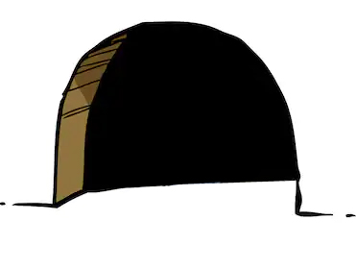


Solution – the Observer pattern
Observable
Observer
Observer
Observer

Slide 5
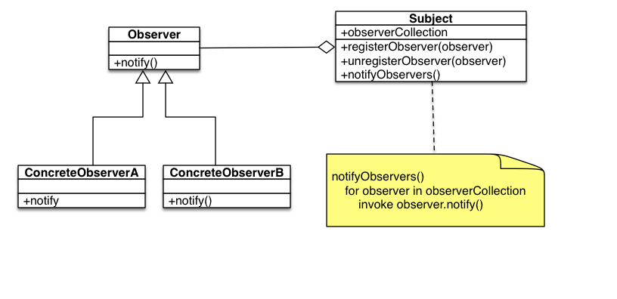
UML diagram

Slide 6

Code – Observable part
public interface IObservable
{
void AddObserver(IObserver observer);
void RemoveObserver(IObserver observer);
void NotifyObservers();
}
public class Observable : IObservable
{
private List<IObserver> _observers = new List<IObserver>();
public int mouseState { get; set; }
public void AddObserver(IObserver observer)
{
_observers.Add(observer);
}
public void RemoveObserver(IObserver observer)
{
_observers.Remove(observer);
}
public void NotifyObservers()
{
foreach (var observer in _observers)
{
observer.Update(this);
}
}
public void ShowRandomMouse()
{
int mouseNewState = new Random().Next(2);
Console.WriteLine("===========================================================");
if (mouseNewState == mouseState)
{
Console.WriteLine("Nothing changed - no need to bother observers...");
} else
{
mouseState = mouseNewState;
if (mouseState == 1)
{
Console.WriteLine("Listen everyone! Mouse apears in the den!");
} else
{
Console.WriteLine("Listen everyone! There is NO mouse in the den!");
}
NotifyObservers();
}
}
}

Slide 7
Code - Observers part
public interface IObserver
{
void Update(Observable observable);
}
public class CatObserver : IObserver
{
public void Update(Observable observable)
{
if (observable.mouseState == 1)
{
Console.WriteLine("Cat starts to chase the mouse.");
} else
{
Console.WriteLine("Cat leaves the room.");
}
}
}
public class ElephantObserver : IObserver
{
public void Update(Observable observable)
{
if (observable.mouseState == 1)
{
Console.WriteLine("Elephant storms out the room terrified.");
}
else
{
Console.WriteLine("Elephant returns into the room.");
}
}
}
public class DogObserver : IObserver
{
public void Update(Observable observable)
{
Console.WriteLine("Dog don't give a f#ck.");
}
}

Slide 8
Code – main and results
static void Main(string[] args)
{
Observable den = new Observable();
den.AddObserver(new CatObserver());
var dog = new DogObserver();
den.AddObserver(dog);
den.AddObserver(new ElephantObserver());
for (var i = 0; i < 10; i++)
{
den.ShowRandomMouse();
if (i == 5)
{
den.RemoveObserver(dog);
}
Thread.Sleep(5000);
}
Console.ReadKey();
}
Listen everyone! There is NO mouse in the den!
Cat leaves the room.
Dog don't give a f#ck.
Elephant returns into the room.
===========================================================
Nothing changed - no need to bother observers...
===========================================================
Listen everyone! Mouse apears in the den!
Cat starts to chase the mouse.
Elephant storms out the room terrified.
===========================================================
Nothing changed - no need to bother observers...
===========================================================
Nothing changed - no need to bother observers...
===========================================================
Listen everyone! There is NO mouse in the den!
Cat leaves the room.
Elephant returns into the room

Slide 9
Thanks everyone!
Code aviable at:
https://github.com/SeniorSSS/DesignPatterns/blob/master/Observer/
Author: Janis Strazdins

