Slide 1
GitHub
By: Jeffri Dabel and Jason Nesbeth

Slide 2
About GitHub
The founders of GitHub Tom Preston-Werner, Chris Wanstrath, PJ Hyett.
GitHub was written in Ruby and an expansion of Git.
As of 2014, GitHub reports having over 3.4 million users and with 16.7 million repositories making it the largest code host in the world.
Notes:
Tom Preston-Werner is most prominently known for his role as founder and former CEO of GitHub, a Git repository web-based hosting service, which he co-founded in 2008 with Chris Wanstrath and PJ Hyett. Preston-Werner is also the creator of the avatar service, Gravatar.
PJ Hyett is a software developer and entrepreneur who co-founded GitHub in 2008, along with Chris Wanstrath and Tom Preston-Werner, to simplify sharing code and make it easy to collaborate on building software. Today, GitHub is the largest code host in the world, with a community of five million people building software together. Prior to founding GitHub, PJ was a partner at Err Free, and a senior software engineer at CNET Network.

Slide 3
What is GitHub?
It is a web version control application that hosts the Git repositories created by companies and individuals. It offers all of the distributed revision control and source code management(SCM) functionality of Git as well as adding its own features.

Slide 4
Version Control
Version control is a system that records changes to a file or set of files over time so that you can recall specific versions later.
There are three different systems for version control, all of which Git and GitHub uses for full functionality.
There are:
Local Version Systems
Centralized Version Systems
Distributed Version Systems

Slide 5
Local Version System
Many people’s version-control method of choice is to copy files into another directory (perhaps a time-stamped directory, if they’re clever). This approach is very common because it is so simple, but it is also incredibly error prone. It is easy to forget which directory you’re in and accidentally write to the wrong file or copy over files you don’t mean to. To deal with this issue, programmers long ago developed local VCS that had a simple database that kept all the changes to files under revision control.

Slide 6

Local Version System

Slide 7
Centralized Version Systems
The next major issue that people encounter is that they need to collaborate with developers on other systems. To deal with this problem, Centralized Version Control Systems (CVCSs) were developed. These systems, such as CVS, Subversion, and Perforce, have a single server that contains all the versioned files, and a number of clients that check out files from that central place. For many years, this has been the standard for version control.

Slide 8
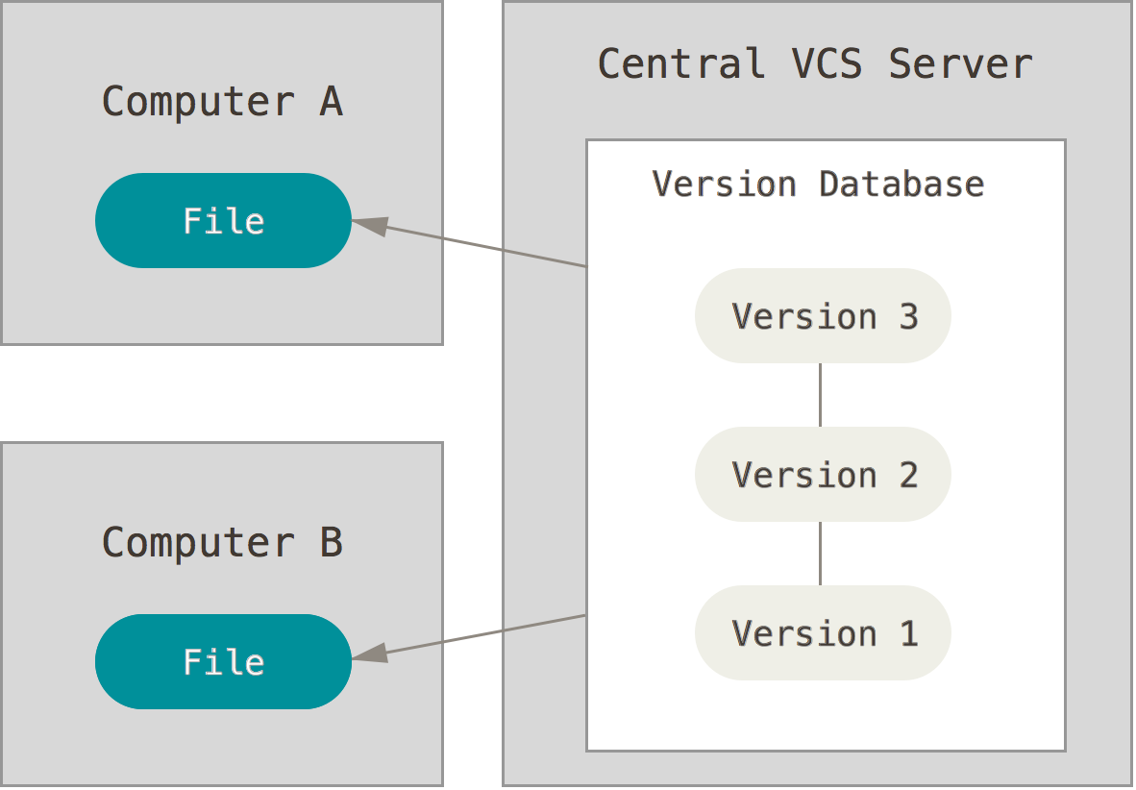
Centralized Version Systems

Slide 9
Distributed Version Systems
This is where Distributed Version Control Systems (DVCSs) step in. In a DVCS (such as Git or Mercurial), clients don’t just check out the latest snapshot of the files: they fully mirror the repository. Thus if any server dies, and these systems were collaborating, any of the client repositories can be copied back up to the server to restore it. Every clone is really a full backup of all the data.

Slide 10
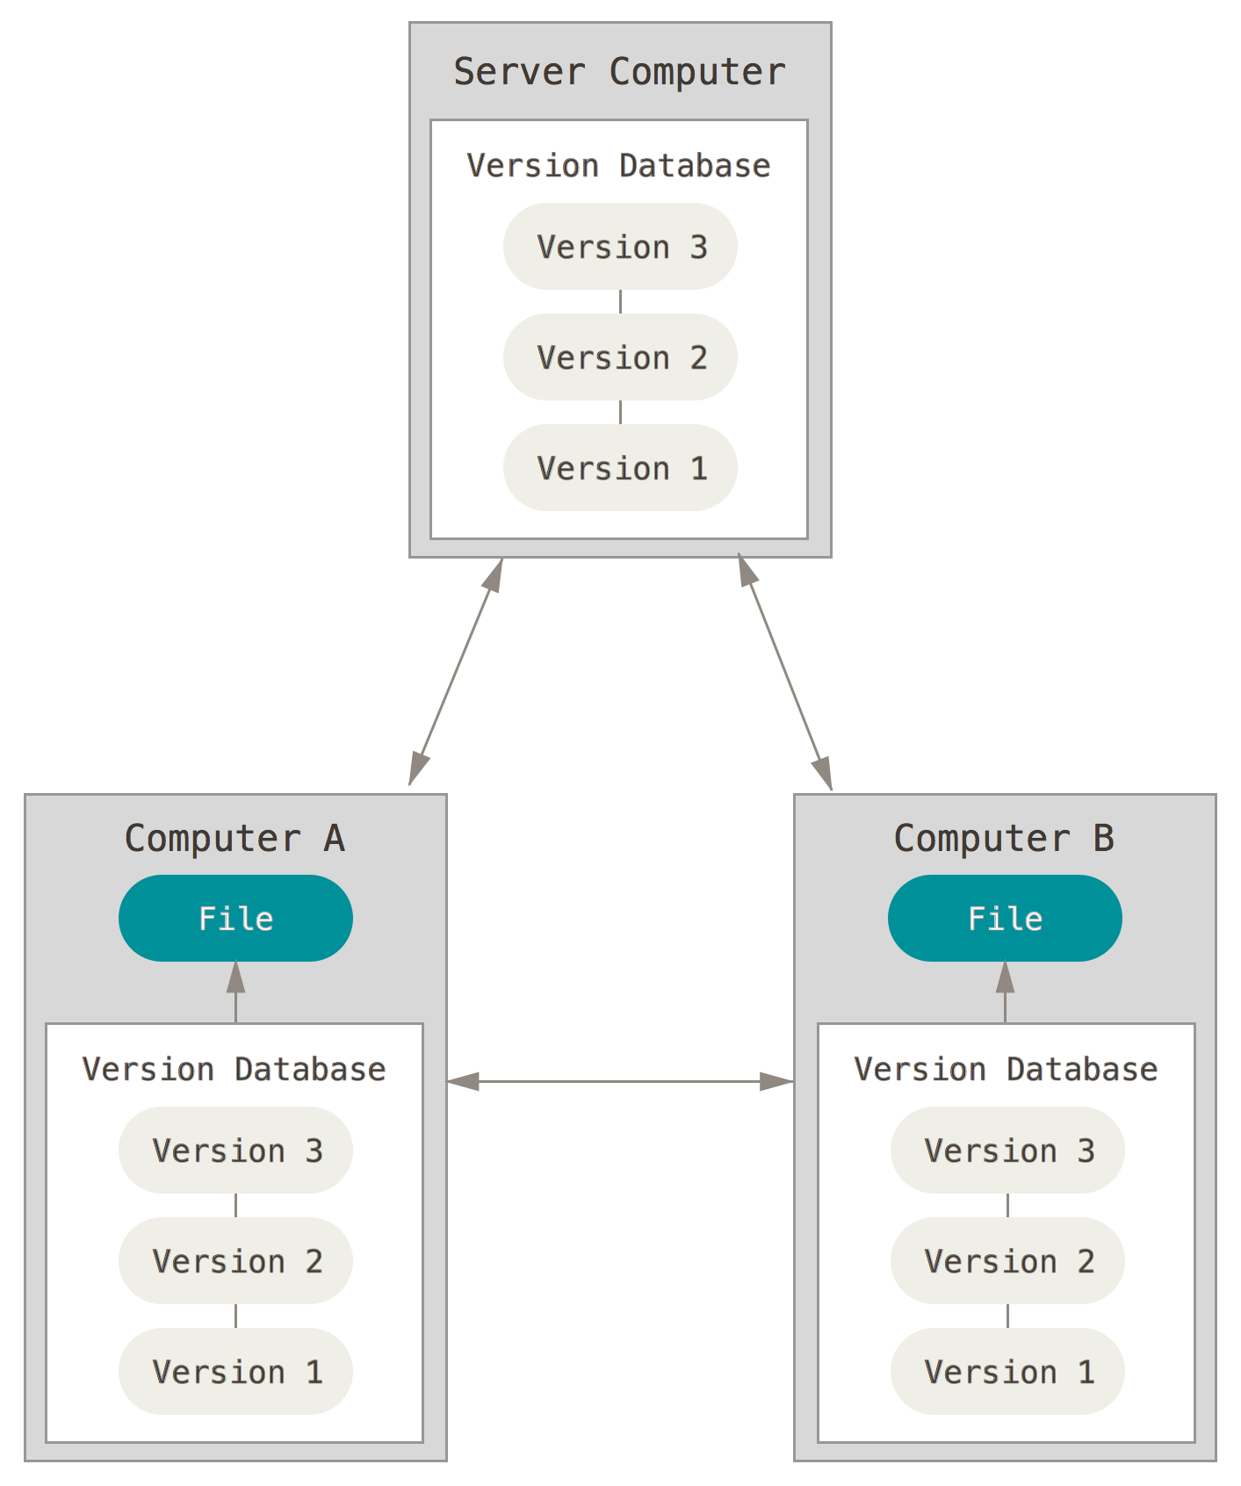
Distributed Version Systems
Notes:
This is where Distributed Version Control Systems (DVCSs) step in. In a DVCS (such as Git, Mercurial, Bazaar or Darcs), clients don’t just check out the latest snapshot of the files: they fully mirror the repository. Thus if any server dies, and these systems were collaborating via it, any of the client repositories can be copied back up to the server to restore it. Every clone is really a full backup of all the data.

Slide 11
Source Code Management
(Git)
Git is the local entity that can link together repositories on your own computer and on GitHub.
Git was made using a proprietary DVCS (Decentralized Version Control System) called BitKeeper.
More about Bitkeeper is here:http://www.bitkeeper.com/
Linus Torvalds (Creator of Linux and git) on git:
https://www.youtube.com/watch?v=4XpnKHJAok8

Slide 12
Other Software like Git and GitHub
Concurrent Version System (CVS) - Central Version Control
Subversion (SVN) - Central Version Control
Mercurial - Distributed Version Control
BitKeeper - Distributed Version Control
Fossil - Distributed Version Control
Many others

Slide 13
GitHub/Git vs. CVS
The main difference is that CVS uses centralized version control while git uses distributed version control.
Setting up an Repository: To set up a repository is much more simple in git than it is in CVS. With git, "git init && git add . && git commit" commands simply create a new repository. However there is a lot of commands that are needed to be done before a new repository on CVS has been created ( http://www.cs.brandeis.edu/~guru/cvs.html ).

Slide 14
GitHub/Git vs. CVS Contd.
Atomic Operations: Because CVS at beginning was a set of scripts around each file, commits (and other operations) are not atomic in CVS; if an operation on the repository is interrupted in the middle, the repository can be left in an inconsistent state. In Git all operations are atomic: either they succeed as whole, or they fail without any changes.
Notes:
For an operation to be atomic is to have the operation to fully complete itself instead of leaving it halfway like how a round robin scheduler would do it inside of a CPU.

Slide 15
GitHub/Git vs. CVS Contd.
Easy Branching: In CVS you would have to tag branches to have a name for a whole repository branch (that can fail in some cases). Add to that the fact that CVS doesn't have merge tracking, so you have to either remember, or manually tag merges and branching points, and manually supply correct info for "cvs update -j" to merge branches, and it makes for branching to be unnecessarily hard to use. However in Git, it remembers all required info by itself (so merging a branch is as easy as "git merge branchname"), because distributed development naturally leads to multiple branches so it had to develop merge tracking.

Slide 16
GitHub/Git vs. CVS Contd.
Rename (and copy) tracking: File renames are not supported in CVS, and manual renaming might break history in two, or lead to invalid history where you cannot correctly recover the state of a project before rename. Git uses heuristic rename detection, based on similarity of contents and filename. You can also request detecting of similar files. This means that you can actually see information inserted into the commit that the file was renamed.

Slide 17
GitHub/Git vs. CVS Contd.
Binary files: CVS has only a very limited support for binary files (e.g. images), requiring users to mark binary files explicitly when adding (or later using "cvs admin", or via wrappers to do that automatically based on file name), to avoid mangling of binary file via end-of-line conversion and keyword expansion. Git automatically detects the binary file based on contents in the same way other tools do it; you can override this detection using gitattributes mechanism.

Slide 18
GitHub/Git vs. CVS Contd.
Amending commits: In distributed version control systems such as Git, the act of publishing is separate from creating a commit. One can change (edit, rewrite) unpublished part of history without inconveniencing other users. In particular if you notice typo (or other error) in commit message, or a bug in commit, you can simply use "git commit --amend". This is not possible in CVS.

Slide 19
GitHub/Git vs. CVS Contd.
Commit before merge: Git uses commit-before-merge rather than merge-before-commit (or update-then-commit) like CVS . While you were editing files, preparing for creating new commit (new revision) someone else created a new commit on the same branch and it is now in repository, CVS forces you to first update your working directory and resolve conflicts before allowing you to commit. This is not the case with Git. You first commit, saving your state in version control, then you merge other developer changes. You can also ask the other developer to do the merge and resolve conflicts.

Slide 20
GitHub/Git vs. CVS Contd.
More tools: Git offers much more tools than CVS. One of more important is "git bisect" that can be used to find a commit (revision) that introduced a bug; if your commits are small and self-contained it should be fairly easy then to discover where the bug is.

Slide 21
GitHub/Git vs. CVS Contd.
No need for central repository: With Git there is no need to have single central place where you commit your changes. Each developer can have its own repository (or better repositories: private one in which he/she does development, and public ones where she/he publishes the part that is ready), and they can pull/fetch from each other repositories, in symmetric fashion. On the other hand it is common for larger project to have socially defined/nominated central repository from which everyone pull from (to get changes from).

Slide 22
GitHub/Git vs. SVN
The Distributed Nature of Git vs. the Centralized Nature of SVN:
In Git or GitHub since every user has a copy of the repository that they are working on, if the system decided to crash then there is a backup on at least one computer.If any repository is lost due to system failure only the changes which were unique to that repository are lost. If users frequently push and fetch changes with each other this tends to be a small amount of loss, if any

Slide 23
GitHub/Git vs. SVN
However in SVN if the central server crashed then all the history and the work that was completed on the project is lost. This means that users must communicate over the network with the central repository to obtain history about a file. Backups must be maintained independently of the VCS.

Slide 24
GitHub/Git vs. SVN
Accessibility Issues: Because subversion controls access, in order for daily checks to be allowed, the user requires commit access. In git, users are able to have version control of their own work while the source is controlled by the repository owner.
Performace: Git is extremely fast. Since all operations (except for push and fetch) are local there is no network latency involved to:
Perform a diff.
View file history.
Commit changes.
Merge branches.
Obtain any other revision of a file (not just the prior committed revision).
Switch branches.

Slide 25
GitHub API
OAuth2 is a protocol that lets external apps request authorization to private details in a user’s GitHub account without getting their password. This is preferred over Basic Authentication because tokens can be limited to specific types of data, and can be revoked by users at any time.
All developers need to register their application before getting started. A registered OAuth application is assigned a unique Client ID and Client Secret. The Client Secret should not be shared.

Slide 26
GitHub API Contd.
This can be used for any application that a developer would want to create as the only functions needed is to be able to view, push and pull repositories and all other information on GitHub.
GitHub’s API is built on top of HTTP and accessible through any programming language in which you can make an HTTP request, including command-line tools in a terminal.

Slide 27
Listing Authorizations
This is a command that can list the repositories that the company or user are authorized to access from the app to GitHub so it gets the authorizations and then after communication it gets a response and returns information of the url of the repository, the scope of the repository,the fingerprint that differentiates the repositories of same user and the date updated and date it was created.

Slide 28
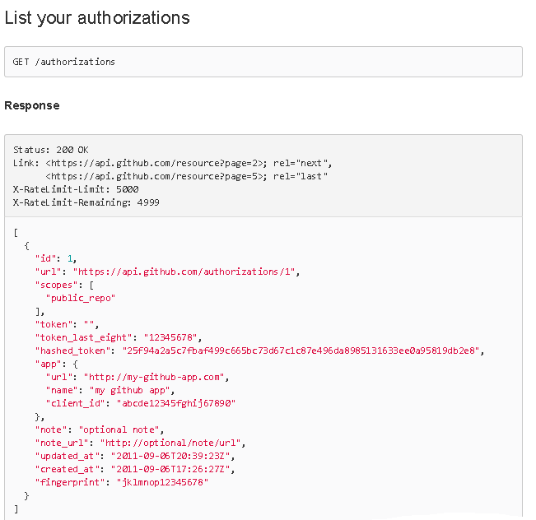
Listing Authorizations

Slide 29
Listing Authorizations
Example: When you get a list of repositories, you get the summary representation of each repository. Here, you can fetch the list of repositories owned by the octokit organization: GET /orgs/octokit/repos

Slide 30
Rate Limiting
For OAuth you can make up to 5000 requests from GitHub per hour. For unauthenticated users you can only make 60 requests from GitHub per hour.
You can use certaion headers to:
Check the rate limit using “X-RateLimit-Limit”
Check the number of requests that have not been used up using “X-RateLimit-Remaining”
Check the time remaining till the limit is to reset using “X-RateLimit-Reset”

Slide 31
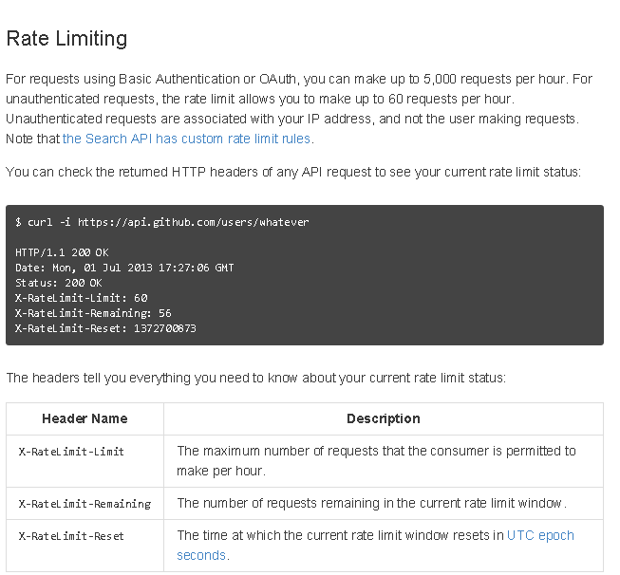
Rate Limiting

Slide 32
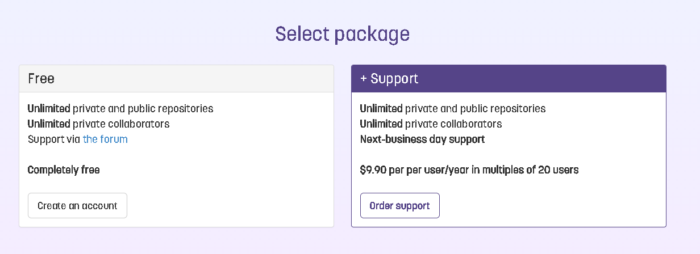
Web Applications that uses GitHub API
GitLab
https://about.gitlab.com/features/
There is unlimited collaboration and public and private repos.
Notes:
This is one of the sites that uses OAuth API to give them access to repositories for their own customer’s use when using these different packages that they offer. Therefore one can have the public and private repositories without paying a fee at all. On the other hand if there is need for a question to be answered right away, then you would have to pay for that. The Dashboard for this application if very similar to using GitHub for Windows.

Slide 33
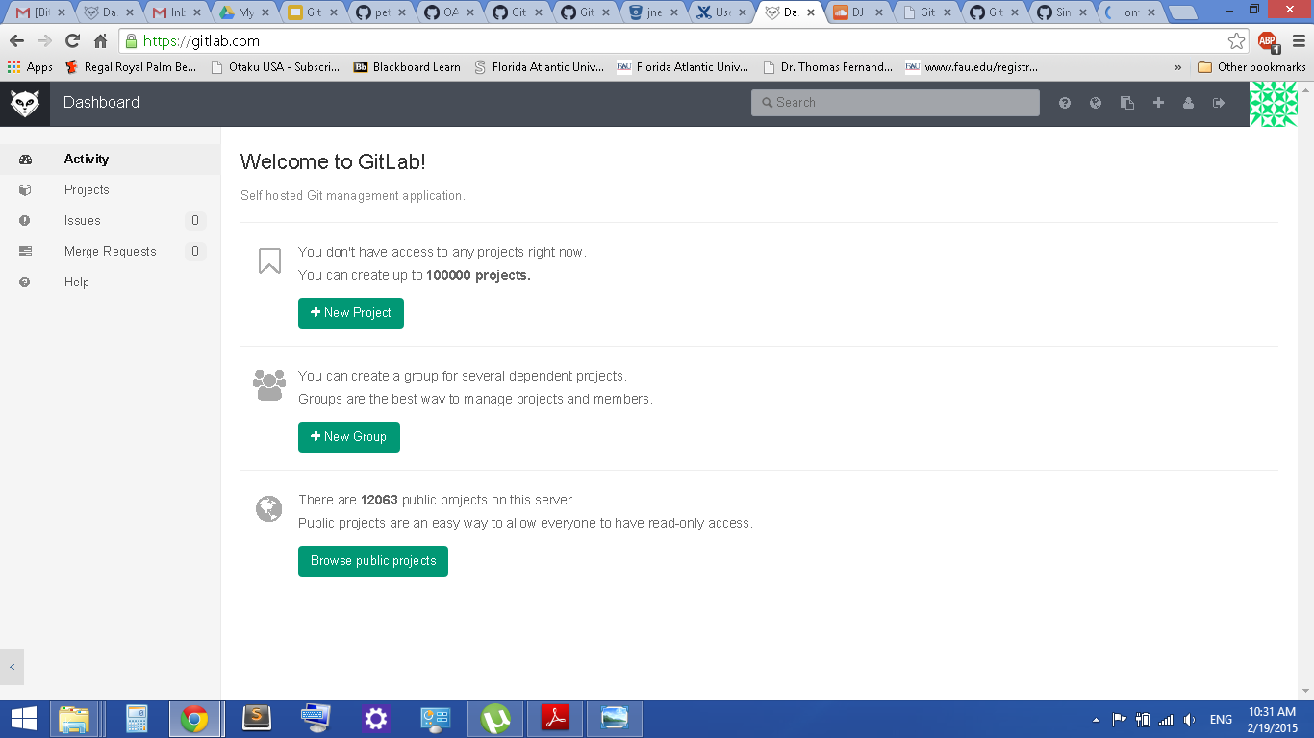
GitLab Dashboard

Slide 34
Web Applications that uses GitHub API
BitBucket
https://bitbucket.org/
You can have up to 5 users free to collaborate with.

Slide 35
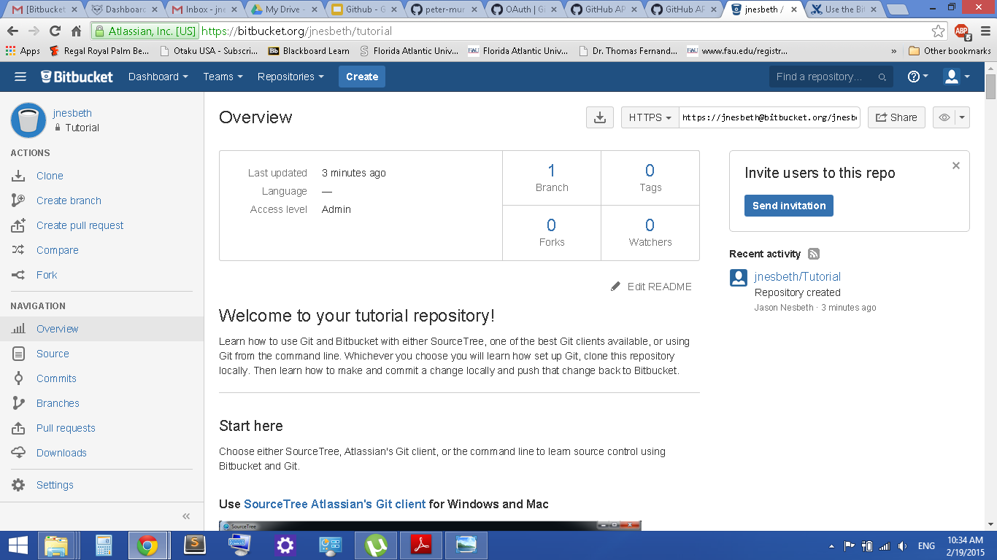
BitBucket Dashboard

Slide 36
How does github generate income?
Any open-licensed projects can be hosted on github for free.
Github makes its money by :
Charging users for close- source projects in private repositories.
Offering Services ( such as github enterprise)
Offering analytical tools

Slide 37
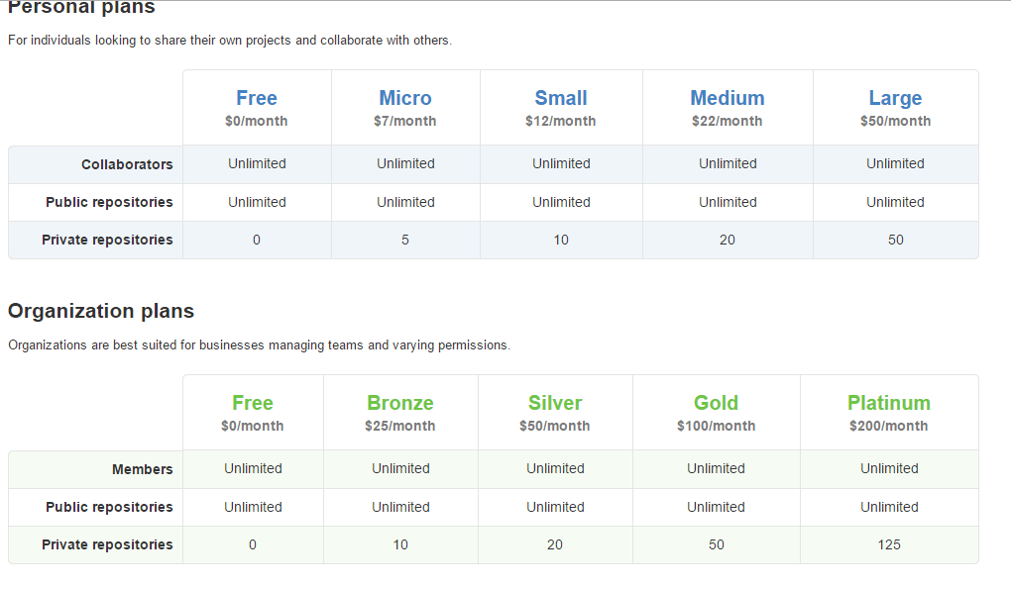
Different plans and Pricing

Slide 38
How much github worth?
According to business Insider, Github, the social coding startup that offers programmers a place to store their code and work on open-source projects, just raised a $100 million on a $750 million evaluation.

Slide 39
What’s next?
github want to be easier for beginners and more powerful to experts.
github wants to be everywhere( mac, pc, linux, futuristic computer phone)
github want to make it easier to work together than alone.
github want to keep changing the way software is developed for the better by making collaborating easier and sharing a no brainer.

Slide 40
Github and politics
David cole spent years as a software developer before announcing he was running for congress from his own district New Jersey. Cole was the first one to release his political platform on the popular software developement site Github.
Cole hopes that his constituents will collaborate on his political policies in similar fashion they do for building software. on github, they can readily comment on or even edit his policies.
Cole’s bigger vision is that all sort of political work from campaigns to the bills proposed by elected officials will be handled in similar fashion.

Slide 41
Github and Politics II
Other political achievements that occurred through github:
the city of Chattanooga,Tennessee the first city in the nation to roll out ultra high speed gigabit internet connections to its citizen posted its data policy draft on github last year.
the city of philadelphia posted its Open Government Plan to the site
The federal government is also experimenting with this idea. President Obama recently signed an executive order directing government agencies to release their data in open, machine-readable formats,and he went as far to put the order itself on github.

Slide 42
Github and politics III
Principal benefits of having political documents on github:
github provides a new way to actually evaluate
Track
integrate public suggestions into policy documents.
suggestion can be discussed the same way we discussed a facebook update.

Slide 43
Github and society
Principal benefits when students used Github
Learn to ship software like a pro
Stop emailing code
Never lose your work
Stay organized
Build a portfolio

Slide 44
Github and Society II
Principal benefits for educators:
Teach more effectively
Distribute starter code
Give students feedback
Private automated Test
Collect Assignment

Slide 45
Github and Society III
Principal Benefits for professional programmers:
lower barriers of collaboration by building powerful features into their products that make it easier to contribute.
help individuals and companies to write better code and faster.

Slide 46
Udacity Employee’s Views on GitHub
https://www.youtube.com/watch?v=THmul1MlYvI#t=70
https://www.youtube.com/watch?v=8N-OLiAMr0g

Slide 47
Works Cited
http://stackoverflow.com/questions/802573/difference-between-git-and-cvs
http://www.cs.brandeis.edu/~guru/cvs.html
https://developer.github.com/v3/oauth/
https://developer.github.com/v3/
http://www.codeforest.net/git-vs-svn
http://en.wikipedia.org/wiki/GitHub
http://www.wired.co.uk/news/archive/2014-03/20/cole-congressional-platform-gihub
https://education.github.com/

