Slide 1


Slide 2


CropGuard
Edge AI Active Learning System for Real-Time Crop Disease Detection
R26-IT-101

Slide 3

Problem & Stakeholders
The Problem
Crop diseases threaten 30-40% of yields. Smallholder farmers in Sri Lanka rely on visual inspection or delayed expert advice – leading to misdiagnosis, pesticide misuse, and devastating losses.
Why It Still Matters?
  Cloud-based AI needs internet rural farmers have none
  Existing apps give generic, non-localized advice
  Static models can't adapt to new diseases or regions
  Heavy models can't run on low-end smartphones
Who is Affected?
Farmers - Lost income & food insecurity. Officers - Overwhelmed & inaccessible. Consumers - Higher prices & contamination. Environment - Soil & water pollution

Slide 4

Research Gap & Objectives
Research Gap – What's Missing?
  Cloud-based AI apps (Plantix, Crop Doctor) require internet – useless offline
  Static deep learning models can't adapt to new diseases or regional variations
  Generic treatment advice – not localized to Sri Lankan practices or languages
  Heavy models can't run on low-end smartphones.
Research Objectives & Solution Approach
  Objective 1: Enable offline, real-time disease detection on low-end smartphones
  Objective 2: Allow continuous adaptation to new diseases & regional variations
  Objective 3: Deliver localized, actionable treatment advice in native languages

Slide 5

Solution Overview & Architecture
Solution
CropGuard = TinyML disease detection + Active Learning + Region-Adaptive Models + RAG Advisory
Integrated Components
  Base Model + Active Learning
    Train model; flag uncertain predictions for expert review & retraining
  Region-Adaptive AutoML
    Fine-tune base model into 9 regional models
  TinyML Compression
    Compress ALL 9 models (9 regional) → <50MB, >85% confidence
  RAG Advisory System
    Retrieve localized treatment advice in Sinhala/Tamil
How It Works?
Farmer captures leaf → selects region model → TinyML runs offline → Disease detected → RAG gives advice in Sinhala/Tamil

Slide 6
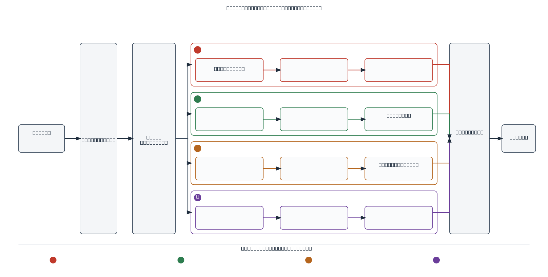
System Architecture

Slide 7

Commercialization & Demo Roadmap
Target Users / Market
Sri Lankan rice farmers, agricultural officers, and farming communities.
Value Proposition
AI-based regional disease detection with offline diagnosis and localized treatment advice.
Cost & Feasibility
Uses open-source AI and mobile technologies. TinyML enables low-cost offline use on smartphones.
Adoption Plan
Pilot with selected farmers → collect feedback → improve the models → expand to wider farming communities.
Commercialization Path
Prototype → Pilot Testing → Regional Deployment → Nationwide Use

Slide 8


Thank You

Slide 9

Original Proposal vs. Final System
Original Plan | Final Implementation | Built By
Train base model + implement active learning | Complete – CNN model trained with confidence-based uncertainty detection + expert validation workflow | Senitha
Fine-tune base model with region-specific data | Complete – 9 region-specific models created using transfer learning + AutoML | Matheesha
Apply TinyML optimization to all models | Complete – Quantization, pruning, distillation applied to ALL 9 models → <50MB, maintain >85% accuracy | Minidu
Develop RAG-based advisory system | Localized Sinhala/Tamil treatment advice from Sri Lankan agricultural sources | Sethmi

Slide 10
Original Proposal vs. Final System
Model Training with Active Learning Pipeline
🎯 Goal
Active Learning-based paddy disease detection system that identifies low-confidence predictions during real-time inference, collects those uncertain images, obtains expert-validated labels.
Challenge | What Happened | Resolution
Initial model training | MobileNetV2 was trained using the 8-class paddy disease dataset with a 70% training, 15% validation, and 15% test split. | Trained a TensorFlow MobileNetV2 model for paddy disease classification.
Uncertain predictions | A test image was predicted as Narrow Brown Leaf Spot at 56.26% confidence. | Applied an 80% confidence threshold to detect uncertain predictions.
Continuous learning | Low-confidence images require expert validation. | Implemented local storage, MongoDB synchronization, and expert labeling.

Slide 11
Original Proposal vs. Final System
Region-Adaptive AutoML Framework with Transfer Learning
Challenge | What Happened | Resolution
Unseen-image performance | V4 achieved 82.86% on existing test images but dropped to 37.24% on unseen images. | Applied Active Learning using difficult false-healthy examples.
Disease confusion | 95 diseased images were incorrectly predicted as Healthy Rice Leaf. | Fine-tuned V4 regional models with hard examples and class weighting.
Final validation | V4.1 reached 53.50% unseen-image accuracy and reduced false-healthy cases to 4. | V4.1 selected as the improved model.
🎯 Goal
Regionalize rice disease detection to improve accuracy by adapting models to different Sri Lankan agricultural zones.

Slide 12
Original Proposal vs. Final System
TinyML-Optimized & Model Compression
⚠️ Key Challenge & Resolution
🎯 Goal
Reduce model size to <50MB while maintaining >85% accuracy for offline deployment on low-end smartphones
Challenge | What Happened | Resolution
Apparent accuracy drop | Initial TFLite tests showed 70%, 50%, & 80% | Identified preprocessing mismatch between testing pipelines
Root cause | Initial TFLite tests showed 70%, 50%, & 80% | Standardized preprocessing across all tests
Final validation | Corrected test showed 97.45% → Float16 gave 97.40% | Compression confirmed NOT the cause of accuracy loss
📊 Compression Results
Metric | Before | After
Model Size | 21.53 MB | 4.6 MB
Inference Time | 3 seconds | 3 seconds
Accuracy | 97.40 | 97.18%
Format | Keras (.keras) | Float16 TFLite
Reduced size by ~80% while maintaining almost identical accuracy

Slide 13
Original Proposal vs. Final System
RAG-Based Localized Treatment Advisory System
🎯 Goal
Develop a retrieval-augmented generation (RAG) decision support layer to provide context-aware, safety-focused and localized treatment recommendations in native languages (Sinhala & Tamil) sourced from verified Sri Lankan agricultural data.
Challenge | What Happened | Resolution
Generic Advice Limitations | Current apps offer general, non-localized treatment rules that fail Sri Lankan farming needs. | Compiled based on agricultural knowledge obtained from reliable sources from the Department of Agriculture, Sri Lanka.
Language & Context Localization | Standard AI frameworks default to generic English outputs. | Integrated Gemini API to dynamically translate and structure treatment advice into clear, local Sinhala and Tamil.
Advisory Safety & Relevance | Risk of generating incorrect chemical dosages or unsafe remedies. | Optimized the RAG pipeline to query curated local vector embeddings and deliver immediate context-aware output upon disease identification

