Slide 1
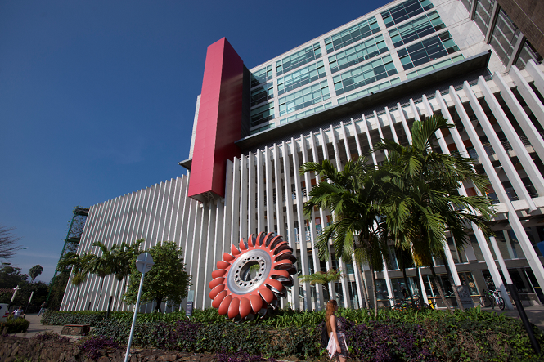

MAINTENANCE
MIGUEL RESTREPO CARRASQUILLA
SAMUEL TAMAYO
DAVID ZULUAGA HENAO
SANTIAGO QUINTERO ALVAREZ
DANILO OCAMPO VÉLEZ
TOMAS ARROYAVE LOAIZA

Slide 2
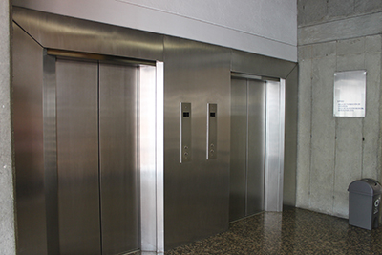
UNIVERSITY SYSTEM
ELEVATORS

Slide 3
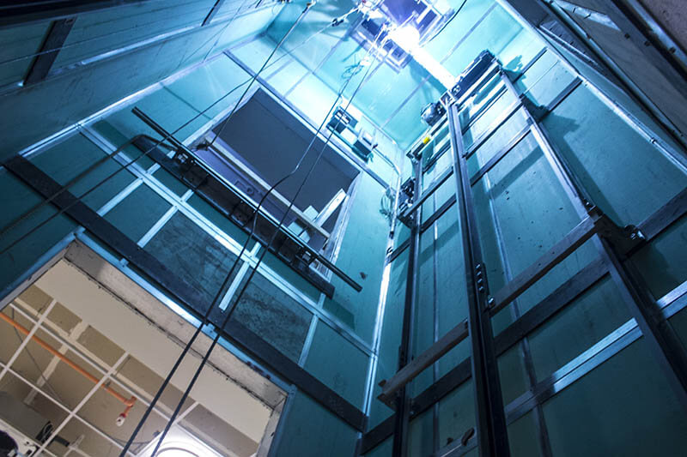
WHAT IS AN ELEVATOR?
DEFINITION
  Permanently installed.
  Car intended for transporting people and objects.
  Suspended by cables, chains, pulleys, or pistons.
  Cable inclination relative to vertical of less than 15°.

Slide 4
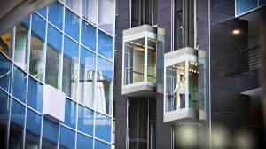
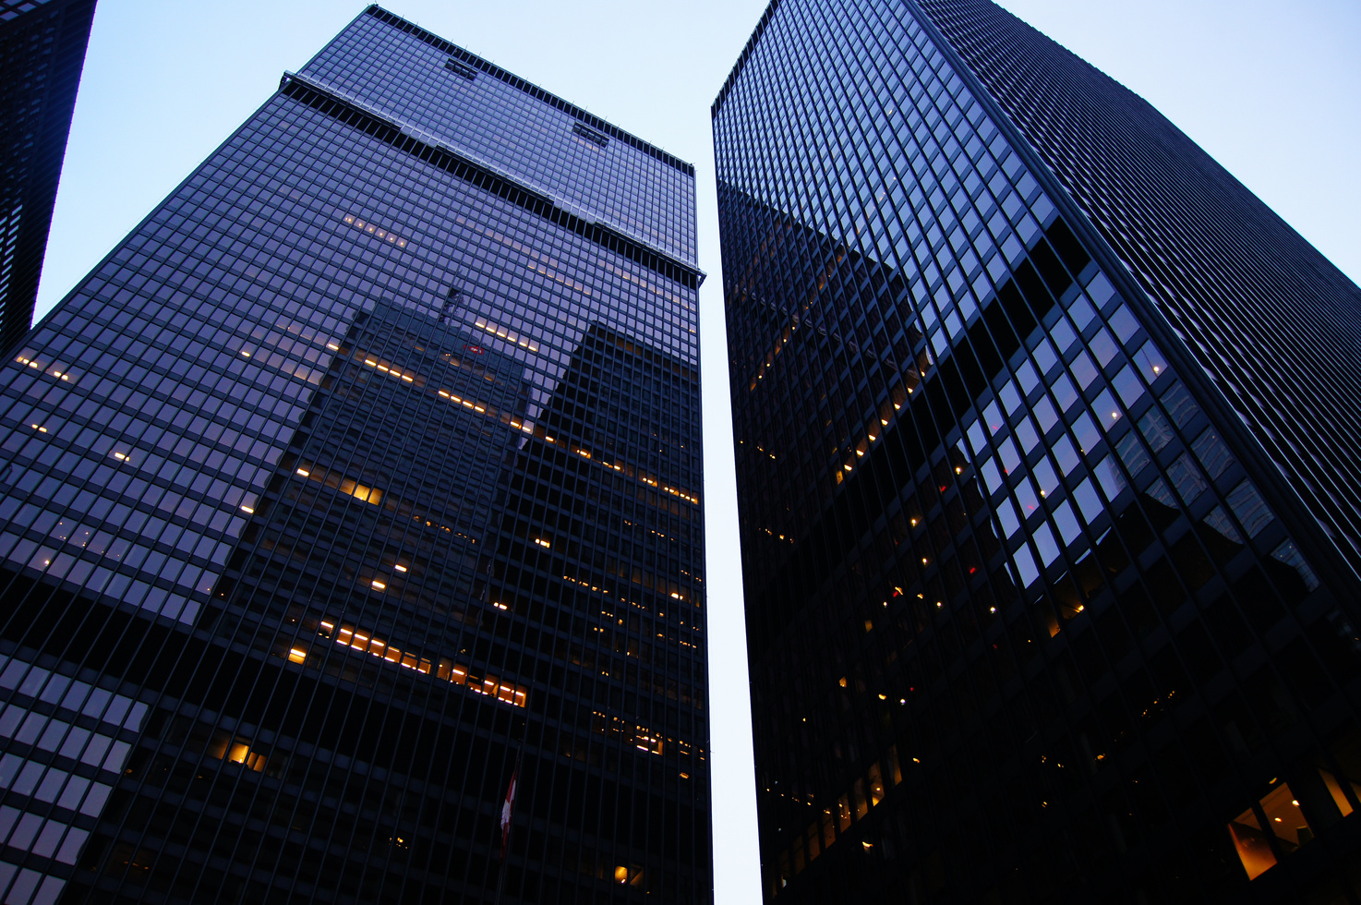
HOW AN ELEVATOR WORKS
Elevators are vertical transportation systems that allow people and goods to move between different levels of a building. They are an essential part of modern life, and their operation relies on a combination of mechanics, electronics, and hydraulics.

Slide 5
COMPONENTS OF AN ELEVATOR
MOTOR
The motor is the heart of the elevator. It is responsible for driving the cable that raises and lowers the car.
CAR
The car is where passengers ride. It is designed to provide a safe and comfortable trip.
COUNTERWEIGHTS
Counterweights are used to balance the weight of the car and passengers, which reduces the amount of energy needed to operate the elevator.

Slide 6
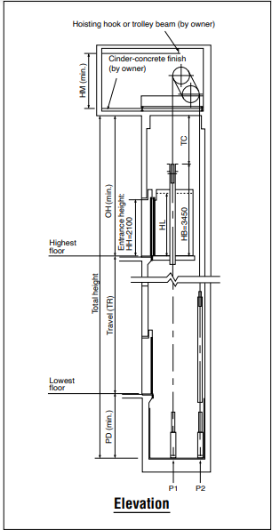
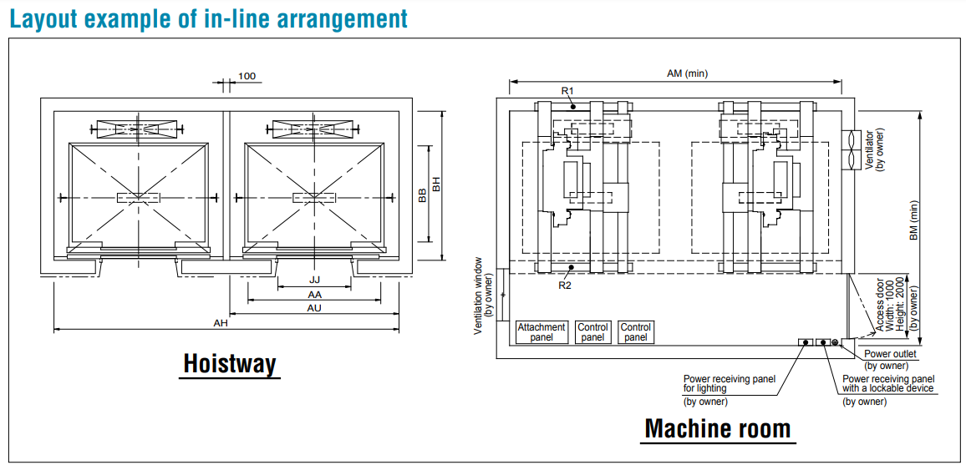
LAYOUT

Slide 7
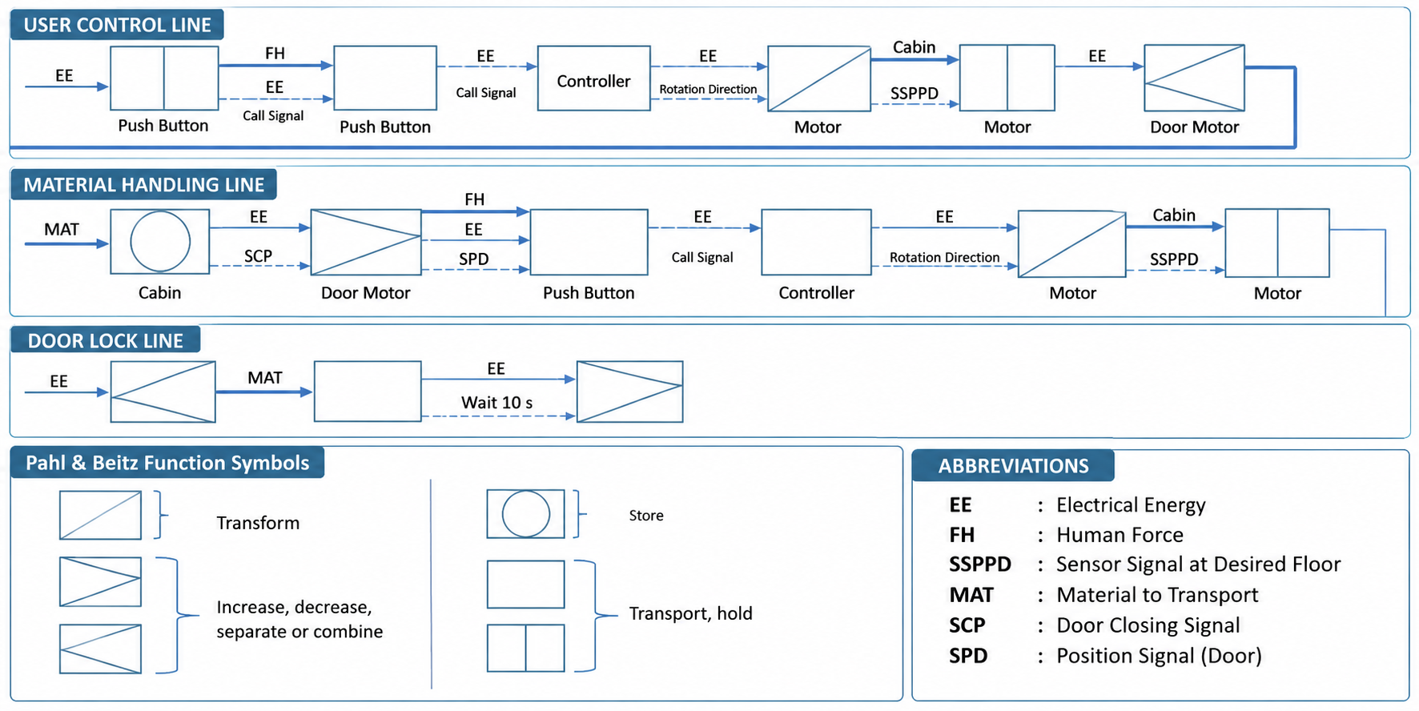
ELEVATOR FUNCTIONAL STRUCTURE

Slide 8
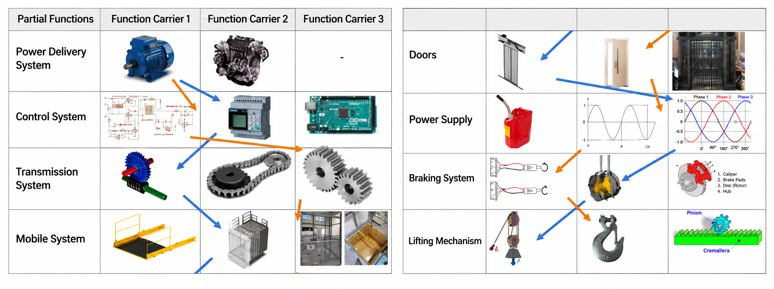
MORPHOLOGICAL MATRIX

Slide 9
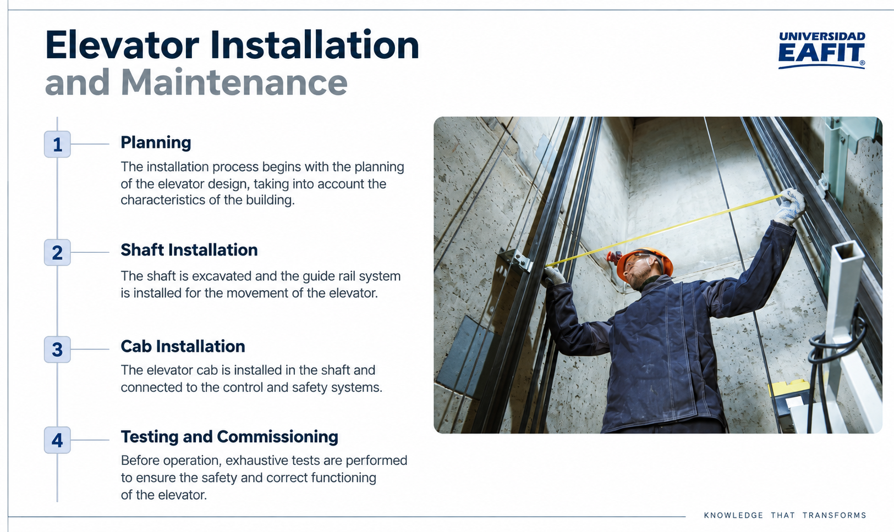

Slide 10
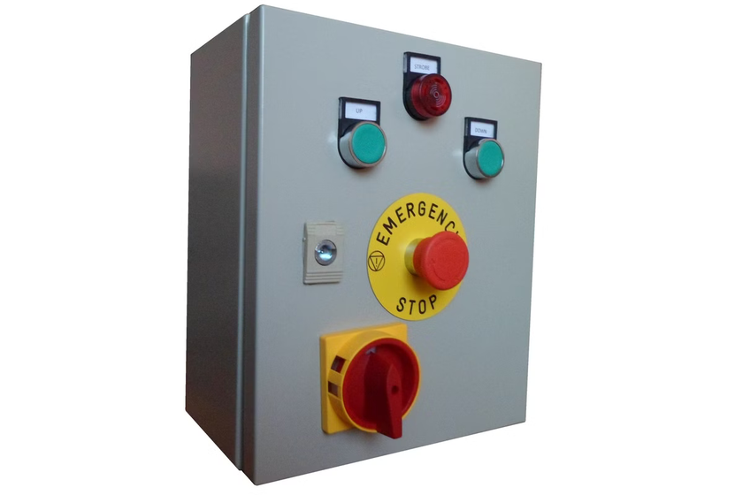
ELEVATOR CONTROL SYSTEMS
Sensors
Sensors detect the position of the car, passenger movement, and other factors important to the elevator's operation.
Controller
The controller receives information from the sensors and uses it to control the elevator's movement.
User Interface
The user interface allows passengers to select the floors they wish to visit.

Slide 11
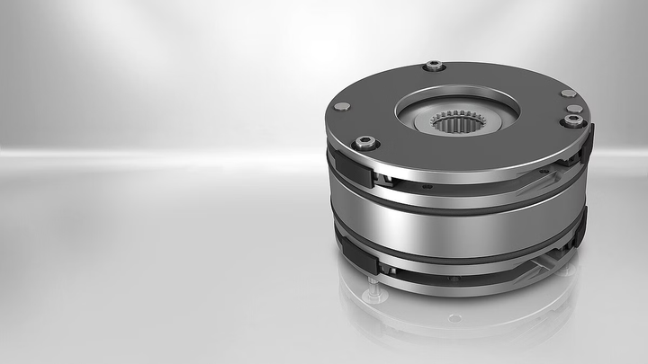

Slide 12
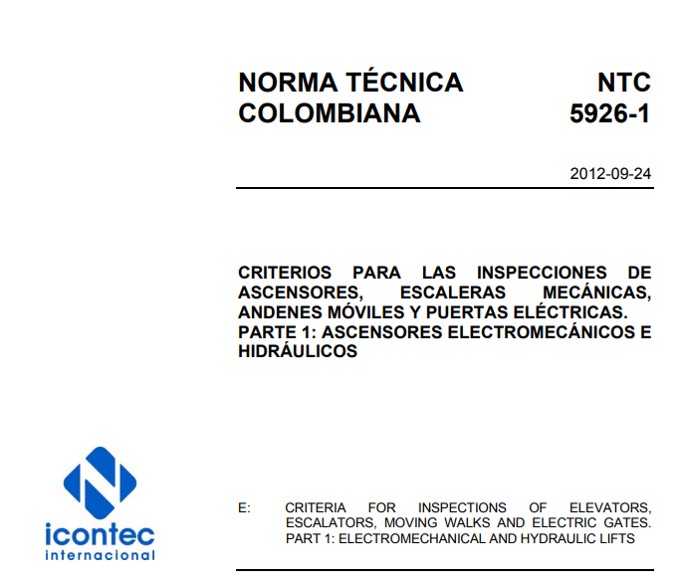

STANDARD
The standard that governs elevators, escalators, moving walkways, and power-operated doors.
NTC – 5926 – 1
For elevators, this is part one of the standard, which establishes the safety and inspection requirements for these systems.

Slide 13
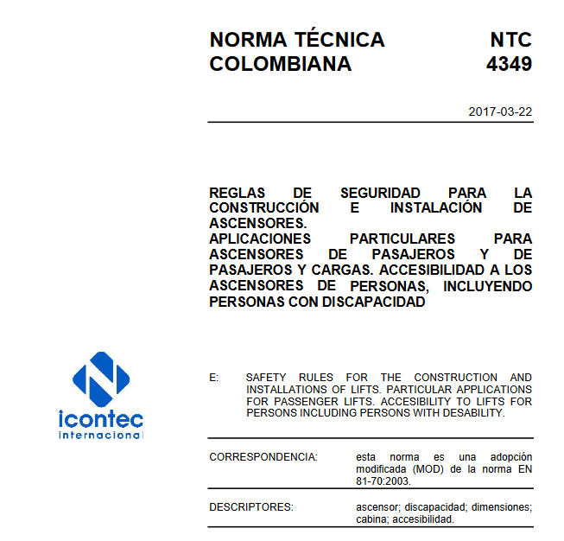
STANDARD
The standard that governs passenger and freight elevators.
NTC – 4349
which establishes safety requirements for the construction and installation of elevators.

Slide 14
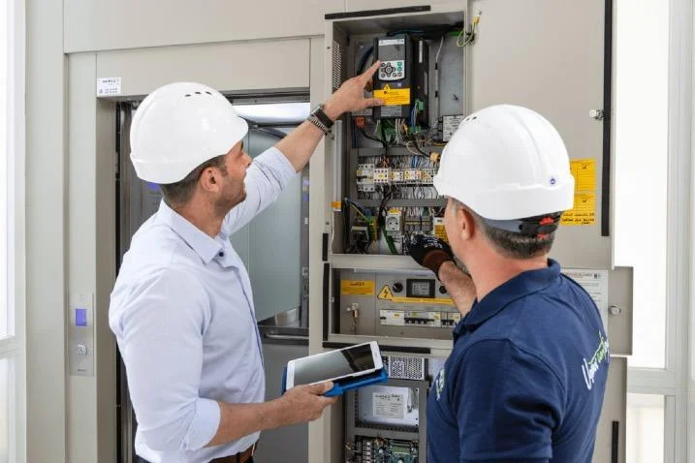

COMPETENT PERSON
A person with demonstrated ability to apply knowledge and skills to a given work activity.
INSPECTION
Examination of a product's design and the product itself, and determination of its conformity with specific requirements or on the basis of professional judgment

Slide 15
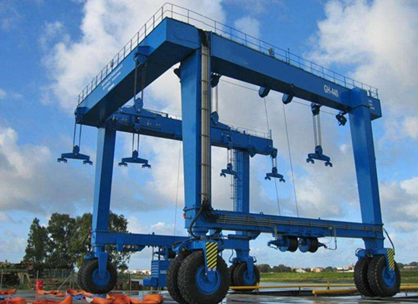
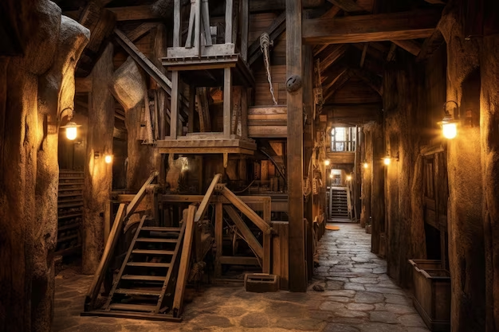
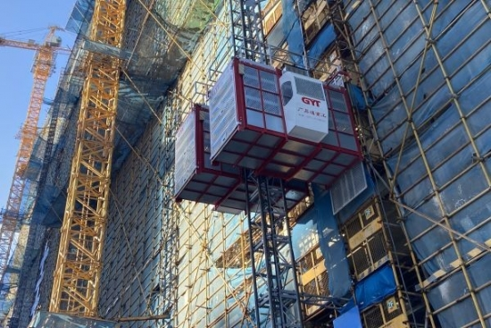
EXCEPTIONS TO THE STANDARD
SHIPS
MINES
CONSTRUCTION SITES
Equipment used to outfit ships and offshore exploration facilities.
Elevators installed in mines or used to handle radioactive material.
Rack-and-pinion elevators, strip lifts, and hoists used on building construction sites.

Slide 16



ELEVATOR BRANDS AT THE UNIVERSITY
ESTILO
SCHINDLER
MITSUBISHI

Slide 17
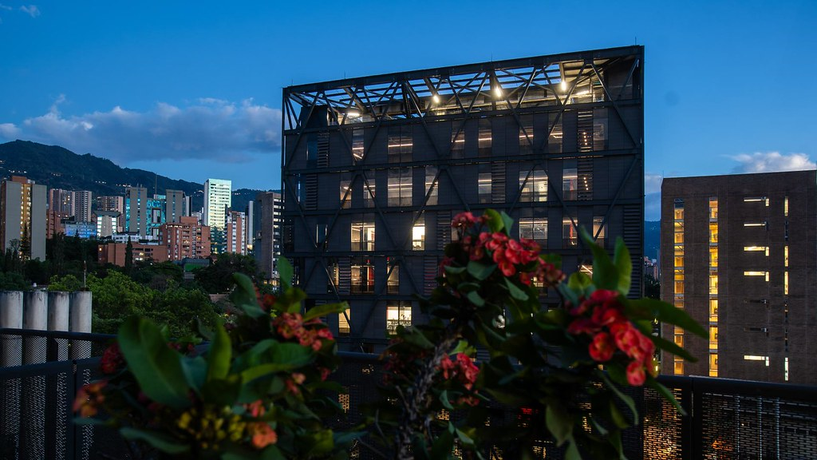
RELEVANT DATA
ESTILO
2-year warranty
Colombian company
Personalized maintenance service with less predictive technology
Complies with relevant local and international regulations
SCHINDLER
PREDICTIVE MAINTENANCE WITH ADVANCED TECHNOLOGY.
Focus on user interface and efficiency
Strict compliance with international standards such as ISO and EN
MITSUBISHI
HIGHLY TECHNOLOGICAL MAINTENANCE WITH REMOTE MONITORING.
Rigorous compliance with ISO and JIS standards, with a focus on efficiency and safety.

Slide 18

WITH WHAT WE HAVE...
Viable ways to reduce costs
1-Adopt a foreign standard that is more rigorous than the Colombian one.
2.-Modernize/upgrade the model of some elevators, pursuing the energy efficiency these companies promise with each updated model (and making sure spare parts are available).
3-Reduce the number of elevators at the university.

Slide 19
THANK YOU!

