Slide 1

Data Analysis of Netflix's Content and Trends
This project delves into the vast content library of Netflix, employing data science techniques to uncover insights into genre distribution, country-wise content contributions, content ratings, and release year trends. The analysis leverages Python libraries and data visualization tools to provide a comprehensive understanding of Netflix's content landscape.
The project aims to answer key questions about Netflix's content, such as the number of movies and TV shows available, the popularity of different genres, the countries producing the most content, and the evolution of Netflix's content over time.

Slide 2





Project Objectives and Design
Content Volume
Determine the number of movies and TV shows on Netflix.
Genre Popularity
Identify the most prevalent genres, such as drama and comedy.
Country Contributions
Analyze content contributions from various countries.
Rating Distribution
Understand the distribution of content ratings and duration trends.
The project aims to understand Netflix’s content using data. We want to find answers to questions like how many movies and TV shows are there, which genres are most popular, which countries make the most content, what are the different types of content ratings and how has Netflix’s content grown over the years?

Slide 3
Dataset Overview and Tools
Dataset Description
Tools and Technologies
The project utilizes the 'netflix_titles.csv' dataset, which includes details about movies and TV shows on Netflix. Key attributes include title, type, director, cast, country, release year, rating, duration, and genre.
Python: For data analysis and cleaning
Jupyter Notebook: For writing and running Python code
Pandas: For data manipulation in table format
NumPy: For mathematical operations
Plotly Express: For creating charts and graphs
This project uses a dataset called ‘netflix\_titles.csv’. It contains details about movies and TV shows available on Netflix. Some of the main details in the dataset are title, type, director and cast, country, release year, rating, duration and genre.

Slide 4

Data Cleaning and Transformation
Missing Values
Removed rows with missing values to ensure data integrity.
Unnecessary Columns
Dropped columns that were not relevant to the analysis.
Date Formatting
Transformed date formats to a proper year format for consistency.
Duplicates
Removed duplicate rows to avoid skewed analysis results.
Before analyzing, we cleaned the data by removing rows with missing values, dropping columns we did not need, changing the date format to proper year format, renaming columns for better understanding and removing duplicate rows. We also selected only the first genre if multiple genres were listed.

Slide 5
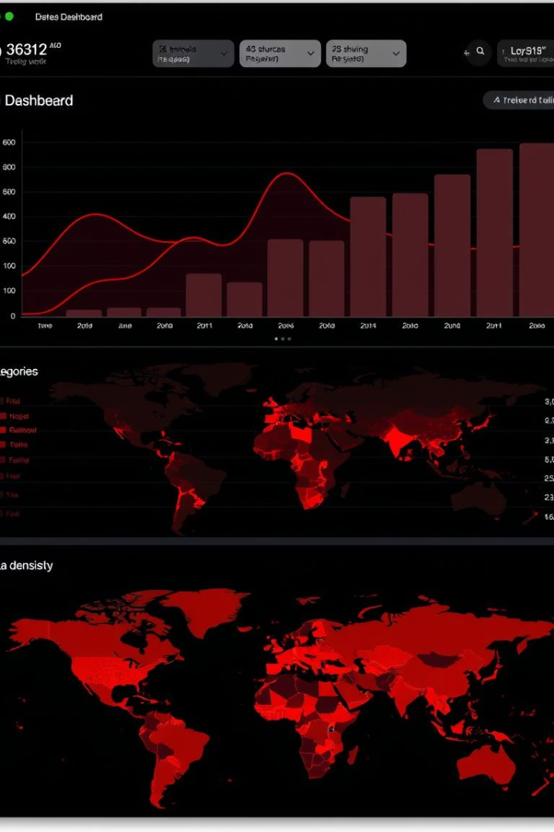




Analysis Modules and Logic
Content Ratio
Top Directors
Common Genres
Movies vs. TV Shows
Directors with most titles
Most popular genres
Country Content
Content by country
We performed different types of analysis on the dataset. Here are some of them: Count of Movies vs TV Shows using a pie chart, Top 5 directors with most titles using a bar chart, Most common genres like Drama and Comedy, Countries that have the most content like USA and India, Rating distribution like TV-MA, PG, etc., Average duration of movies by genre, Number of titles released each year, Top genres in Indian content and Most common release years in USA content.

Slide 6

Distribution of Movies and TV Shows on Netflix
Movies
TV Shows
The pie chart shows the distribution of content on Netflix. As the data indicates, movies make up a significantly larger portion of the content compared to TV shows.

Slide 7
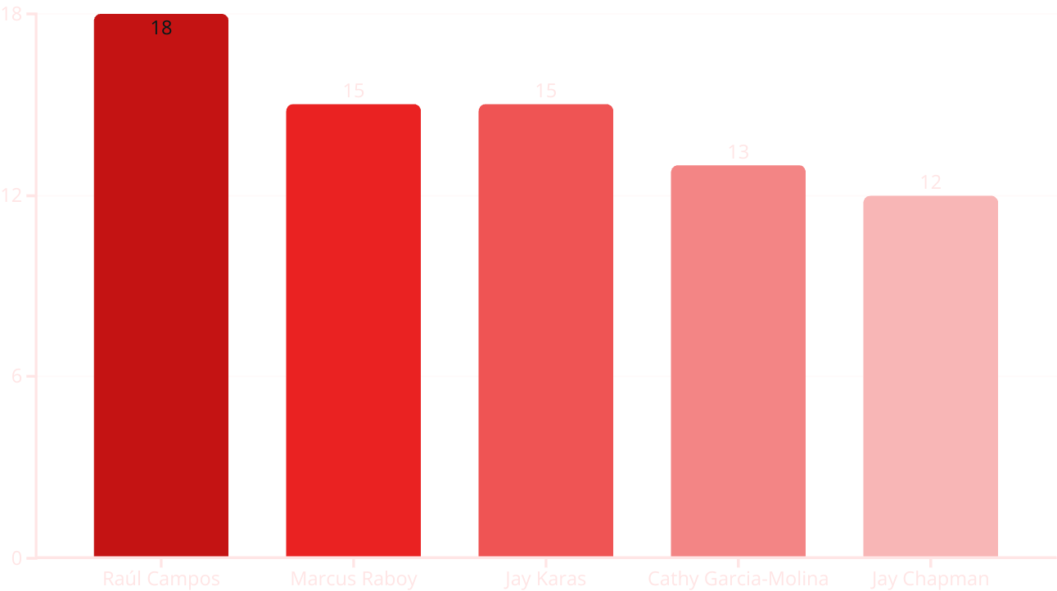
Top Directors on Netflix
This bar chart showcases the directors with the most titles available on Netflix. Raúl Campos leads with 18 titles, followed by Marcus Raboy and Jay Karas, who each have 15 titles. Cathy Garcia-Molina and Jay Chapman have 13 and 12 titles respectively. These directors have significantly contributed to Netflix's diverse content library.

Slide 8
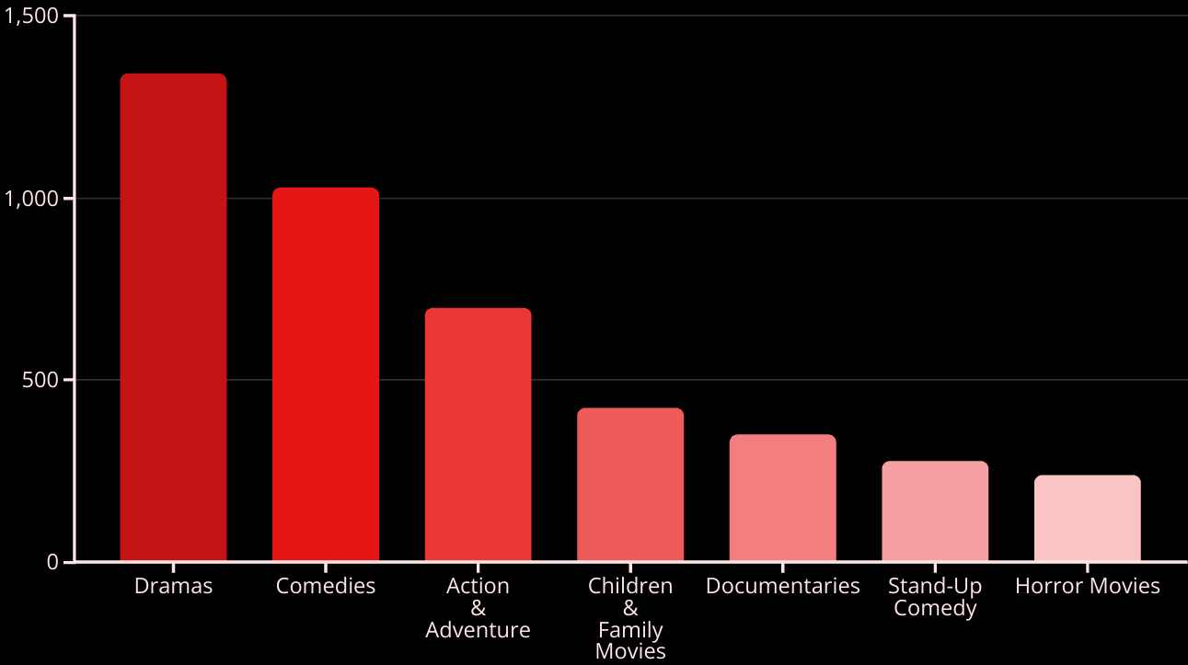
Most Common Genres on Netflix
This bar chart displays the prevalence of different genres on Netflix. Dramas and Comedies are the most abundant, with 1,342 and 1,029 titles respectively. Action & Adventure also holds a significant presence with 696 titles, followed by Children & Family Movies and Documentaries.

Slide 9
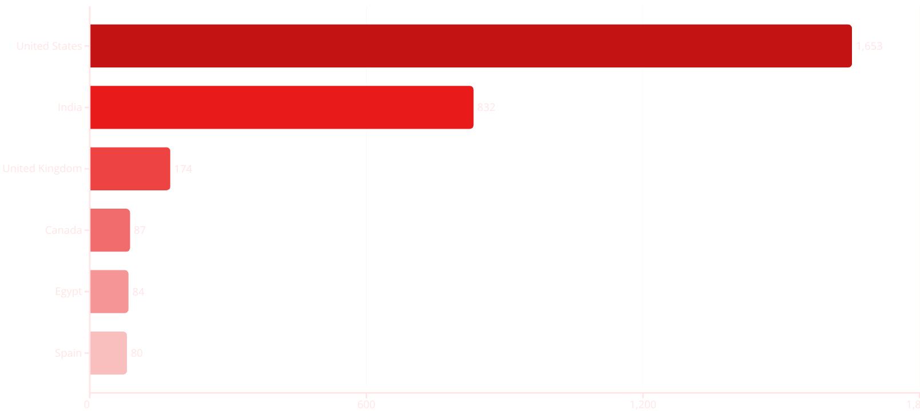
Netflix Content by Country
This horizontal bar chart illustrates the number of titles available on Netflix across different countries. The United States leads with 1,653 titles, followed by India with 832. The United Kingdom, Canada, Egypt and Spain have significantly fewer titles.

Slide 10





Applications and Future Scope
Media Insights
Understand audience preferences.
Platform Improvement
Enhance content library.
Data Analysis
Study content trends.
Learning Resource
Reference for beginners.
This project can be used in many real-world situations. Some examples are media companies can understand what type of content people like, streaming platforms can use such analysis to improve their content library, data analysts can study content trends to make business decisions and students and beginners can learn data analysis using this project as a reference.

Slide 11
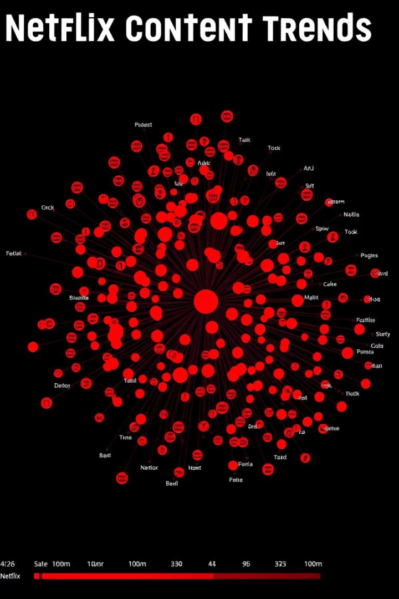
Key Findings and Results
>
Movies
Netflix has more movies than TV shows.
Drama
Genres
Most common genres are Drama and Comedy.
USA
Content
Most content is from the United States and India.
2015
Titles
Titles added increased after 2015.
After analyzing the Netflix dataset, we found many interesting results: Netflix has more movies than TV shows, the most common genres are Drama and Comedy, most content on Netflix is from the United States and India, the most common content ratings are TV-MA, TV-14, and PG-13, movie durations vary by genre, the number of titles added increased a lot after 2015 and the most active release years were 2016 to 2020.

Slide 12
Conclusion and Future Enhancements
User Ratings
1
Add user ratings for better analysis.
Platform Comparison
2
Compare with other streaming platforms.
Recommendation System
3
Build a content recommendation system.
This project helped us understand Netflix’s content in a better way. We learned how to use Python tools to clean and study data. By creating graphs and analyzing the dataset, we got useful insights about content trends on Netflix. In future, we can add more features like user ratings or compare with other platforms to make the project even better.

Slide 13
References
1. Netflix Dataset: https://www.kaggle.com/datasets/shivamb/netflix-shows
2. Python Programming Language - https://www.python.org/
3. Pandas Library - https://pandas.pydata.org/
4. NumPy Library - https://numpy.org/
5. Plotly Express - https://plotly.com/python/plotly-express/
6. Jupyter Notebook - https://jupyter.org/
This project utilized various resources and tools to conduct a comprehensive analysis of Netflix's content and trends. The references listed provide access to the dataset, programming language, and libraries used in this study.

